Slide 1
Basic Case (No Aliases)
Core
Dataset
Extracts ok with RId1
Id1
Cohort Table
Custom Dataset
Id1
RId1
Id1
Extracts ok with RId1

Slide 2
Case With Aliases
Core
Dataset
Extracts ok with RId1
Id1
Cohort Table
Id1
RId1
Custom Dataset
Id2
RId1
Id2
Extracts ok with RId1
Cohort table knows that Id1 and Id2 are aliases for the same person

Slide 3
Case With Aliases
(Problem)
Core
Dataset
Extracts zero records
Because of where logic
Causing implicit join and Id1 != Id2
Id1
Cohort Table
User adds WHERE logic:
‘where custom data value for patient >5’
Id1
RId1
Custom Dataset
Id2
RId1
Id2
Extracts ok with RId1
Cohort table knows that Id1 and Id2 are aliases for the same person

Slide 4
Proposed Fix
Core
Dataset
Extracts correctly because implicit join matches on Id1
Id1
Cohort Table
User adds WHERE logic:
‘where custom data value for patient >5’
Id1
RId1
Custom Dataset
Id2
RId1
Id2
Id1
Proposed fix is to multiply
Input rows by aliases at
upload time
(new row appears with duplicate data but with Id1)

Slide 5
Temporal Case
(Still a problem even with proposed fix)
Core
Dataset
Extracts zero records
Because of where logic
Causing implicit join and Id1 != Id2
Id1
Cohort Table
User adds WHERE logic:
‘where custom data value for patient >5’
Id1
RId1
Custom Dataset
Id2
RId1
Id2
Alias is discovered at T=2
Upload custom data at T=1
(Because this is before T2 when alias is discovered, multiplication does not execute)

Slide 6
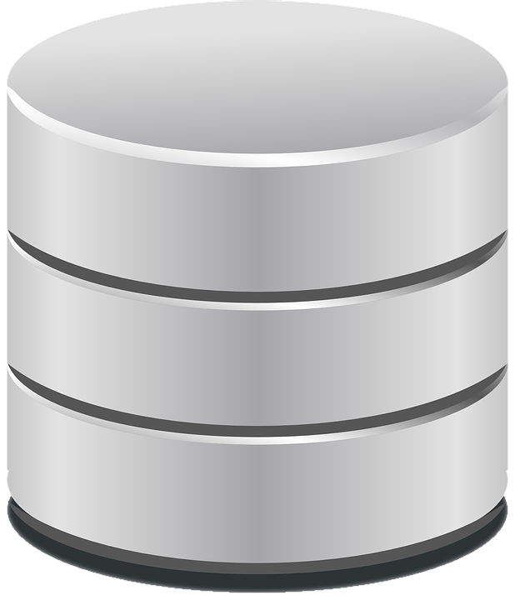
Identifier | Alias
ID1 | ID2
ID2 | ID1
Input Data Table
Pipeline Component
Output Data Table
Identifier | Address1 | Address2 | …
ID1 | 56 | Park St | …
ID3 | 55 | Park Lane | …
Alias Handler
Identifier | Address1 | Address2 | …
ID1 | 56 | Park St | …
ID2 | 56 | Park St | …
ID3 | 55 | Park Lane | …
New row duplicating ID1 input
row data but with it’s alias ID2

