Slide 1


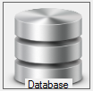





Anonymisation
Database
Email
Component
Source
Component
Anonymisation
Component
Destination
Component
Email sent to database manager
telling him a data load is taking
place

