Slide 1
Events
Refresh Bus
Database State Rechecked
Then Subscribers Notified
Subscribe
Subscribe
Order Publish
object
object
Save
object
RDMPSingleDatabaseObjectControl<T>
Collection Control

Slide 2
Activation (Double Clicking)
IActivateItems (Effectively the API Layer)
ActivateX(X o)
Activate<uiControl,databaseObject>()
Handler{}
Creates window
Double click
object
object
Save
object
RDMPSingleDatabaseObjectControl<T>
Collection Control

Slide 3
Command Execution (drag / drop / copy / paste)
CommandFactory
CommandExecutionFactory
Can translate object into command? Yes/No?
Can Apply Command to Target object in principle?
Drag Aborted/
Allowed
ICommand
DragStarted
CanDrop
object
ICommandExecution
object
object
object
object
IsImpossible
object
Source and target are compatible in
Principle but something about the state
of one or other makes the operation
Invalid.
Give the user this helpful feedback
Collection Control
Collection Control2
(but also applies to dragging within same control)

Slide 4
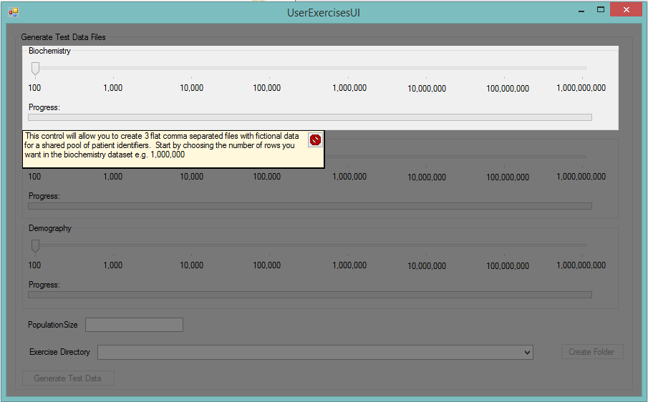
Atomic Command Execution (Standalone Commands)
ICommandExecution
No Objects Required
Provides single launch point for potentially sensitive UI (will make authentication / security / user roles / tutorial development better)

Slide 5
Tab and Collection Management
IActivateItems (Effectively the API Layer)
ToolboxWindowManager
ContentWindowManager
Window already exists?
Item Double Clicked
Yes? Pop it up
No?
Construct it and call
SetDatabaseObject(x)
ResearchDataManagementPlatform.csproj
object
object
object
Cohort Identification Collection
Catalogue / Data Export Manager etc
object
object
object
Catalogues Collection
RDMPSingleDatabaseObjectControl<T>s

Slide 6
Collections
IActivateItems (Effectively the API Layer)
RDMPCollectionCommonFunctionality
object
object
object
Handles right clicking collection tree nodes, renaming in cells, drag and drop support (see Command Execution slide) etc. Works for all collections hosted by ToolboxWindowManager
Collection Control

Slide 7
Tabs
RDMPSingleDatabaseObjectControl<T>

