Slide 1
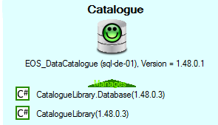
Must Match
Database Version
RDMP Major Version
Minor Version
Build Version
(Non breaking software changes)
Database Version

