Slide 1
Multiple Automation Sources
Single Destination
Constantly polled
for new tasks
DLEAutomationSource
Tasks (OnGoingAutomationTask)
DQEAutomationSource
Tasks
CacheAutomationSource
Tasks
Automation Destination
Plugin Source X
Tasks
Executes all Tasks immediately as they arrive in Parallel
Plugin Source Y
Tasks

Slide 2
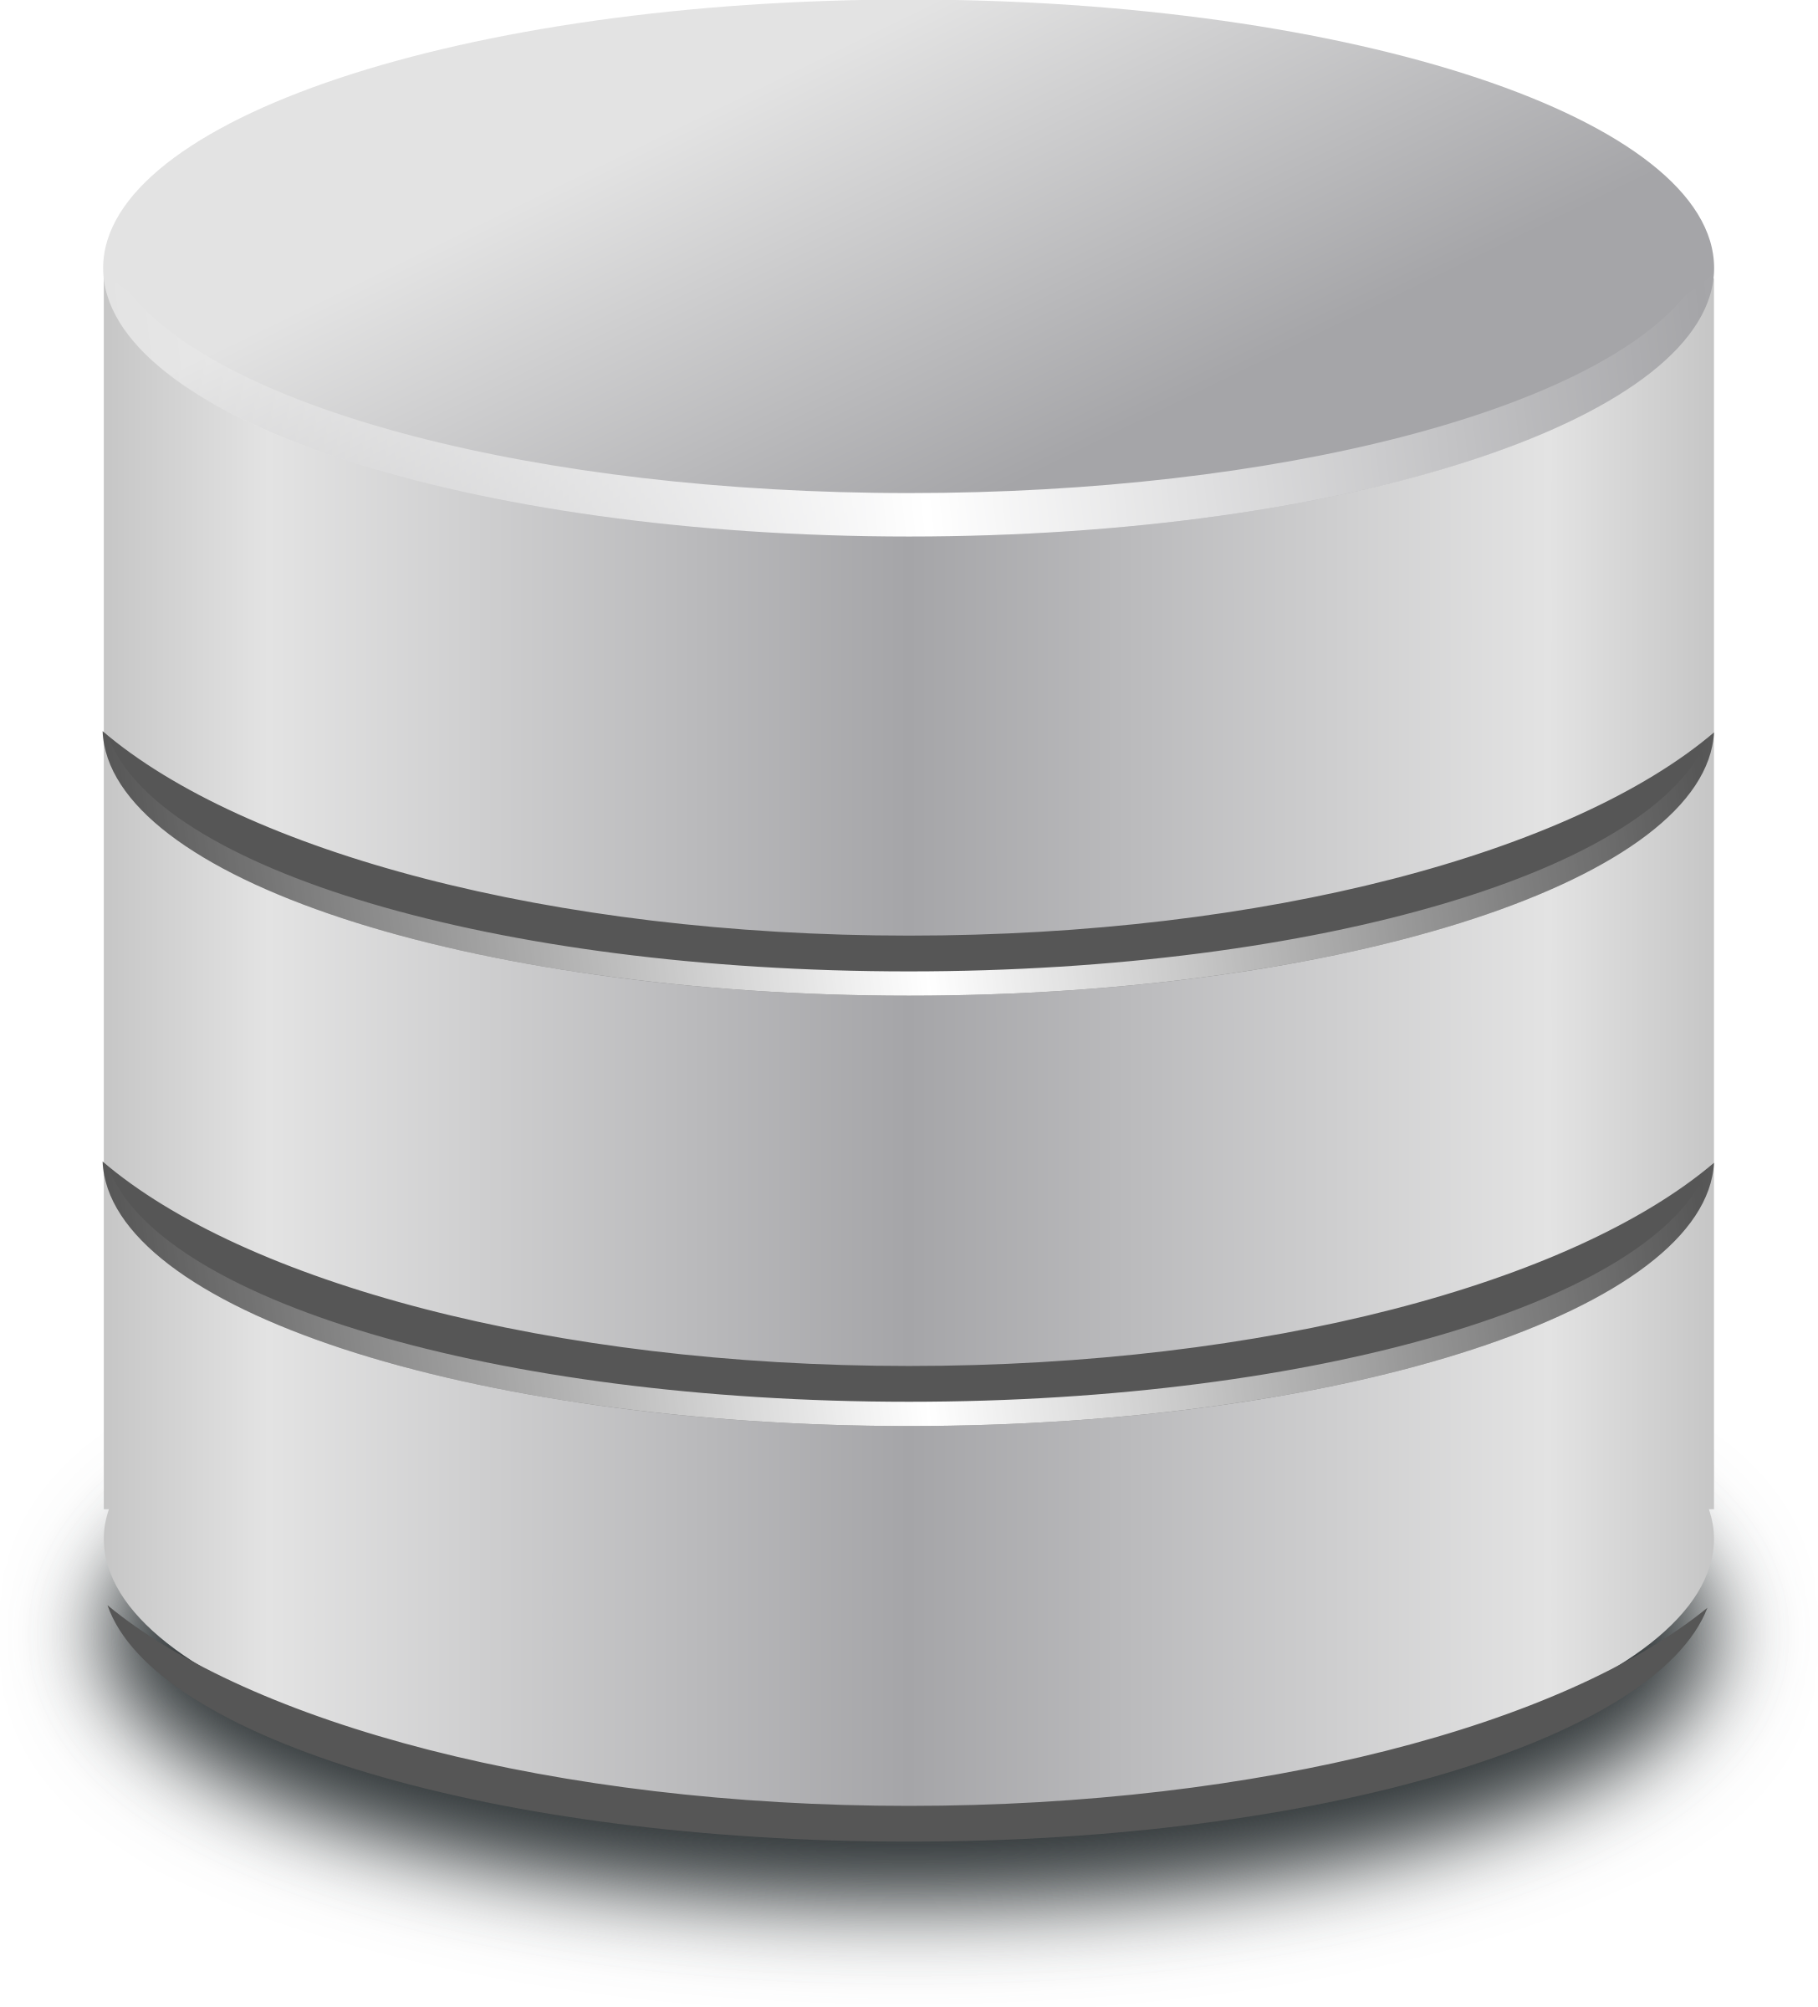


Bits you have to write
IPluginAutomationSource
Decide whether or not to create an ongoing task here (return null if no)
IAutomateable
Do your actual work in here (DO NOT CALL THIS METHOD FROM YOUR SOURCE CLASS – it will get
called on your behalf later on by the AutomationDestination). Make sure to regularly update
task.Job to ping it’s Lifeline and set appropriate statuses (Running, Crashed etc).
OnGoingAutomationTask Contents:
Database reference (AutomationJob) so everyone system wide knows how it’s getting on, if it’s still alive, Crashed etc
You should periodically call task.Job.TickLifeline(); in your RunTask method so people know your alive
You should call task.Job.SetLastKnownStatus() when you are changing statuses
At the end of your RunTask method if the job completed successfully then you should call DeleteInDatabase()
Cancellation Token, if someone flips the cancellation bit in the database record on AutomationJob then you should finish up
Only applies to your RunTask method
Only happens if someone using Dashboard.exe orders the job terminated via the database mid execution
You should watch this Token for cancellation
You should pass this Token into any await /async Tasks you run in RunTask so they don’t block forever
Repository. The Catalogue database reference, lets you discover anything stored by the Data Catalogue (which is everything!)

