Slide 1
RDMP Architecture
Data Catalogue, Load, Export and Quality Engines

Slide 2
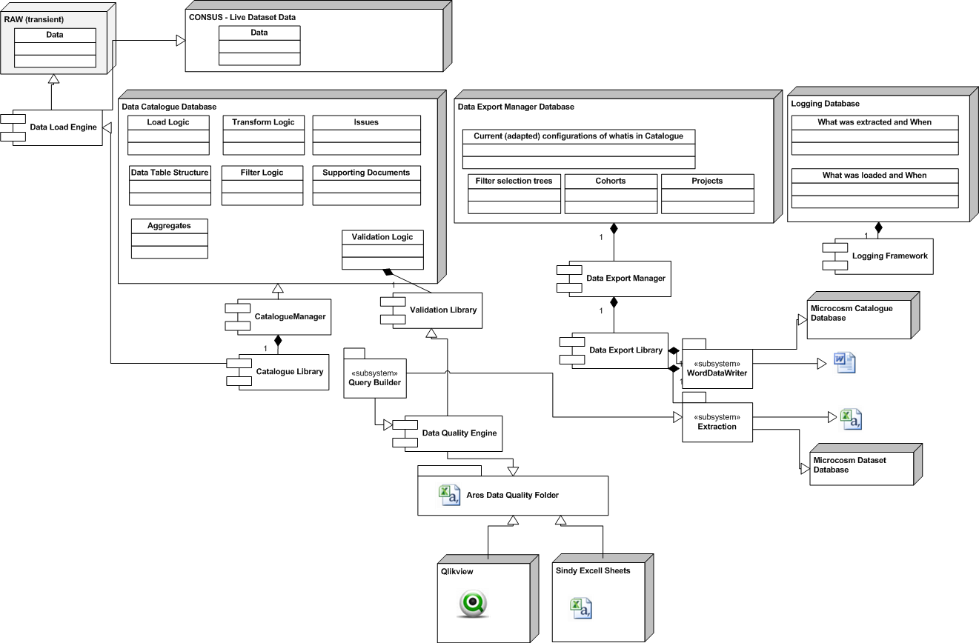
Architecture

Slide 3
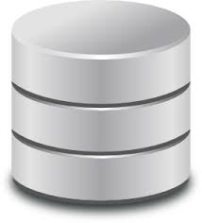





Applications
Export Database
Cohort Database
Data Catalogue
Live HIC Data
STAGING HIC Data
RAW HIC Data

Slide 4
Applications
Export Database
Cohort Database
Data Catalogue
Live HIC Data
STAGING HIC Data
RAW HIC Data

Slide 5
Data Load
Export Database
Cohort Database
Data Catalogue
How to load?
Source
What to anonymise?
Live HIC Data
STAGING HIC Data
RAW HIC Data

Slide 6
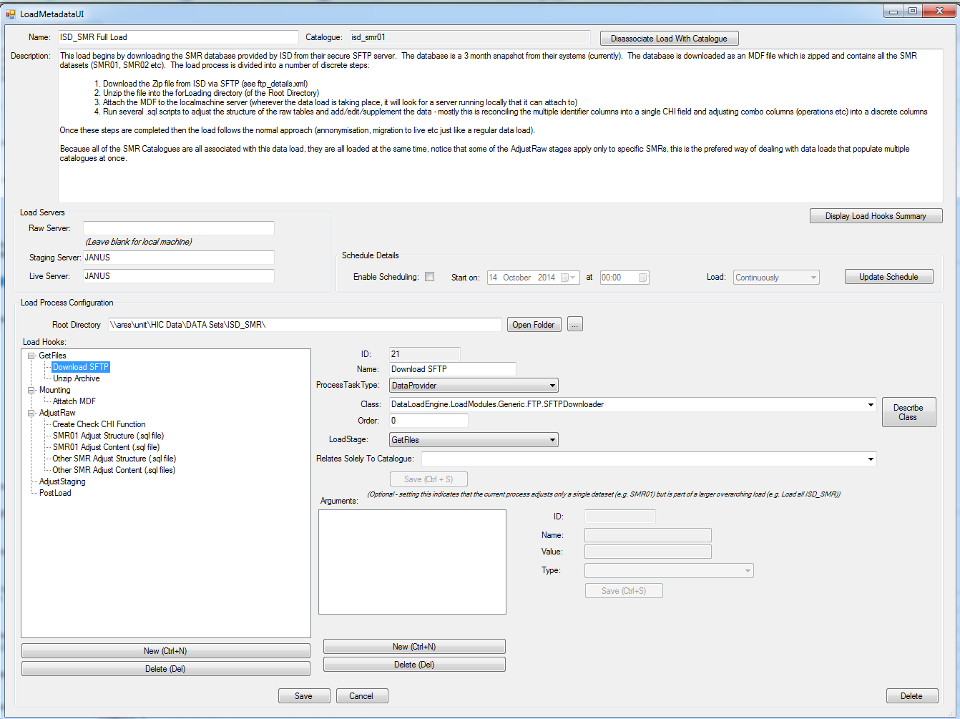

Slide 7
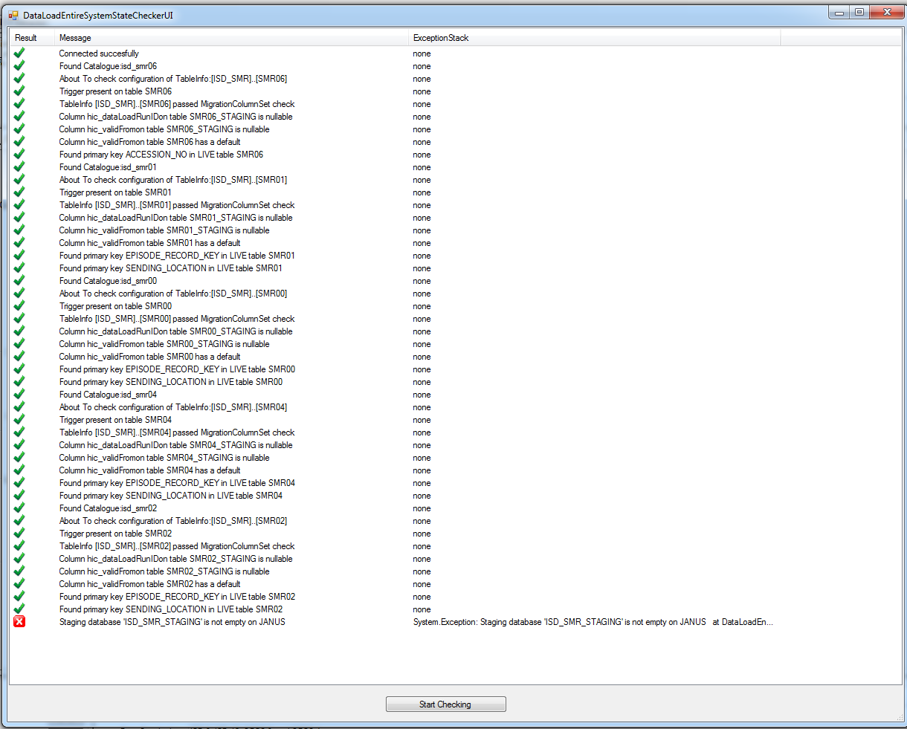

Slide 8
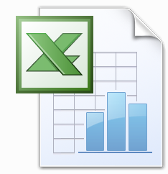
Data Load
Export Database
Cohort Database
Data Catalogue
What Validation Rules?
How to extract data (SQL)?
Live HIC Data
STAGING HIC Data
RAW HIC Data
Data Quality Reports
Data Quality Reports

Slide 9
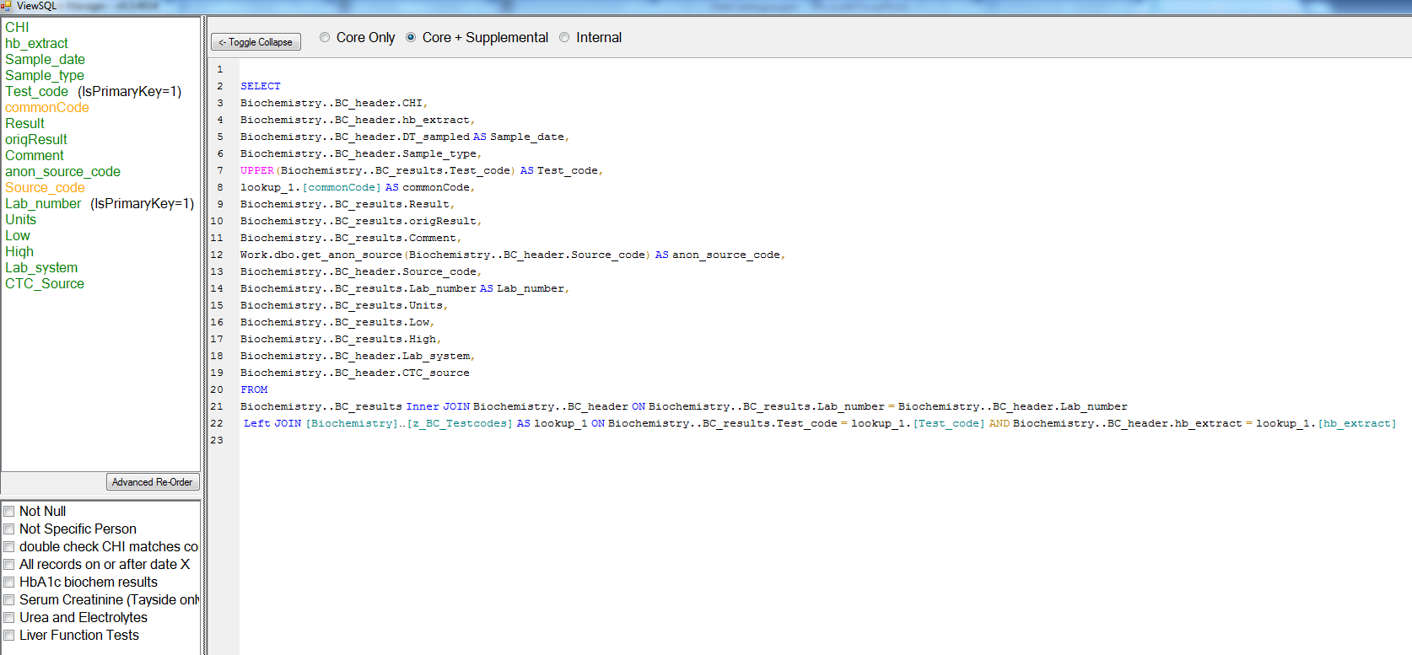

Slide 10



Data Load
Export Database
Cohort Database
Data Catalogue
What Validation Rules?
How to extract data (SQL)?
Available Filters?
Issues?
Descriptive data?
Research Data
Descriptive data
And time series
Live HIC Data
STAGING HIC Data
RAW HIC Data

Slide 11
Each ‘Catalogue’ Holds:
High level description of dataset
Descriptive metadata about every extractable column
Technical details of how columns are extracted including transforms
Which columns are anonymised / hashed / etc
Tracked issues on a column by column basis (linked to JIRA)
Dataset load steps
Available filters for extraction (e.g. no ‘future’ records)
Which columns should be used for cohort linkage
Additional linked documents / handy SQL related to the dataset
Any lookups that can be (optionally) joined to/extracted
Dataset primary keys, join information (LEFT/RIGHT etc), the column which indicates periodicity etc
What logging task dataset should be logged under
Aggregation configurations for useful statistics (e.g. records over time, number of hospital admissions after date of death – errors).

Slide 12
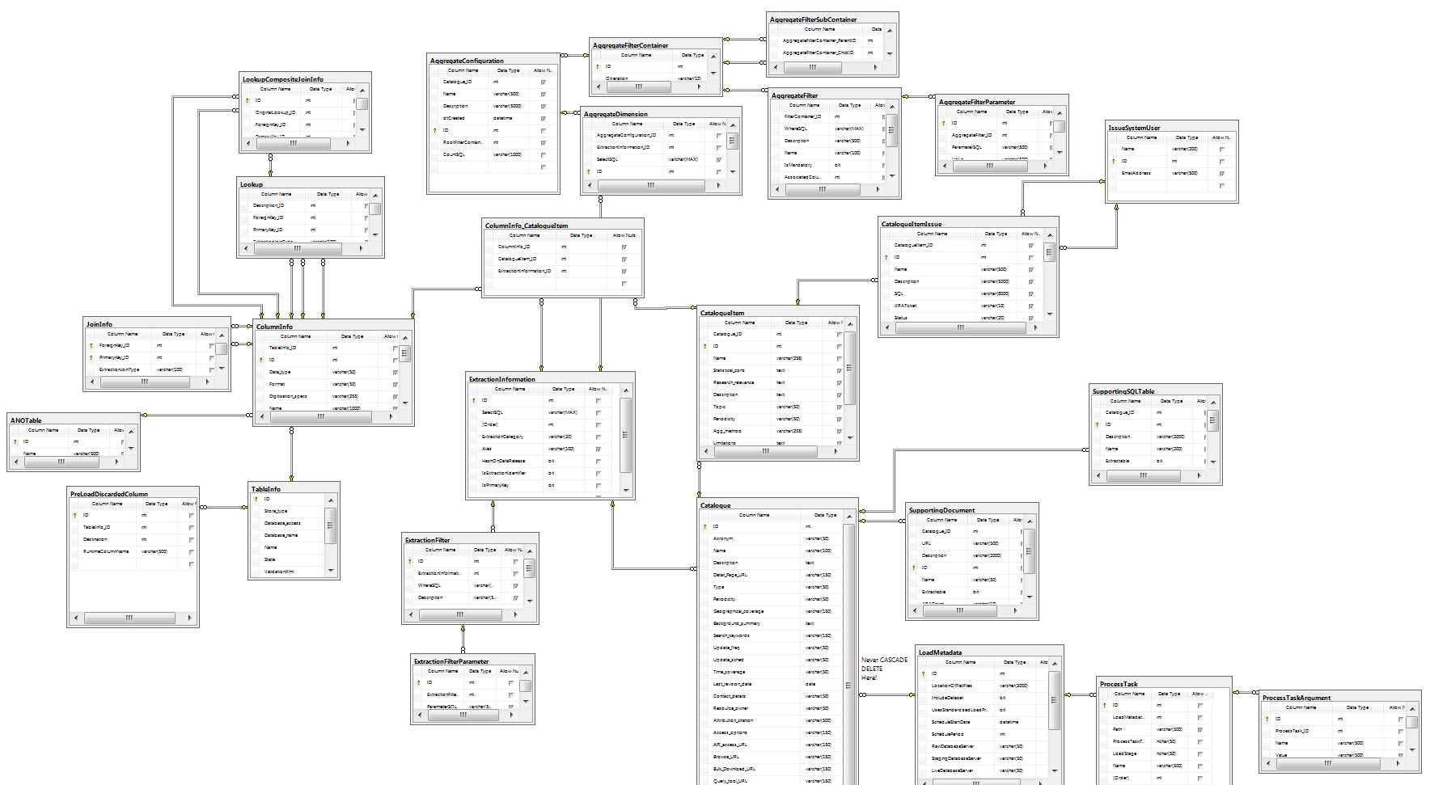

Slide 13
Demo

