Slide 1
Current Model

Slide 2
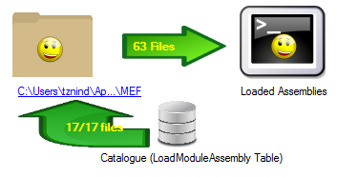
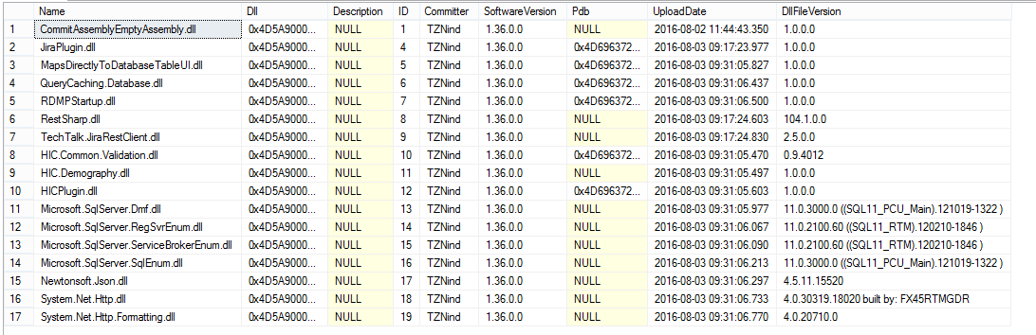
User Interface
Runtime
MEFFileDownloaded
ICheckNotifier _mefCheckNotifier
Database Repository
MEF
SafeDirectoryCatalog
Startup
PluginBootstrapper
Upload Time
PluginProcessor
PluginManifestAgreementChecker
(AppDomain Proxy)

Slide 3
New Model

Slide 4

Plugin Table
ID | Plugin Name | Last Validated NUGET Package
1 | JIRA | 1.0.34.0
2 | SCIStore | 1.0.34.0
NUGET Package
(dlls)
M
1
LoadModuleAssembly Table
PATCH/Mismatch: Evaluate MISL/CIL Method Calls
SciStore.dll
Runtime:
Download to MEF subdirectory
Register for Assembly Resolve events
Navigate assembly load events to correct directory
JIRA.dll
Newtonsoft.Json.dll
(Version 4.5)
Newtonsoft.Json.dll
(Version 6.0)
%AppData%\JIRA\
%AppData%\SCIStore\

