Slide 1



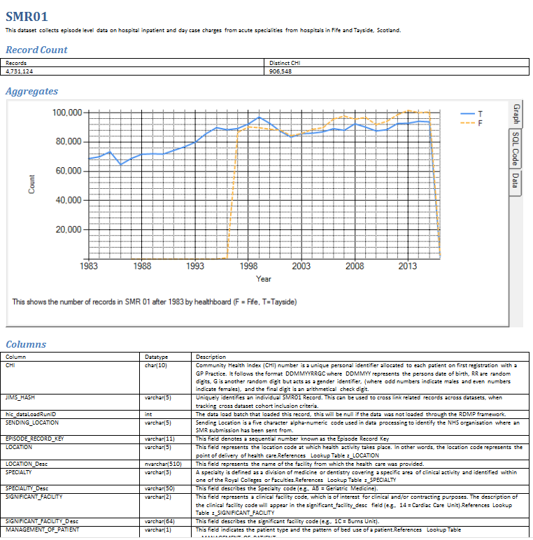




Live Data Repository(s)
July 2001-September2014
Help with SMR
Lookup1 z_specialtyCode
10. Calculate INTERSECT x,y,z
Datasets & descriptions
Fixed aggregates
Counts
Data Range
Supporting Documents (Extractable)
What are the available filters?
What are the parameters to filter X?
Schedule job ‘@numberOfTimes =9’
Get cached answer for job Y
Calculate INTERSECT x,y,z
2. Fixed aggregates
9. Get cached answer for job Y
Datasets & descriptions
Available filters
7. Parameters for filters
3. Counts
Cohort Identification
Start With
Must Also Appear In
Cannot Appear In
10,000
10,000
SMR 01 - ‘list of ICD codes’ @IcdList
480
Share – ‘Not contacted more than’ @numberOfTimes
1,000
460
16,000
6 and 7 must not pollute Aggregate or CohortIdentificationConfiguration in CatalogueDatabase. They should be fixed life duration
Filter + parameters X,Y,Z + @Table valued function parameters too.
GRO – ‘Anyone in GRO’

Slide 2
Requirements
List of Catalogues
By Folder
All visible at first
Searchable
Only public/extractable/non deprecated ones
CatalogueItem descriptions
‘Extractable’ Support Documents download
Display dataset range discarding outliers
Display count and distinct count
Aggregate graphs
Only display Extractable Aggregates
Identifiers cannot appear in the dataset (IsExtractionIdentifier / HashOnDataRelease)
Results cannot come directly from the live dataset, they must be manually added to the cache by a data analyst to prevent mistakes
Cohort Manager (either developed in house or InSite https://www.custodix.com/ - or alternative)

