Slide 1
Super Set 1 – Study Inclusion Criteria
In Isolation
CHI
WHERE…
In Isolation
Set 1
Set 2
UNION
CHI
WHERE…
In Isolation
Incremental
Set 3
EXCEPT
CHI
WHERE…
In Isolation
Incremental
Set 4
EXCEPT
Baby CHI
@params
WHERE…
In Isolation
Incremental
Super Set 2 – Complex Inclusion Criteria
UNION
In Isolation
Incremental
Set 5
CHI
WHERE…
In Isolation
Set 6
INTERSECT
CHI
@params
WHERE…
In Isolation
Incremental
Super Set 2 – Study Exclusion Criteria
EXCEPT
In Isolation
Incremental
Set 7
CHI
@params
WHERE…
In Isolation
Set 8
UNION
CHI
@params
WHERE…
In Isolation
Incremental

Slide 2



Inclusion Criteria
Inclusion
Total
Inclusion Set 1 - Volunteers
In Isolation
CHI
In Isolation
People in SHARE
Active=1
People in TARDIS
CHI
WHERE…
In Isolation
Exclusion Criteria For Volunteers
Dead People
CHI
WHERE…
In Isolation
Decrement
Children of Doctors In Strife (SMR02)
Baby CHI
CHI in Ds1
In Isolation
Decrement
Inclusion Set 2 - Automatically Volunteered
In Isolation
People in Angus Royal Infirmary
CHI
WHERE…
In Isolation
SMR Conditions (neural)
CHI
@conditions1 varchar(500) = ‘neural bleed, neural shock, neurosis’
WHERE…
In Isolation
Exclusion Criteria
Final
Total
SMR Conditions (dem)
CHI
@conditions2 varchar(500) = ‘dementia’
WHERE…
In Isolation
Decrement
SMR Conditions (psyc)
CHI
@conditions3 varchar(500) = ‘psychosis’
WHERE…
In Isolation
Decrement

Slide 3
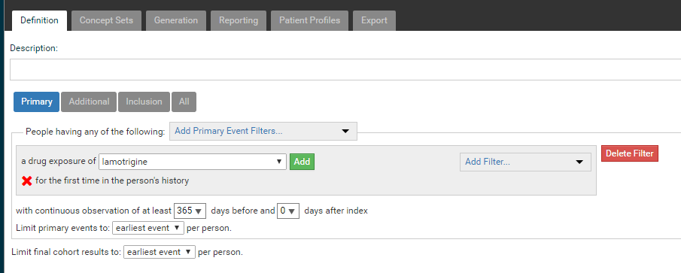
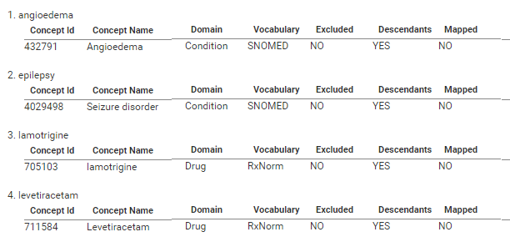
Other Software

Slide 4
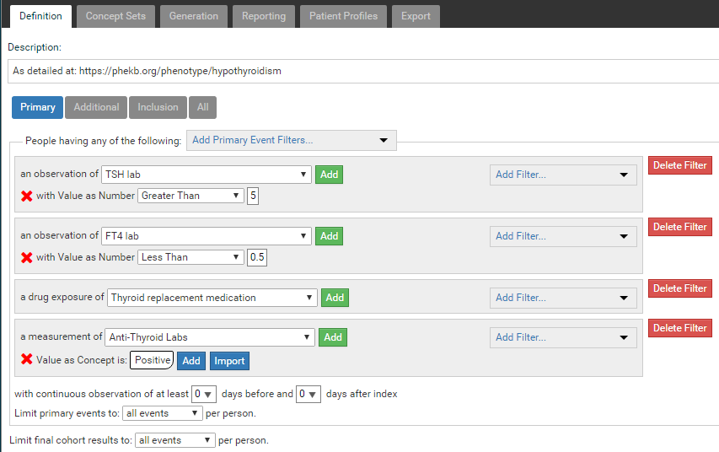
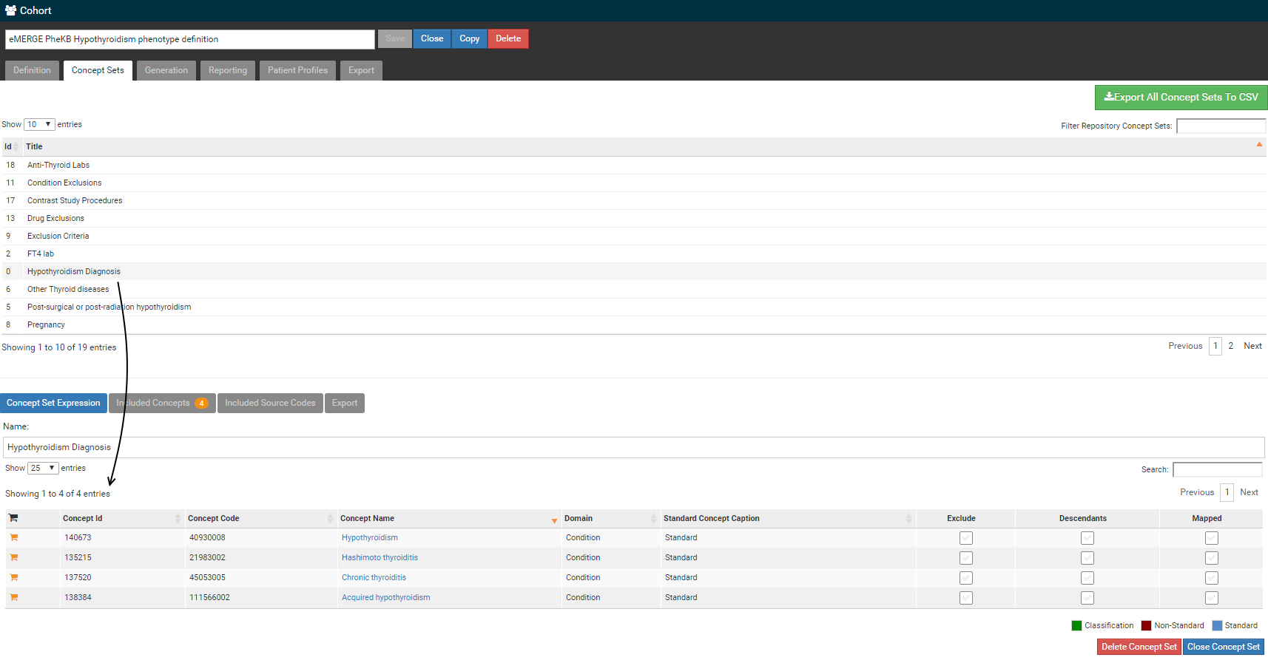

Slide 5
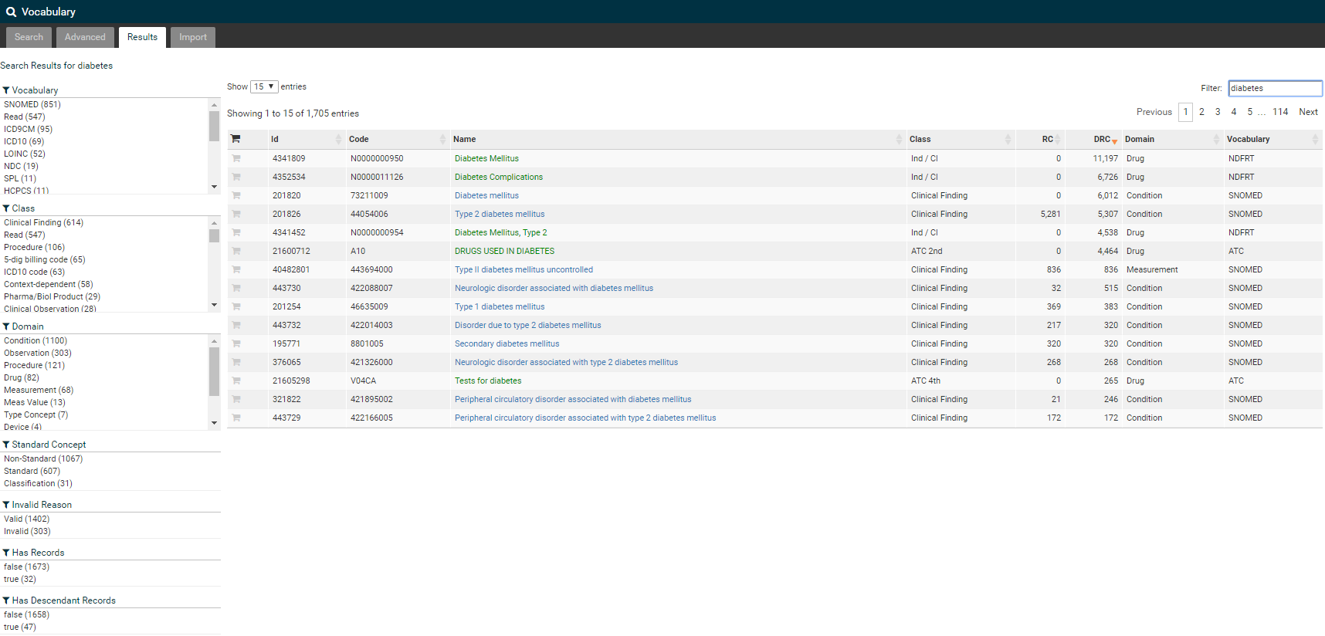

Slide 6






ETL₁
Data Release
Researcher
Cohort
Generation
Activity
Hospital 1
ETL₃
ETL₄
ETL₅
Monthly
Release
ETL₂
Repository
I2B2/Qlikview
Data Collector
(e.g. Government agency)
Research Data Management Group
(i.e. You)
Hospital 2
Cohort
Manager
Dataset
Loader
(Preserving Data Format)
Researcher
ETL₁
Data Release
Hospital 1
ETL₃
Monthly
Release
ETL₂
Repository
Data Collector
(e.g. Government agency)
Research Data Management Group
(i.e. You)
Hospital 2

Slide 7
Cohort Builder
Search:

