Slide 1
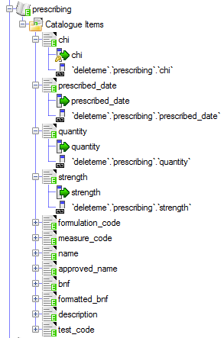

What is a Cohort?
This is the patient identifier column
(should be the same in all datasets*)
Project extractions using cohorts in
This source will have chi (Identifiable)
Replaced with ReleaseID (Anonymisation)
Cohort Database
Private Id:
Release Id:
chi varchar(10)
ReleaseID varchar(300)
New cohorts (patient lists) get
uploaded for use in extraction projects
(Release Identifiers are usually allocated by Upload Pipeline**)
* If you have multiple patient field types between datasets (e.g. chi , barcode, nhs number) then you can create multiple cohort tables.
** If you have your own relase identifier allocation system you can select ‘Leave Blank’ as the allocation strategy and populate them yourselves.

