Slide 1
QWIPO QUANTUM-ENHANCED FEDERATED B2B INTELLIGENCE NETWORK (a next generation approach to secure and intelligent business collaboration)

Slide 2
PROBLEM STATEMENT
Businesses in B2B trade face challenges like data silos, pricing conflicts, and slow decision-making.
Sharing sensitive data directly is risky due to privacy concerns.
Current AI models struggle with large-scale, secure, and real-time collaboration.

Slide 3
SOLUTION OVERVIEW Business Data (Local)Each business keeps its own data privately. Federated Learning Model training happens locally. Only encrypted model updates are shared, not raw data. Quantum Optimization Layer Quantum algorithms are applied for faster processing & better accuracy. Secure Aggregator Combines updates into a global model. Maintains privacy & trust. Intelligence Dashboard Provides real-time insights: Pricing optimization Demand forecasting Supply chain efficiency Risk analysis

Slide 4
Innovation & Uniqueness : Federated Learning – trains models across businesses without sharing raw data. Quantum Computing – accelerates data analysis and optimization. Secure Collaboration – ensures privacy with encrypted communication. Real-Time B2B Intelligence – provides insights on pricing, demand, and supply. Decision Support Dashboard – user-friendly interface for businesses.

Slide 5
Scalability : Scaling to global supply chains. Integration with block chain for audit or trust. Full ai driven decision making system. Deploying on cloud-based quantum services. Expansion to healthcare, finance, and logistics.

Slide 6
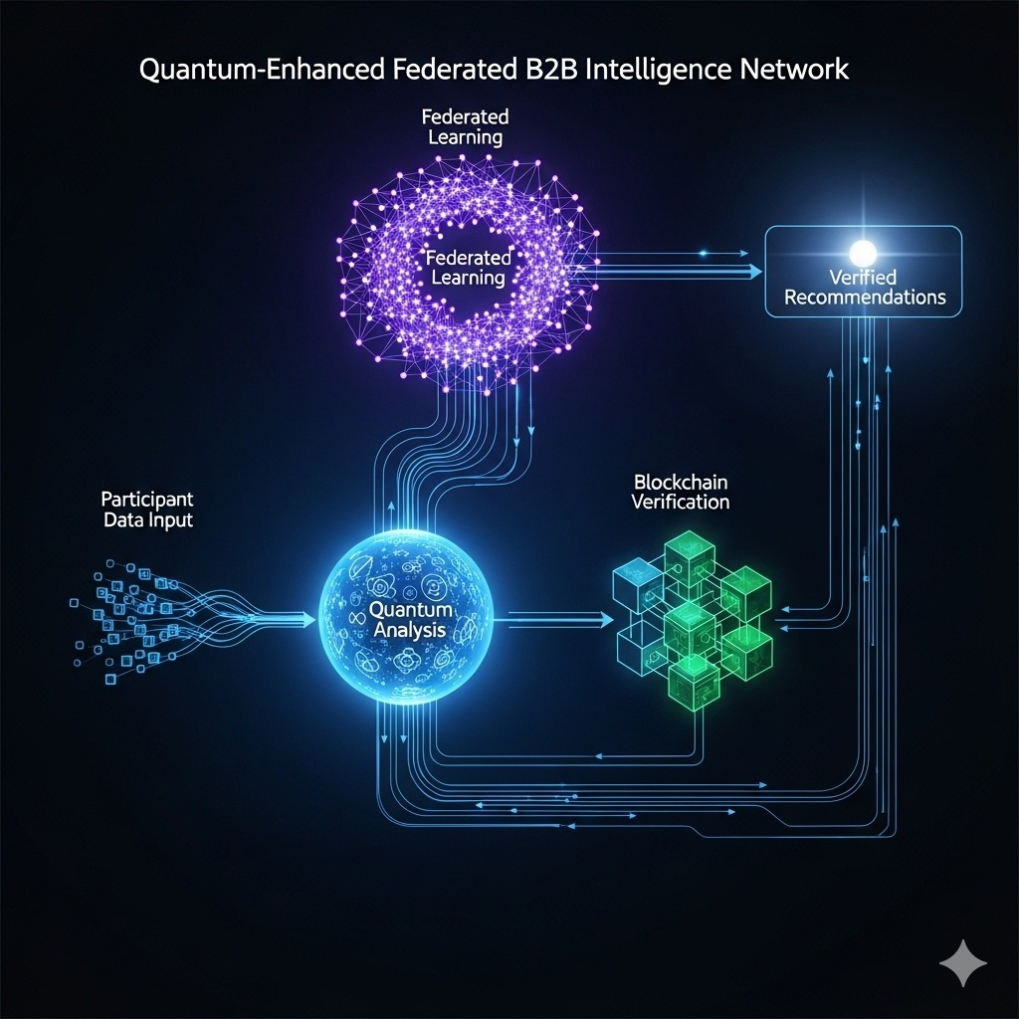
SYSTEM ARCHITECTURE

Slide 7
THANK YOU

