Slide 1


Allez
Doesn’t reverse-engineering and debugging code feel like something huge is constantly chasing you?

Slide 2
File Structure
adipose/
gastroc/
liver/
kidney/
liver/
Gene Universe Data
Base Gene Expression Data (module_dict.pickle)
Python script to generate Gene Set Data
Python script to generate Gene Universe Data
Allez
Enrichment
Results
All erichments data
Enrichment Looks Normal Data
Enrichment Looks Abnormal Data
Gene Set Data (named either SIGNED or UNSIGNED)
SIGNED/
UNSIGNED/

Slide 3
How to use the auto-Allez scripts
These are designed to be CHTC-compatible automated ways to scan modules from WGCNA analysis and even compartmentalize them to specific subsets of their components using the Allez package.
To run them you’ll need the following packages. Use ‘library(package)’ in the command line to load them and if you can’t then install/reinstall them
rstudioapi (comes with Rstudio)
WGCNA (from BioConductor)
dplyr (from CRAN)
tidyverse (from CRAN)
shiny (from CRAN)
shinyFiles (probably from CRAN)
DT (from CRAN)
Allez (probably from Bioconductor, if not that then try Github)
org.Mm.eg.db (from Bioconductor)
BiocManager (the Bioconductor base package, from CRAN)
To install from CRAN, use ‘install.packages(“package_name”)’
To install from Bioconductor, use ‘BiocManager::install(“package name”)
To install from github, there are several options that use a package called devtools

Slide 4
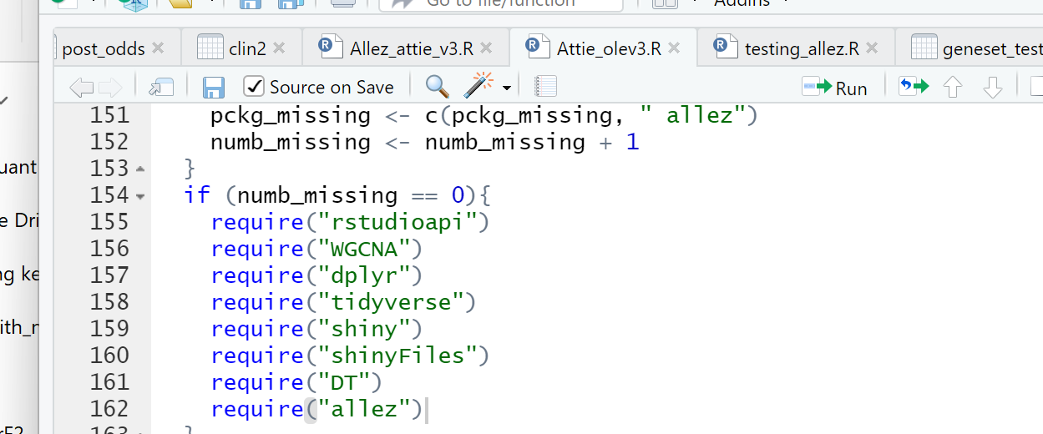
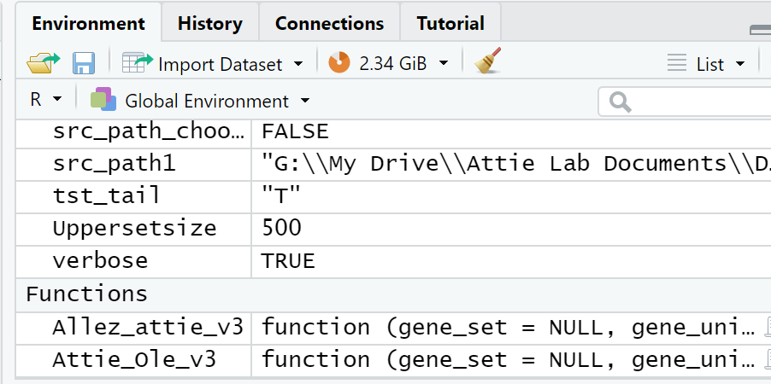
Set your directory and source the functions
This uses 2 scripts:
Attie_olev3.R
Allez_attie_v3.R
First, set your directory to where you want to save everything. You can do this by typing library(rustioapi) in the command line to activate the rstudioapi package and then typing setwd(selectDirectory()), which will prompt you to pick the folder you want.
Then activate both functions. This is done either by typing ‘source(“file/path/to/the/relevant/file”) in the terminal or clicking “source on save” at the top of the scripts when you open them in R Studio (see right) and clicking save after
Source-on-save will let Rstudio see the function in the environment:

Slide 5
Set up your input files
To use Allez, you need your input files: the “gene set” and “gene universe” files.
“gene set” files have the list of genes in the modules you want to scan
“gene universe” files have all of the genes in the set you want to scan. To increase power, the universe isn’t all of the mouse or human genome, but the set of all genes/proteins in your tissue you measured.
Allez uses Official Gene Symbols (e.g. Abcc8, Zfp148) which makes it difficult sometimes to use since these can change so always check the Ensemble or Entrez IDs for your gene to make sure you’re using the up-to-date one.
These scripts can handle modules with multiple compartments/tissues/types of transcript surveyed. It was initially written to do this
All input files are comma separated files (the .csv extension)
Make sure there are no empty cells. Avoid this by using ‘delete’ on any row that lacks data so that it doesn’t import as empty cells. It will cause errors otherwise
While the user interface Allez just takes lists of symbols, the files I’ll describe were formatted to work with the scripts I wrote.

Slide 6
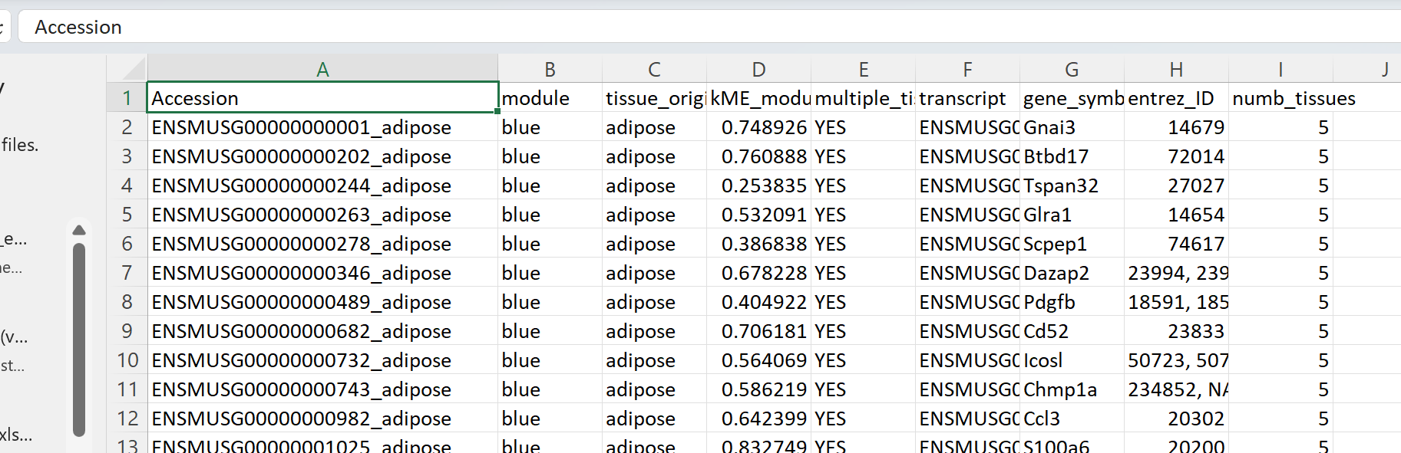
Set up your input files- the “gene set” file
In your “gene set” file you’ll need the following columns:
Accession (the unique identifier associated with your transcript of interest. Usually this is to avoid redundant gene annotations (scanning multiple tissues or looking at isoforms) which will cause errors with how the scripts curate the data before sending it to Allez
DO NOT RENAME THE COLUMNS

Slide 7
Set up your input files- the “gene set” file
In your “gene set” file you’ll need the following columns:
Module colors
The module colors are generated by the WGCNA package

Slide 8
Set up your input files- the “gene set” file
In your “gene set” file you’ll need the following columns:
tissue_origin
For modules that have more than one tissue, it will have the tissue associated with each gene (accession)
For modules that look at different gene categories within a module (or isoforms) it will contain their annotations (e.g. protein coding, miRNA, etc) but it will still have “tissue_origin” as the header. You can change the output file annotations but leave the input files’ column names alone
For modules without these concerns, it will just be the tissue it came from and all will have the same annotation (e.g. “islet” for transcripts only from islets)

Slide 9
Set up your input files- the “gene set” file
In your “gene set” file you’ll need the following columns:
“kME_module”
This has the kME value for the module it’s assigned to.
This can be blank. I used it in some of my further scripts but you don’t need it. Don’t delete the column though if you choose not to have information here.

Slide 10
Set up your input files- the “gene set” file
In your “gene set” file you’ll need the following columns:
“multiple_tissues”
Will have “YES” if it has multiple tissues/compartments/categories in a module, or “NO” if it’s all a single value

Slide 11
Set up your input files- the “gene set” file
In your “gene set” file you’ll need the following columns:
“transcript”
I actually use Ensembl gene IDs more than transcript IDs but the ensembl annotation is what I put here
Can be left blank, but don’t delete the column

Slide 12
Set up your input files- the “gene set” file
In your “gene set” file you’ll need the following columns:
“gene_symbol”
This is the gene symbol you’ll put into Allez that goes with your Accession ID

Slide 13
Set up your input files- the “gene set” file
In your “gene set” file you’ll need the following columns:
“entrez_ID”
This is the entrez ID value for the gene.
Can be left blank, but don’t delete the column

Slide 14
Set up your input files- the “gene set” file
In your “gene set” file you’ll need the following columns:
“numb_tissues”
This is the number of unique tissues/compartments/categories in the module. If you’re not using that sort of annotation, set it to 1

Slide 15
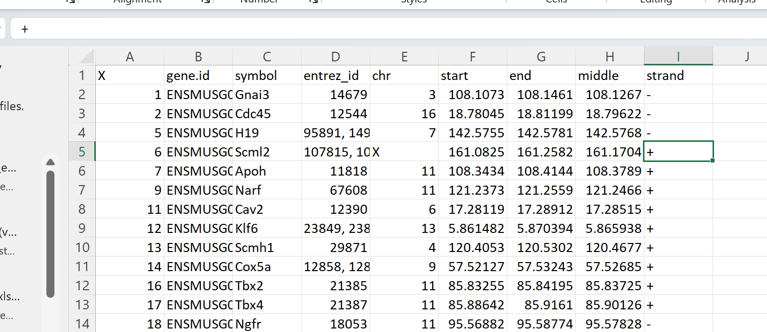
Set up your input files- the “universe” file
The universe file is a list of all genes you measured in your tissue of interest
In your “gene universe” file you’ll need the following columns:
“X”
Is just the row number. Don’t delete the column

Slide 16
Set up your input files- the “universe” file
In your “gene universe” file you’ll need the following columns:
“gene.id”
The Ensembl gene ID. It can be blank, but I don’t recommend it. It’s useful since gene symbols change regularly. Don’t delete the column

Slide 17
Set up your input files- the “universe” file
In your “gene universe” file you’ll need the following columns:
“symbol”
The gene symbols. This will be what Allez uses.

Slide 18
Set up your input files- the “universe” file
In your “gene universe” file you’ll need the following columns:
“entrez_id”
The entrez ID for the gene. It can be left blank but don’t delete the column.

Slide 19
Set up your input files- the “universe” file
In your “gene universe” file you’ll need the following columns:
The gene position & strand columns
These columns contain the relevant gene position info. They can be left blank but don’t delete the columns.

Slide 20
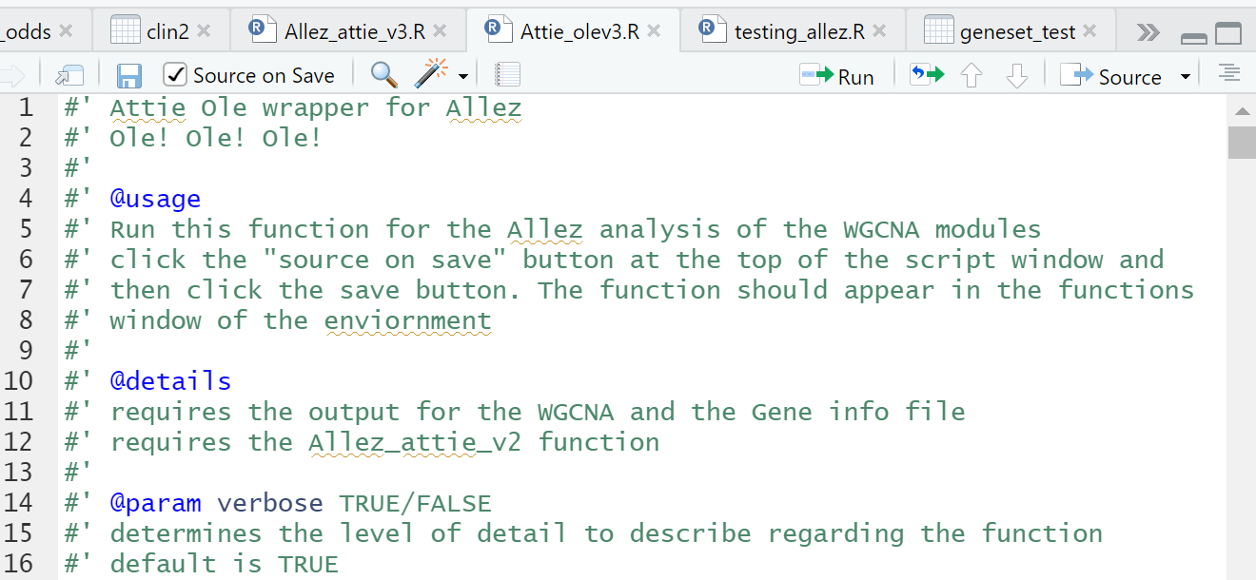
Running the scripts
I recommend using a script to do this, but you can enter all of this from the command line.
The top of each script has the relevant information about the parameters and the input
Help info has the #’ designation in front of the line, as you can see to the right

Slide 21
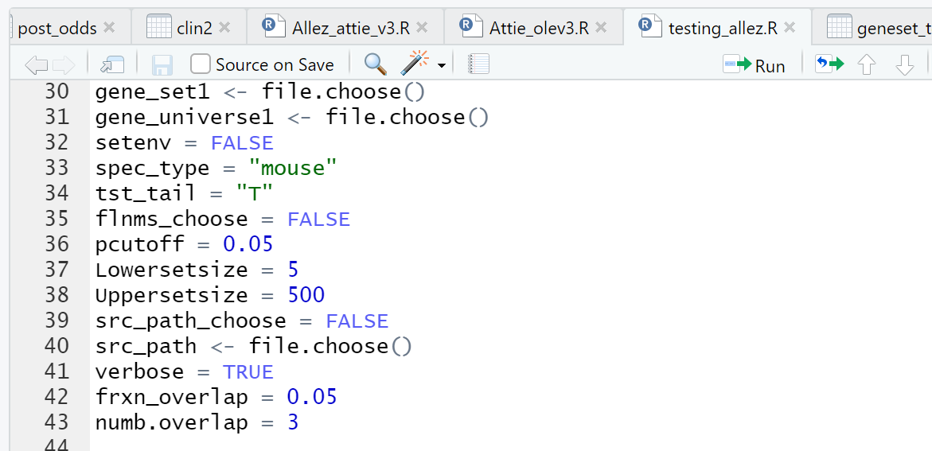
Running the scripts- set your variables
In general, to run this you’ll set the variables you need and then run the function with these variables
In this example, gene_set1 is a character vector showing the filepath for the “gene set” input file. You can either use ‘file.choose()’ from rstudioapi to graphically select it or you can set it to the path character string by typing it in

Slide 22
Running the scripts- set your variables
Similarly, gene_universe1 in this example is the path to your “gene universe” file, either chosen graphically or manually entered.
The variables below it in this example are optional to enter directly.

Slide 23
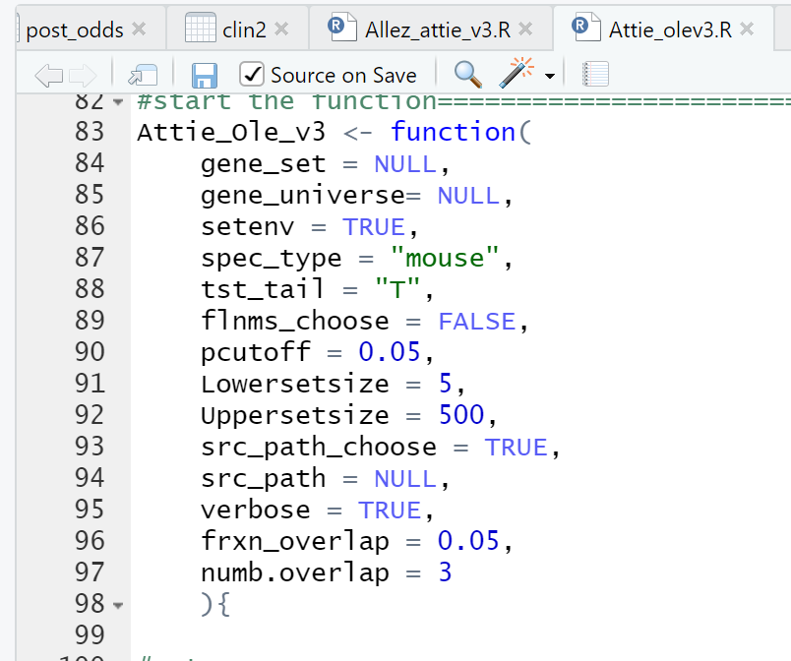
Running the scripts- set your variables
In any function, default options are visible in the function’s script. For example, in the Attie_olev3 script, you can see the defaults entered after it is defined as a function name.
This means if you type only ‘Attie_Ole_v3()’, the function will assume its essential variables are set to the values you see here.
You can do it this way on your own computers, but I prefer not to because defaults use graphical input (choosing the files for example). That doesn’t work on the CHTC and I’m trying to make this compatible with the CHTC

Slide 24
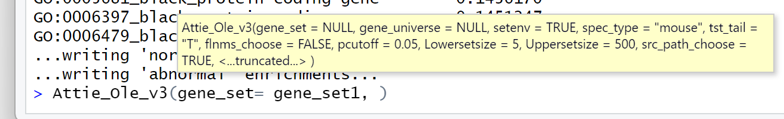
Running the scripts- set your variables
To set any value to the option you choose, when you type the function command into the command line or run it from a script, you can set the specific parameter you want by typing ‘name_of_function_parameter = your_choice’ (as seen below). The option you select doing this must still be the type of input the function expects for that variable
In this example, I’ve typed the command in the terminal and set the gene_set variable. I can see the other variables and their defaults in the little yellow window

Slide 25
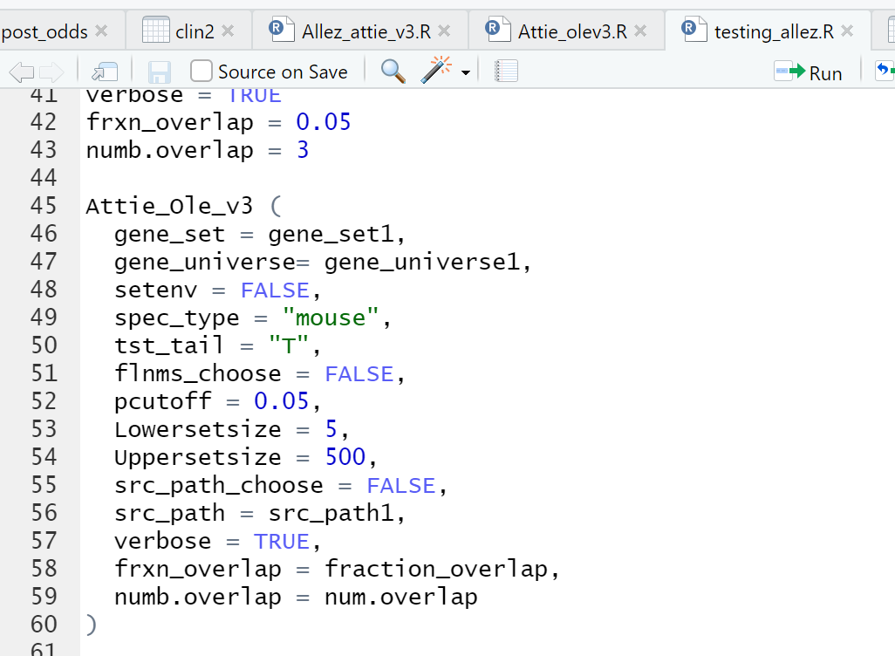
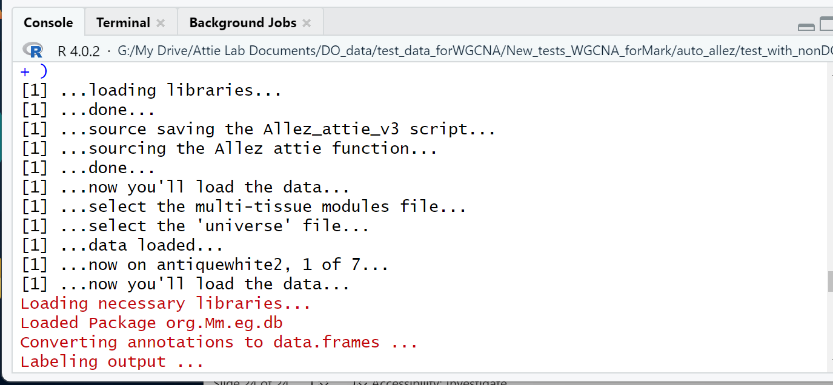
Running the scripts- set your variables
When you’ve set your variables, run the function with the parameters set as you’ve chosen. The example using the variables I’d shown previously is to the right.
When the function runs, it should spit out messages at you as it goes to show you what it’s doing:

Slide 26
The output
The script should always produce 3 .csv files:
“All_enrichments.csv”
“enriched_looks_normal.csv”
“enriched_seems_abnormal.csv”
In cases where you’re running modules with annotations for multiple tissues or categories in them for the genes you’re scanning, there’s a fourth file “enriched_looks_normal_no_all.csv”

Slide 27
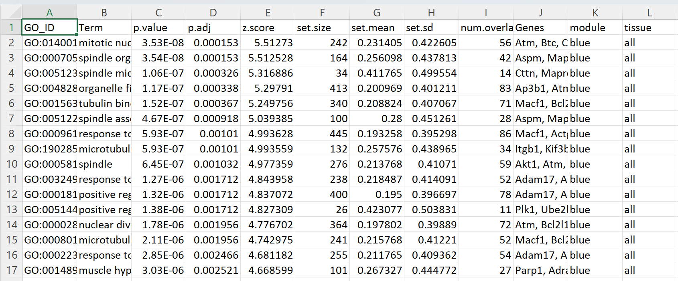
The output- All_enrichments.csv
This file is every enrichment that Allez considered significant according to the options you set
For each term, in addition to the standard output (GO annotation, term, p-value, z score, set size, etc), you’ll know the module that enrichment refers to and the tissue/category in the module that was scanned (if it’s all the tissues/categories it will say “all” as in below)

Slide 28
The output- Normal vs Abnormal
This is more of a personal preference thing but I noticed that there were huge p-values for modules that were small and had small numbers of overlapping genes or modules that had large numbers of genes but few overlapping genes. This made me uncomfortable and, since some of the parameters the graphical Allez uses are invisible to me and therefore may not be implemented, I set up a user-defined “normal” threshold using two terms: the frxn_overlap and numb.overlap settings.
This means that the user can weed out all of the enrichments that fall below their minimum number of overlapping genes (e.g. 3 genes) with the term’s whole list or with a small fraction of overlapping genes (max is 1 where all genes in the term appear in the module, default is 0.05)
The enriched_looks_normal.csv is all of the terms that are above those thresholds. The enriched_seems_abnormal.csv is every term that doesn’t meet either or both of those thresholds.

Slide 29
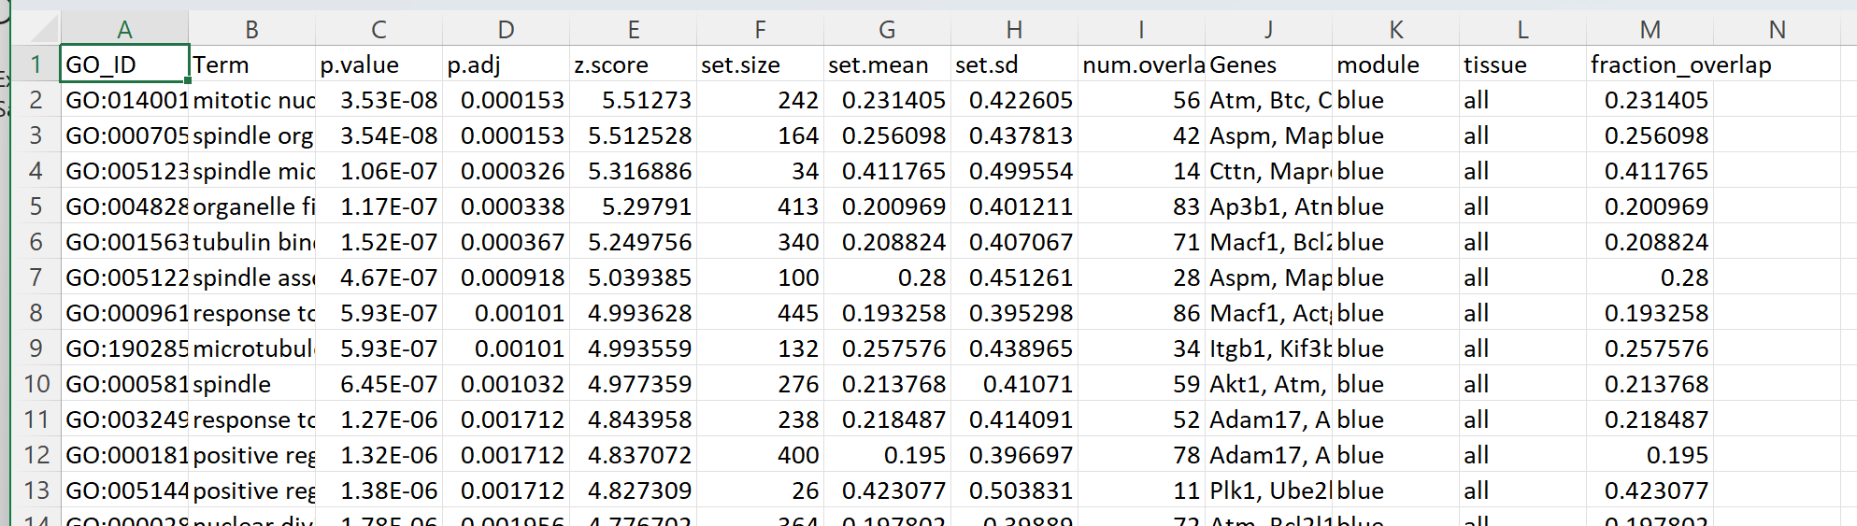
The output- Normal vs Abnormal
The enriched_looks_normal.csv is all of the terms that are above those thresholds.
You can see here that the file includes the whole module “all” as well as the specific sub-categories

Slide 30
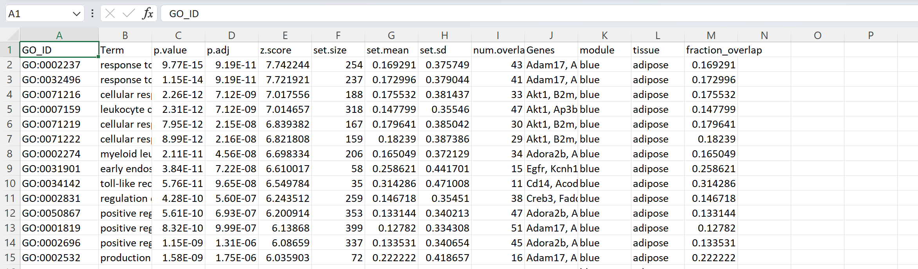
The output- Normal vs Abnormal
enriched_looks_normal_no_all.csv is the same, except that it is displaying only the individual subgroups of genes within a module associated with a specific tissue/category, such as in this example where the GO on line 2 is for the subset of genes in the blue module from the adipose tissue only
If no module in your input file has multiple tissues annotated in it in the “tissue_origin” column, this file will not be generated.

