Slide 1
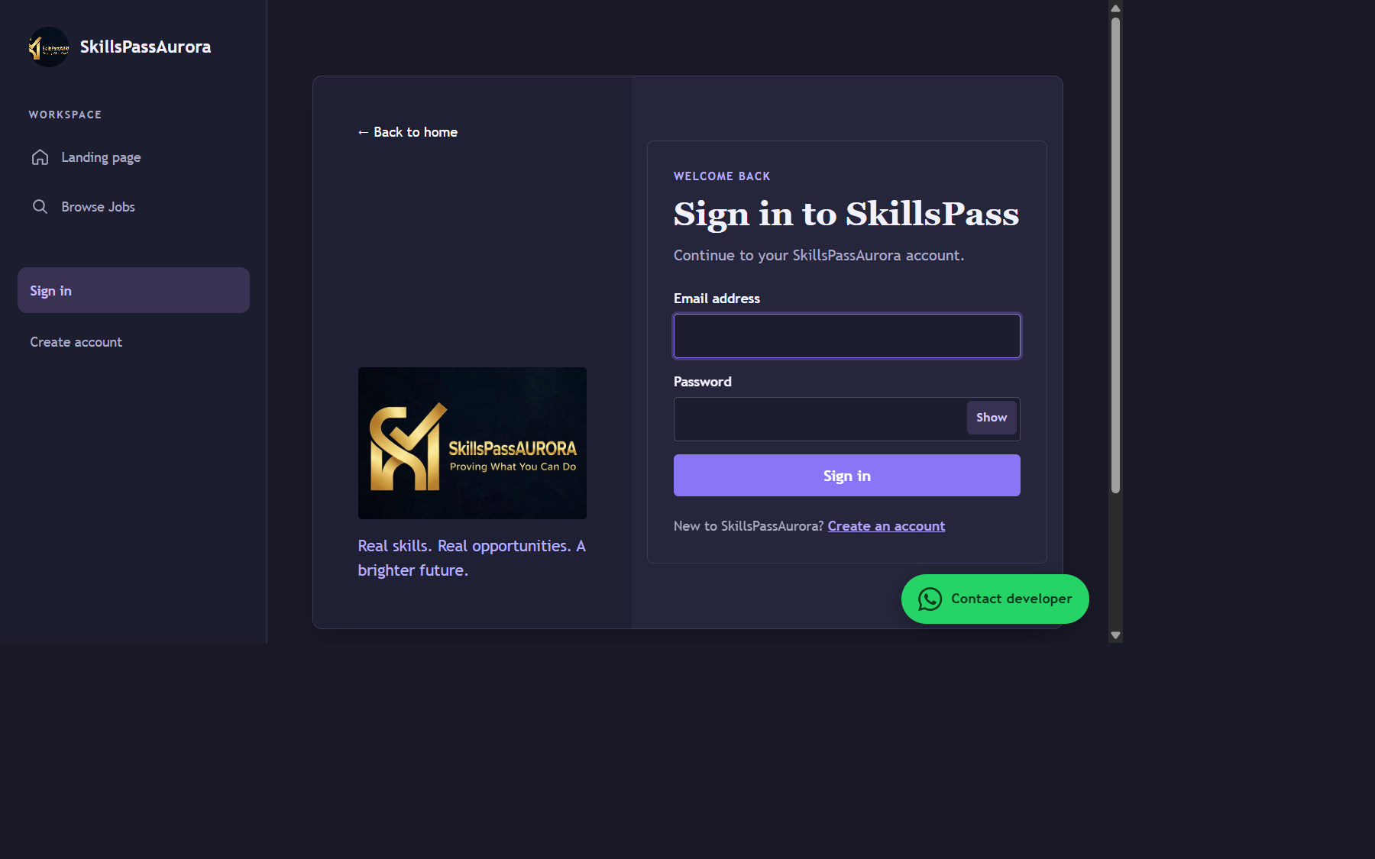
PRODUCT OVERVIEW • OCTOBER 2026
SkillsPassAurora
Your skills are not useless.
How the platform works • Job Seeker and employer journeys • Security • Data model • Setup
A walkthrough of the current PHP + MySQL system
Live application screen • local XAMPP capture

Slide 2
01 | PURPOSE
One marketplace, two sides of the hiring process
The product creates a structured path from discovering a role to selecting a job seeker.
For job seekers
For employers
Shared foundation
Discover available work, apply with context, and share a public skills profile.
Publish openings, review applications, review job seeker applications, and hire.
Accounts, job listings, application status, profiles, and access controls.
Product promise
Make opportunity discovery and job seeker review clearer: each job has an owner, each application is tied to a job seeker, and hiring updates the job status.
Built as a server-rendered PHP application with MySQL/MariaDB persistence; no JavaScript framework is required.
SKILLSPASSAURORA | SYSTEM WALKTHROUGH | 28 OCT 2026
2

Slide 3
02 | ROLES
Two account types share one workflow
Role checks happen on the server as well as being reflected in the interface.
JOB SEEKER / JOB SEEKER
EMPLOYER
1 Create a job seeker account\n2 Browse available jobs\n3 Submit a required cover letter\n4 Add experience or portfolio link\n5 Track application status\n6 Maintain profile and picture
1 Create an employer account\n2 Post a role and required skills\n3 Review applications to own jobs\n4 Review job seeker applications\n5 Select a job seeker\n6 Follow hiring metrics and statuses
Public profiles show name, role, member date, and picture; email and private application data stay hidden.
SKILLSPASSAURORA | SYSTEM WALKTHROUGH | 28 OCT 2026
3

Slide 4
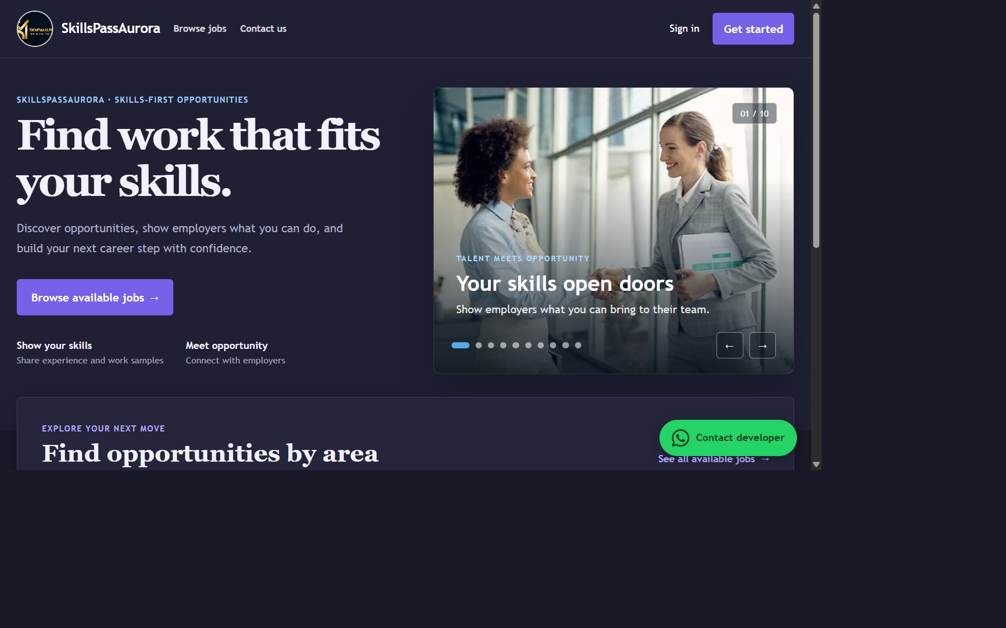
03 | JOB SEEKER JOURNEY
Job Seeker experience: discover, present, apply
The application form collects context beyond a résumé-style profile.
Discover
Browse available roles from the landing page or Jobs navigation.
Apply with context
Cover letter required; relevant experience and HTTP/HTTPS portfolio link optional.
Track progress
Application status is visible to the job seeker: pending, accepted, or rejected.
Actual landing page screenshot captured from local XAMPP
SKILLSPASSAURORA | SYSTEM WALKTHROUGH | 28 OCT 2026
4

Slide 5
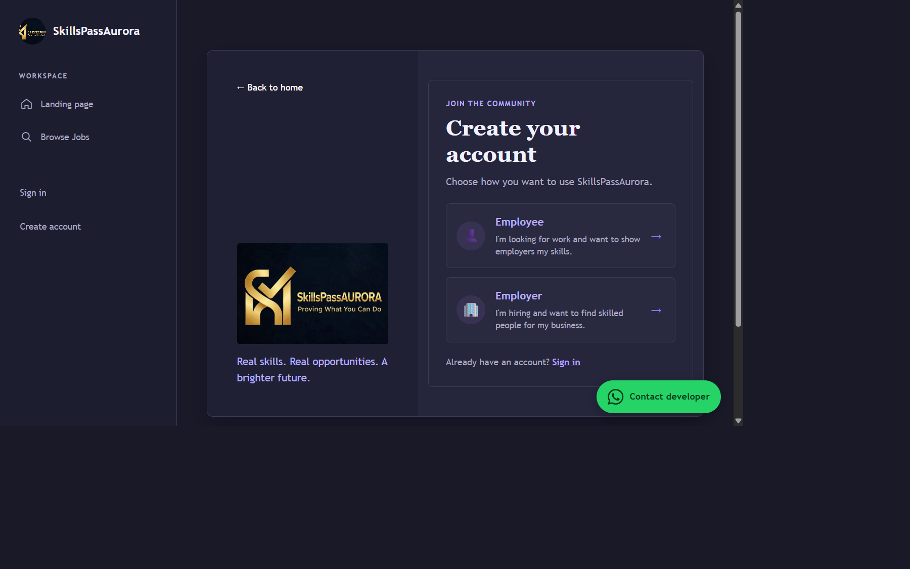
04 | EMPLOYER WORKFLOW
Employers publish roles and manage their hiring pipeline
The dashboard’s charts and metrics are employer-only and scoped to the signed-in employer.
EMPLOYER DASHBOARD • ILLUSTRATIVE LAYOUT
Jobs
Apps
Review
Filled
Total / filled
Received
Pending
Hires
Applications over 7 days
Application status
Pending
Accepted
Rejected
Dashboard graphic is illustrative; an authenticated employer screen was not captured.
Actual account-role selection screen
SKILLSPASSAURORA | SYSTEM WALKTHROUGH | 28 OCT 2026
5

Slide 6
05 | APPLICATION LIFECYCLE
From job post to hire: an explicit state transition
The database links each application to one job seeker and one job.
Employer posts
Job Seeker applies
Employer reviews
Job Seeker selected
→
→
→
Job starts Available
One application per job
Details access is controlled
Job becomes Taken
Application record
Hiring outcome
Required cover letter; optional experience and portfolio URL. A unique job and job seeker pairing prevents duplicate applications.
Selecting an eligible applicant marks the job Taken and rejects other pending applications for that job.
Employer actions are checked against the signed-in employer and the employer’s own job records.
SKILLSPASSAURORA | SYSTEM WALKTHROUGH | 28 OCT 2026
6

Slide 7
06 | PREMIUM ACCESS & CHECKOUT
Premium access expands the free limits
Free employers can post up to 8 active jobs; free job seekers can view 8 jobs each month.
Employer job limit
Job seeker limit
Premium access
Free employers can maintain up to 8 active available jobs; premium users can post more.
Free job seekers can view up to 8 different jobs per month; views are tracked monthly.
An active premium entitlement bypasses these free-plan job limits.
Checkout enforcement
Sandbox MTN MoMo: top up 500 XAF, then spend 500 XAF for 50 Premium days. No withdrawals; not live.
• Server checks job-posting and monthly job-view limits\n• Premium expiry is checked against the user record\n• Job views are tracked by user, month, and job ID\n• Limit notices are shown when the free allowance is reached
Activation follows a provider-confirmed payment; sandbox mode never charges real money.
SKILLSPASSAURORA | SYSTEM WALKTHROUGH | 28 OCT 2026
7

Slide 8
07 | EMPLOYER DASHBOARD
Metrics and charts provide a quick hiring pulse
Dashboard data refreshes every 30 seconds; employers can also refresh manually.
TOTAL JOBS
APPLICATIONS
AWAITING REVIEW
JOBS FILLED
Total / filled
Total received
Pending
Hires
Applications over the last 7 days
Applications by status
Pending
Accepted
Rejected
Live charts and map use this employer's own records and refresh every 30 seconds; slide previews are illustrative.
SKILLSPASSAURORA | SYSTEM WALKTHROUGH | 28 OCT 2026
8

Slide 9
08 | PROFILES & PRIVACY
Profiles are shareable; private contact details are not
One profile supports job seeker discoverability without exposing email by default.
Public profile
Private by default
Picture validation
Display name, account type, member date, and profile picture.
Email and private application data are not displayed on public profiles.
JPEG, PNG, or WebP; maximum 2 MB; image dimensions and detected MIME type are checked.
Applicant details are associated with the employer’s own jobs. No applicant-unlock payment is required.
Applications can include a required cover letter, optional experience, and an optional HTTP/HTTPS portfolio URL.
Public profile route is designed to expose a limited view; always verify authorization on private actions server-side.
SKILLSPASSAURORA | SYSTEM WALKTHROUGH | 28 OCT 2026
9

Slide 10
09 | SYSTEM ARCHITECTURE
A compact server-rendered stack
Each request passes through PHP before data is read or changed in the relational database.
Browser\nJob Seeker / employer
PHP 8.1+\nindex.php + PDO
MySQL / MariaDB\nInnoDB tables
External services\nSMTP + MTN MoMo sandbox wallet top-ups
→
→
→
Server responsibilities
Database responsibilities
Integrations
Authentication, role checks, validation, CSRF, workflows, JSON refresh endpoint.
Relationships, unique constraints, indexes, cascading cleanup, durable state.
SMTP handles sign-in codes; MTN MoMo Collection API handles sandbox wallet top-ups and payment-status checks.
No frontend framework is required; the dashboard charts are SVG rendered in the browser from employer-scoped JSON data.
SKILLSPASSAURORA | SYSTEM WALKTHROUGH | 28 OCT 2026
10

Slide 11
10 | DATA & SCALE
The schema supports a very large user ID space
A 64-bit identifier is a capacity foundation—not a promise of unlimited storage or throughput.
users
jobs + applications
wallet ledger
BIGINT UNSIGNED primary key; unique email; role index; password and OTP hashes; optional profile image.
Employer and job seeker account links; unique job/account pair; status and lookup indexes.
Wallet top-ups, ledger entries, Premium expiry, and job views support wallet purchases and usage limits.
What BIGINT UNSIGNED means
Real capacity depends on disk space, profile-picture storage, indexes, backup/restore design, query load, and server resources. Scale testing and operations planning are still needed.
The identifier range is 0 to 18,446,744,073,709,551,615. One million users is well within this ID range.
Use the single schema.sql file for fresh installs or non-destructive updates to existing databases.
SKILLSPASSAURORA | SYSTEM WALKTHROUGH | 28 OCT 2026
11

Slide 12
11 | SECURITY
Security controls built into the application
Security is layered across login, writes, data access, uploads, and external services.
Password protection
Step-up OTP
Safer requests
Passwords are hashed; incorrect attempts are counted and capped.
At 10 failed attempts, email OTP is required; hashed, 10-minute expiry, up to 5 attempts, 1-minute resend wait.
PDO prepared statements, session regeneration, and CSRF tokens on state-changing forms.
Server authorization
Output & uploads
Secrets & payments
Employer ownership checks guard posting, reviewing, and hiring actions.
Dynamic text is escaped; uploads are MIME-, size-, and dimension-validated.
SMTP and MTN sandbox credentials belong in server environment settings, never committed code.
Operationally: enable HTTPS, keep PHP/MySQL patched, restrict database privileges, back up data, and test recovery.
SKILLSPASSAURORA | SYSTEM WALKTHROUGH | 28 OCT 2026
12

Slide 13
12 | SETUP & WALKTHROUGH
How to launch and demonstrate the current system
A short guided demo can explain the product even before a large dataset is loaded.
LOCAL SETUP
DEMO FLOW
1 Start Apache and MySQL in XAMPP\n2 Import the single schema.sql file for a fresh install or safe database update\n3 Set DB_HOST / DB_NAME / DB_USER / DB_PASS\n4 Install Composer dependencies\n5 Configure SMTP for OTP email\n6 Set MTN MoMo sandbox credentials in server environment
1 Show the landing page and account roles\n2 Register employer; post an available job\n3 Register job seeker; browse and apply\n4 Review the application as employer\n5 Top up wallet in sandbox; confirm the provider, then buy Premium from wallet\n6 Select job seeker; observe job marked Taken
Slides 14-16 show code screenshots for the live charts, employer job map, and wallet. Populate the database with test accounts and jobs before a live demo.
SKILLSPASSAURORA | SYSTEM WALKTHROUGH | 28 OCT 2026
13

Slide 14
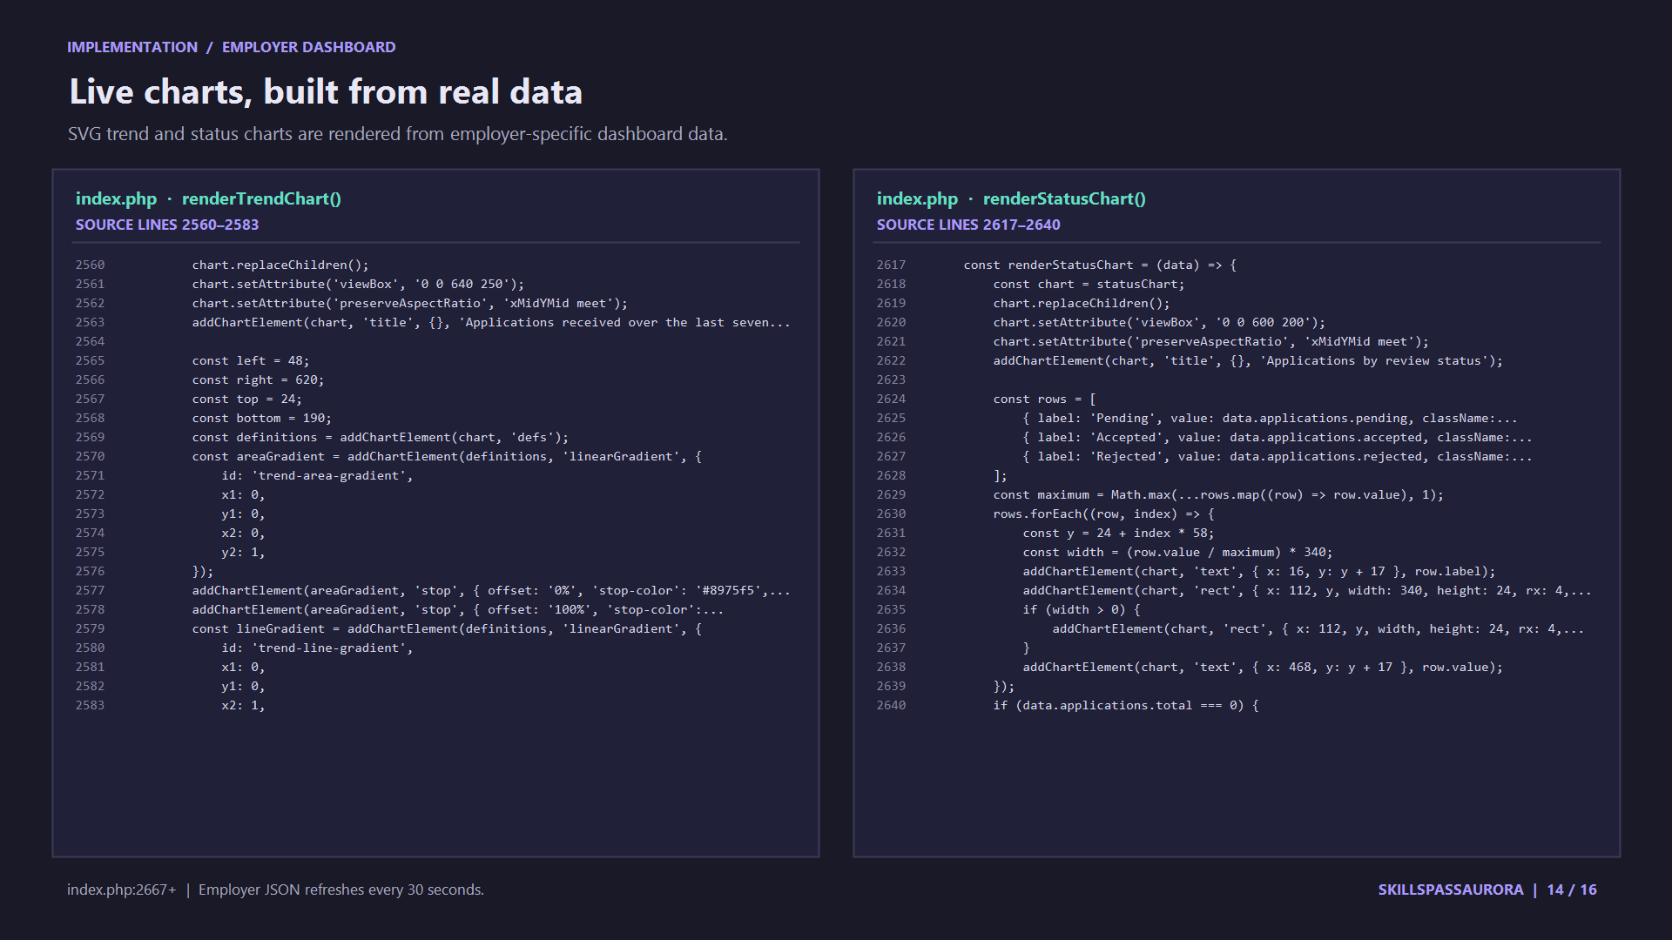

Slide 15
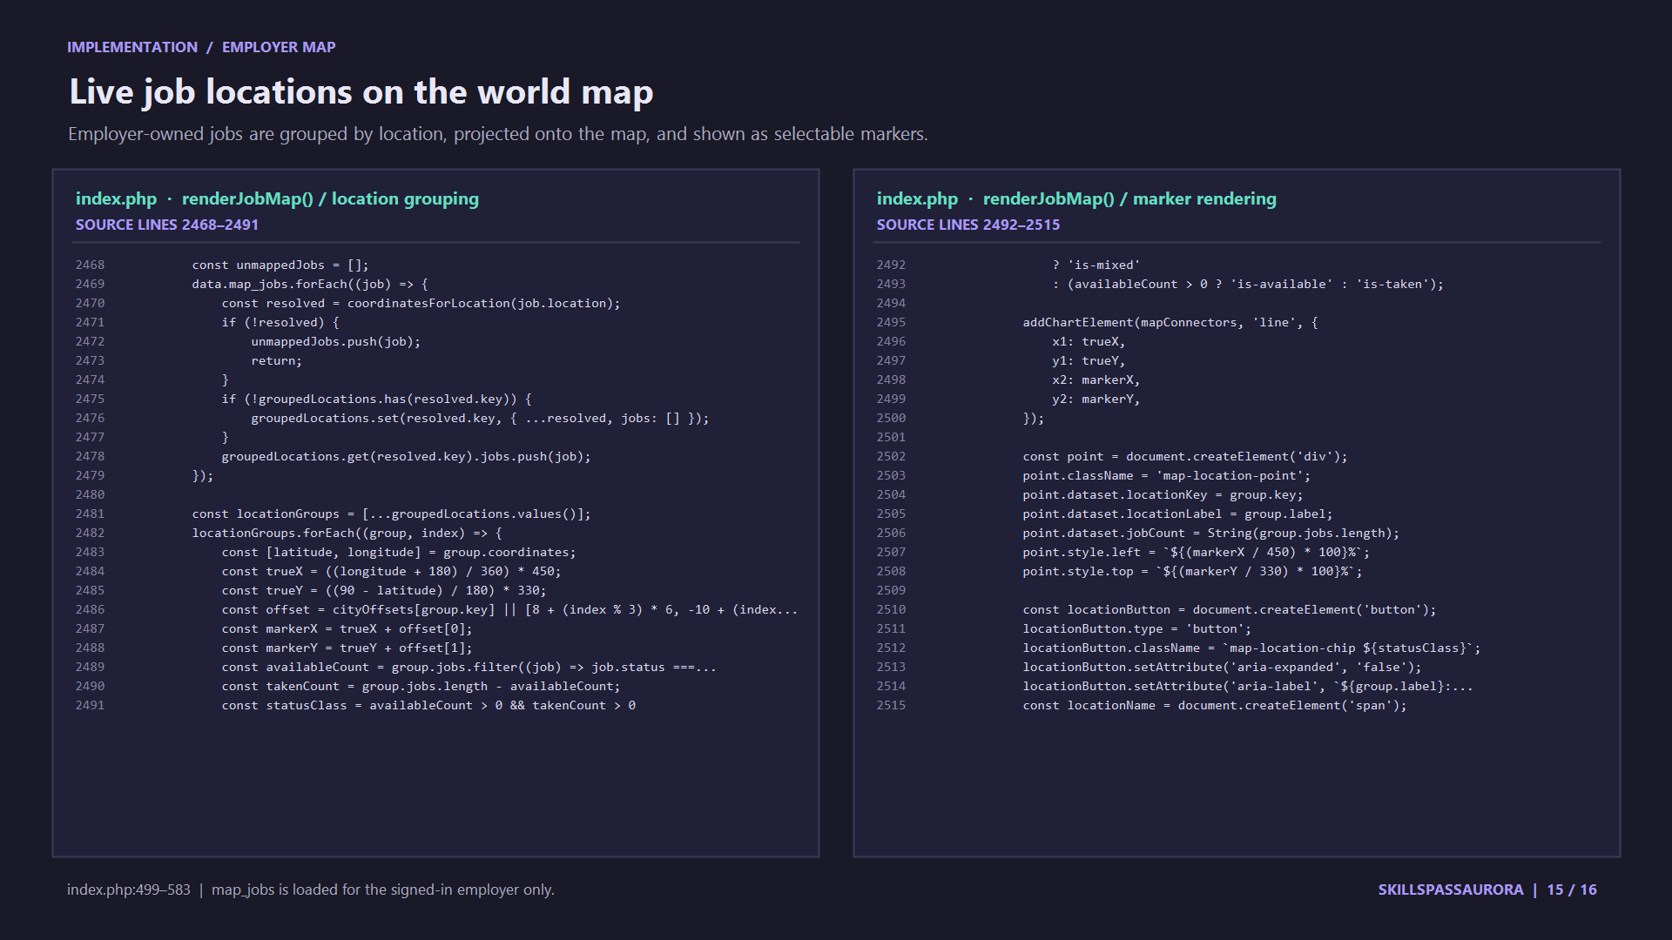

Slide 16
