Slide 1

Data-Driven Insights in Retail Analytics
An Exploratory Data Analysis of Large-Scale Retail Transactions Using Statistical and Visualization Techniques
Submitted By :- Yug Rathi

Slide 2
📊 Introduction
Analyzing customer behavior and sales patterns using data
Focus on pricing, discounts, delivery, and customer segments
Applying Univariate, Bivariate & Multivariate Analysis
Goal: Extract insights to improve revenue and business decisions
Identifying key factors influencing customer purchasing decisions
Supporting data-driven strategies for business growth

Slide 3
📌 Project Overview
This project focuses on analyzing an e-commerce dataset to understand customer purchasing behavior and overall sales performance
It involves data cleaning, preprocessing, and transformation to ensure accurate and reliable analysis
Various analytical techniques such as Univariate, Bivariate, and Multivariate analysis are applied to explore patterns and relationships
The study examines key factors like product pricing, quantity, discounts, delivery time, and customer segments
Visualizations are used to represent trends and correlations in an easy-to-understand manner
The overall aim is to derive meaningful insights that can support better business decisions and improve customer satisfaction

Slide 4
❗ Problem Statement
E-commerce businesses generate large amounts of data, but extracting meaningful insights from it is a major challenge
There is a need to understand how factors like pricing, discounts, customer segments, and delivery impact sales and returns
Lack of clear analysis makes it difficult to identify key drivers of revenue and customer behavior
Businesses often struggle to balance discount strategies, optimize delivery performance, and reduce return rates
This project aims to analyze the dataset to uncover patterns, relationships, and trends that can support better decision-making

Slide 5
Objectives
To analyze the e-commerce dataset and understand overall sales and customer behavior
To perform Univariate, Bivariate, and Multivariate analysis for deeper insights
To identify key factors affecting revenue such as product price, quantity, and discounts
To study the impact of customer segments on purchasing patterns
To examine how delivery performance influences return behavior
To derive actionable insights that can support better business decisions

Slide 6
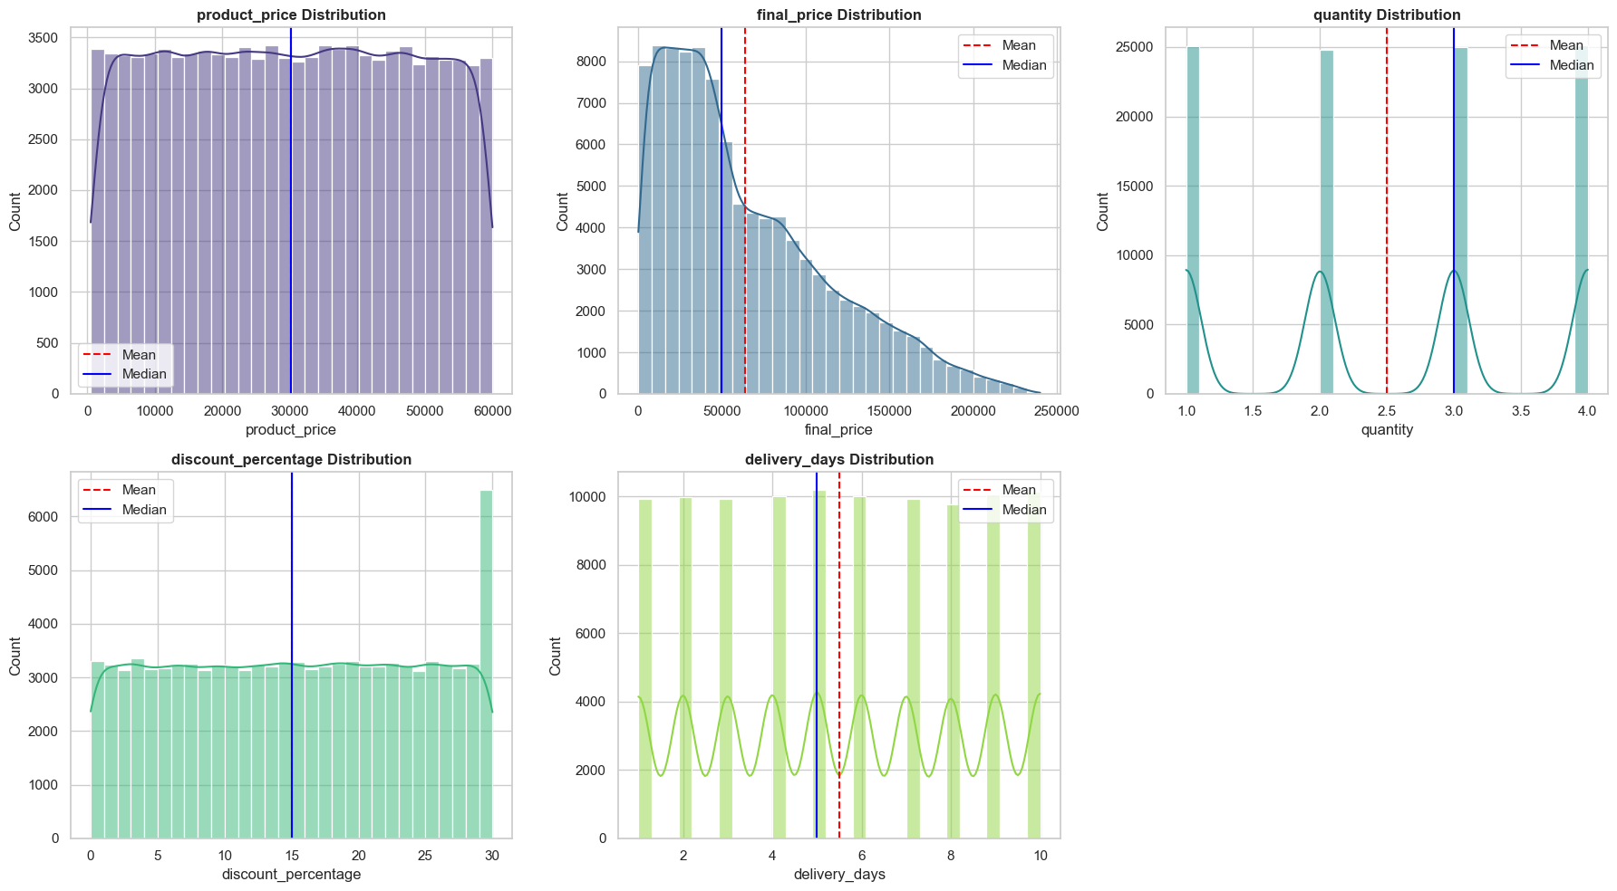
Distribution Analysis (Univariate)
Product Price shows a fairly uniform distribution, indicating a wide range of product pricing across the dataset
Final Price is positively skewed, as the mean is higher than the median, indicating the presence of high-value transactions
Quantity is concentrated around lower values (1–3), showing that most purchases involve limited number of items
Discount Percentage appears evenly distributed, suggesting a consistent discount strategy across products
Delivery Days show a relatively balanced distribution with slight variation, indicating a stable delivery system
Overall, most variables show stable and well-distributed patterns, with slight skewness in pricing due to high-value purchases

Slide 7
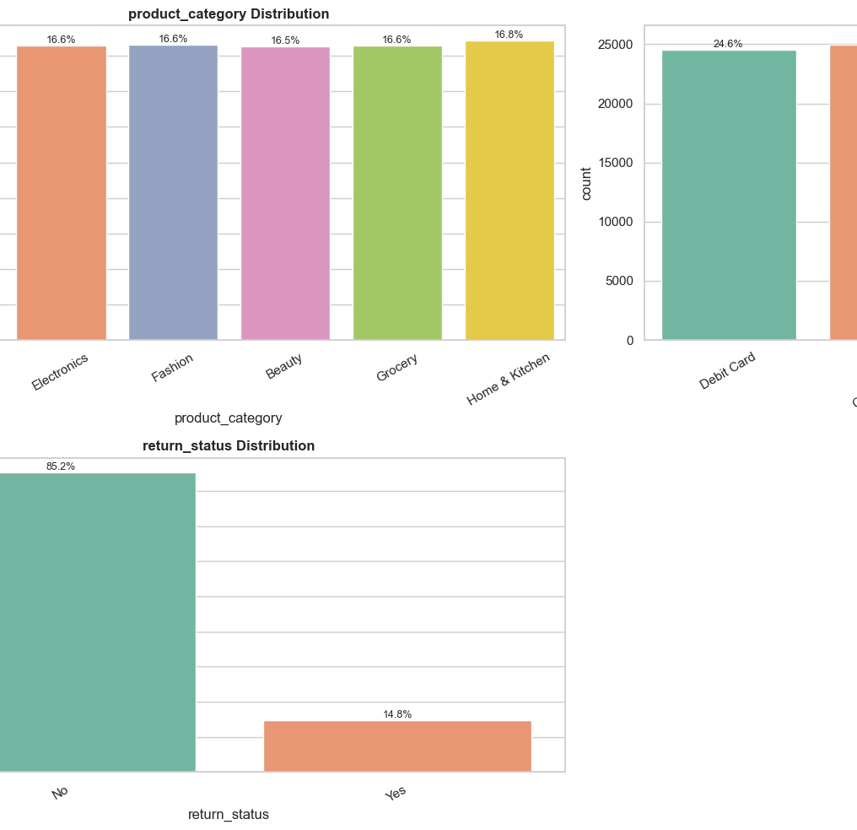
Categorical Distribution (Univariate)
Product categories are evenly distributed, with each category contributing almost equally (~16–17%), indicating a balanced product mix
No single category dominates, suggesting diversified inventory and sales distribution
Payment methods are also uniformly distributed, with all methods (Debit Card, Credit Card, UPI, COD) having nearly equal usage
This reflects customer flexibility and equal preference across payment options
Return status shows a strong imbalance, where majority of orders are not returned (~85%)
Only a small portion (~15%) of orders are returned, indicating high customer satisfaction and efficient operations
Overall, the dataset shows balanced categorical distributions with low return rates, supporting stable business performance

Slide 8
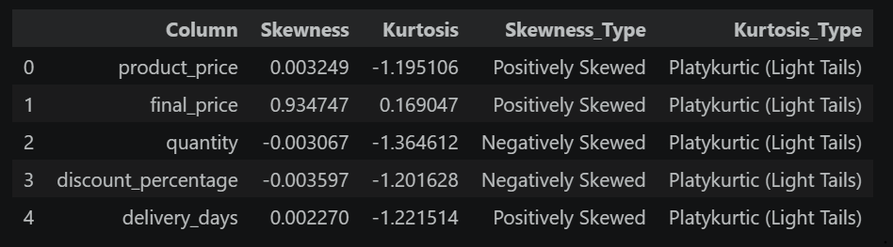
📊 Skewness & Kurtosis
Most variables show near-zero skewness, indicating fairly balanced distributions
final_price is positively skewed, suggesting presence of some high-value transactions
quantity and discount_percentage show slight negative skewness, indicating more higher-end values
All variables are platykurtic, meaning distributions have light tails and fewer extreme outliers
Overall, the data is relatively stable with low extreme variations, making it suitable for analysis

Slide 9
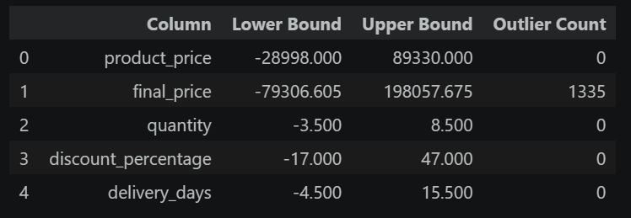
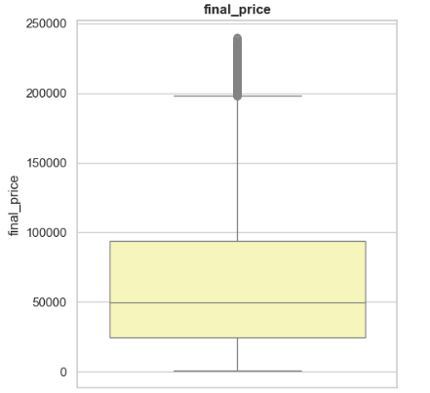
📊 Outlier Analysis
Outliers are observed only in final_price, with a significant count compared to other variables
Other features like product_price, quantity, discount_percentage, and delivery_days show no major outlier presence
The boxplot confirms that outliers are mainly on the higher end, indicating extreme high-value transactions
This suggests a right-skewed distribution driven by a small number of large purchases
These outliers are likely genuine business events (premium or bulk purchases) rather than data errors
Outliers were handled using the IQR method with median replacement to ensure a more stable dataset for analysis
Most outliers were concentrated in final_price, indicating high-value transactions rather than noise

Slide 10
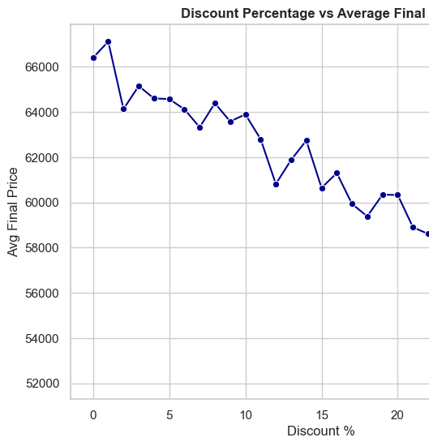
Discount vs Final Price (Bivariate)
There is a clear negative relationship between discount percentage and average final price
As discount increases, the average final price consistently decreases
The decline is gradual, indicating a controlled impact of discounts on revenue
No sharp spikes are observed, suggesting stable pricing and discount strategy
Higher discounts (above ~20–25%) lead to a significant drop in revenue per transaction
Moderate discounts maintain a balance between customer attraction and revenue generation

Slide 11
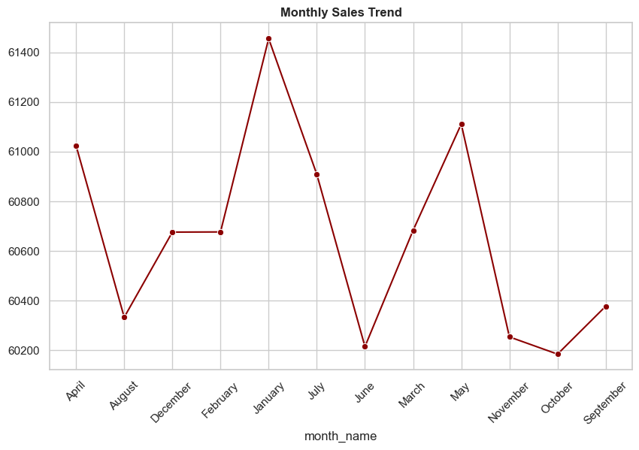
Monthly Sales Trend (Bivariate)
Sales show moderate fluctuations across different months, indicating changing demand patterns
A clear peak is observed in January, suggesting higher customer activity during this period
Some months like June and October show relatively lower sales performance
The variation indicates the presence of seasonal or time-based demand trends
There is no extreme volatility, showing overall stability in sales throughout the year
Periodic rises and drops suggest influence of festive seasons, promotions, or customer buying cycles

Slide 12
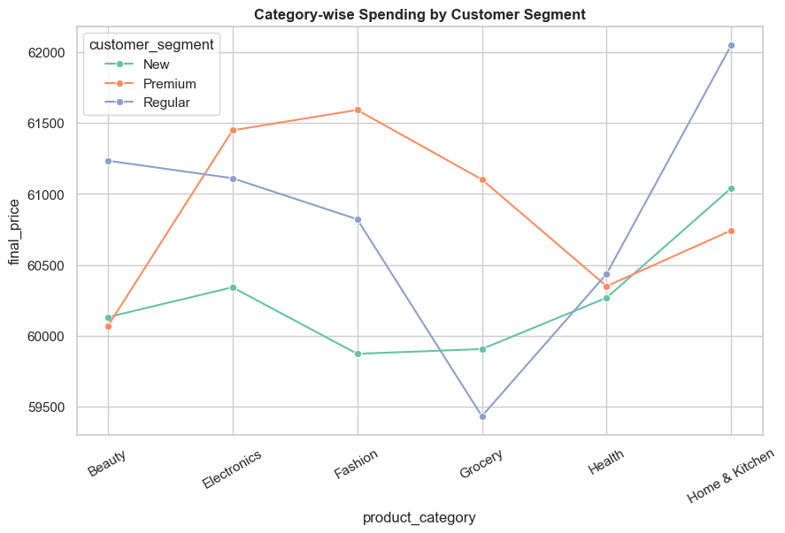
Category-wise Spending by Customer Segment (Multivariate)
Premium customers consistently show higher spending across all product categories
Regular and New customers spend comparatively less, indicating clear spending differences between segments
The gap between segments varies across categories, showing that customer behavior is category-dependent
Some categories show a noticeable increase in spending, indicating higher customer interest or value perception
Spending trends are relatively stable, with no sudden fluctuations across categories
Overall, customer segmentation plays a significant role in influencing purchase behavior and revenue

Slide 13
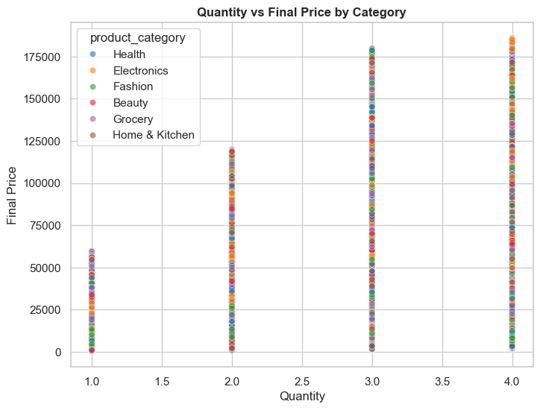
Quantity vs Final Price by Category (Multivariate)
There is a clear positive relationship between quantity and final price across all categories
As quantity increases from 1 to 4, the final price rises significantly, indicating volume-driven revenue
All product categories follow a similar upward trend, showing consistent purchasing behavior
Higher quantities (3–4) are associated with high-value transactions, contributing majorly to revenue
Some categories show slightly higher price ranges, indicating variation in product value across categories
The spread of points suggests diverse pricing within each category, not a fixed price range
Overall, both quantity and product category together influence total transaction value

Slide 14
Learning Outcomes
Gained practical experience in data cleaning and preprocessing techniques
Developed skills in Univariate, Bivariate, and Multivariate data analysis
Learned to use visualization tools like Matplotlib and Seaborn for effective data representation
Improved ability to interpret data and extract meaningful insights
Understood how data analysis supports real-world business decision-making
Enhanced problem-solving and analytical thinking skills

Slide 15
✅ Conclusion
The analysis provided clear insights into customer behavior, sales patterns, and key business factors
Product price and quantity were identified as major drivers of revenue, while discounts showed a limited but strategic impact
Customer segmentation revealed significant differences in spending patterns across different groups
Delivery performance was found to influence return behavior, highlighting the importance of efficient logistics
Overall, the project demonstrates how data analysis can transform raw data into actionable insights
These findings can help businesses improve decision-making, optimize strategies, and enhance customer satisfaction

Slide 16
Thank You
Thank you for your time and attention
I hope this analysis provided meaningful insights
Your valuable feedback and suggestions are welcome.

