Slide 1
Presentation On
Computer vision Syndrome
A eye care based computer system

Slide 2
Team Members
Md. Saiful azam (141352033 )
Md. Sifat hossain (153402342)
Md. SIRAzul islam(153402341 )
SAYED SAYEEDUR RAHMAN(153402309 )

Slide 3
Introduction
You may have experienced at least one of the common symptoms of computer vision syndrome which include:
Eyestrain
Headaches
Blurred vision
Dry eyes

Slide 4
Background Study
Now a days most of the people uses computer in office and home for long time mostly 8 to 12 hours a day. They continuously using this for without a single break sometimes they forget for the pressure of work as a result their eyes blink rate decreases, which really hamper eye’s.
Almost maximum people use computer in our country . most of the people are suffering for CVS diseases . Most of the time it seems that many people don’t care this , they think it is not hamper their eyes .
The common reasons are
They forget to take leave in proper time
They don’t have proper knowledge about this diseases
Can’t get proper advice..

Slide 5
Proposed System
Eyeblink detection is made up of four phases.
(1) Image Capture.
(2) Face Detection.
(3) Eye localization.
(4) Blink Detection.

Slide 6
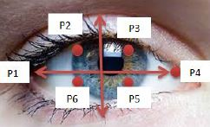

Eye and Blink Detection
We are using this formula to calculate for eye area detection and blink detection

Slide 7
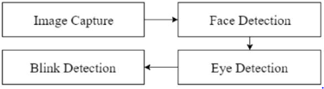
Flow Chart

Slide 8
How does system work ?
Real time capture from camera using webcam
Face detection (Dlib)
Eye area detection ( Dlib )
Count number of blink
Alert alarm

Slide 9
Why this system is unique from other?
This system is special for notifying accurately at certain time if anyone is affected by CVS.
This system can track him/her count eye-blink simultaneously
We try to implement recent developed method

Slide 10
Feature
Notify alarm when need to take leave .
Automatic monitor your eye blink rate when anyone work in front of screen of devices.
Give a healthy support to protect you from CVS.

Slide 11
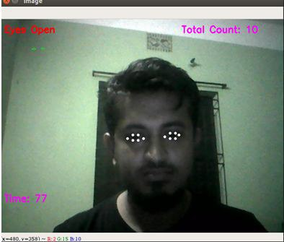
Project Screenshot

Slide 12
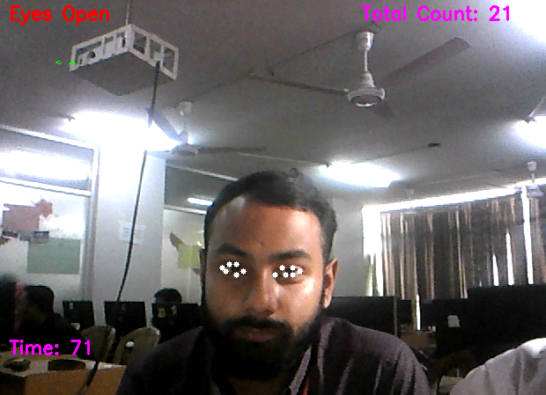
Project Screenshot

Slide 13
Projects problems
This can not count blink in dark and low light
This program’s performance is not very high
This can not count blink whom eyes are small
It can not count blink whom are using glasses

Slide 14
Thank you.

