Slide 1


WELCOME
Design and Development of Online Doctor Appointment ANDROID
Application System

Slide 2




MD SIFAT HOSSAIN
153402342
MD. SIRAZUL ISLAM
153402341
MUNSHI SAYED-UZ-ZAMAN
141352032
MEMBER

Slide 3
Brain Storming
Priority Matrix
Project Selection
Concept Mapping
Requirement Analysis
Story Boarding
Prototyping
Use Case Diagram
CONTENTS
Sequence Diagram
Database Design

Slide 4
SMART MAN POWER SOLUTION
This Is An Android App. Its Abilities To Provide Dynamic, Disciplined And Dedicated Services In Labour Contract , Packaging Services , Security And Housekeeping.
TRAVEL GUIDE SOLUTION
Use Travel Guide Solution App We Can Easily Travel One Place (Historical) To Another Place. We Can Easily Find Out Where Our Historical Place Situated. We Mark Where Our Historical Place Situated In Google Map, With Short Description .
BRAIN STORMING
DOCTOR’S CHAMBER INFORMATION
Here Our All Doctor’s Information Include. Individual All Doctor’s Phone Number, Chamber, Which Specialist. Man Can Easily Find A Doctor Details. Its Very Helpful Our Society.

Slide 5
SMART MAN POWER SOLUTION
10%
15%
10%
24%
59%
COST
TIME
FISIBILITY
TOTAL
LOCAL DOMAIN
TRAVEL GUIDE SOLUTION
15%
18%
24%
24%
81%
PRIORITY MATRIX
COST
TIME
FISIBILITY
TOTAL
LOCAL DOMAIN
DOCTOR’S CHAMBER INFORMATION
18%
20%
24%
24%
86%
COST
TIME
FISIBILITY
TOTAL
LOCAL DOMAIN

Slide 6
DOCTOR’S CHAMBER
INFORMATION
PROJECT SELECTION

Slide 7
APPOINMENT CELL #
HOSPITAL ADDRESS
DOCTOR’S NAME
CHARGING AMOUNT
HOSPITAL NAME
DEGREE
DOCTOR’S CHAMBER
LICENCE NUMBER
WORKING DAY
CONCEPT MAPPING
SPECIALIST
MEETING TIME
CITY
PICTURE
EXPERIENCE YEAR
TEACHER OR NOT

Slide 8



HARDWARE
SOFTWARE
OTHER
PC
SERVER PC
NET
ANDROID STUDIO
EMULATOR
JAVA RUN TIME ENVIRONMENT
MYSQL
SERVER SIDE LANGUAGE (PHP)
BROWSER
HOSPITAL SURVEY
REQUIRMENT ANALYSIS

Slide 9
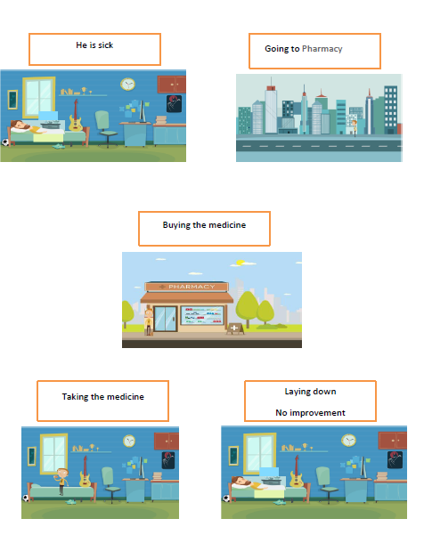
TWO DAYS AGO
STORY BOARDING

Slide 10
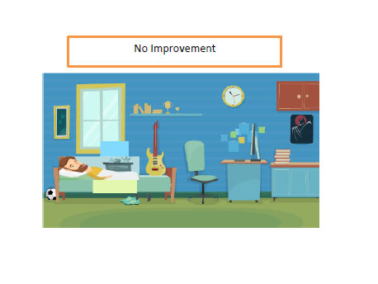
PREVIOUS DAY
STORY BOARDING

Slide 11
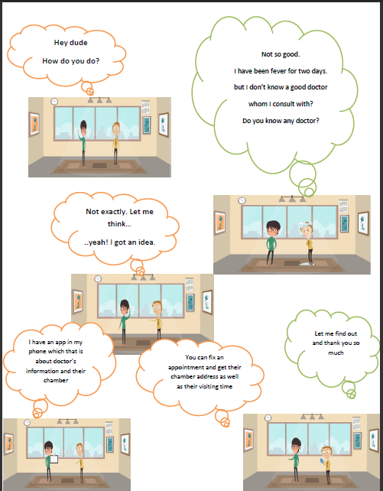
PRESENT DAY AT AFTERNOON
STORY BOARDING

Slide 12
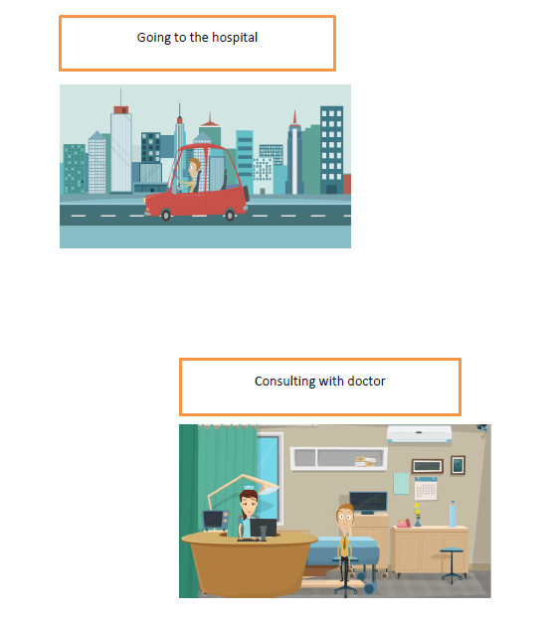
NEXT DAY AT MORNING
STORY BOARDING

Slide 13
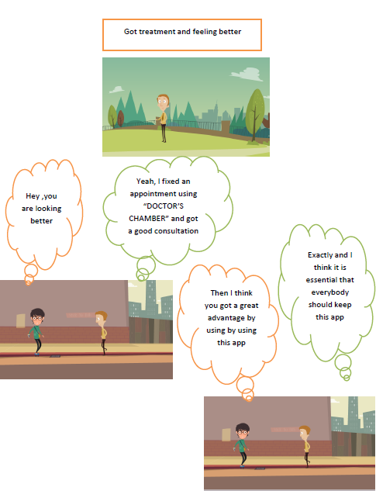
SAME DAY AT AFTERNOON
STORY BOARDING

Slide 14
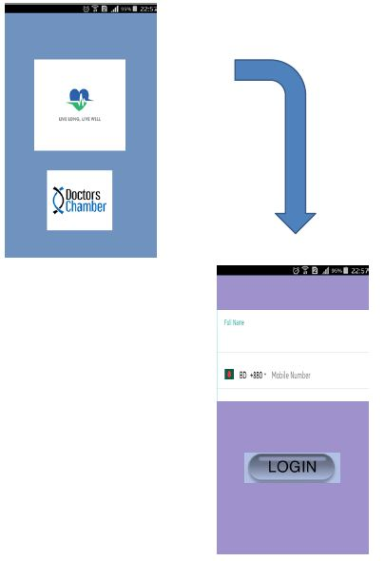
LOG IN APP
PROTOTYPING

Slide 15
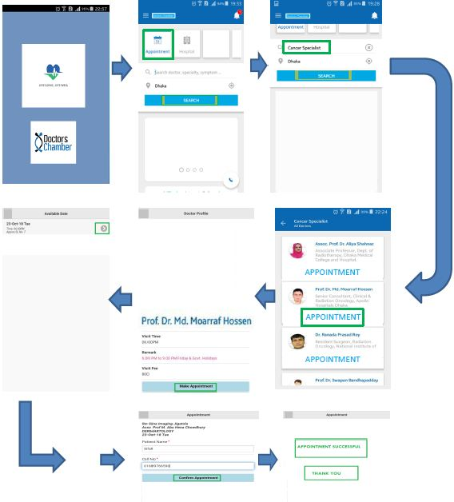
PROTOTYPING

Slide 16
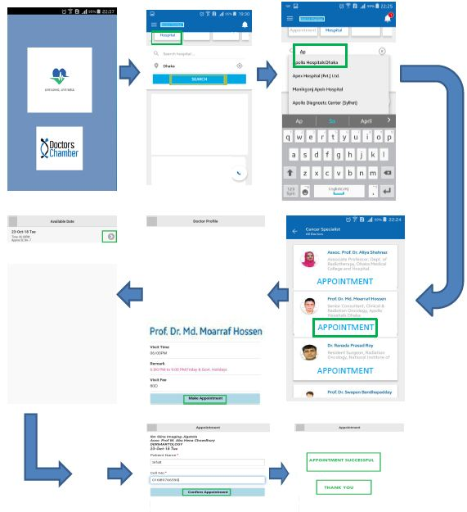
PROTOTYPING

Slide 17
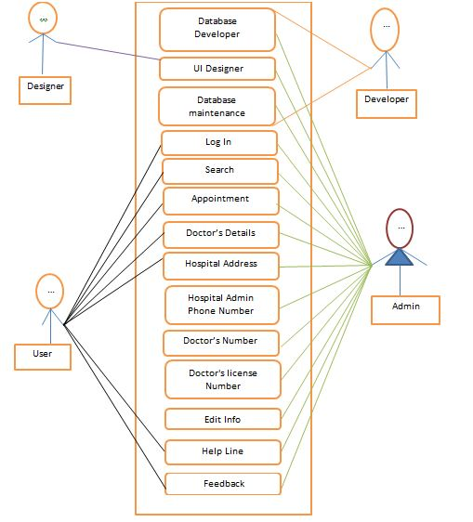
USE CASE DIAGRAM

Slide 18
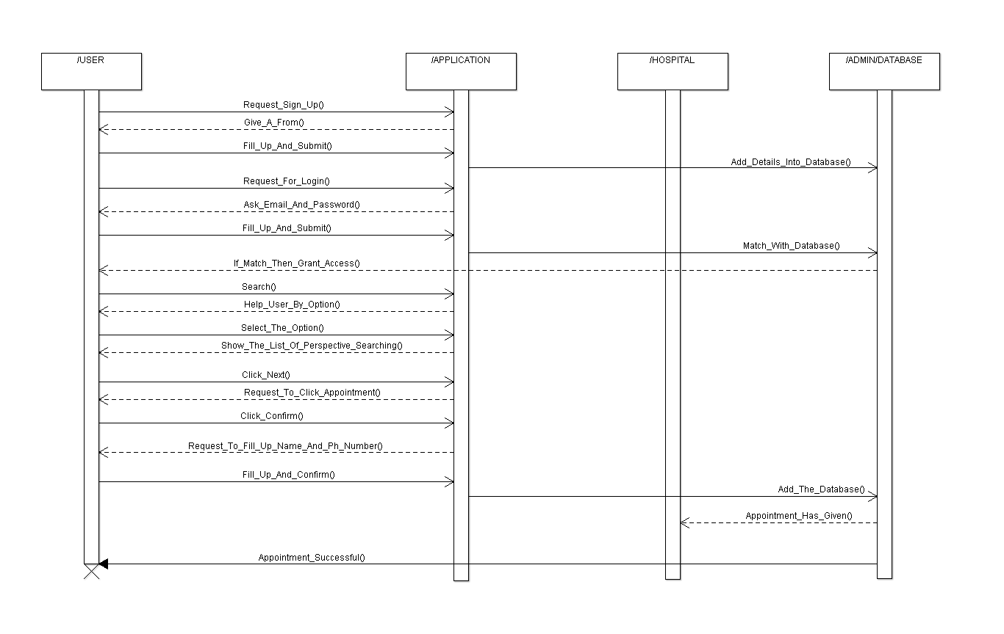
SEQUENCE DIAGRAM

Slide 19
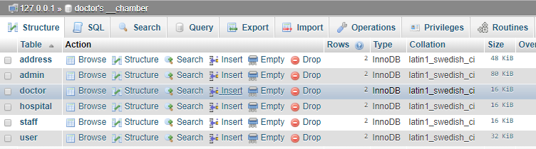
DOCTOR’S CHAMBER TABLE
DATABASE DESIGN

Slide 20



HOSPITAL
DOCTOR
DATABASE DESIGN
USER

Slide 21



ADDRESS
STAFF
DATABASE DESIGN
ADMIN

Slide 22
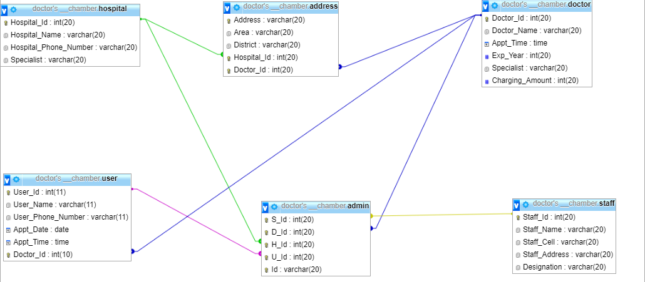
DATA BASE SCHEMA

Slide 23
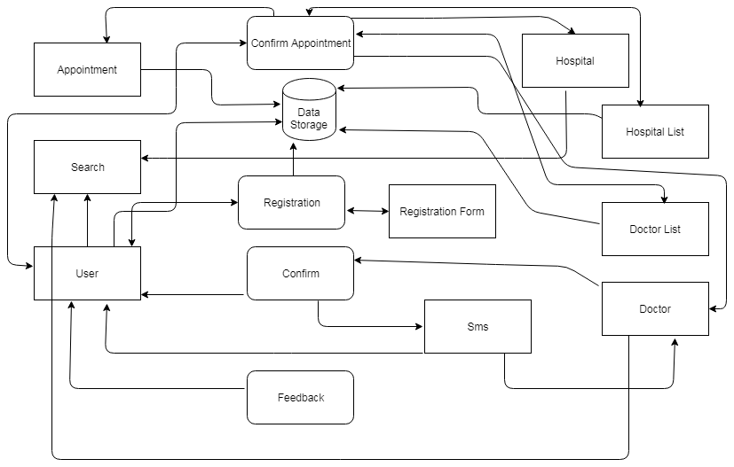
DATA FLOW DIAGRAM

Slide 24
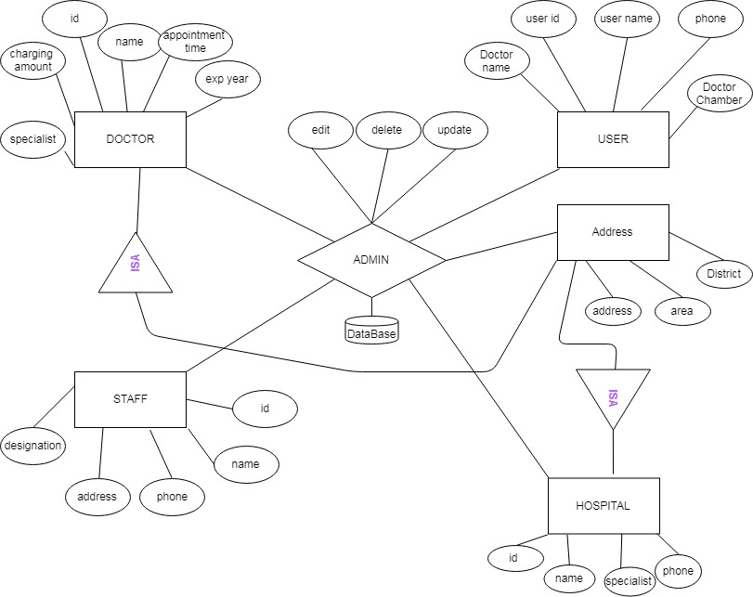
ER DIAGRAM

Slide 25
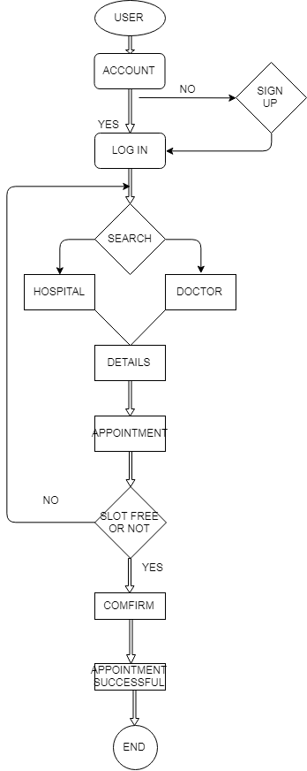
ACTIVITY DIAGRAM

Slide 26
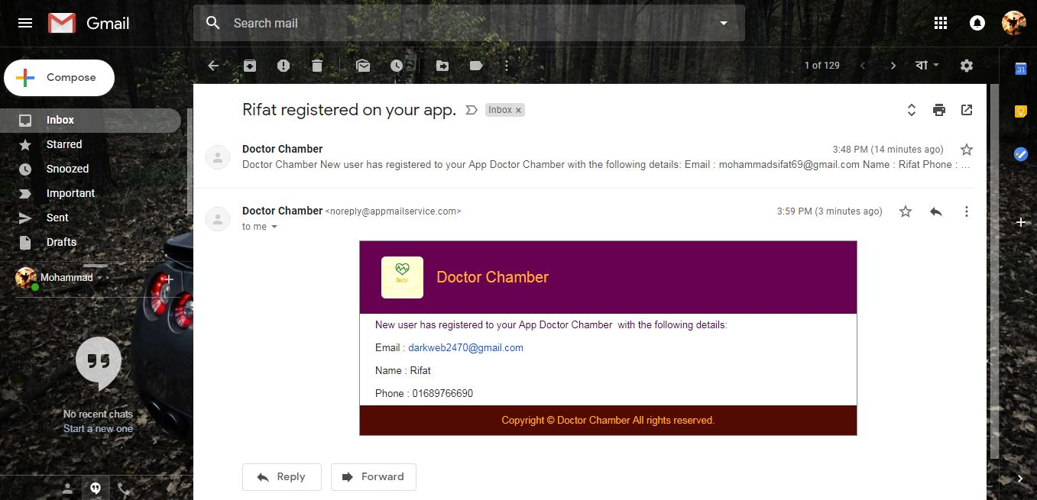
ADMIN VIEW
New User Data
IMPLEMENT

Slide 27
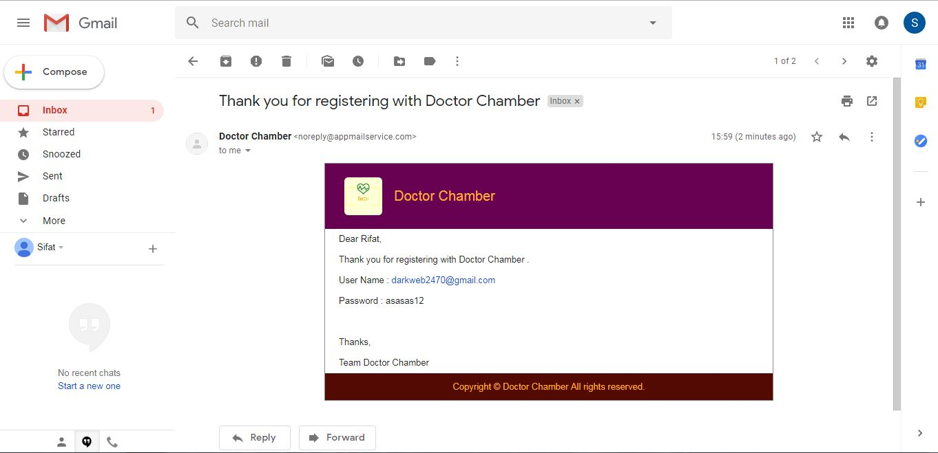
USER VIEW
Confirm User By Mail
IMPLEMENT

Slide 28
THANK YOU

