Slide 1
Chương 4_3
JAVA SERVER FACE

Slide 2
NỘI DUNG
Starting a Project
Creating Web Pages
Adding Components to a Web Page
Getting Help
Testing a Web Application
Connecting Web Pages and Handling User Actions
Editing Java Code
Handling User Input
Storing and Passing Data
Connecting to Databases
Debugging a Web Application

Slide 3
Create a Visual Web JSF Application project
Choose File > New Project from the main menu.
In the New Project wizard, select the Java Web category and the Web Application project type, and click Next.
Name the project GettingStarted. Note the default project location. Browse and select a different location if you like.
(Optional) Select the Use Dedicated Folder for Storing Libraries checkbox and specify the location for the libraries folder. See Sharing Project Libraries for more information on this option.
Click Next.
Choose a server (Tomcat) and Java EE version.
Click Next.
In the Frameworks panel, select the Visual Web JavaServer Faces framework
Click Finish to create the new project in the default location or the location chosen in step c.

Slide 4
Creating Web Pages
With Visual Web JSF applications, you use JavaServer Pages (JSP) technology and page beans (also known as backing beans) instead of HTML pages.
The JSP page is a template from which the server generates the HTML response to be displayed in the browser (the client).
The page bean contains the logic that the server executes both when it generates the HTML response and after a user submits the page.
When you add a web page in a Visual Web JSF application, the IDE creates both a JSP file and a Java source file for you.
You mostly use the Visual Designer and the Properties window to develop the web page. The IDE modifies the JSP code and Java code to implement what you design. Most of your work can be done from the Visual Designer and the Properties window.

Slide 5
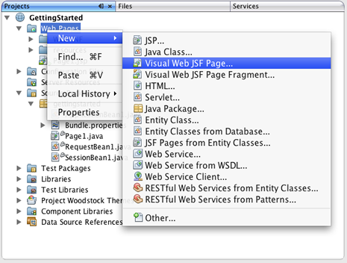
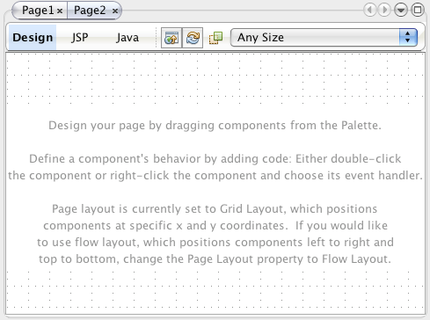
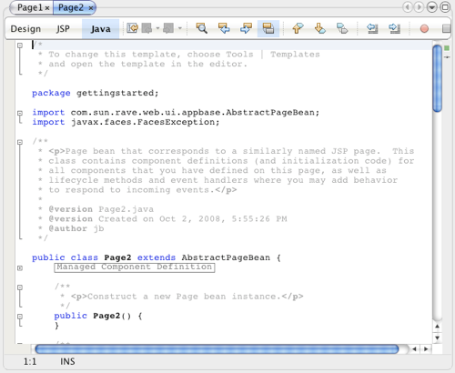
Create Pages.jsp

Slide 6
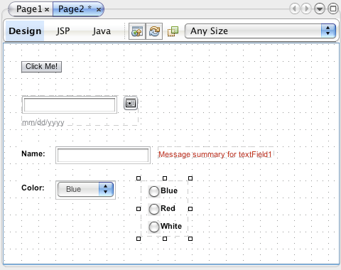
Create Page2.jsp - Adding Components

Slide 7
Drag a Button Component onto the page, type Click Me! and press Enter
Drag a Calendar Component onto the page
…
Drag a Drop Down List component onto the page and set its label property to Color. Right-click the Drop Down List component and choose Configure Default Options to open the Options Customizer.
Use similar steps to create a Radio Button Group component with the choices Blue, White, and Red, but do not close the Options Customizer quite yet.

Slide 8
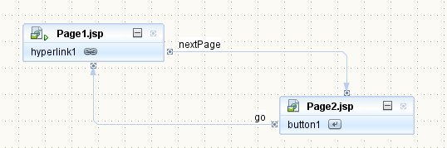
Connecting Web Pages and Handling User Actions
When a user types a URL, clicks a link, or clicks a button, the browser sends a request to the server. The server maps the request to a JSP page and uses that JSP page and its associated page bean to render a response.
Right-click Page1 and choose Set As Start Page to make it the start page.

Slide 9
Handling User Input
You bind a validator to an input component, such as a Text Field component, by dropping the validator onto the input component. For example, after you add a Text Field component to a page in the Visual Designer, you can drag a Length Validator from the Validators section in the Palette and drop it on the Text Field.
Alternatively, you can drop the validator onto the page and set the input component's validator property to that validator object. For example, you can drop a Long Range Validator on a blank spot on the page, which adds longRangeValidator1 to the Navigator window. You can then select an input component in the Visual Designer, such as the Text Field component, and choose longRangeValidator1 from its validatorExpression property's drop-down list. You can use the same validator for more than one component.

Slide 10

Storing and Passing Data

Slide 11
JSF-managed beans
JSF-managed beans are standard JavaBeans that are used to hold user-entered data in JSF applications. JSF-managed beans need to be declared in the application's faces-config.xml file.
NetBeans can help expedite things by automatically adding our managed beans to faces-config.xml.
Cretate new managed bean: File | New, select JavaServer Faces from the category list, and JSF Managed Bean from the file type list.

