Slide 1

Chương 5
Mạng cục bộ
5.2 Ethernet

Slide 2

A bit of history…
1970 Mạng vô tuyến ALOHAnet được triển khai ở đảo Hawaiian
1973 Metcalf và Boggs phát minh Ethernet, truy nhập ngẫu nhiên ở mạng hữu tuyến
1979 Chuẩn DIX Ethernet II
1985 Chuẩn IEEE 802.3 LAN (10 Mbps)
1995 Fast Ethernet (100 Mbps)
1998 Gigabit Ethernet
2002 10 Gigabit Ethernet
Ethernet là chuẩn LAN phổ biến
Metcalf’s Sketch

Slide 3
IEEE 802.3 MAC: Ethernet
Giao thứcMAC:
CSMA/CD
Slot Time là một tham số hệ thống quan trọng
  Biên trên về thời gian phát hiện va chạm
  Biên trên về thời gian chiếm kênh
  Biên trên về độ dài của segment tạo bởi va chạm
  Lượng tử (quantum) cho định trình truyền lại
  max{round-trip propagation, MAC jam time}
Truncated binary exponential backoff
  Backoff cho lần truyền lại n: 0 < r < 2^{k}-1, với k=min(n,10)
  Từ bỏ truyền sau 16 lần truyền lại

Slide 4
Các tham số cơ bản của IEEE 802.3
Tốc độ truyền dẫn: 10 Mbps
Frame tối thiểu: 512 bits = 64 bytes
Slot time: 512 bits/10 Mbps = 51.2 μsec
  51.2 μsec x 2x10⁵ km/sec =10.24 km, 1 chiều
  Cự ly 5.12 km round trip
Cự ly max: 2500 meters + 4 repeaters
Để tăng tốc độ gấp 10 lần cần giảm cự ly đi 10 lần

Slide 5
IEEE 802.3 MAC Frame
802.3 MAC Frame
7
1
6
6
2
4
Preamble
Destination
address
Source
address
Length
Information
Pad
FCS
SD
Synch
Start
frame
64 - 1518 bytes
Mỗi lần truyền frame bắt đầu từ đầu (“from scratch”)
Preamble giúp máy thu đồng bộ đồng hồ với máy phát
7 bytes của chuỗi 10101010 tạo nên một sóng vuông
Start frame byte chuyển thành 10101011
Máy thu tìm thay đổi trong mẫu 10

Slide 6
IEEE 802.3 MAC Frame
802.3 MAC Frame
7
1
6
6
2
4
Preamble
Destination
address
Source
address
Length
Information
Pad
FCS
SD
Synch
Start
frame
64 - 1518 bytes
0
Single address
Destination address
  single address
  group address
  broadcast = 111...111
Addresses
  local or global
Global addresses
  24 bits đầu được gán cho manufacturer;
  24 bits tiếp theo gán bởi manufacturer
  Cisco 00-00-0C
  3COM 02-60-8C
1
Group address
0
Local address
1
Global address

Slide 7
IEEE 802.3 MAC Frame
802.3 MAC Frame
7
1
6
6
2
4
Preamble
Destination
address
Source
address
Length
Information
Pad
FCS
SD
Synch
Start
frame
64 - 1518 bytes
Length: số bytes trong trường Information
  Max frame 1518 bytes, trừ preamble & SD
  Max information 1500 bytes: 05DC
Pad: đảm bảo min frame bằng 64 bytes
FCS: CCITT-32 CRC, bao gồm toàn bộ addresses, length, information, pad fields
  NIC loại bỏ các frames không có độ dài thích hợp hay không thỏa mãn CRC

Slide 8
DIX Ethernet II Frame Structure
Ethernet frame
7
1
6
6
2
4
Preamble
Destination
address
Source
address
Type
Information
FCS
SD
Synch
Start
frame
64 - 1518 bytes
DIX: Digital, Intel, Xerox joint Ethernet specification
Type Field: xác định protocol của PDU ở trường information, ví dụ, IP, ARP
Framing: Làm sao máy thu biết độ dài frame?
  Tín hiệu physical layer, byte count, FCS

Slide 9
SubNetwork Address Protocol (SNAP)
Các chuẩn của IEEE giả thiết LLC luôn được sử dụng
Các giao thức lớp trên phát triển cho DIX hy vọng vào trường Type
DSAP, SSAP = AA, AA chỉ thị SNAP PDU;
03 = Type 1 (connectionless) service
SNAP được sử dụng để đóng khung các Ethernet II frames
ORG
Type
3
2
SNAP PDU
SNAP Header
Information
LLC PDU
AA AA 03
1
1
1
MAC Header
FCS

Slide 10


IEEE 802.3 Physical Layer
Table 6.2 IEEE 802.3 10 Mbps medium alternatives
 | 10base5 | 10base2 | 10baseT | 10baseFX
Medium | Thick coax | Thin coax | Twisted pair | Optical fiber
Max. Segment Length | 500 m | 200 m | 100 m | 2 km
Topology | Bus | Bus | Star | Point-to-point link
Hubs & Switches!
(a)
transceivers
(b)
Thick Coax: Stiff, hard to work with
T connectors flaky

Slide 11
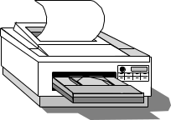
Ethernet Hubs & Switches
Single collision domain
High-Speed backplane or interconnection fabric
(a)
●     
(b)
●   
Dây xoắn rẻ tiền
Dễ làm việc
Tin cậy
Cấu hình Star, CSMA-CD
Dây xoắn rẻ tiền
Bridging tăng tính mở (scalability)
Các collision domains riêng biệt
Full duplex operation

Slide 12
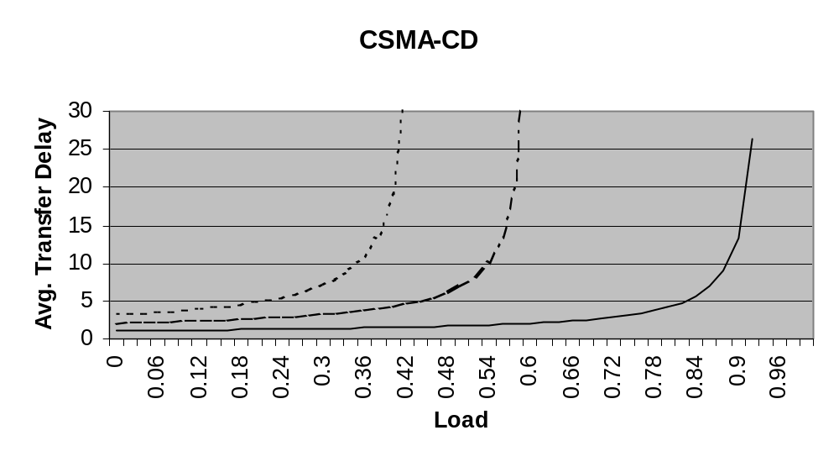
Ethernet Scalability
a = .1
a = .01
a = .2
Thông lượng max của CSMA-CD phụ thuộc vào tích trễ băng thông chuẩn hóa a=t_{prop}/X
Tăng tốc độ bit lên 10 lần = tăng X lên 10 lần
Để giữ a không đổi cần: giảm t_{prop} (distance) đi 10 lần; hoặc tăng độ dài frame lên 10 lần

Slide 13
Fast Ethernet
Table 6.4 IEEE 802.3 100 Mbps Ethernet medium alternatives
 | 100baseT4 | 100baseT | 100baseFX
Medium | Twisted pair category 3 UTP 4 pairs | Twisted pair category 5 UTP two pairs | Optical fiber multimode Two strands
Max. Segment Length | 100 m | 100 m | 2 km
Topology | Star | Star | Star
Để đảm bảo tương thích với 10 Mbps Ethernet:
Cùng frame format, cùng interfaces, cùng protocols
Cấu hình Hub chỉ sử dụng với twisted pair & fiber
Cấu hình Bus & cáp đồng trục bị loại bỏ
Cáp xoắn Category 3 (chuẩn cho telephone thông thường) yêu cầu 4 cặp
Cáp đôi dây xoắn Category 5 yêu cầu 2 pairs (phổ biến nhất)
Sử dụng trong phần lớn các mạng LAN

Slide 14
Gigabit Ethernet
Table 6.3 IEEE 802.3 1 Gbps Fast Ethernet medium alternatives
 | 1000baseSX | 1000baseLX | 1000baseCX | 1000baseT
Medium | Optical fiber multimode Two strands | Optical fiber single mode Two strands | Shielded copper cable | Twisted pair category 5 UTP
Max. Segment Length | 550 m | 5 km | 25 m | 100 m
Topology | Star | Star | Star | Star
Slot time increased to 512 bytes
Small frames need to be extended to 512 B
Frame bursting to allow stations to transmit burst of short frames
Frame structure preserved but CSMA-CD essentially abandoned
Extensive deployment in backbone of enterprise data networks and in server farms

Slide 15
10 Gigabit Ethernet
Table 6.5 IEEE 802.3 10 Gbps Ethernet medium alternatives
 | 10GbaseSR | 10GBaseLR | 10GbaseEW | 10GbaseLX4
Medium | Two optical fibers Multimode at 850 nm 64B66B code | Two optical fibers Single-mode at 1310 nm 64B66B | Two optical fibers Single-mode at 1550 nm SONET compatibility | Two optical fibers multimode/single-mode with four wavelengths at 1310 nm band 8B10B code
Max. Segment Length | 300 m | 10 km | 40 km | 300 m – 10 km
Giữ nguyên cấu trúc frame
Chính thức từ bỏ giao thức CSMA-CD
LAN PHY cho các ứng dụng thuộc mạng nội bộ
WAN PHY cho các kết nối vùng rộng sử dụng SONET OC-192c
Triển khai rộng khắp ở các mạng metro

Slide 16

Typical Ethernet Deployment
Server farm
Server
Server
Server
Gigabit Ethernet links
Switch/router
Switch/router
Gigabit Ethernet links
Server
Ethernet switch
Ethernet switch
Server
Ethernet switch
Server
100 Mbps links
100 Mbps links
100 Mbps links
Hub
Hub
Hub
10 Mbps links
10 Mbps links
10 Mbps links
Department A
Department B
Department C

