Slide 1

A discrete age-structured mathematical model for the application of measles vaccination strategies Ziyabukwa Mthi Supervisor: Dr L. Bolton Co-supervisor: Mr. J. Bingham Department of Mathematical Sciences Stellenbosch University South Africa 21 0ctober 2022

Slide 2
Introduction

Slide 3
Measles vaccine
Public Health Intervention
Vaccine Schedule
Vaccination Awareness
MMR1 at 6 – 12 months
MMR 2 at 1 – 5 years

Slide 4
Methods Mathematical Model
Model assumption:
Model is deterministic and compartmental
Host population is homogeneously mixed.
Per capita natural death and birth rates are both consistent over time.
A host population of a constant size.
Infants who receive the both measles vaccine dose consecutively develop a permanent immunity to the disease

Slide 5
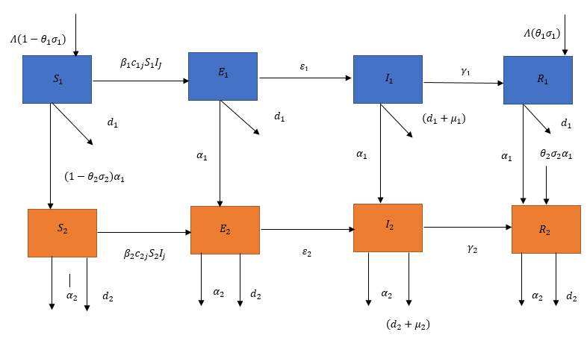
Methods
Subdivide the host population into two age groups,
Considering age-specific differences in vaccination schedules, mortality, and contact patterns
Figure 1: Model diagram for a measles vaccination model with two age group.

Slide 6
Measles vaccination model

Slide 7
Parameter estimation

Slide 8
Methods
Immune profile analysis

Slide 9
Methods
Effect of improving vaccination coverage of measles
Explore different possibility of vaccine coverage rate
Increase vaccine coverage from 71.1% - 95%
Keep efficacy at 95%
Observe the influence of increasing the vaccination coverage

Slide 10
Methods
Limitations
Newborns are not included in the study
The children above the age of 5 years (60 months), young adults and adults, are not included in the study.
Code design
R studio (version 4.2.0)

Slide 11
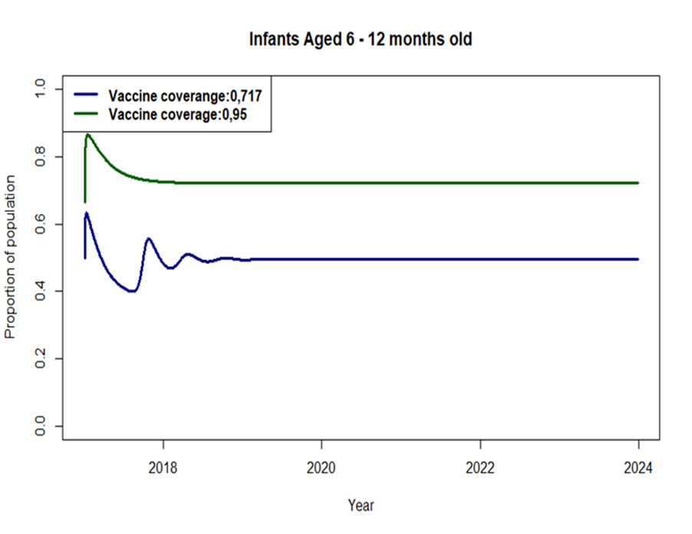
Immune profile analysis
Immunity profiles of the population for infants aged 6 – 12 months.

Slide 12
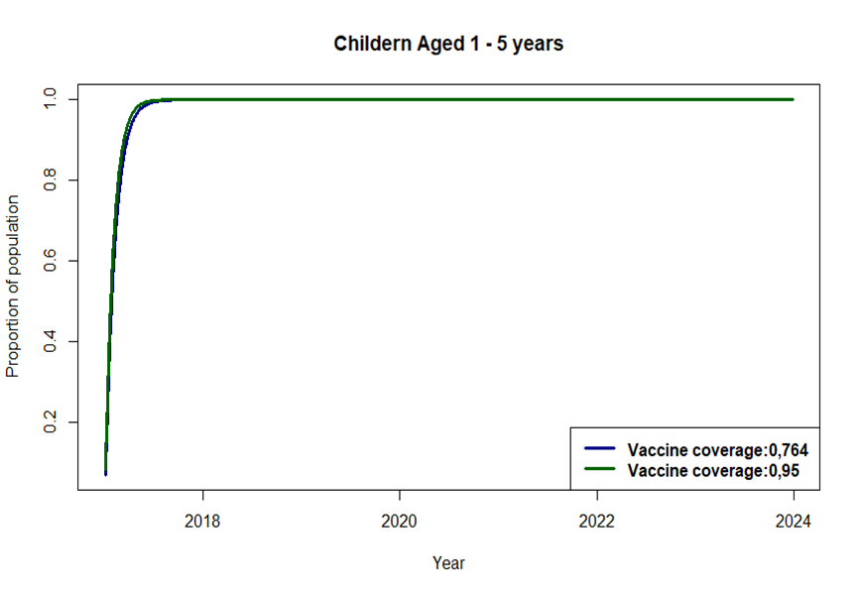
Immune profile analysis
Immunity profiles of the population children aged 1 – 5 years.

Slide 13
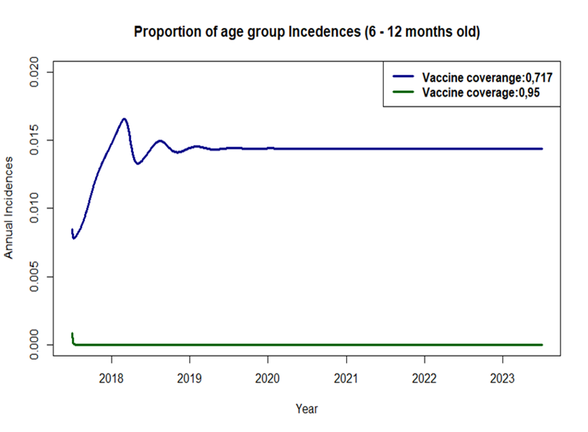
Effect of improving vaccination coverage of measles
Proportion of measles incidence from age groups 1 under two different sets of vaccination coverage.

Slide 14
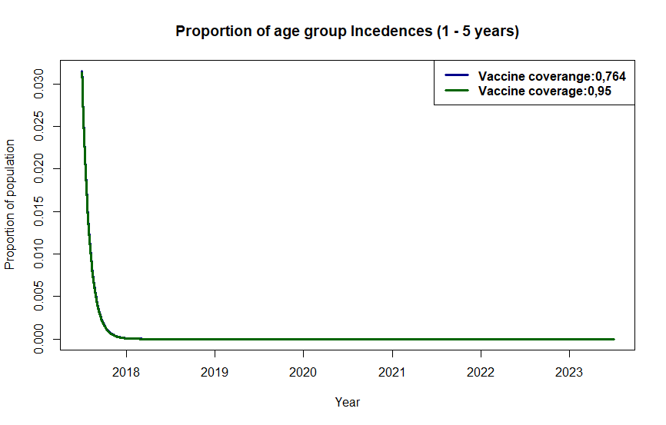
Effect of improving vaccination coverage of measles
Proportion of measles incidence from age group 2 under two different sets of vaccination coverage.

Slide 15
Conclusion

