Slide 1
MARKETPLACE OPERATIONS / PROJECT P0
BEYOND THE DELIVERY DATE
From Brazilian e-commerce source files to a decision-ready BigQuery warehouse
Olist e-commerce dataset • Python ETL • SQL analysis • SCD Type 2 seller tracking
BEYOND THE DELIVERY DATE • 01
Notes:
Introduce Michael Skinner and Sukhman Brar. We use historical Olist data to build a warehouse and examine delivery reliability and customer reviews. The client and watchlist policy are project-defined, and the data covers 2016–2018.
Data source: live read-only BigQuery query results from olist-delivery-insights.p0_warehouse, verified for this corrected deck.

Slide 2
01 / CLIENT BRIEF
The business problem
Where do delivery promises break most often?
How does delivery lateness relate to review scores?
Are some customer regions promised unrealistic dates?
Do freight charges relate to customer satisfaction?
Can seller history support targeted monitoring?
BEYOND THE DELIVERY DATE • 02
Notes:
Explain the business questions rather than promising causal answers. Freight means the shipping charge recorded for the order, not the carrier's internal cost. Hand over between speakers according to the agreed split.
Data source: live read-only BigQuery query results from olist-delivery-insights.p0_warehouse, verified for this corrected deck.

Slide 3
02 / SOLUTION OVERVIEW
Data → trusted warehouse → decisions
01 INGEST
02 MODEL
03 ANALYZE
04 ACT
Eight Olist CSVs
Python validation + staging
BigQuery star schema
Order-item fact + dimensions
Eight SQL analyses
Five charts from BigQuery
Region, category and seller
operations recommendations
BEYOND THE DELIVERY DATE • 03
Notes:
My part was building the data foundation. We started with eight related CSV files. Python validates and cleans them, then loads staging tables. SQL connects the accepted data into a warehouse. Our partner's analysis uses that consistent starting point. The five charts in this deck were generated from actual BigQuery query results.
Data source: live read-only BigQuery query results from olist-delivery-insights.p0_warehouse, verified for this corrected deck.

Slide 4
03 / IMPLEMENTATION
A reproducible, quality-checked pipeline
Load and clean source files, preserving rejected records and load logs
Stage eight source tables, including category translation
Sum payments and select the latest review before joining to items
Build the BigQuery fact, dimensions and order-level analytical view
Validate uniqueness, referential integrity and seller history intervals
BEYOND THE DELIVERY DATE • 04
Notes:
Each source is described in YAML: path, columns, types, keys, and cleaning rules. We check required values, dates, prices, freight charges, and review scores. Rejected rows keep their original values and first failure reason. Every source run logs read, loaded, rejected, and duplicate counts. We sum payments and choose the latest review before joining to items; we do not average all reviews. Matching file/config fingerprints and destination metadata let unchanged files be skipped. The verified initial load removed zero duplicates, but the code handles them.
Data source: live read-only BigQuery query results from olist-delivery-insights.p0_warehouse, verified for this corrected deck.

Slide 5
04 / DATA MODEL
One item-level fact, plus an order-level view
dim_date
ORDER-LEVEL VIEW
PK date_key
Year • quarter • month
order_delivery
98,658 known orders
One row per order
Review averages and
payment totals do not
repeat across items.
1:N
dim_product
fact_order_item
dim_customer
PK product_key
Category • weight
Photos
1:N
N:1
PK customer_key
Customer ID
City • state
PK order_item_key
FK product, customer, seller, date
Price • freight • delivery features
1:N
dim_seller • type 2
PK seller_key • tier
Effective dates • current flag
Fact grain: (order_id, order_item_id) • 112,650 items; eight have unknown order details.
BEYOND THE DELIVERY DATE • 05
Notes:
The star's centre has one row per order item. An order with three items therefore appears three times. That is useful for product analysis, but its review should not receive three votes. The order_delivery view provides one row per known order with items for review averages and payment totals. It has 98,658 rows. Dimension keys identify product, customer, purchase date, and the seller version valid at purchase. The eight items with rejected parent orders remain flagged with unknown order outcomes.
Data source: live read-only BigQuery query results from olist-delivery-insights.p0_warehouse, verified for this corrected deck.

Slide 6
05 / QUALITY ASSURANCE
Evidence that the warehouse works
550,751
112,650
accepted source records
fact order items
8
0
rejected anomalous orders
broken fact-dimension links
BEYOND THE DELIVERY DATE • 06
Notes:
The 550,751 figure counts accepted records across eight different source tables; it is not the number of unique orders. Eight orders claimed to be delivered but lacked a customer delivery date. Their source order records are rejected, while their eight items are retained and flagged. Zero broken fact/dimension links includes explicit unknown members. It does not mean every source value was complete. All 20 live warehouse checks passed, and the 22 local tests passed during verification.
Data source: live read-only BigQuery query results from olist-delivery-insights.p0_warehouse, verified for this corrected deck.

Slide 7
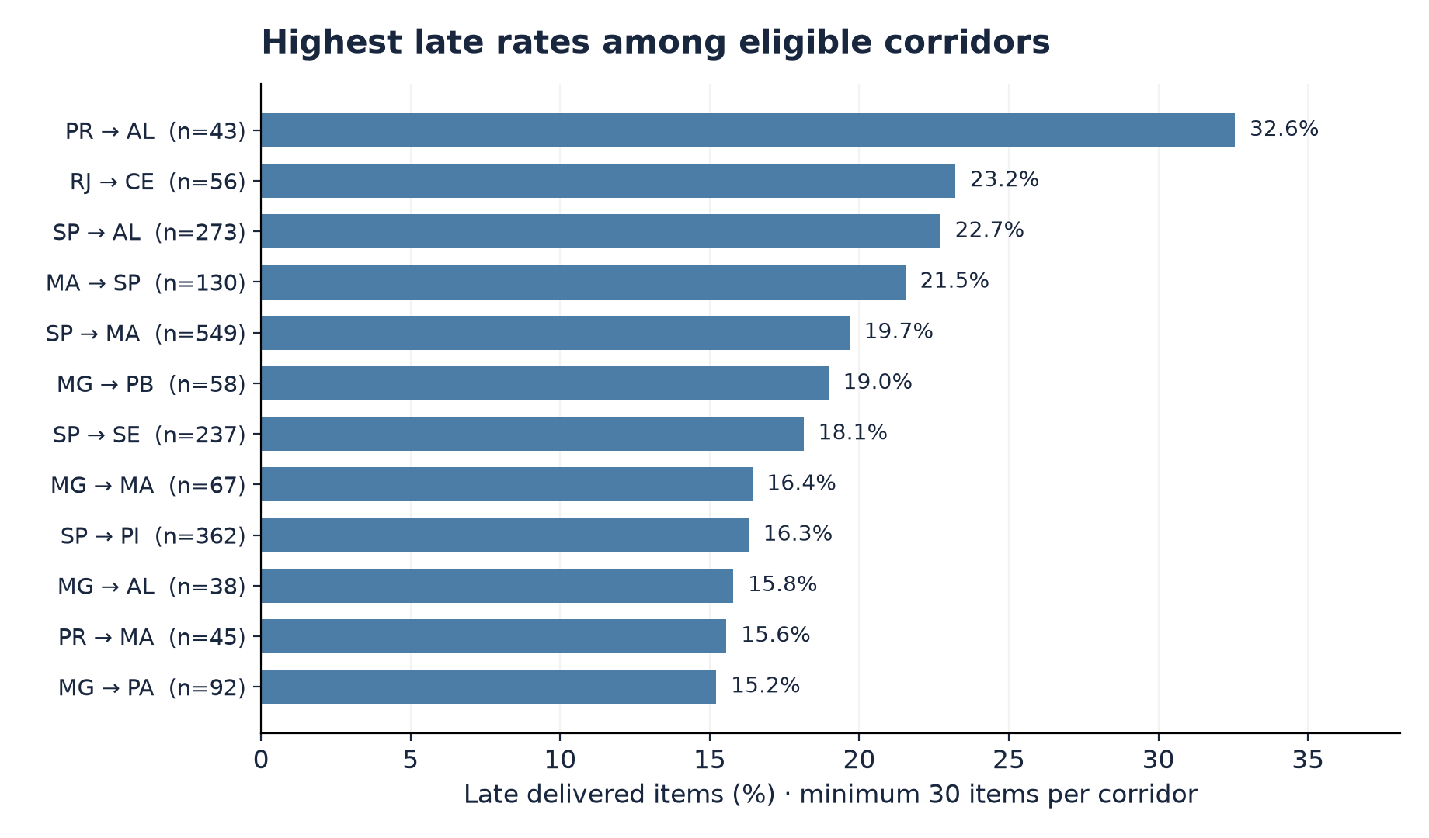
P0 / DATASET → WAREHOUSE
Q1 / Where do late deliveries concentrate?
WHAT IT TELLS US
Highest rate: PR → AL, 32.6% (14 of 43 items).
Volume also matters: SP → RJ has 1,269 late items at 13.5%.
Source: live BigQuery results • olist-delivery-insights.p0_warehouse
BEYOND THE DELIVERY DATE • 07
Notes:
Source: 01_late_rate_by_corridor.sql, executed against BigQuery. Chart shows the first 12 ranked corridors, minimum 30 delivered items. PR to AL: 14 late out of 43, 32.56%. SP to RJ: 1,269 late out of 9,403, 13.50%. Highest rate is not the same as largest number of affected items. Prioritisation should consider both rate and volume.
Data source: live read-only BigQuery query results from olist-delivery-insights.p0_warehouse, verified for this corrected deck.

Slide 8
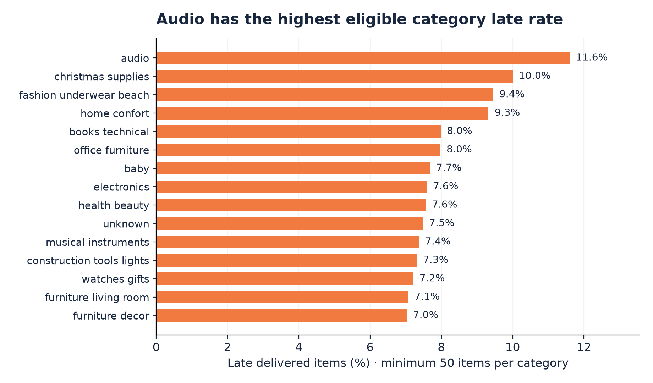
P0 / DATASET → WAREHOUSE
Q1 / Which product categories are riskiest?
WHAT IT TELLS US
Audio leads eligible categories: 11.6% late across 362 delivered items.
Minimum 50 items; unknown categories are retained.
Top 15 returned categories; rates count delivered items, not distinct orders.
Source: live BigQuery results • olist-delivery-insights.p0_warehouse
BEYOND THE DELIVERY DATE • 08
Notes:
Source: 02_late_rate_by_category.sql, executed against BigQuery. Audio: 42 late out of 362 delivered items, 11.60%. The chart retains the unknown-category group returned by the query. The rate is item-weighted. Products sharing an order have the same order-level delivery outcome; do not call the counts distinct orders.
Data source: live read-only BigQuery query results from olist-delivery-insights.p0_warehouse, verified for this corrected deck.

Slide 9
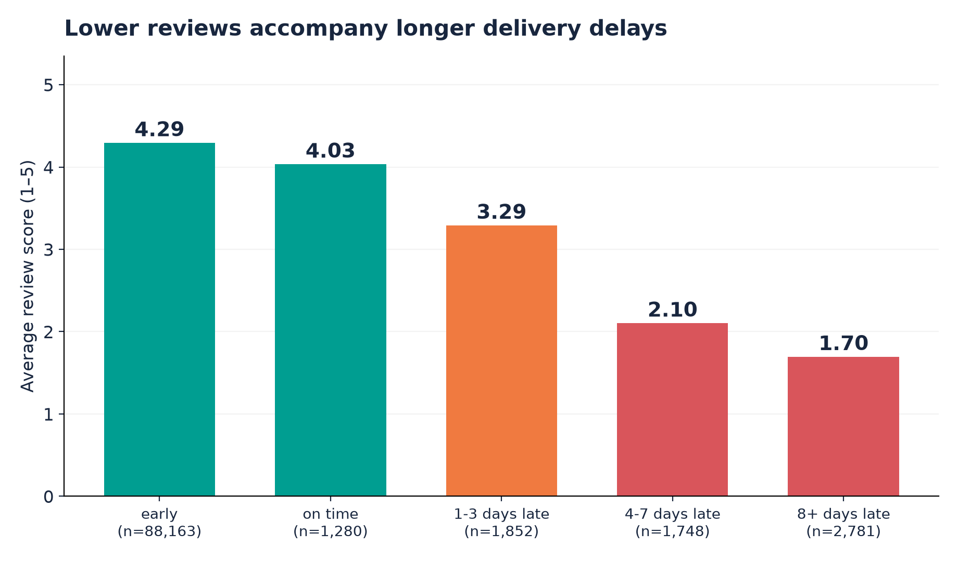
P0 / DATASET → WAREHOUSE
Q2 / The review penalty of late delivery
WHAT IT TELLS US
Early deliveries average 4.29 stars; deliveries 8+ days late average 1.70.
This is an association, not proof of causation.
Source: live BigQuery results • olist-delivery-insights.p0_warehouse
BEYOND THE DELIVERY DATE • 09
Notes:
Source: 03_review_by_lateness.sql, one reviewed delivered order per observation. Early: 88,163 orders, mean 4.294. On time: 1,280, mean 4.034. 1–3 days late: 1,852, mean 3.291. 4–7: 1,748, mean 2.103. 8+: 2,781, mean 1.696. There are 95,824 reviewed delivered orders. Delivery on the promised calendar date is on time. Describe association, not cause.
Data source: live read-only BigQuery query results from olist-delivery-insights.p0_warehouse, verified for this corrected deck.

Slide 10
06 / ADDITIONAL ANALYSIS
Late orders account for a larger share of low reviews
6.7%
32.5%
of reviewed delivered orders late
of 1–2 star reviews from late orders
-0.267
-0.176
Pearson: days late vs. review score
Spearman: average tied ranks
Negative association should not be interpreted as a causal effect: product quality, communication and other factors also affect reviews.
BEYOND THE DELIVERY DATE • 10
Notes:
Verified in live BigQuery: 95,824 reviewed delivered orders. Late share 0.0666; late share of 1–2-star reviews 0.3246 (3,983 of 12,272). Pearson days_late vs review_score = -0.2673752. Correct Spearman with average ranks for tied values = -0.1764424. The repository's original RANK-only calculation gives -0.1927398 and should not be presented as standard Spearman. Average tied rank is RANK() + (COUNT(*) OVER (PARTITION BY value) - 1) / 2.0. Both correlations include negative days_late values for early deliveries. These are observational associations; no causal or guaranteed review improvement is established.
Data source: live read-only BigQuery query results from olist-delivery-insights.p0_warehouse, verified for this corrected deck.

Slide 11
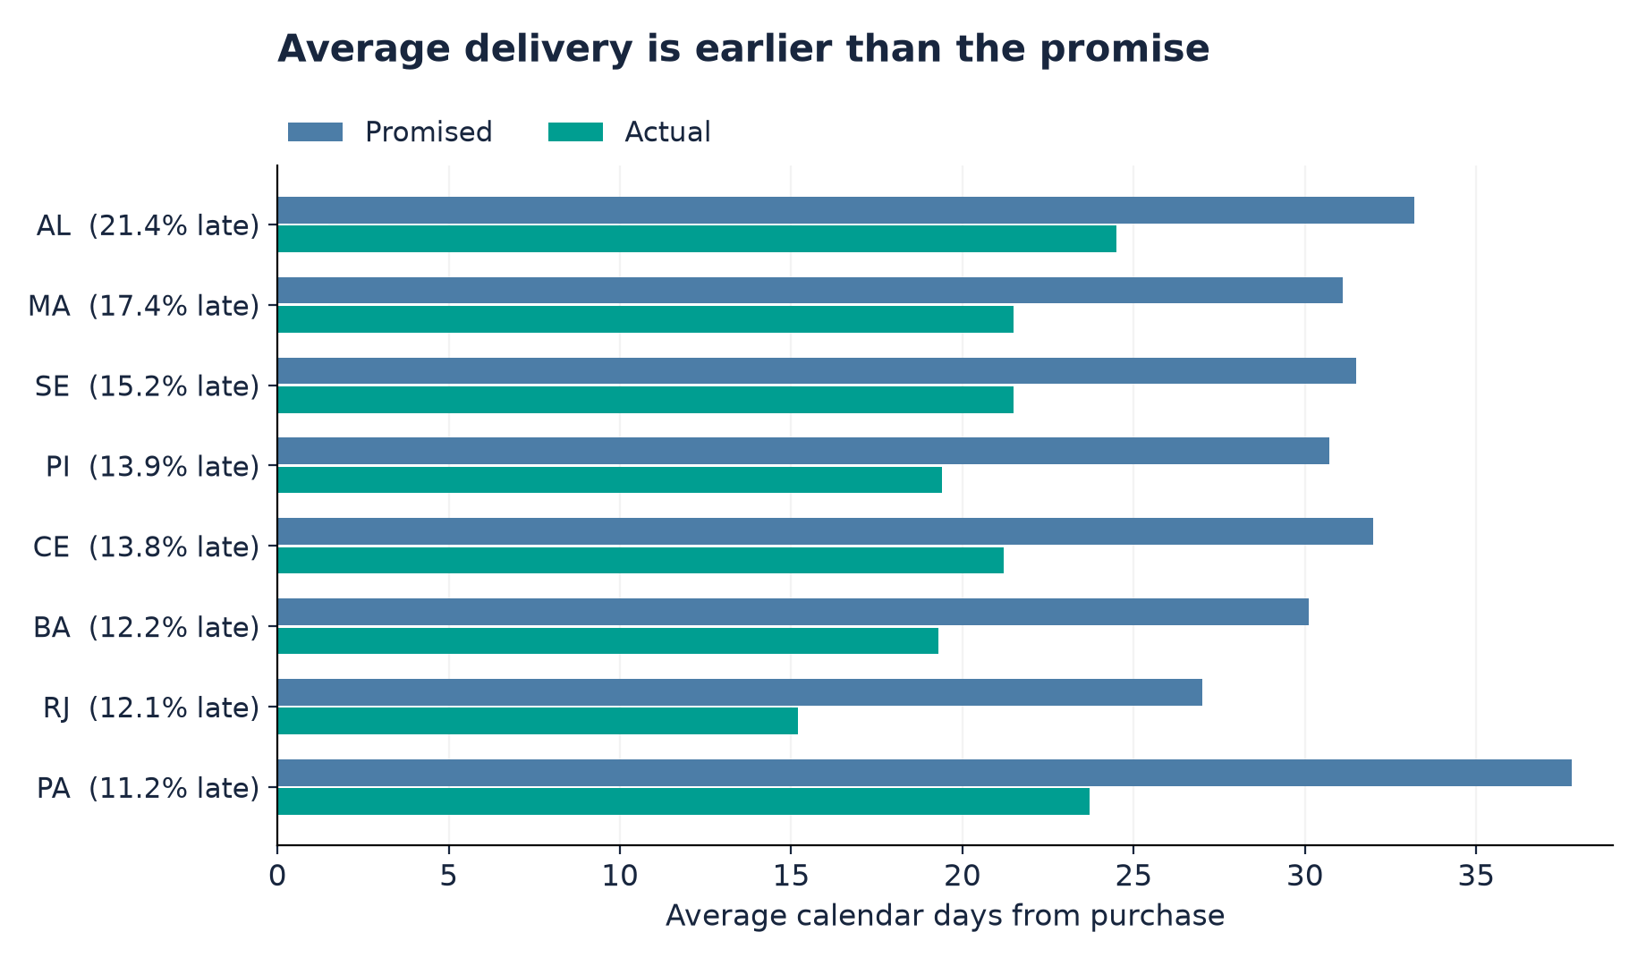
P0 / DATASET → WAREHOUSE
Q3 / Promised versus actual delivery time
WHAT IT TELLS US
All 24 eligible states deliver earlier than promised on average.
AL: 33.2 promised days vs. 24.5 actual, yet 21.4% arrive late.
Investigate variability and the late tail.
Eight highest-late-rate states shown; all have ≥100 delivered orders. Rates include orders without reviews.
Source: live BigQuery results • olist-delivery-insights.p0_warehouse
BEYOND THE DELIVERY DATE • 11
Notes:
Source: 04_promise_realism_by_state.sql, executed against BigQuery. Include states with at least 100 delivered orders, whether reviewed or not: 24 eligible states. The chart shows the eight with highest late rates. Every eligible state arrives earlier than promised on average. AL: 33.2 promised days, 24.5 actual days, 21.41% late. This distinguishes average performance from a problematic late tail. A separate reviewed-order analysis finds lower scores for late orders in 26 of all 27 states, or all 24 states meeting the 100-order threshold. That separate comparison is not the data plotted here and does not eliminate confounding.
Data source: live read-only BigQuery query results from olist-delivery-insights.p0_warehouse, verified for this corrected deck.

Slide 12
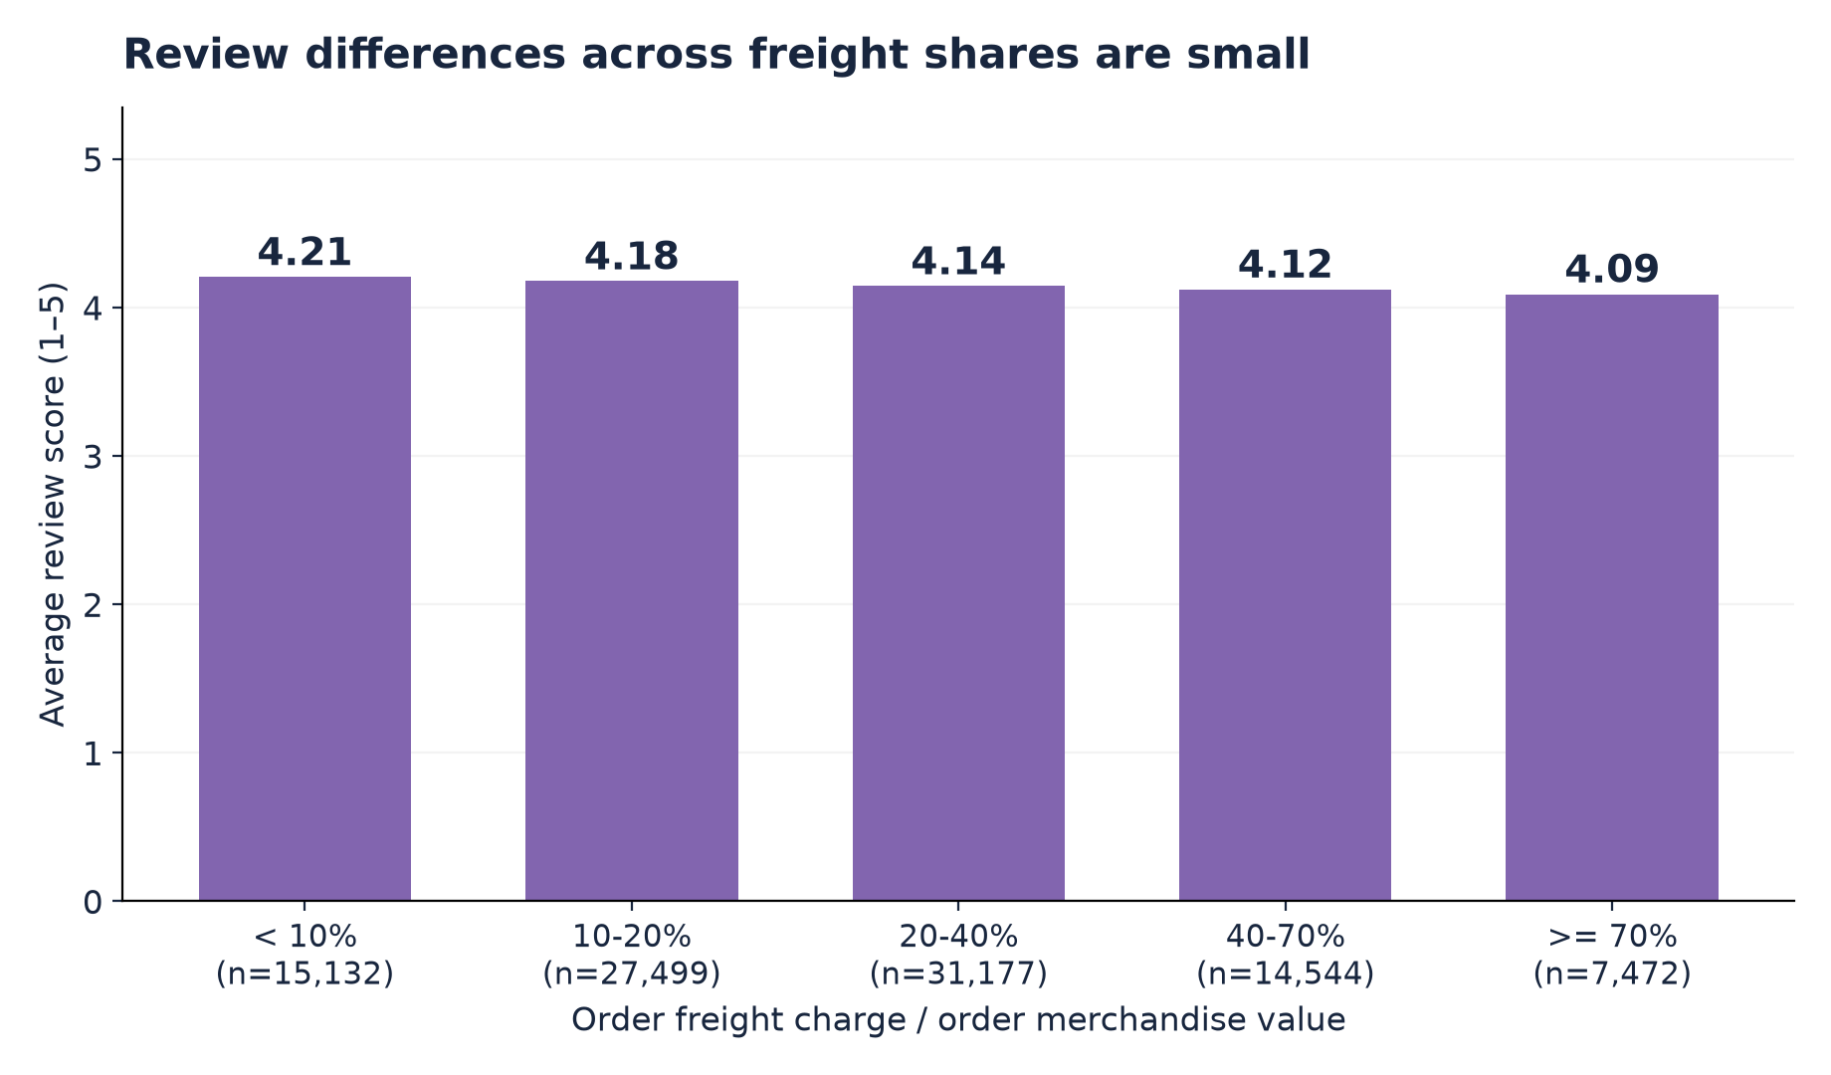
P0 / DATASET → WAREHOUSE
Q4 / Freight burden vs. satisfaction
WHAT IT TELLS US
Review differences are small: 4.21 stars below 10% freight share vs. 4.09 at 70% or more.
Pearson r = −0.024.
No causal effect is established.
Source: live BigQuery results • olist-delivery-insights.p0_warehouse
BEYOND THE DELIVERY DATE • 12
Notes:
Source: BigQuery bucket query used by chart_freight_vs_satisfaction, plus 05_freight_vs_satisfaction.sql. The ratio is total order freight divided by total merchandise value. Bucket counts: 15,132; 27,499; 31,177; 14,544; 7,472. Means: 4.206; 4.177; 4.144; 4.122; 4.089. Pearson r=-0.0238, n=95,824: the linear association is very weak. Freight charged is not shipping cost. Do not claim that lowering charges would cause better reviews.
Data source: live read-only BigQuery query results from olist-delivery-insights.p0_warehouse, verified for this corrected deck.

Slide 13
07 / SCD TYPE 2 HISTORY
Q5 / Time-aware seller monitoring
Simulated Watchlist if previous quarter: ≥20 delivered items AND ≥15% late
Seller tier versions are stored with effective_from and effective_to dates
Transactions join by the seller version valid at purchase time
Historical transitions are preserved instead of overwritten
Policy is simulated; tier comparisons cannot establish intervention effects
BEYOND THE DELIVERY DATE • 13
Notes:
We introduced a simulated quarterly review policy, not a historical Olist watchlist. The preceding delivery quarter needs at least 20 completed delivered items and at least 15% late items for Watchlist. Otherwise the label is Standard, including insufficient-data quarters. A tier change preserves the old row and opens a new version. Periods are effective_from <= purchase_date < effective_to. The fact joins by the stored seller_key. Using completed deliveries from the previous quarter avoids future-information leakage. In the live outcome query, Standard has 107,056 delivered items and a 6.62% late rate; Watchlist has 3,133 and a 5.75% late rate. These descriptive groups do not show that a real intervention improved outcomes. Review scores in that query are item-weighted.
Data source: live read-only BigQuery query results from olist-delivery-insights.p0_warehouse, verified for this corrected deck.

Slide 14
08 / ACTIONS
Recommendations for Marketplace Operations
Prioritize high-volume, high-lateness corridors and categories
Review late-delivery tails by state alongside promised and actual durations
Proactively communicate with buyers when deliveries risk exceeding estimates
Use quarterly seller watchlist as a review trigger—not automatic punishment
Re-run the pipeline and monitor outcomes by cohort over time
BEYOND THE DELIVERY DATE • 14
Notes:
Present these as proposed actions to test and monitor. Choose routes using both volume and late rate. Average deliveries are earlier than promised, so investigate variability and late tails rather than claiming promises are generally too optimistic. Proactive communication is a recommendation, not a measured treatment effect. Use the simulated watchlist to trigger investigation, not automatic penalties.
Data source: live read-only BigQuery query results from olist-delivery-insights.p0_warehouse, verified for this corrected deck.

Slide 15
09 / LIVE DEMO
Demo / A reproducible path from raw data to insight
Show accepted/rejected source-row audit and warehouse build report
Inspect fact_order_item and historical dim_seller in BigQuery
Run Q2: review score by delivery lateness bucket
Run Q5: seller watchlist outcomes using seller_key
Connect the SQL result to the corresponding presentation charts
BEYOND THE DELIVERY DATE • 15
Notes:
Show a single completed run in load_log and its eight rejects; retries can create extra audit history, so filter by run_id. Confirm 112,650 fact items. Show one seller with multiple effective-date versions. Hand over to the analytics speaker for Q2 (03_review_by_lateness.sql) and Q5 (06_seller_watchlist_outcomes.sql). Render project placeholders before running SQL manually. Explain how the query output matches the deck's charts. Keep the live demo short; do not reload all CSVs during the presentation.
Data source: live read-only BigQuery query results from olist-delivery-insights.p0_warehouse, verified for this corrected deck.

Slide 16
10 / CLOSE
What we delivered
Python ingestion, cleaning, load logs and repeatable build scripts
BigQuery star schema and order-level analytical view
Data quality tests and validated seller history
Eight business-question SQL files and chart-generation code
An operations-focused interpretation of delivery risk and reviews
Questions?
BEYOND THE DELIVERY DATE • 16
Notes:
Close with what is implemented and what the evidence supports. Both speakers should participate. No claim is made that the simulated policy was actually deployed or that correlation establishes cause. Repository documentation should be updated to link the completed analyses, charts, deck, and schema diagram before submission.
Data source: live read-only BigQuery query results from olist-delivery-insights.p0_warehouse, verified for this corrected deck.

