Slide 1
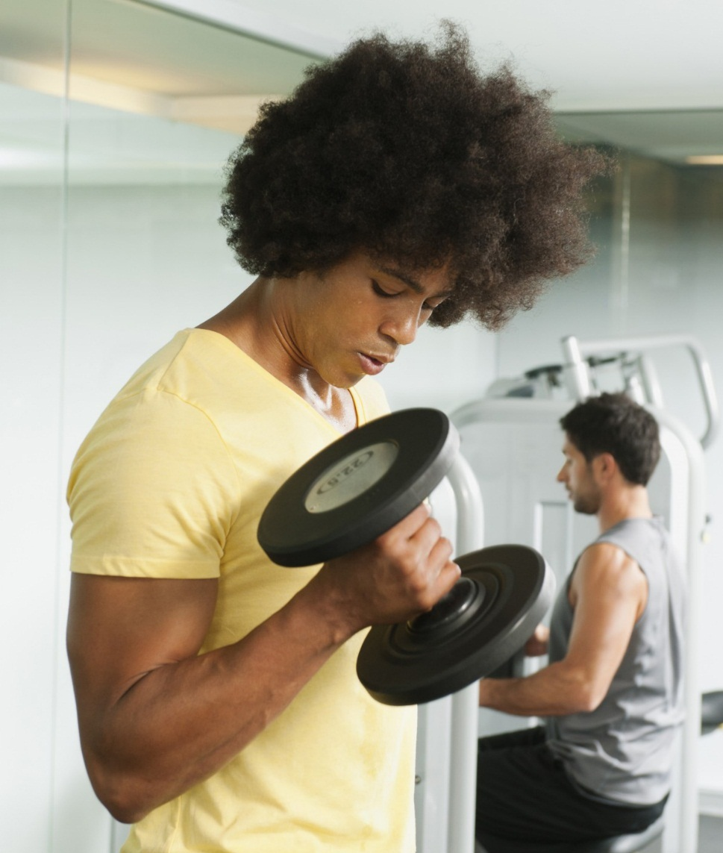
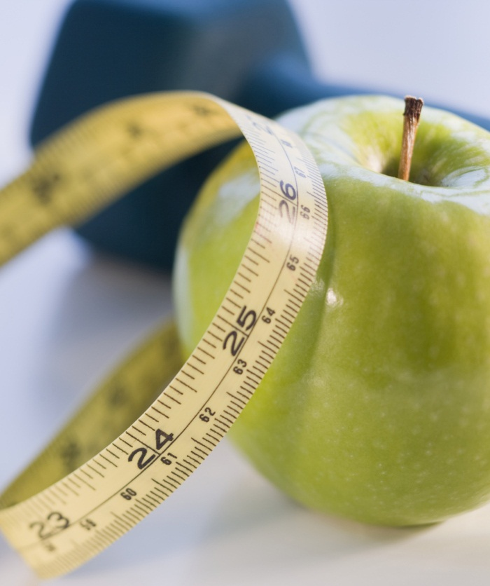

The Relationships between Age and Running Biomechanics

Slide 2
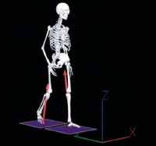
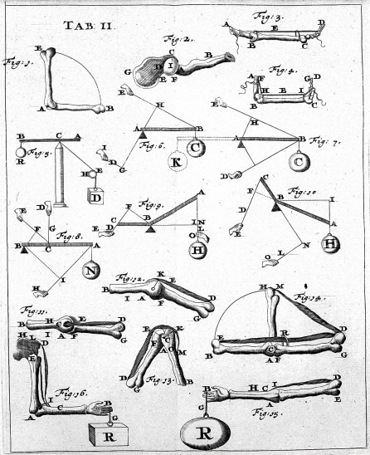
ABSTRACT
Purpose: This study aimed to identify the relations among age and selected running biomechanics
本研究旨在确定18-60岁的年龄与所选运动生物力学的关系
Results: Running velocity was inversely related to age (r = -0.27, P = 0.005) because of decreased stride length (r = -0.25, P = 0.008) but not rate. Peak vertical GRF (r = -0.23, P = 0.016) and peak horizontal propulsive GRF decreased with age (r = -0.38, P G 0.0001). Age-based regression equations and per-year reductions in all variables significantly related to age are reported.
运行速度与年龄（r = -0.27，P = 0.005）呈负相关，因为步幅长度减小（r = - 0.25，P = 0.008），而不是速率。GRF垂直分量的峰值（r = -0.23，P = 0.016），及GRF水平推进力分量的峰值随年龄增长而下降（r = -0.38，P G 0.0001）。报告显示基于年龄的回归方程和与年龄显着相关的所有变量每年减少量和年龄相关。
l
Purpose: This study aimed to identify the relations among age and selected running biomechanics
Methods: Experienced (n = 110) healthy runners (male, 54%) provided informed consent and ran at their training pace while motion and force data were captured. Kinematics, ground reaction forces (GRF), and lower limb joint torques and powers were correlated with age using Pearson product–moment correlations and linear regression.
Results: Running velocity was inversely related to age (r = -0.27, P = 0.005) because of decreased stride length (r = -0.25, P = 0.008) but not rate. Peak vertical GRF (r = -0.23, P = 0.016) and peak horizontal propulsive GRF decreased with age (r = -0.38, P G 0.0001). Age-based regression equations and per-year reductions in all variables significantly related to age are reported.

Slide 3
Conclusions:
Key Words: OLDER RUNNERS, JOINT TORQUE, POWER, AGING, GAIT Running

Slide 4
PURPOSE
Because most age-related literature on biomechanical gait adaptations treats age as a dichotomous variable comparing young and old populations (e.g., (11), mean ages of young and old adults were 31 and 69 yr), few studies have taken a developmental approach to aging.
因为大多数与生物力学步态适应相关的年龄相关文献将年龄视为比较年轻人和老年人的二分变量（例如，（11），年龄和老年人的平均年龄为31岁和69岁），很少有研究采取发展方式 老化。
The purpose of this study was to investigate the age-related adaptations in the biomechanics of running throughout the age range of 18–60 yr. The results of this study can have implications for developing training programs and performance equipment for the aging runner and ultimately may lead to reduced injury in older runners.
本研究的目的是调查18至60岁年龄段运动的生物力学的年龄相关适应性。 这项研究结果影响老年人训练方法和设备的开发，进而会减少老年人受伤的风险。

Slide 5
METHODS
Participants
Runners who were injury free for at least 6 months and with current training unaffected by any previous injury (males, n = 59; females, n = 51; mean age, 41.8 +- 8.8 yr; mean mass, 70.9 +- 12.8 kg; mean body mass index (BMI), 23.4 +-2.8 kg/m-2) were recruited through advertisements on the Internet and in newspapers and by brochures posted at local running stores.
通过互联网和报纸上刊登广告，及在当运动商店张贴的宣传单的方式所招募的运动员至少6个月没有受过伤，且目前的训练不受任何以前的伤病的影响（男性，n = 59;女性，51岁;平均年龄41.8±8.8岁;平均体重70.9±12.8公斤; 平均身体质量指数（BMI），23.4±2.8kg / m-2）。
Testing Protocol
Anthropometric measurements.
Body mass and height were measured and recorded with the participants wearing running shorts, a tight-fitting T-shirt, and no shoes. Instruments were calibrated weekly.
参与者穿着短裤，紧身T恤，不穿鞋子，并测量他们的身体质量和高度。 测试设备仪器每周进行校准。

Slide 6
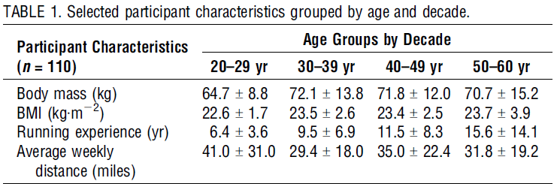
METHODS
Instruments
An AMTI model OR6-5-1 (Advanced Mechanical Technology, Inc., Watertown, MA) force platform was embedded in a 22.5-m raised walkway at the Wake Forest University Runners_ Clinic and used to measure GRF (480 Hz).
在Wake Forest University Runners_ Clinic将一个AMTI模型OR6-5-1（Advanced Mechanical Technology，Inc.，Watertown，MA）力测试平台安装在22.5米长的升高走道上，并用于测量GRF（480Hz）。

Slide 7
DISCUSSION
Understanding age-related adaptations and deficits in running will enhance the design and implementation of training programs that focus on attenuating these changes (21) and programs aimed at reducing injury and/or improving performance in older runners (31).Reducing the rate of decline in running biomechanics with age and the incidence of injury and improving performance will enable older runners to maintain their running programs longer into older ages, thereby enhancing cardiovascular, neuromuscular, and skeletal health, functional capacity, and overall quality of life.
了解年龄相关的适应和运动中的不足将会提高训练计划的设计和实施，这些训练计划主要是减少那些旨在降低老年人的受伤风险或改善运动性能方面的变化。随着年龄的增长运动生物力学方面速率的下降，损伤发生概率和运动方面的改善将使老年跑步者能够在老年生活中保持更长的运动计划，从而增强心血管，神经肌肉和骨骼健康，功能能力和整体生活质量。
We also note that our data support the emerging proposition that long-term running behavior ameliorates the increase in body weight and BMI evident in sedentary middle-age adults (27,29,48). Present 30- to 59-yr-old participants had nearly identical mass and BMI values, and their values were only slightly higher than those in 20- to 29-yr-old participants. Hence, it seems that long-term running may be an effective nonpharmacologic weight maintenance intervention that may be effective in combating obesity-related comorbidities.
我们还注意到，我们的数据支持新兴的命题，长期运动改善了久坐中年人群体重和体重指数的增加。 目前30至59岁的参与者具有几乎相同的质量和BMI值，它们的价值仅略高于20岁至29岁的参与者。 因此，似乎长期运动可能是有效的非药物维持体重的方法，并可能有效地对抗肥胖相关并发症。

Slide 8
CONCLUSION
Because running continues to be a popular form of exercise, it is important for athletic trainers, physical therapists, and physicians to understand the biomechanical adaptations that occur with age. Overall, our data show that running biomechanics decline linearly and they provide estimates of the magnitude of the reductions on a per-year basis. Reductions in the basic running characteristics of stride length and velocity between the ages of 23 and 59 yr are due primarily to reduced ankle moment and power production during the stance phase but not reduced knee or hip function. Whether these reductions were due to physiological limitations or the conscious selection of lowering ankle mechanics remains to be clarified. We propose, however, that attenuating the biomechanical deficits observed with aging may enable people to continue running longer into older age, prolonging disability-free lives and maintaining cardiovascular health.
因为运动仍然是一种流行的运动形式，因此运动训练者，物理治疗师和医生了解随年龄发生的生物力学适应性是重要的。 总的来说，我们的数据显示，运行生物力学线性下降，并提供每年减少量的估计。 23至59岁之间的步幅长度和速度的基本运动特征的降低主要是由于在起步相阶段的踝关节力矩和力减少，而不是膝盖或髋关节功能方面的减弱。 这些减少是由于生理限制还是有意识地选择降低能够踝关节力矩的动作仍有待澄清。 然而，随着年龄变化所观察到的生物力学方面特征值的减少可能使人们能够运动更长时间，延长健康的生活并维持心血管健康。

Slide 9

WEBSITES： http://www.acsm.org/public-information/acsm-journals/medicine-science-in-sports-exercise

Slide 10
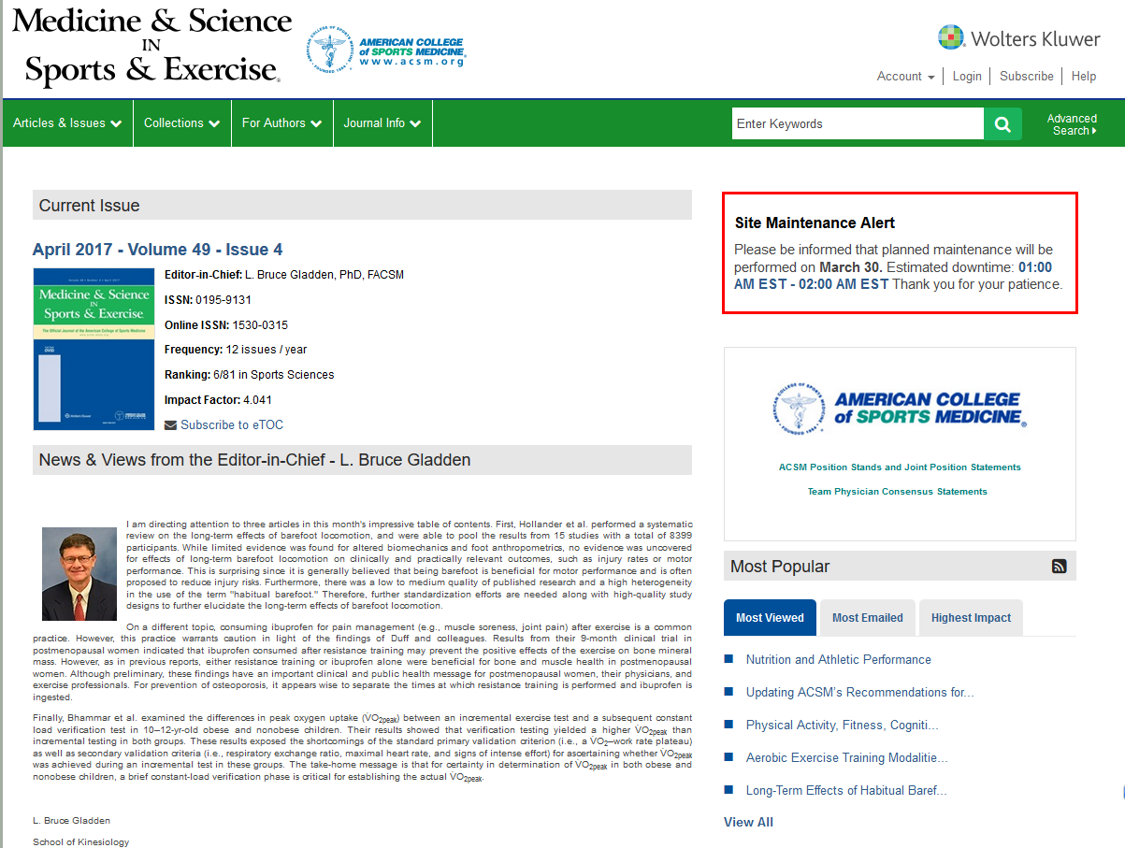
WEBSITES： http://journals.lww.com/acsm-msse/pages/default.aspx

Slide 11
Thank you for your listening!

