Slide 1
Food delivery menu interface
Presented by:
Nagalakshmi Karri(24A31A05GX)
Riyaz Mohammed(24A31A05IJ)
Snigdha Nistala(24A31A05HC)
Divya Rednam(24A31A05HK)
CSE-E

Slide 2
Objective
To design and develop a responsive Food Delivery Menu Interface
To allow users to browse food items easily
To simulate add to cart functionality
To provide a simple and user-friendly UI
To enhance understanding of front-end web development
To improve understanding of DOM manipulation and JavaScript event handling

Slide 3
Project Overview
This project is a web-based food ordering interface
Built using HTML, CSS, and JavaScript
Focuses on UI design and interactivity
Displays food items with images, price, and categories
Includes cart simulation feature

Slide 4
Technologies Used
HTML – Structure of the webpage
CSS – Styling and layout design
JavaScript – Interactivity and cart logic
GitHub Pages – Hosting the project
VS Code – Development environment

Slide 5
Features
Responsive food menu layout
Category-based food display
Add to Cart functionality
Quantity update system
Simple and clean UI design
Mobile-friendly interface

Slide 6
Working Logic
User opens the food menu page
Food items are displayed with images and prices
User selects items and clicks Add to Cart
Cart updates dynamically using JavaScript
Total price is calculated automatically

Slide 7
System Flow
Home Page loads menu
User browses food items
User adds items to cart
Cart updates in real-time
Final order summary is displayed

Slide 8
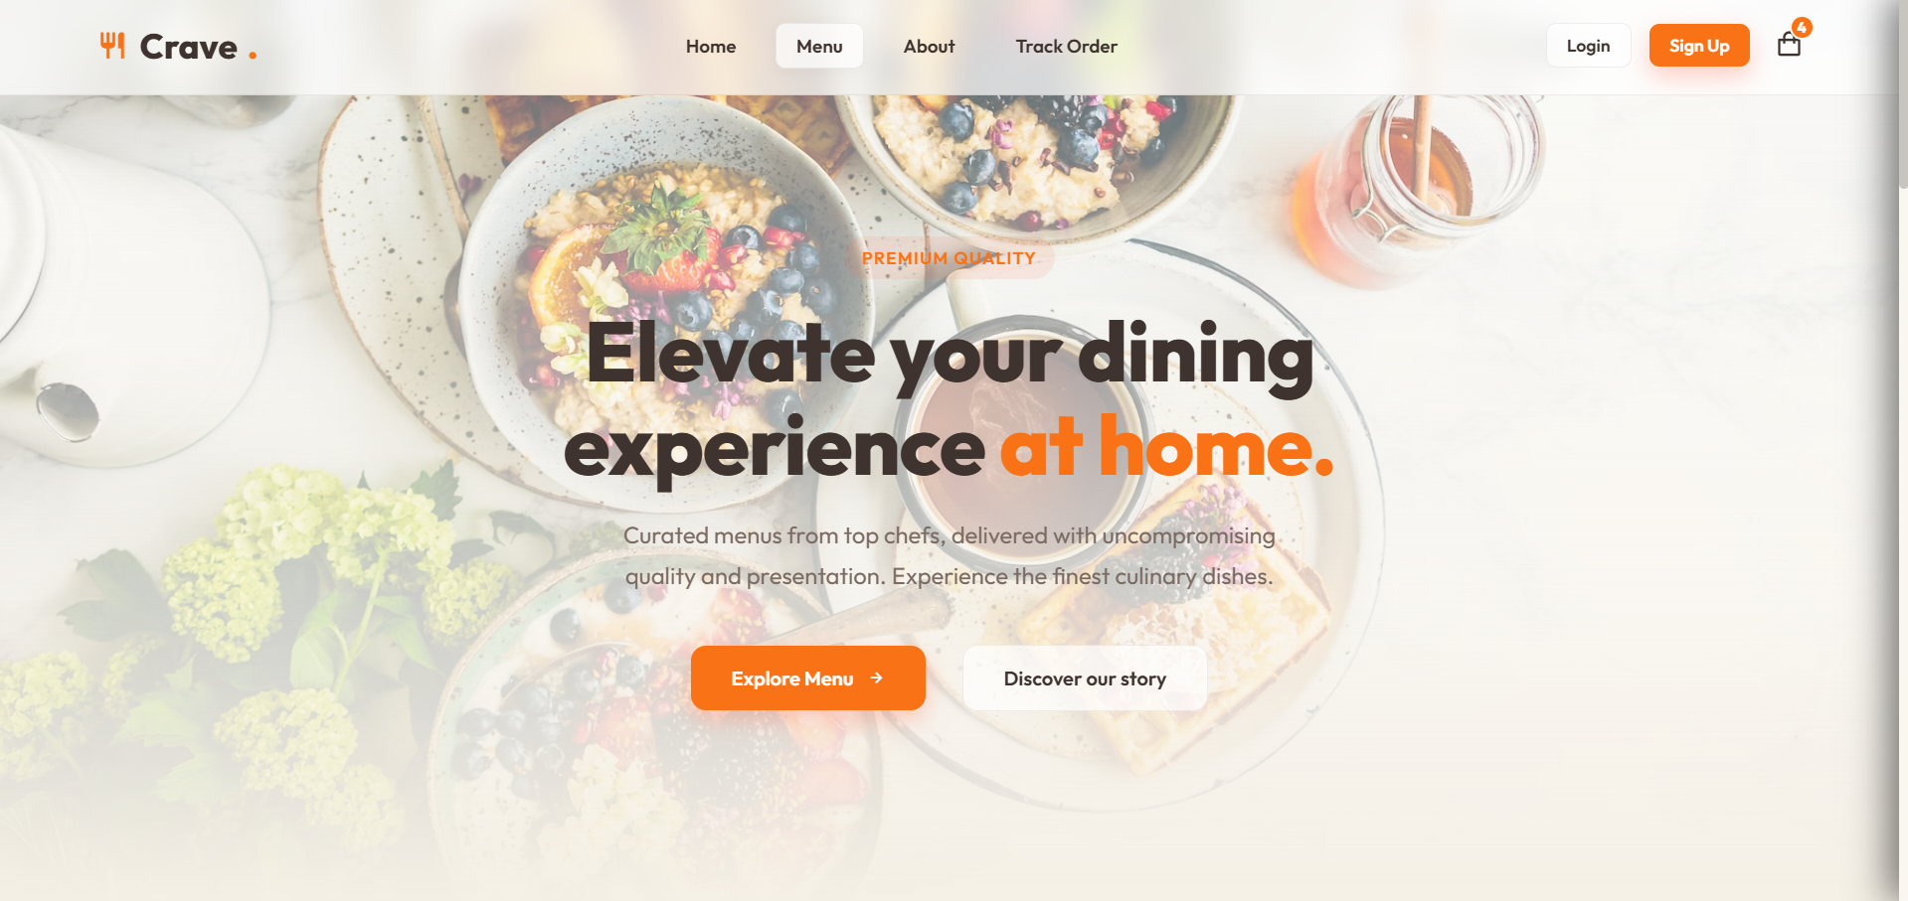
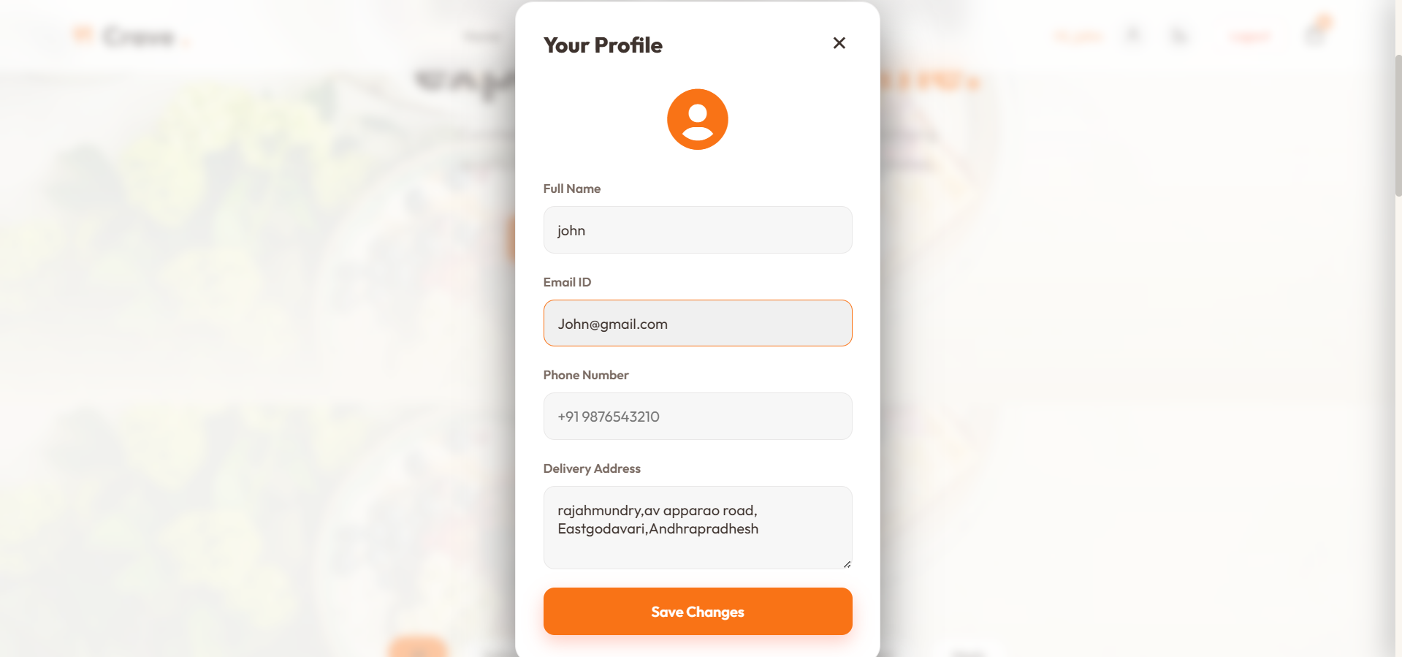
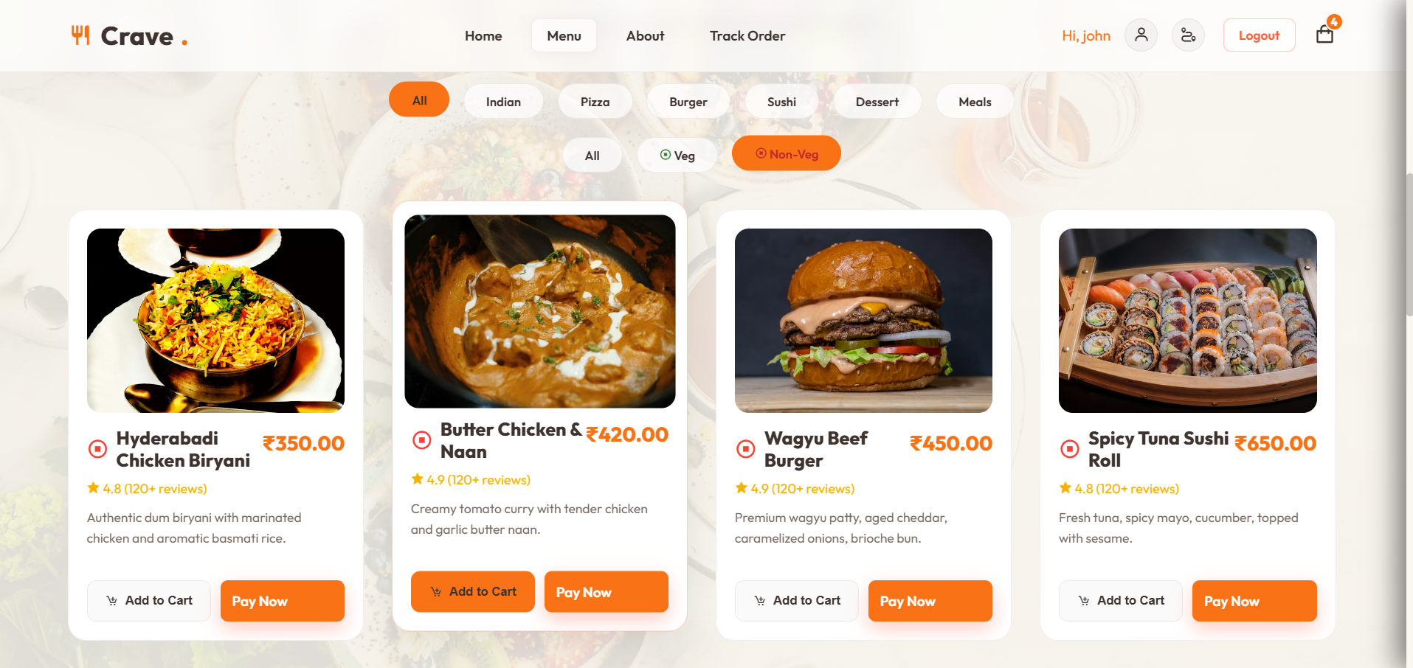
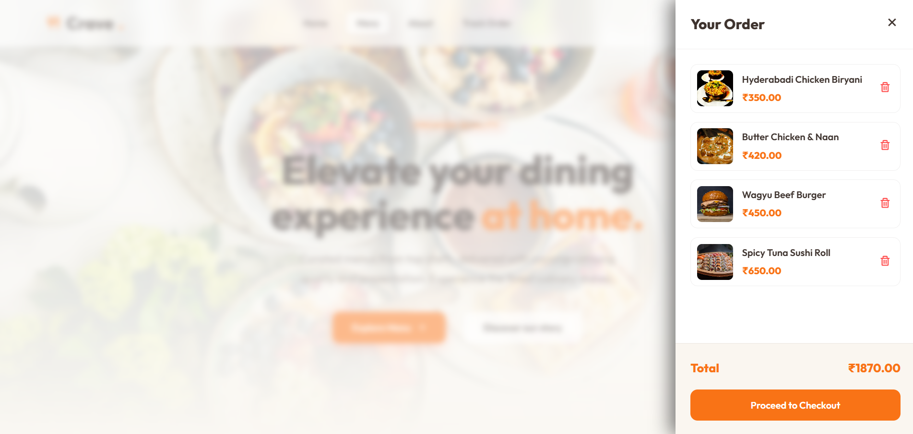
Screenshots
Home Page login page
Menu page cart page

Slide 9
Advantages
Easy to use interface
Fast food browsing system
Lightweight and responsive design
Helps users understand ordering flow
Good practice for web development skills

Slide 10
Limitations
No backend database integration
No real payment system
No user login system
Data is not permanently stored

Slide 11
Future Enhancements
Add backend using Node.js or PHP
Implement user login & authentication
Integrate payment gateway
Add real-time order tracking
Store data in database (MySQL / MongoDB)

Slide 12
Conclusion
The project successfully demonstrates a Food Delivery Interface
It helps understand frontend development concepts
Provides a basic simulation of online ordering systems
Can be expanded into a full-stack application in future

