Slide 1

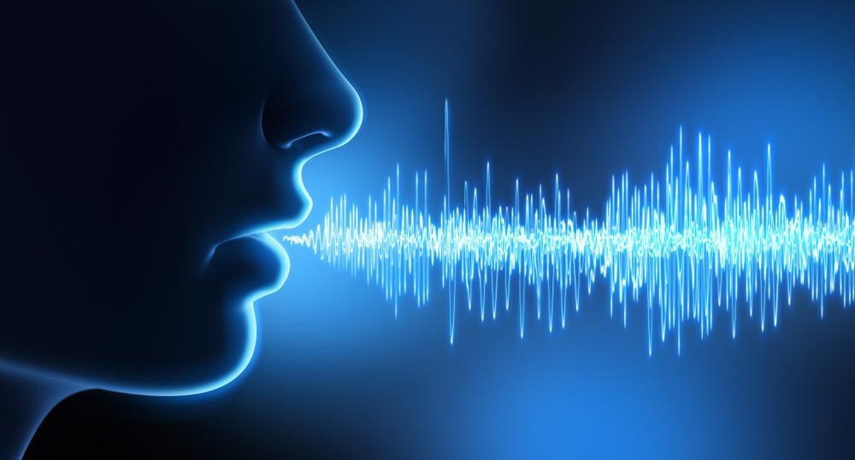


AI-Based Voice
Gender Recognition
B Vennela Keerthika
9.10.2025

Slide 2



Abstract
AI-based voice gender recognition is an application of machine learning that classifies a speaker's gender from their voice. By analyzing speech features such as pitch, timbre, and rhythm, AI models can predict whether a voice is male, female, or non-binary. .

Slide 3



Introduction
AI uses speech features—pitch, resonance—to detect gender. Deep learning increases accuracy. Applied in assistants, marketing, and security.

Slide 4


Softwares
Programming Language: Python (widely used for AI and ML development.
Speech Processing: Librosa (for audio analysis), PyAudio (for audio input/output)
Machine Learning: Scikit-learn, TensorFlow, Keras (for building models)
Audio Feature Extraction: MFCC, Spectrograms, Chroma Features
Operating System: Windows/Linux/Mac (based on user preference)
Dataset Tools: Access to voice datasets like CommonVoice (Mozilla), VoxCeleb, etc.

Slide 5
Scope
Classifies gender from voice.
Fits virtual assistants, security systems.
Enables gender-aware responses.
Research expands to non-binary recognition and diversity.

Slide 6



Inputs
Datasets
Voice Data
Speech Features
Additional Metadata
CommonVoice
VoxCeleb
TIMIT
LibriSpeech

Slide 7


Expexted Output
Predicted Gender: The primary output of the system is a classification label (e.g., Male, Female, Non-Binary).
Confidence Scores: The AI model may also return a confidence level, indicating how sure it is of its prediction (e.g., 85% confident that the voice is female).
Real-Time Processing: In applications like voice assistants, the output should be delivered in real-time, enabling interaction without delays.

Slide 8
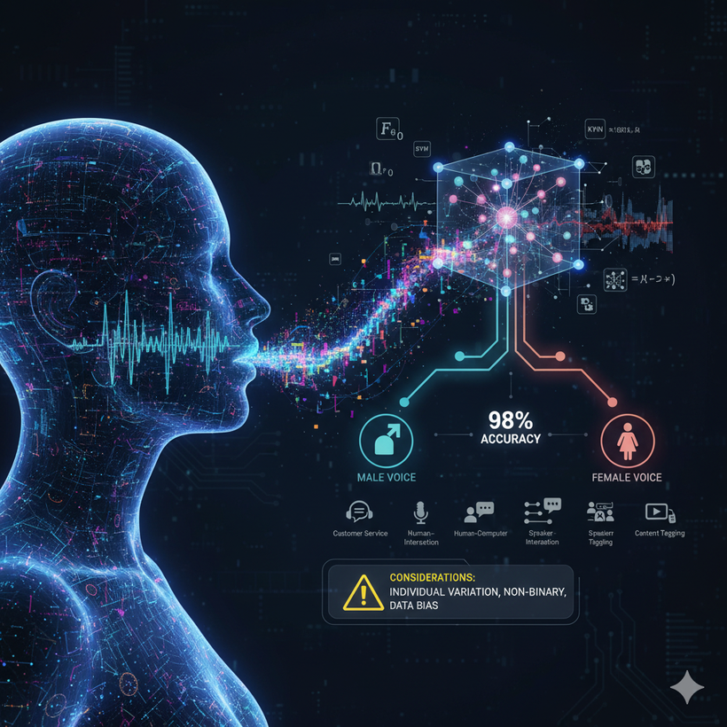


Conclusion
Voice gender recognition aids healthcare, security, customer service. Overcomes noise and inclusivity challenges. Future promises better accuracy, ethics, and diversity.

