Slide 1
Title : Simple Rock-Paper-Scissors Game
Student name: student id:
Man dhanani 24AIML007
Pal gabani 24AIML010
Kirtan jogani 24aiml014

Slide 2
Objective: To create a game where the user plays rock- paper-scissors against the computer using C.
Course Learning Outcome(CLO): By the end of this project, students will be able to implement basic game logic and randomization techniques in C.

Slide 3
Program Overview: The Simple Rock-Paper-Scissors Game is a C program where users compete against the computer by selecting Rock, Paper, or Scissors. The computer's choice is randomly generated, and the winner is determined based on standard rules. Scores are tracked, and users can play multiple rounds until they choose to quit. The program demonstrates game logic randomization Input validation and looping.

Slide 4
Function:
srand(time(NULL)): Seeds the random number generator with the current time, ensuring different random numbers in each game.
Program Flow:
1. The program starts by including necessary header files.
2. It declares variables to store game information.
3. The random number generator is seeded.
4. The game loop starts.
5. The user is prompted to enter their choice.
6. The computer's choice is generated randomly.

Slide 5
7. The winner is determined based on the choices.
8. The choices and the result are displayed.
9. The user is asked if they want to play another round.
10. The loop continues until the user chooses to stop.
11. Final statistics are displayed.
12. The program ends.

Slide 6
Code:
#include <stdio.h>
#include <stdlib.h>
#include <time.h>
int main() {
int user_choice, computer_choice, rounds = 0, user_wins = 0, computer_wins = 0, ties = 0;
char choice_name[10];
srand(time(NULL)); // Seed the random number generator
while (1) {
printf("\nRound %d\n", ++rounds);
printf("Enter your choice (1 for Rock, 2 for Paper, 3 for Scissors): ");
scanf("%d", &user_choice);

Slide 7
// Validate user input
while (user_choice < 1 || user_choice > 3) {
printf("Invalid choice. Please enter a number between 1 and 3: ");
scanf("%d", &user_choice);
}
// Generate computer's choice randomly
computer_choice = rand() % 3 + 1;
// Determine the winner
if (user_choice == computer_choice) {
printf("It's a tie!\n");
ties++;
} else if ((user_choice == 1 && computer_choice == 3) ||
(user_choice == 2 && computer_choice == 1) ||
(user_choice == 3 && computer_choice == 2)) {
printf("You win!\n");
user_wins++;
} else {
printf("Computer wins!\n");
computer_wins++;
}

Slide 8
// Display choices
switch (user_choice) {
case 1:
strcpy(choice_name, "Rock");
break;
case 2:
strcpy(choice_name, "Paper");
break;
case 3:
strcpy(choice_name, "Scissors");
break;
}
printf("You chose: %s\n", choice_name);

Slide 9
switch (computer_choice) {
case 1:
printf("Computer chose: Rock\n");
break;
case 2:
printf("Computer chose: Paper\n");
break;
case 3:
printf("Computer chose: Scissors\n");
break;
}
// Ask if the user wants to play another round
printf("Do you want to play another round? (yes/no): ");
char answer[4];
scanf("%s", answer);

Slide 10
if (strcmp(answer, "no") == 0) {
break;
}
}
printf("\nGame Over!\n");
printf("Total Rounds: %d\n", rounds);
printf("User Wins: %d\n", user_wins);
printf("Computer Wins: %d\n", computer_wins);
printf("Ties: %d\n", ties);
return 0;
}

Slide 11
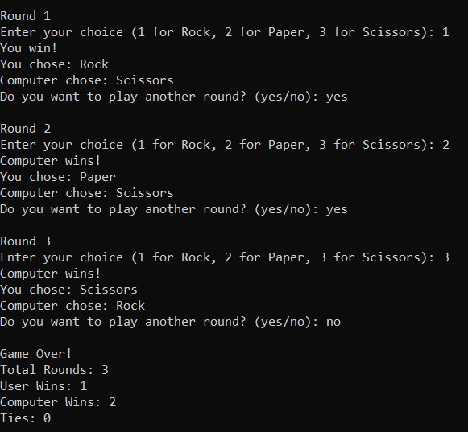
Output:

Slide 12


