Slide 1


Artificial Intelligence and Data Science
Data Science and Visualization
24ADI204
DATA-VIZ HACK-A-BIT (2025-2026)
Team Number:
1. Gokulnaath M (24BAD026)
2. Jayaraksha Reguraj (24BAD044)
3. Kamalesh N (24BAD054)
4. Nishanth P (24BAD405)

Slide 2
Project Walkthrough
01. Project Scope
07. Data Cleaning
13.Key Insights /Results
02.Problem Statement
08. Outlier Handling
14.Dashboard
03. Objectives
09. EDA
15.Demo Video
04. Project Workflow
10. Correlation Analysis
16.Future Enhancements
05. Dataset Overview
11. Feature Engineering
17.Team Contribution
06. Target Variable
12. PCA
18.Conclusion/Reference

Slide 3

Project Scope
Scope: Utilizing the Framingham Heart Study dataset to perform end-to-end data science—from cleaning and exploratory analysis to predictive modeling and interactive visualization.
Focus: Identifying high-risk patient profiles for 10-year Coronary Heart Disease (CHD) to support clinical decision-making.

Slide 4
Problem Statement
The Challenge: Cardiovascular disease is often a "silent killer" with complex, compounding risk factors.
The Problem: Raw medical data is often noisy and unstructured, making it difficult for healthcare providers to pinpoint which patients require immediate preventative intervention.
Goal: Bridge the gap between raw clinical data and actionable risk stratification.

Slide 5
Objectives
Predict 10-year CHD risk using longitudinal study data.
Identify top behavioral and clinical influencers (e.g., smoking, BP, age).
Stratify the patient population into priority segments for medical intervention.
Develop an interactive dashboard for real-time risk assessment.

Slide 6
Project Workflow
Data Acquisition: Framingham Heart Study Dataset (4,240 records).
Preprocessing: Handling null values and outliers.
EDA: Univariate, Bivariate, and Multivariate analysis.
Modeling: Population segmentation and Decision Tree logic.
Visualization: Power BI Dashboard development.

Slide 7
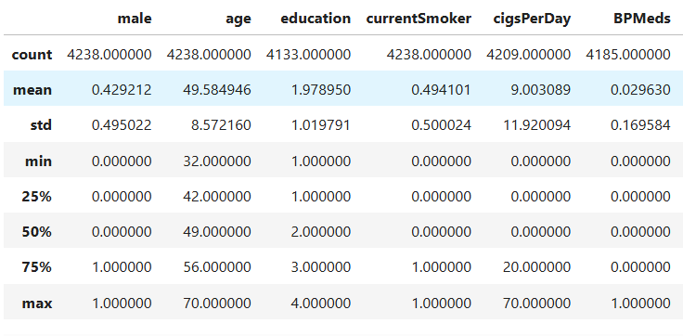
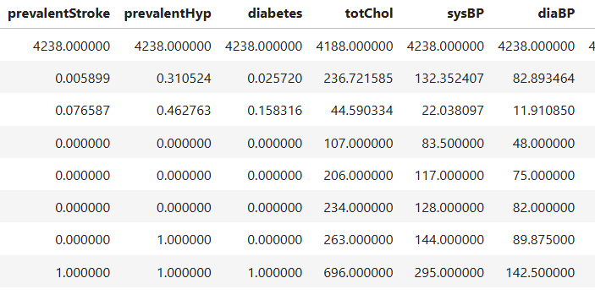
Dataset Overview
Source: Framingham Heart Study (Kaggle).
Size: 4,240 records | 16 features.
Domains: * Demographic: Age, Gender, Education.
Behavioral: Smoking status, Cigarettes per day.
Medical: Total Cholesterol, Systolic/Diastolic BP, BMI, Heart Rate, Glucose

Slide 8
Target Variable
Variable Name: TenYearCHD
Definition: A binary indicator (1 or 0) showing whether a patient developed Coronary Heart Disease within a 10-year period.
Prevalence: 15% of the analyzed population (644 patients) were identified as High Risk.

Slide 9
Data Cleaning
Missing Values: Significant nulls found in glucose, BMI, and totChol.
Imputation: Categorical features handled via Mode; numerical features handled via Median for robustness against noise.
Process: Dropping duplicates and removing non-useful columns to streamline the model.

Slide 10
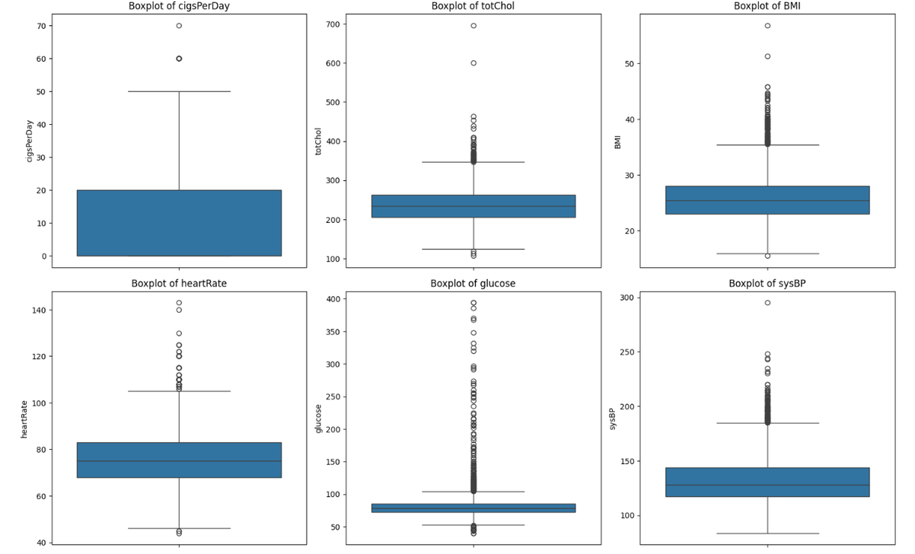
Outlier Handling
Detection: Identified via Boxplots and Z-Scores for clinical metrics (BP, Cholesterol).
Treatment: IQR Capping was applied to prevent extreme values from skewing the predictive logic while maintaining data integrity.

Slide 11
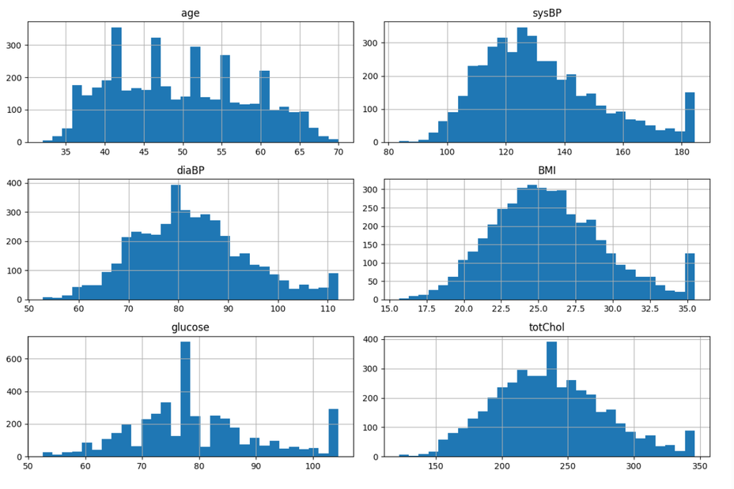
Exploratory Data Analysis
Univariate: Age, BMI, and Glucose exhibit right-skewed distributions.
Bivariate: CHD patients show significantly higher median age and blood pressure compared to non-CHD patients.
Key Finding: Smoking intensity (quantity) shows a stronger link to risk than just smoking status alone.

Slide 12
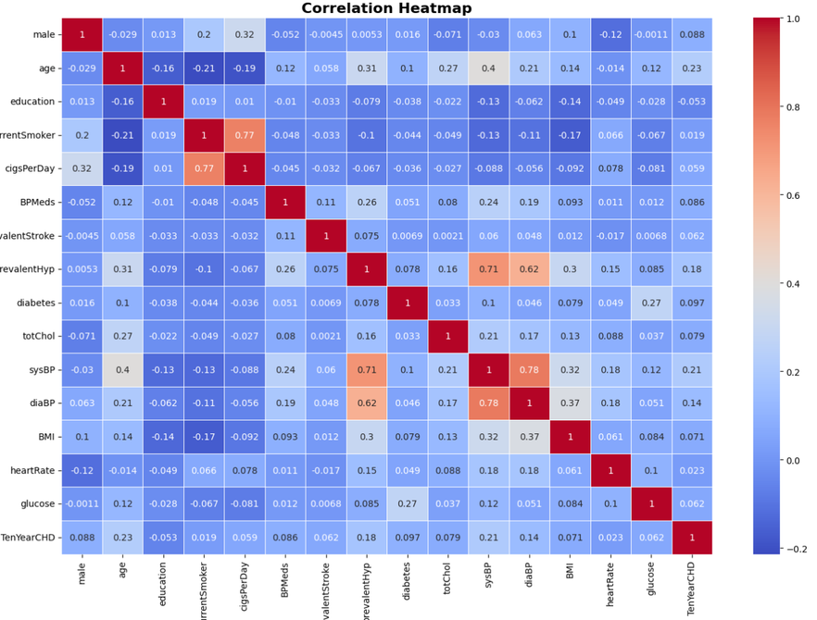
Correlation Analysis
Clinical Links: Strong positive correlation between Systolic and Diastolic Blood Pressure.
Metabolic Links: BMI and Glucose levels are positively correlated.
Insights: High correlation between age and the onset of hypertension

Slide 13
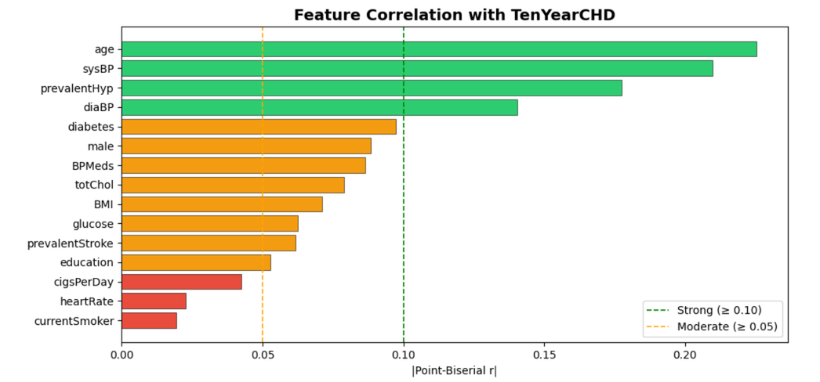
Feature Engineering
Unified Risk Score: Transformed raw clinical features into a single Risk Score for dashboarding.
PCA: Applied Principal Component Analysis to visualize target distribution and manage multicollinearity among clinical features

Slide 14
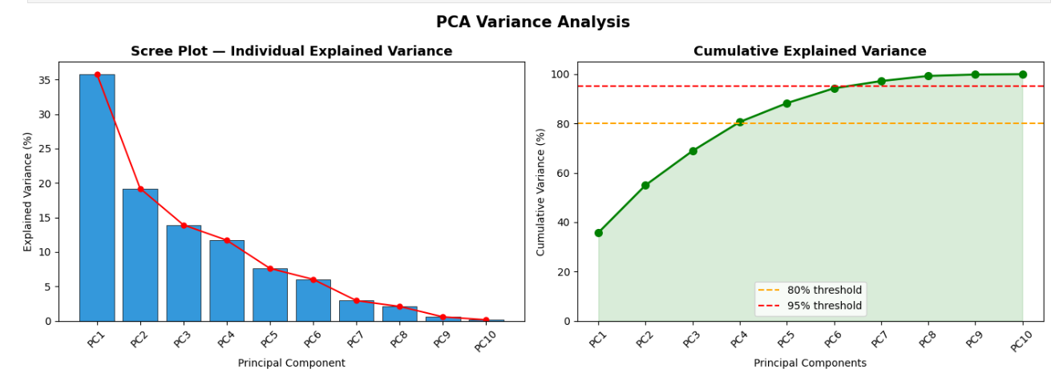
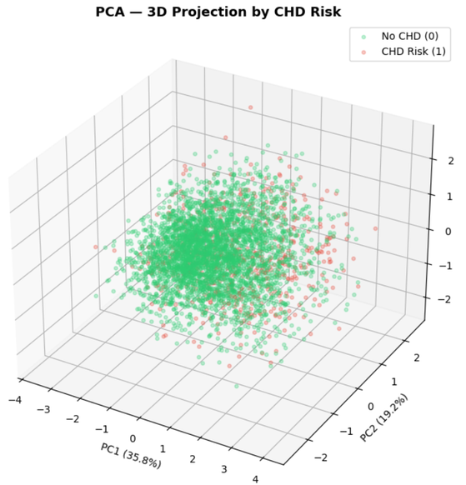
Dimensionality Reduction
Dimensionality Reduction (PCA)
Technique: Principal Component Analysis.
Goal: Solve multicollinearity by projecting features into a lower-dimensional space.
Result: Visualized target distribution clearly and enhanced the robustness of the risk metrics.

Slide 15
Key Insights / Results
Primary Influencers: Stroke history (3.13x increase) and age (2.93x increase) are the top risk drivers.
Segmentation: Segment 1 (31.9% risk) and Segment 2 (29.7% risk) are the priority intervention groups.
The Pathway: Age (60+) is the "primary entry gate" for risk, which compounds with hypertension and smoking.

Slide 16
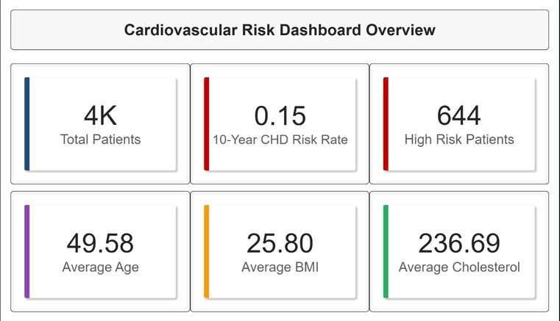
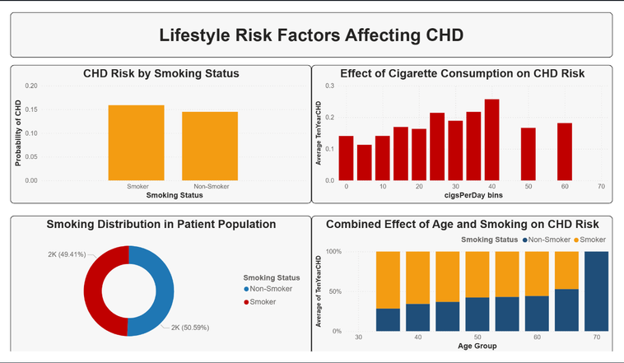
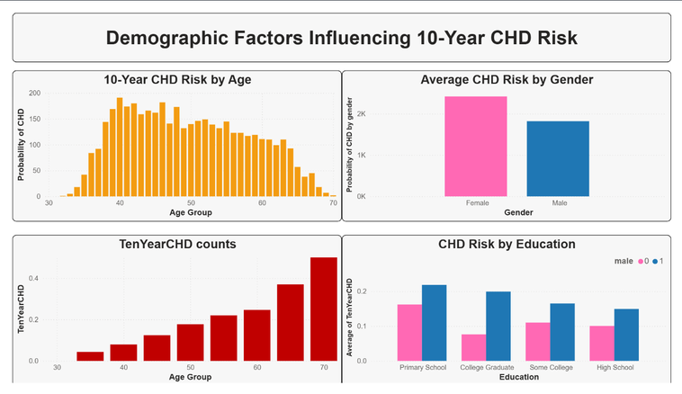
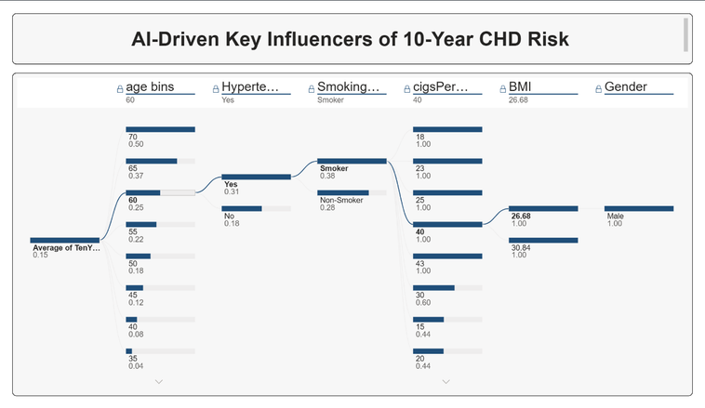
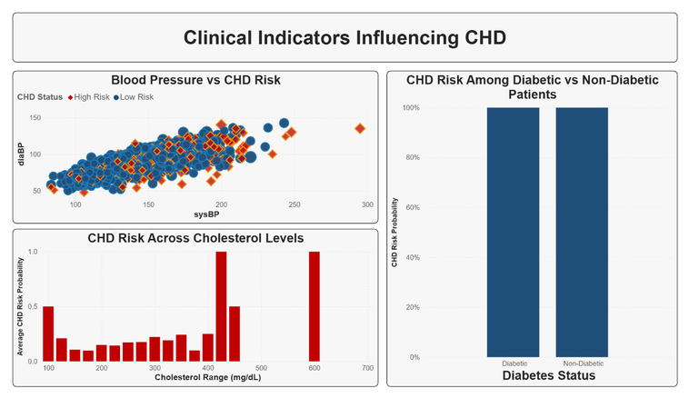
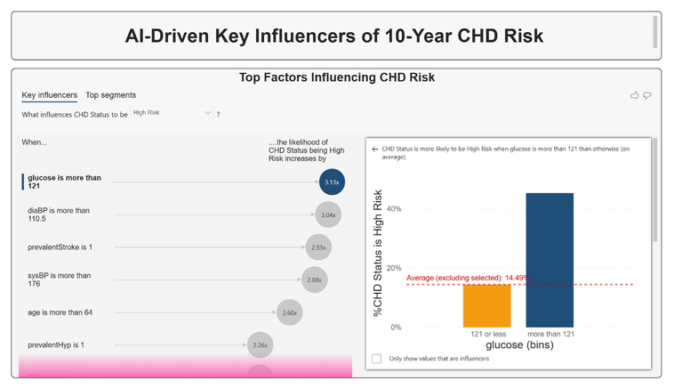
Visualization Dashboard
KPIs: Avg Age 49, Avg BMI 25.8, Avg Chol 236
Tool: AI Influencer visual ranking BP and Glucose as top factors.

Slide 17
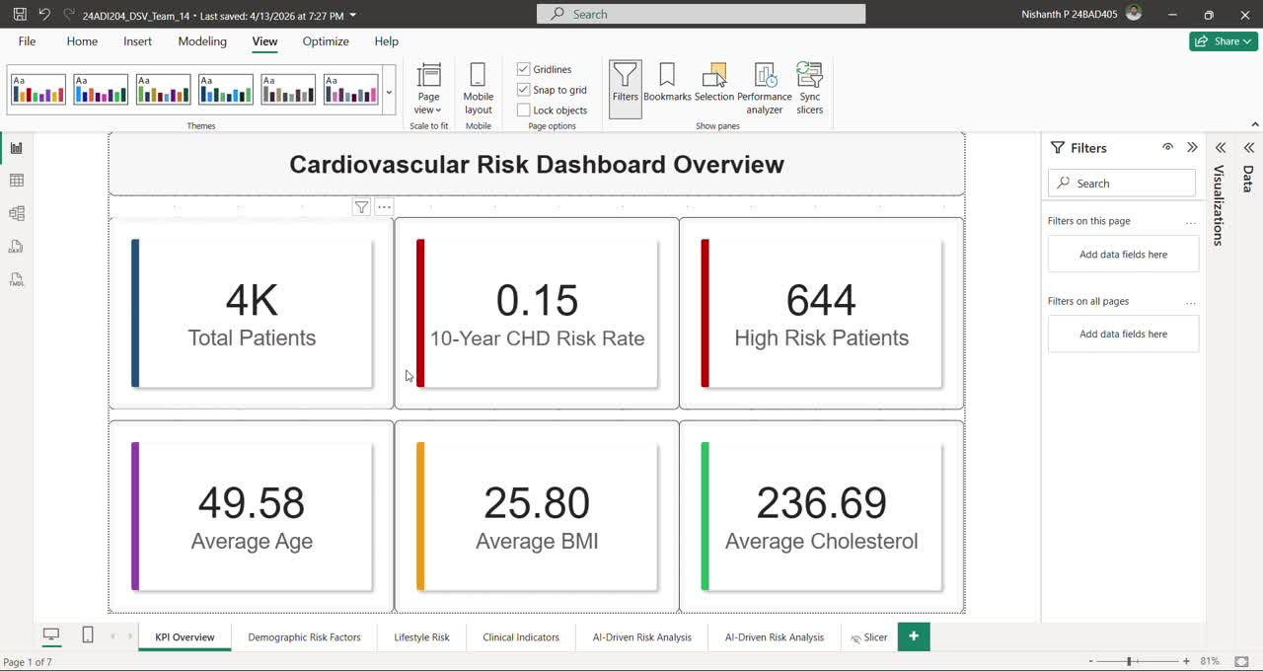
Demo Video

Slide 18
Future Enhancements
Integration with IoT/Wearable heart rate monitors for real-time tracking.
Applying deep learning for more granular predictive accuracy.
Expanding datasets to include dietary and genetic markers.

Slide 19
Individual Contribution
Gokulnaath M: Data Engineering & PCA Implementation
Jayaraksha Reguraj: Narrative Design & Visual Storytelling
Kamalesh N: Data Analysis & Statistical Modeling
Nishanth P: Dashboard Design & Research

Slide 20
Conclusion and References
Summary: Identified that a multi-factorial profile (Male, 60+, Hypertensive, Heavy Smoker) represents the most critical intervention cohort.
References: Framingham Heart Study Dataset; Simplilearn Power BI Course.

