Slide 1
MONARCH ANALYTICS
Business Performance Audit Report
Confidential | Prepared by Monarch Analytics
March 2026
DATA-DRIVEN DECISIONS | REVENUE GROWTH | BUSINESS CLARITY

Slide 2
Executive Summary
Key findings from the business performance audit
• Total Revenue Analyzed: ₹154,000 • Lead-to-Sale Conversion: 73.3% • Customer Acquisition Cost: ₹17,920 • Return on Ad Spend: 7.9x • Customer LTV: ₹81,461 • Customer Retention Rate: 0.0% • Gross Margin: 63.6% • Revenue Leaks Detected: 1 • Estimated Revenue at Risk: ₹1,221,920
1
Revenue Leaks Detected
₹1,221,920
Revenue at Risk

Slide 3
Key Metrics Snapshot
Core KPIs across sales, marketing, and customer
₹154,000
Total Revenue
₹14,000
Avg Deal Value
73.3%
Win Rate
7.9x
ROAS
₹17,920
CAC
₹81,461
LTV
0.0%
Retention
63.6%
Gross Margin

Slide 4
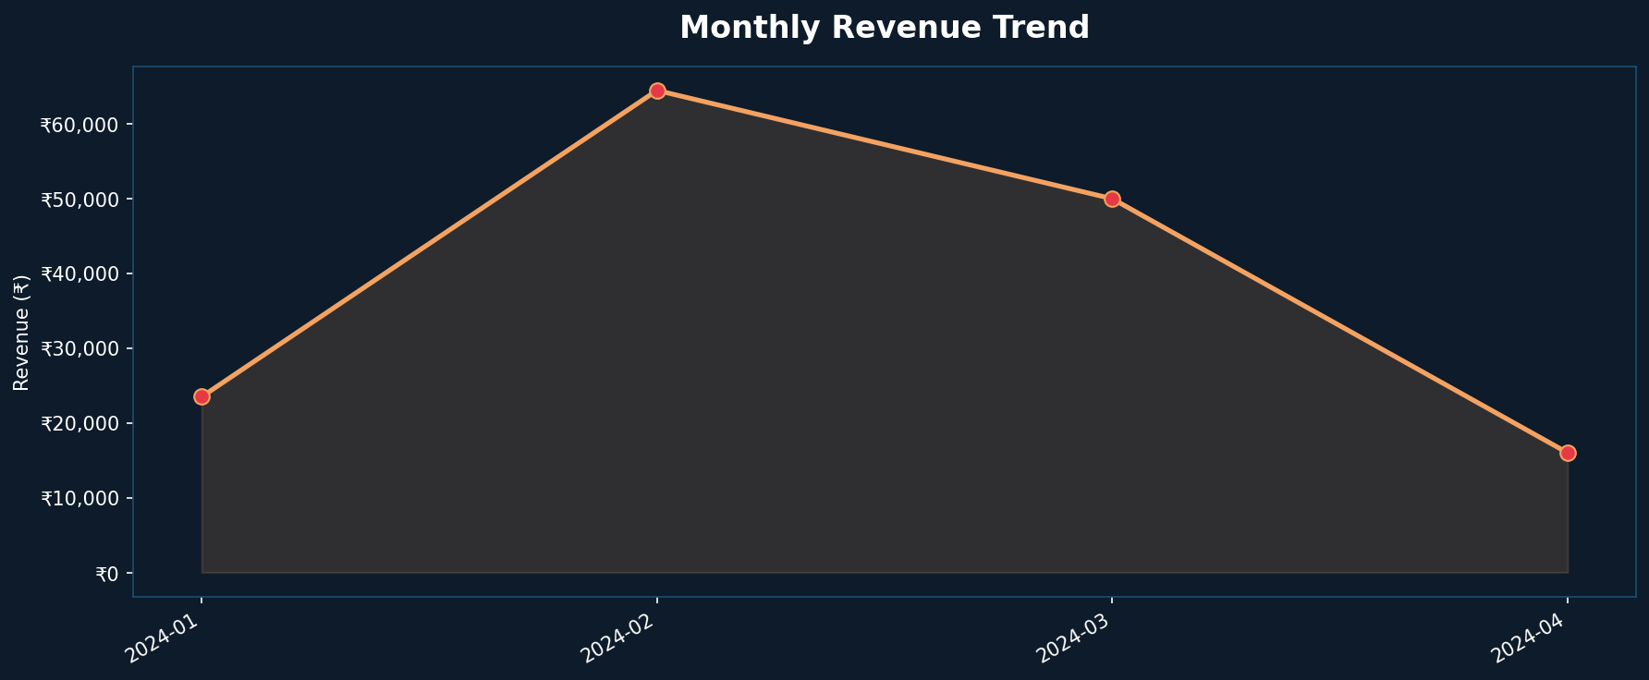
Revenue Performance
Monthly revenue trend analysis

Slide 5
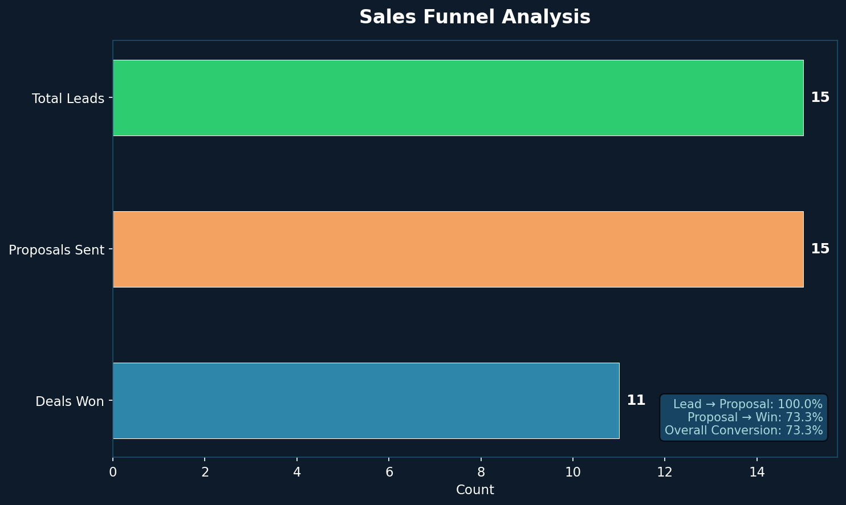
Sales Funnel Analysis
Lead-to-close conversion performance

Slide 6
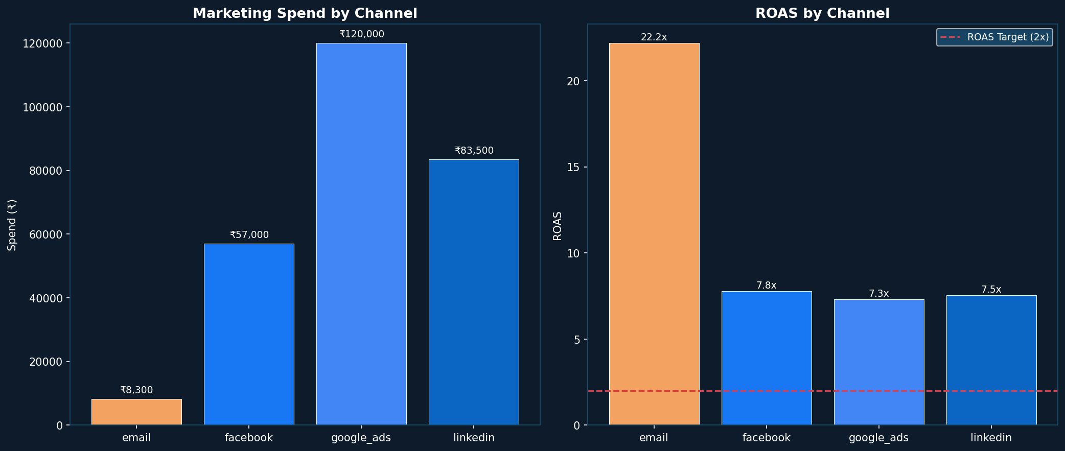
Marketing Efficiency
Channel performance and spend effectiveness

Slide 7
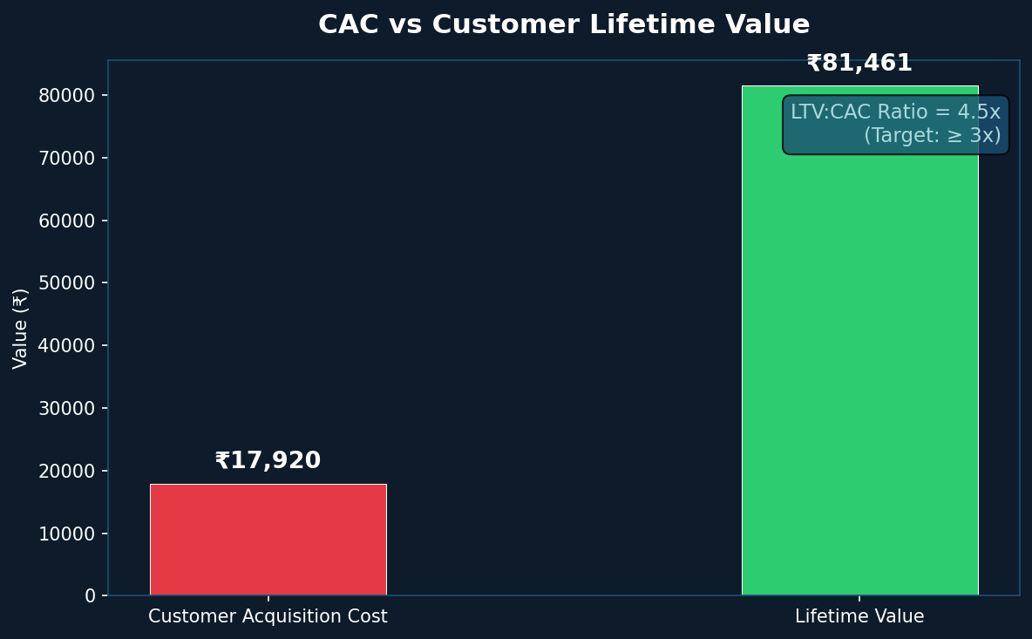
CAC vs Customer Lifetime Value
Sustainability of customer acquisition investment

Slide 8
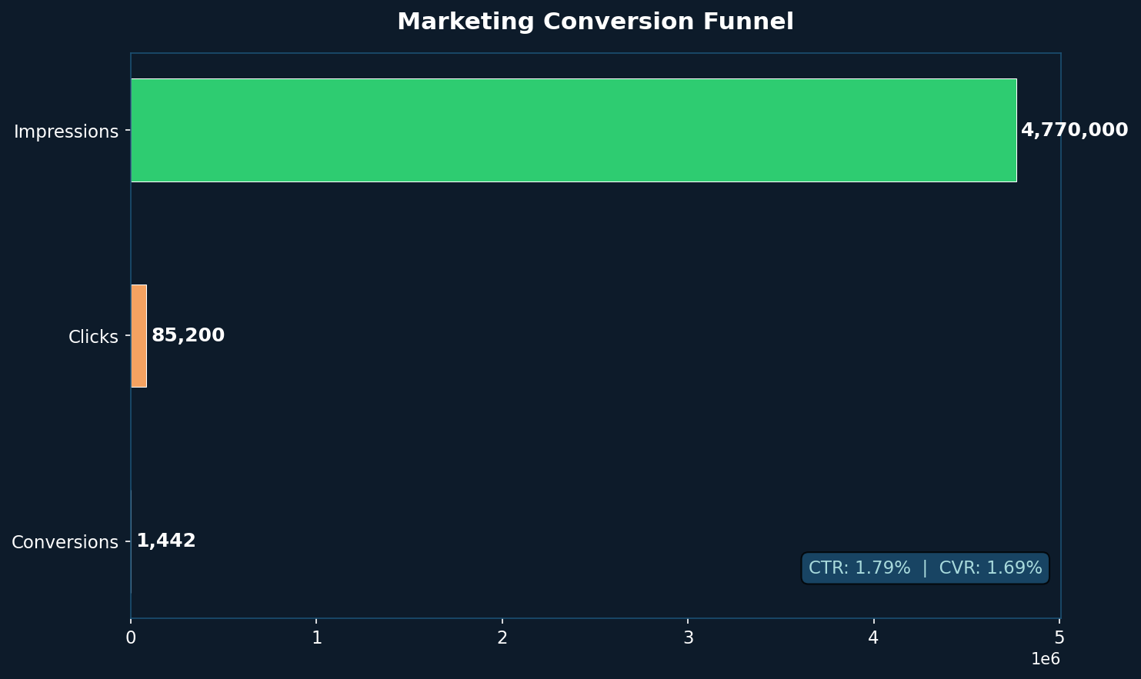
Marketing Conversion Funnel
Impression-to-conversion drop-off analysis

Slide 9
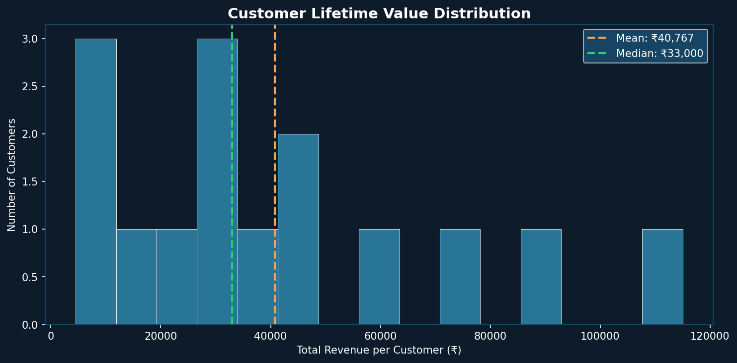
Customer Lifetime Value Distribution
Revenue concentration and value segmentation

Slide 10
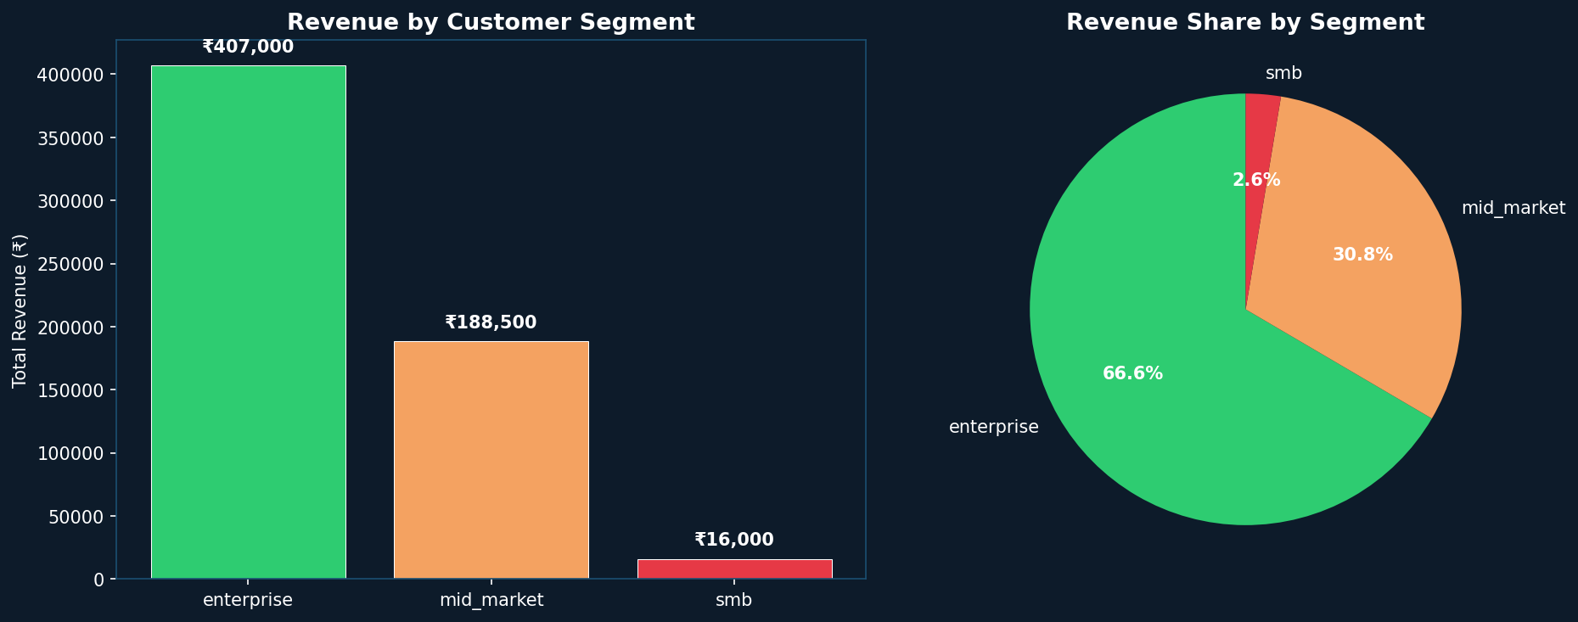
Customer Segment Analysis
Revenue and retention by customer tier

Slide 11
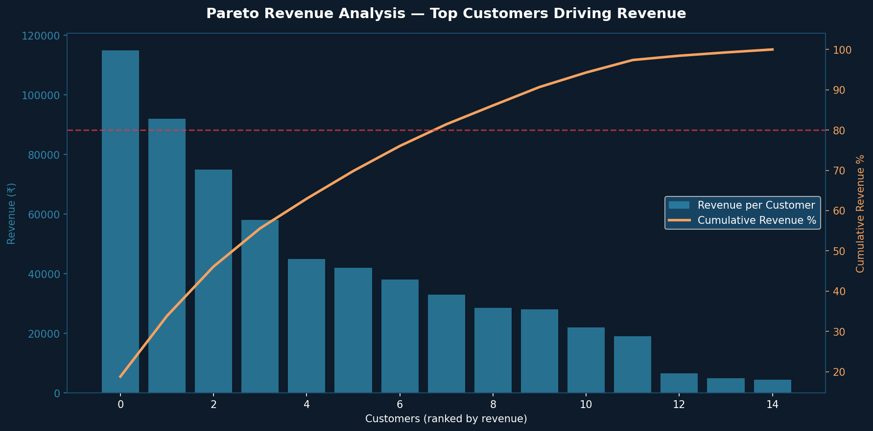
Pareto Revenue Analysis
Top 20% of customers drive 46.1% of total revenue

Slide 12
Revenue Leak Detection Results
Automated analysis of business performance gaps
[9/10] ⚠️ CUSTOMER CHURN ISSUE — Retention rate is 0.0%, below the 40% threshold. 15 customers have churned.

Slide 13
Fix | Improve | Ignore Framework
Prioritized action plan based on impact and effort
🔴 FIX (Immediate)
• Customer Churn Issue
🟡 IMPROVE (This Quarter)
• None identified
🟢 IGNORE (Low Impact)
• None identified

Slide 14
Recommended Actions
Prioritized steps to recover revenue and improve performance
1. Implement customer success program. Add 30/60/90 day check-ins. Launch loyalty program and monitor NPS. Identify churn triggers in exit interviews.

Slide 15
90-Day Implementation Roadmap
Execution timeline for audit recommendations
Days 1–30
Quick Wins
• Fix top funnel leaks
• Pause low-ROAS ad sets
• Launch churn survey
Days 31–60
Growth Sprint
• Implement retention program
• Pricing review
• Sales enablement rollout
Days 61–90
Scale Up
• Review KPI dashboard
• Measure improvements
• Expand winning channels

Slide 16
Financial Impact Estimate
Revenue recovery potential from addressing identified leaks
Total Revenue Analyzed: ₹154,000 Revenue at Risk (Leaks): ₹1,221,920 Revenue at Risk (%): 793.5% If all recommendations are implemented: Estimated Revenue Recovery: ₹733,152 – ₹1,099,728 Conservative ROI on Audit: 12x

Slide 17
Data Sources & Methodology
How this audit was conducted
Data Sources Analyzed: • Sales CRM Data (transactions, deal stages, pipeline) • Marketing Spend Data (channels, campaigns, ROAS) • Customer Database (LTV, retention, segments) • Product Catalog (pricing, margins, cost structure) • Operational Metrics (departmental KPIs) Methodology: • Standardized data intake with format validation • Automated data cleaning and normalization • Rule-based revenue leak detection engine • Industry benchmark comparison • Pareto analysis for revenue concentration • Cohort-based customer segmentation

Slide 18
About Monarch Analytics
Your Business Intelligence Partner
Monarch Analytics is a data intelligence firm that helps growth-stage businesses unlock revenue trapped in underperforming systems. We productize every audit — so your insights are delivered fast, consistently, and with measurable financial impact. Our Approach: • Standardized audit framework across all client engagements • Automated KPI calculation and revenue leak detection • Interactive dashboards and automated reporting • Actionable recommendations backed by data Contact: hello@monarchanalytics.in | monarchanalytics.in

Slide 19
MONARCH ANALYTICS
Continue the Growth Journey
Monarch Analytics Retainer — Monthly Intelligence Partnership
✅ Monthly KPI Dashboard Updates ✅ Quarterly Business Performance Audits ✅ Dedicated Analytics Support (Slack / Email) ✅ Revenue Leak Monitoring Alerts ✅ Custom Dashboard & Reporting ✅ Strategic Growth Advisory Sessions
Schedule Your Strategy Call → monarchanalytics.in

Slide 20
MONARCH ANALYTICS
Thank You
This report was automatically generated by the Monarch Analytics Audit System.
Data-Driven Decisions. Revenue Growth. Business Clarity.
CONFIDENTIAL | © Monarch Analytics | monarchanalytics.in

