Slide 1
Machine Learning
Unsupervised Learning

Slide 2
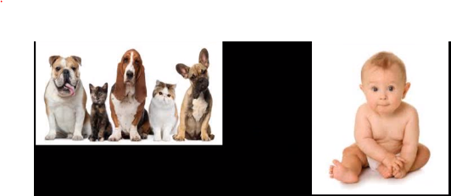
What is Unsupervised Learning?
Unsupervised learning is a type of self-organized Hebbian learning that helps find previously unknown patterns in data set without pre-existing labels.

Slide 3
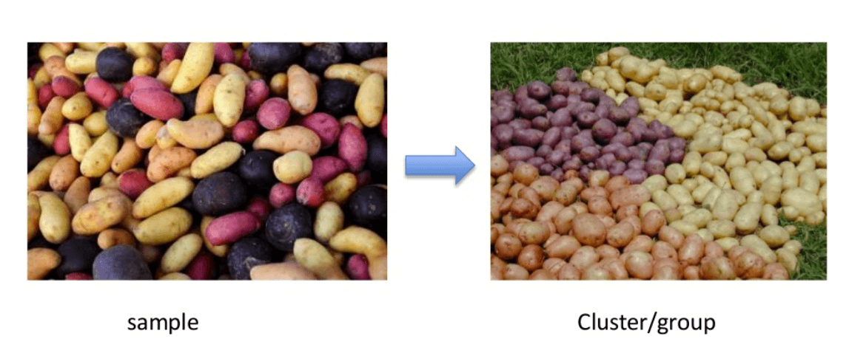
What is Unsupervised Learning?

Slide 4
What is Unsupervised Learning?
Unsupervised learning problems can be further grouped into clustering and association problems.
Clustering: A clustering problem is where you want to discover the inherent groupings in the data, such as grouping customers by purchasing behavior.
Association: An association rule learning problem is where you want to discover rules that describe large portions of your data, such as people that buy X also tend to buy Y.

Slide 5
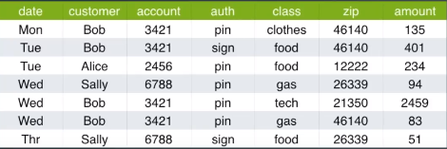
What is Unsupervised Learning?

Slide 6
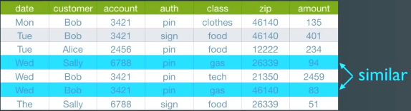
What is Unsupervised Learning?

Slide 7
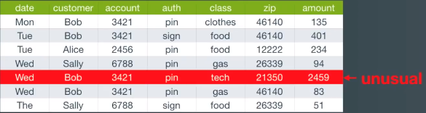
What is Unsupervised Learning?

Slide 8
Types of Distance Metrics used in ML
Manhattan distance
Euclidean distance
Minkowski distance
Hamming distance (Self Study)
Cosine distance (Self Study)

Slide 9
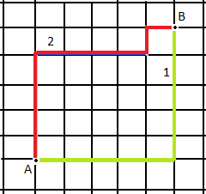

Types of Distance Metrics used in ML
Manhattan distance: We use Manhattan distance, also known as city block distance, or taxicab geometry if we need to calculate the distance between two data points in a grid-like path.
Manhattan distance is used to calculate the shortest travel time between two points in a grid-like city layout.

Slide 10
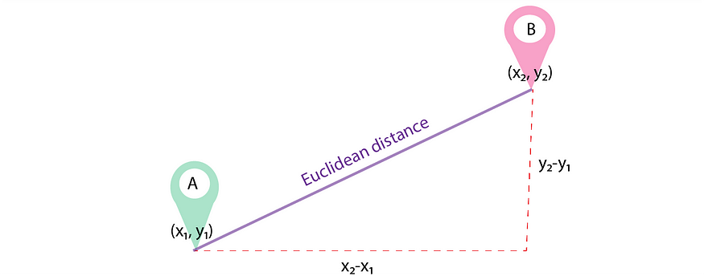
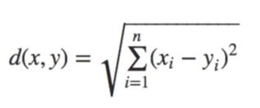
Types of Distance Metrics used in ML
Euclidean distance: Euclidean distance is the straight line distance between 2 data points in a plane.
Clustering Customers in Retail: A retail company wants to segment its customers based on purchasing behavior. They collect data on the number of purchases and the amount spent by each customer. Using Euclidean distance, they can measure the similarity between customers and cluster them into groups (e.g., high spenders vs. low spenders) for targeted marketing.

Slide 11
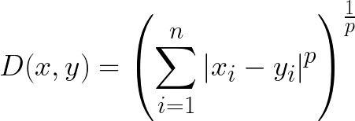
Types of Distance Metrics used in ML
Minkowski distance: This distance metric is a generalization of the Euclidean and Manhattan distance metrics. It determines the similarity of distances between two or more vectors in space. In machine learning, the distance metric calculated from the Minkowski equation is applied to determine the similarity of size.
where
p=1 for Manhattan distance
p=2 for Euclidean distance
p=infinity for Chebyshev distance

Slide 12
Types of Distance Metrics used in ML
Hamming distance: The Hamming distance algorithm is primarily used for comparing two strings of equal length and determining how many positions in those strings are different. t's particularly useful in various applications where you need to measure the similarity or dissimilarity between binary strings.
Example: Error Detection and Correction: Hamming distance is used in error-correcting codes, such as the Hamming code, to detect and correct errors in transmitted data. By comparing received binary data to the expected data, it's possible to identify and fix bit errors.

Slide 13
Types of Distance Metrics used in ML
Example of Hamming Distance
Suppose there are two strings 1101 1001 and 1001 1101.
11011001 ⊕ 10011101 = 01000100. Since, this contains two 1s, the Hamming distance, d(11011001, 10011101) = 2.

Slide 14
Types of Distance Metrics used in ML
Cosine Distance: Cosine distance & Cosine Similarity metric is mainly used to find similarities between two data points. As the cosine distance between the data points increases, the cosine similarity, or the amount of similarity decreases, and vice versa. Thus, Points closer to each other are more similar than points that are far away from each other.

Slide 15
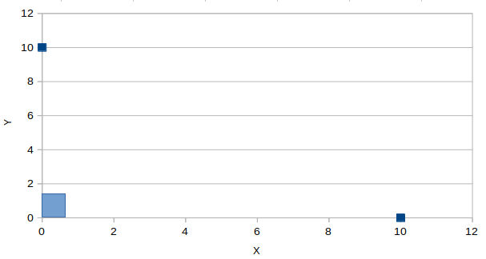
Types of Distance Metrics used in ML
In the above image, there are two data points shown in blue, the angle between these points is 90 degrees, and Cos 90 = 0. Therefore, the shown two points are not similar, and their cosine distance is 1 — Cos 90 = 1.

Slide 16
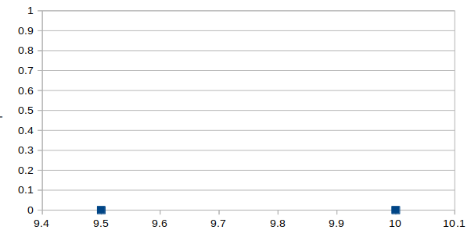
Types of Distance Metrics used in ML
Now if the angle between the two points is 0 degrees in the above figure, then the cosine similarity, Cos 0 = 1 and Cosine distance is 1- Cos 0 = 0. Then we can interpret that the two points are 100% similar to each other.

Slide 17
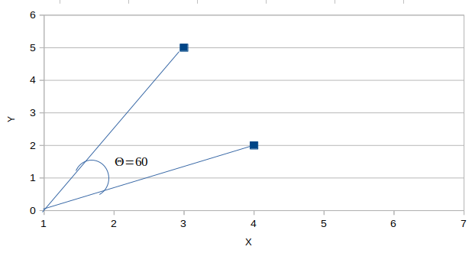
Types of Distance Metrics used in ML
In the above figure, imagine the value of θ to be 60 degrees, then by cosine similarity formula, Cos 60 =0.5 and Cosine distance is 1- 0.5 = 0.5. Therefore the points are 50% similar to each other.

Slide 18
Types of Distance Metrics used in ML
How it works: Each user is represented as a vector of movie ratings. For example, if User A has rated movies like this:
Movie | Matrix | Titanic | Inception | Toy Story
User A | 5 | 4 | 0 | 3
Movies | Matrix | Titanic | Inception | Toy Story
User B | 4 | 5 | 2 | 3
Using cosine similarity, the system calculates how "close" User A and User B's preferences are, based on their ratings for common movies. If User A has not watched "Inception," but User B rated it 2, the system might still suggest "Inception" to User A based on the overall similarity.

Slide 19
Types of Distance Metrics used in ML
Where is it used?
Taking the example of a movie recommendation system, Suppose one user (User #1) has watched movies like 12th Fail, and Super 30, which are of biographical drama, and another user (User #2) has watched movies like Catch me If you can, and Cast Away, which are also biographical drama genre. So the recommendation system will use this data to recommend User #1 to see Catch me If you can, and Cast Away as User #1 and User #2 both prefer the biographical drama genre.
Similarly, Suppose User #1 loves to watch movies based on horror, and User #2 loves the action-thriller genre. In this case, User #2 won’t be suggested to watch a horror movie as there is no similarity between the action-thriller and the horror genre.

Slide 20
Unsupervised Learning Techniques
K-means algorithm
Hierarchical clustering
Principal Component Analysis
DBSCAN (Density-Based Spatial Clustering of Applications with Noise)
K-Nearest Neighbors (K-NN)

Slide 21
K-means algorithm
K-means clustering is an unsupervised machine learning algorithm used to group a dataset into k clusters.
The goal of the algorithm is to group similar data points together while maximizing the dissimilarity between different clusters.
It's widely used for various applications, including customer segmentation, image compression, and data preprocessing.

Slide 22
Working of K-means algorithm
Initialization: Choose the number of clusters (k) you want to create and randomly initialize k cluster centroids. Each centroid represents the center of a cluster.
Assignment Step: For each data point, calculate its distance from each of the k centroids. Assign the data point to the cluster whose centroid is closest to it. This forms k initial clusters.
Update Step: Recalculate the centroids of the k clusters by taking the mean of all the data points assigned to each cluster.
Repeat: Repeat the assignment and update steps iteratively until either a maximum number of iterations is reached or the centroids stop changing significantly.
Convergence: The algorithm is considered to have converged when the centroids of the clusters no longer change substantially between iterations.

Slide 23
Working of K-means algorithm: Example
Point | Coordinates
A1 | (2,10)
A2 | (2,6)
A3 | (11,11)
A4 | (6,9)
A5 | (6,4)
A6 | (1,2)
A7 | (5,10)
A8 | (4,9)
A9 | (10,12)
A10 | (7,5)
A11 | (9,11)
A12 | (4,6)
A13 | (3,10)
A14 | (3,8)
A15 | (6,11)
STEP1: randomly initialize k cluster centroids
Centroid 1=(2,6) is associated with cluster k=1.
Centroid 2=(5,10) is associated with cluster k=2.
Centroid 3=(6,11) is associated with cluster k=3.

Slide 24
Working of K-means algorithm: Example
Point | Distance from Centroid 1 (2,6) | Distance from Centroid 2 (5,10) | Distance from Centroid 3 (6,11) | Assigned Cluster
A1 (2,10) | 4 | 3 | 4.123106
A2 (2,6) | 0 | 5 | 6.403124
A3 (11,11) | 10.29563 | 6.082763 | 5
A4 (6,9) | 5 | 1.414214 | 2
A5 (6,4) | 4.472136 | 6.082763 | 7
A6 (1,2) | 4.123106 | 8.944272 | 10.29563
A7 (5,10) | 5 | 0 | 1.414214
A8 (4,9) | 3.605551 | 1.414214 | 2.828427
A9 (10,12) | 10 | 5.385165 | 4.123106
A10 (7,5) | 5.09902 | 5.385165 | 6.082763
A11 (9,11) | 8.602325 | 4.123106 | 3
A12 (4,6) | 2 | 4.123106 | 5.385165
A13 (3,10) | 4.123106 | 2 | 3.162278
A14 (3,8) | 2.236068 | 2.828427 | 4.242641
A15 (6,11) | 6.403124 | 1.414214 | 0
The distance function between two points
a = (x1, y1) and b = (x2, y2) is defined as-
Euclidean Distance =
√((x₂ - x₁)² + (y₂ - y₁)²)
(x₁, y₁) = (2, 6)
(x₂, y₂) = (2, 10)
Euclidean Distance C1
= √((2 - 2)² + (6 - 10)²)
= √(0² + 4²)
= √(0 + 16)
= √16
= 4

Slide 25
Working of K-means algorithm: Example
Point | Distance from Centroid 1 (2,6) | Distance from Centroid 2 (5,10) | Distance from Centroid 3 (6,11) | Assigned Cluster
A1 (2,10) | 4 | 3 | 4.123106
A2 (2,6) | 0 | 5 | 6.403124
A3 (11,11) | 10.29563 | 6.082763 | 5
A4 (6,9) | 5 | 1.414214 | 2
A5 (6,4) | 4.472136 | 6.082763 | 7
A6 (1,2) | 4.123106 | 8.944272 | 10.29563
A7 (5,10) | 5 | 0 | 1.414214
A8 (4,9) | 3.605551 | 1.414214 | 2.828427
A9 (10,12) | 10 | 5.385165 | 4.123106
A10 (7,5) | 5.09902 | 5.385165 | 6.082763
A11 (9,11) | 8.602325 | 4.123106 | 3
A12 (4,6) | 2 | 4.123106 | 5.385165
A13 (3,10) | 4.123106 | 2 | 3.162278
A14 (3,8) | 2.236068 | 2.828427 | 4.242641
A15 (6,11) | 6.403124 | 1.414214 | 0
Euclidean Distance =
√((x₂ - x₁)² + (y₂ - y₁)²)
(x₁, y₁) = (5, 10)
(x₂, y₂) = (2, 10)
Euclidean Distance C2
= √((5 - 2)² + (10 - 10)²)
= √(3² + 0²)
= √(9 + 0)
= √9
= 3

Slide 26
Working of K-means algorithm: Example
Point | Distance from Centroid 1 (2,6) | Distance from Centroid 2 (5,10) | Distance from Centroid 3 (6,11) | Assigned Cluster
A1 (2,10) | 4 | 3 | 4.123106 | Cluster 2
A2 (2,6) | 0 | 5 | 6.403124 | Cluster 1
A3 (11,11) | 10.29563 | 6.082763 | 5 | Cluster 3
A4 (6,9) | 5 | 1.414214 | 2 | Cluster 2
A5 (6,4) | 4.472136 | 6.082763 | 7 | Cluster 1
A6 (1,2) | 4.123106 | 8.944272 | 10.29563 | Cluster 1
A7 (5,10) | 5 | 0 | 1.414214 | Cluster 2
A8 (4,9) | 3.605551 | 1.414214 | 2.828427 | Cluster 2
A9 (10,12) | 10 | 5.385165 | 4.123106 | Cluster 3
A10 (7,5) | 5.09902 | 5.385165 | 6.082763 | Cluster 1
A11 (9,11) | 8.602325 | 4.123106 | 3 | Cluster 3
A12 (4,6) | 2 | 4.123106 | 5.385165 | Cluster 1
A13 (3,10) | 4.123106 | 2 | 3.162278 | Cluster 2
A14 (3,8) | 2.236068 | 2.828427 | 4.242641 | Cluster 1
A15 (6,11) | 6.403124 | 1.414214 | 0 | Cluster 3
Euclidean Distance =
√((x₂ - x₁)² + (y₂ - y₁)²)
(x₁, y₁) = (6, 11)
(x₂, y₂) = (2, 10)
Euclidean Distance C3
= √((6 - 2)² + (11 - 10)²)
= √(4² + 1²)
= √(16 + 1)
= √17
= 4.12

Slide 27
Working of K-means algorithm: Example
Now, we will calculate the new centroid for each cluster.
In cluster 1, we have 6 points i.e. A2 (2,6), A5 (6,4), A6 (1,2), A10 (7,5), A12 (4,6), A14 (3,8).
To calculate the new centroid for cluster 1, we will find the mean of the x and y coordinates of each point in the cluster.
Mean= [ (2+6+1+7+4+3) /6 , (6+4+2+5+6+8)/6 ]= [(23/6) , (31/6) ]
Hence, the new centroid for cluster 1 is (3.833, 5.167).

Slide 28
Working of K-means algorithm: Example
In cluster 2, we have 5 points i.e. A1 (2,10), A4 (6,9), A7 (5,10) , A8 (4,9), and A13 (3,10).
Hence, the new centroid for cluster 2 is (4, 9.6)
In cluster 3, we have 4 points i.e. A3 (11,11), A9 (10,12), A11 (9,11), and A15 (6,11).
Hence, the new centroid for cluster 3 is (9, 11.25).

Slide 29
Working of K-means algorithm: Example
Point | Distance from Centroid 1 (3.833, 5.167) | Distance from centroid 2 (4, 9.6) | Distance from centroid 3 (9, 11.25) | Assigned Cluster
A1 (2,10) | 5.169 | 2.040 | 7.111 | Cluster 2
A2 (2,6) | 2.013 | 4.118 | 8.750 | Cluster 1
A3 (11,11) | 9.241 | 7.139 | 2.016 | Cluster 3
A4 (6,9) | 4.403 | 2.088 | 3.750 | Cluster 2
A5 (6,4) | 2.461 | 5.946 | 7.846 | Cluster 1
A6 (1,2) | 4.249 | 8.171 | 12.230 | Cluster 1
A7 (5,10) | 4.972 | 1.077 | 4.191 | Cluster 2
A8 (4,9) | 3.837 | 0.600 | 5.483 | Cluster 2
A9 (10,12) | 9.204 | 6.462 | 1.250 | Cluster 3
A10 (7,5) | 3.171 | 5.492 | 6.562 | Cluster 1
A11 (9,11) | 7.792 | 5.192 | 0.250 | Cluster 3
A12 (4,6) | 0.850 | 3.600 | 7.250 | Cluster 1
A13 (3,10) | 4.904 | 1.077 | 6.129 | Cluster 2
A14 (3,8) | 2.953 | 1.887 | 6.824 | Cluster 2
A15 (6,11) | 6.223 | 2.441 | 3.010 | Cluster 2

Slide 30
Working of K-means algorithm: Example
Now, we will calculate the new centroid for each cluster for the third iteration.
In cluster 1, we have 5 points i.e. A2 (2,6), A5 (6,4), A6 (1,2), A10 (7,5), and A12 (4,6). To calculate the new centroid for cluster 1, we will find the mean of the x and y coordinates of each point in the cluster. Hence, the new centroid for cluster 1 is (4, 4.6).
In cluster 2, we have 7 points i.e. A1 (2,10), A4 (6,9), A7 (5,10) , A8 (4,9), A13 (3,10), A14 (3,8), and A15 (6,11). Hence, the new centroid for cluster 2 is (4.143, 9.571)
In cluster 3, we have 3 points i.e. A3 (11,11), A9 (10,12), and A11 (9,11). Hence, the new centroid for cluster 3 is (10, 11.333).

Slide 31
Working of K-means algorithm: Example
Point | Distance from Centroid 1 (4, 4.6) | Distance from centroid 2 (4.143, 9.571) | Distance from centroid 3 (10, 11.333) | Assigned Cluster
A1 (2,10) | 5.758 | 2.186 | 8.110 | Cluster 2
A2 (2,6) | 2.441 | 4.165 | 9.615 | Cluster 1
A3 (11,11) | 9.485 | 7.004 | 1.054 | Cluster 3
A4 (6,9) | 4.833 | 1.943 | 4.631 | Cluster 2
A5 (6,4) | 2.088 | 5.872 | 8.353 | Cluster 1
A6 (1,2) | 3.970 | 8.197 | 12.966 | Cluster 1
A7 (5,10) | 5.492 | 0.958 | 5.175 | Cluster 2
A8 (4,9) | 4.400 | 0.589 | 6.438 | Cluster 2
A9 (10,12) | 9.527 | 6.341 | 0.667 | Cluster 3
A10 (7,5) | 3.027 | 5.390 | 7.008 | Cluster 1
A11 (9,11) | 8.122 | 5.063 | 1.054 | Cluster 3
A12 (4,6) | 1.400 | 3.574 | 8.028 | Cluster 1
A13 (3,10) | 5.492 | 1.221 | 7.126 | Cluster 2
A14 (3,8) | 3.544 | 1.943 | 7.753 | Cluster 2
A15 (6,11) | 6.705 | 2.343 | 4.014 | Cluster 2

Slide 32
Working of K-means algorithm: Example
Now, we will calculate the new centroid for each cluster for the third iteration.
In cluster 1, we have 5 points i.e. A2 (2,6), A5 (6,4), A6 (1,2), A10 (7,5), and A12 (4,6). To calculate the new centroid for cluster 1, we will find the mean of the x and y coordinates of each point in the cluster. Hence, the new centroid for cluster 1 is (4, 4.6).
In cluster 2, we have 7 points i.e. A1 (2,10), A4 (6,9), A7 (5,10) , A8 (4,9), A13 (3,10), A14 (3,8), and A15 (6,11). Hence, the new centroid for cluster 2 is (4.143, 9.571)
In cluster 3, we have 3 points i.e. A3 (11,11), A9 (10,12), and A11 (9,11). Hence, the new centroid for cluster 3 is (10, 11.333).

Slide 33
Working of K-means algorithm: Example
Here, you can observe that no point has changed its cluster compared to the previous iteration. Due to this, the centroid also remains constant. Therefore, we will say that the clusters have been stabilized. Hence, the clusters obtained after the third iteration are the final clusters made from the given dataset.

Slide 34
Sample datasets for K-means
Customer Segmentation Dataset: This dataset can be used to segment customers based on their shopping behaviors.
Customer_ID | Age | Annual_Income (INR) | Spending_Score (1-100) | Number_of_Visits | Online_Purchase Frequency
C001 | 25 | 35,000 | 70 | 12 | 10
C002 | 45 | 75,000 | 35 | 6 | 5
C003 | 34 | 60,000 | 55 | 15 | 20
C004 | 50 | 100,000 | 40 | 8 | 7
C005 | 29 | 40,000 | 80 | 20 | 25

Slide 35
Sample datasets for K-means
Student Performance Dataset: This dataset clusters students based on academic performance and study habits.
Student_ID | Study_Hours_per_Week | GPA | Attendance (%) | Number_of_Extracurriculars | Test_Scores (%)
S001 | 25 | 3.8 | 95 | 2 | 85
S002 | 15 | 3.2 | 90 | 1 | 78
S003 | 30 | 4.0 | 98 | 3 | 92
S004 | 20 | 3.5 | 85 | 2 | 80
S005 | 10 | 2.8 | 80 | 1 | 70
Cluster 1 (High Performers):These students dedicate more time to studying (25-30 hours per week), have high GPAs (3.8-4.0), and attend more extracurricular activities (2-3). Their attendance is nearly perfect (95%-98%), and they score well on tests (85%-92%).
Example: Students S001, S003.

Slide 36
Sample datasets for K-means
Student Performance Dataset: This dataset clusters students based on academic performance and study habits.
Student_ID | Study_Hours_per_Week | GPA | Attendance (%) | Number_of_Extracurriculars | Test_Scores (%)
S001 | 25 | 3.8 | 95 | 2 | 85
S002 | 15 | 3.2 | 90 | 1 | 78
S003 | 30 | 4.0 | 98 | 3 | 92
S004 | 20 | 3.5 | 85 | 2 | 80
S005 | 10 | 2.8 | 80 | 1 | 70
Cluster 2 (Moderate/Low Performers): These students study fewer hours (10-20 hours per week), have moderate-to-low GPAs (2.8-3.5), and attend fewer extracurricular activities (1-2). Their attendance is lower (80%-90%), and their test scores range from 70% to 80%.
Example: Students S002, S004, S005.

Slide 37
How to Determine the Optimal K for K-Means?
The Elbow Method
The Silhouette Method (Assignment)

Slide 38
How to Determine the Optimal K for K-Means?
The Elbow Method: This is probably the most well-known method for determining the optimal number of clusters. It is also a bit naive in its approach.
Calculate the Within-Cluster-Sum of Squared Errors (WSS) [also known as inertia] for different values of k, and choose the k for which WSS becomes first starts to diminish. In the plot of WSS-versus-k, this is visible as an elbow.

Slide 39
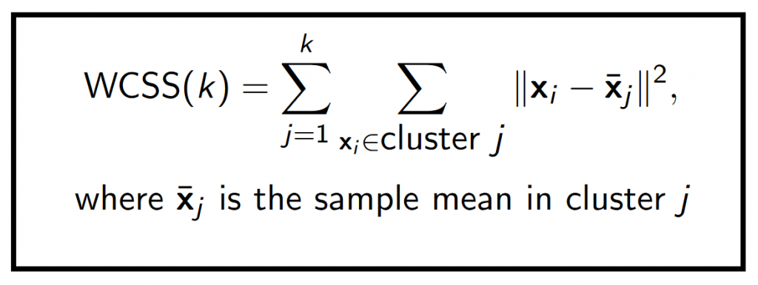
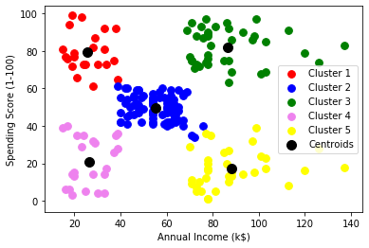
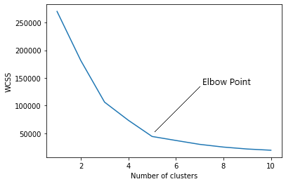
How to Determine the Optimal K for K-Means?

Slide 40
Exercise
Data points: A(1,1), B(2,1), C(4,3), D(5,4)
Centroids: M1(1,0), M2(5,5)
Task:
Assign each point to the nearest centroid using Euclidean distance.
Recompute centroids (Upto one iteration)

Slide 41
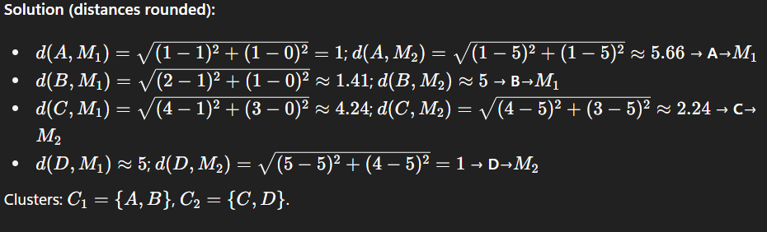
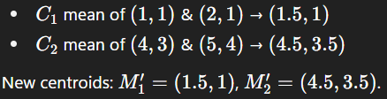
How to Determine the Optimal K for K-Means?

Slide 42
Hierarchical Clustering

Slide 43
Hierarchical Clustering
Hierarchical clustering is a connectivity-based clustering model that groups the data points together that are close to each other based on the measure of similarity or distance
Types of Hierarchical Clustering
  Agglomerative Clustering
  Divisive clustering

Slide 44
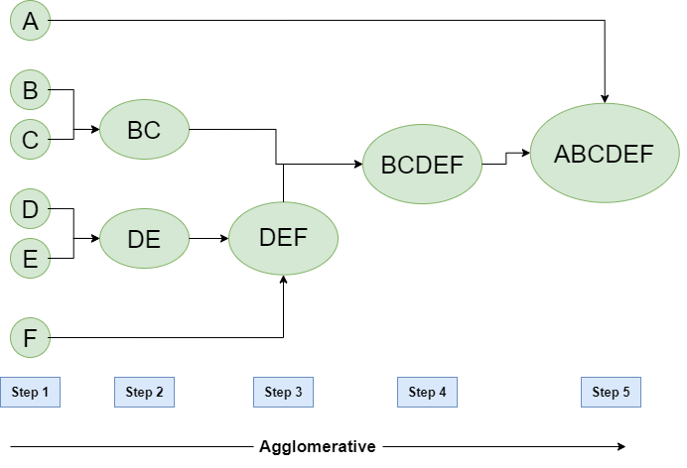
Agglomerative Clustering (AGglomerative NESting(AGNES))
To group the datasets into clusters, it follows the bottom-up approach. It means, this algorithm considers each datapoint as a single cluster at the beginning, and then start combining the closest pair of clusters together. It does this until all the clusters are merged into a single cluster that contains all the datasets.

Slide 45
Agglomerative Clustering (AGglomerative NESting(AGNES))
The process of Agglomerative nesting typically follows these steps:
Initialization: Start with each data point as its own cluster, treating them as singleton clusters.
Pairwise Distance Calculation: Calculate the pairwise distance between all clusters or data points. The choice of distance metric (e.g., Euclidean distance, Manhattan distance) and linkage criterion (e.g., single-linkage, complete-linkage, average-linkage) determines how the distance between clusters is computed.
Merge Closest Clusters: Identify the two closest clusters based on the distance metric and linkage criterion. Merge these two clusters into a single new cluster.
Update the Hierarchy: Add the newly formed cluster to the hierarchy, indicating that it was created by merging its constituent clusters.
Repeat: Repeat steps 2-4 iteratively until there is only one cluster left, which becomes the root of the hierarchy.

Slide 46
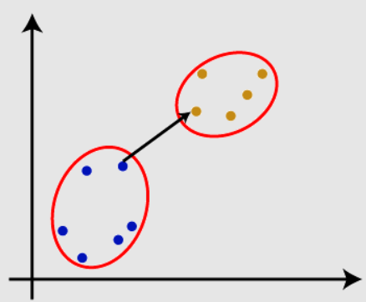
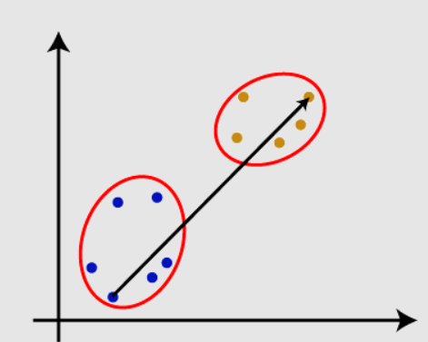
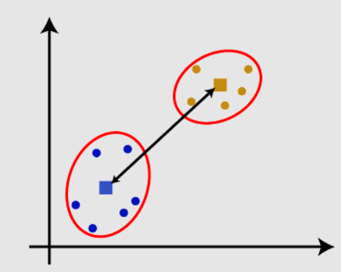
Agglomerative Clustering (AGglomerative NESting(AGNES))
Agglomerative clustering linkage algorithm (Cluster Distance Measure)
Single Linkage
Complex Linkage
Centroid Linkage

Slide 47
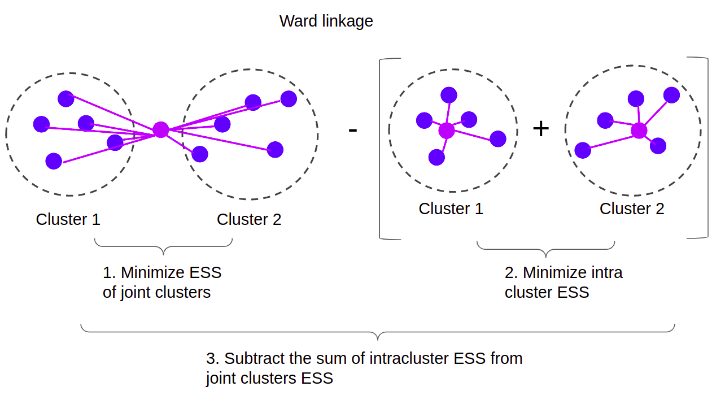
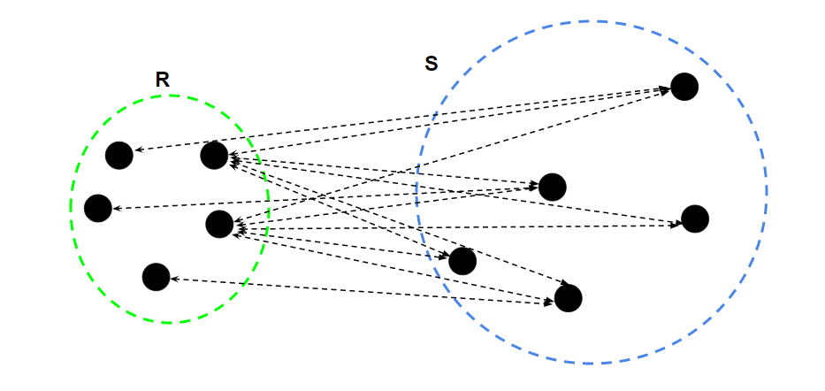
Agglomerative Clustering (AGglomerative NESting(AGNES))
Agglomerative clustering linkage algorithm (Cluster Distance Measure)
Average Linkage
Ward’s Linkage
Ward's method aims to minimize the variance within each cluster when merging two clusters, making it a variance minimization approach.
Definitive Guide to Hierarchical Clustering with Python and Scikit-Learn (stackabuse.com)

Slide 48
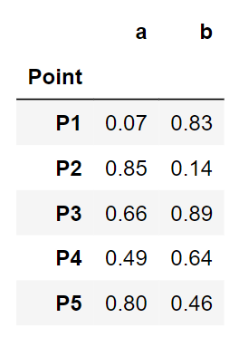
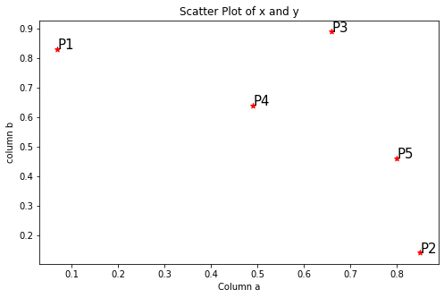
Agglomerative Clustering (AGglomerative NESting(AGNES))

Slide 49
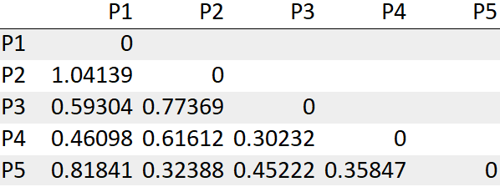
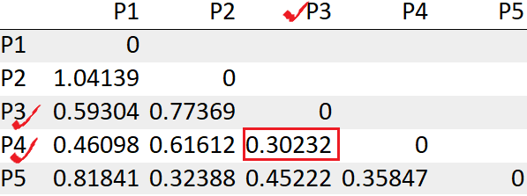
Agglomerative Clustering (AGglomerative NESting(AGNES))
Step2: Calculating the distance matrix in Euclidean method
Step 4: Re-compute the distance matrix after forming a cluster
Update the distance between the cluster (P3,P4) to P1
= Min(dist(P3,P4), P1)) -> Min(dist(P3,P1),dist(P4,P1))
= Min(0.59304, 0.46098)
= 0.46098
Update the distance between the cluster (P3,P4) to P2
= Min(dist(P3,P4), P2) -> Min(dist(P3,P2),dist(P4,P2))
= Min(0.77369, 0.61612)
= 0.61612
Update the distance between the cluster (P3,P4) to P5
= Min(dist(P3,P4), P5) -> Min(dist(P3,P5),dist(P4,P5))
= Min(0.45222, 0.35847)
= 0.35847
Step 3: Look for the least distance and merge those into a cluster
We see the points P3, P4 has the least distance “0.30232”. So we will first merge those into a cluster.

Slide 50
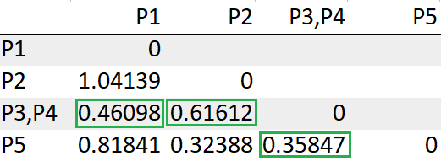
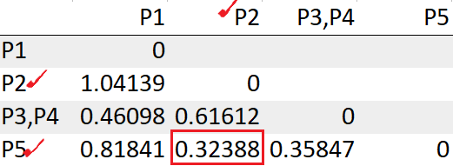
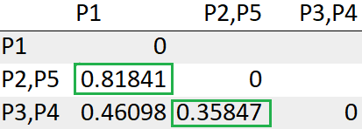
Agglomerative Clustering (AGglomerative NESting(AGNES))
Update the distance between the cluster (P2,P5) to P1
= Min(dist((P2,P5),P1)) -> Min(dist(P2,P1), dist(P5, P1))
= Min(1.04139, 0.81841)
= 0.81841
Update the distance between the cluster (P2,P5) to (P3,P4)
= Min(dist((P2,P5), (P3,P4))) -> = Min(dist(P2,(P3,P4)), dist(P5,(P3,P4)))
= Min(dist(0.61612, 0.35847))
= 0.35847
Step4
We see the points P2, P5 has the least distance “0.32388”. So we will group those into a cluster and re-compute the distance matrix.
Repeat steps 3,4 until we are left with one single cluster.

Slide 51
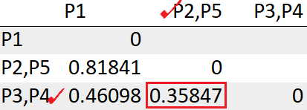
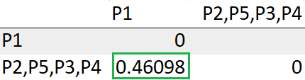
Agglomerative Clustering (AGglomerative NESting(AGNES))
After re-comput the distance matrix, we need to again look for the least distance.
Theoretically, below are the clustering steps:
P3, P4 points have the least distance and are merged
P2, P5 points have the least distance and are merged
The clusters (P3, P4), (P2, P5) are clustered
The cluster (P3, P4, P2, P5) is merged with the datapoint P1
The cluster (P2,P5) has the least distance with the cluster (P3, P4) “0.35847”. So we will cluster them together.
Update the distance between the cluster (P3,P4, P2,P5) to P1
= Min(dist(((P3,P4),(P2,P5)), P1))
= Min(0.46098, 0.81841)
= 0.46098

Slide 52
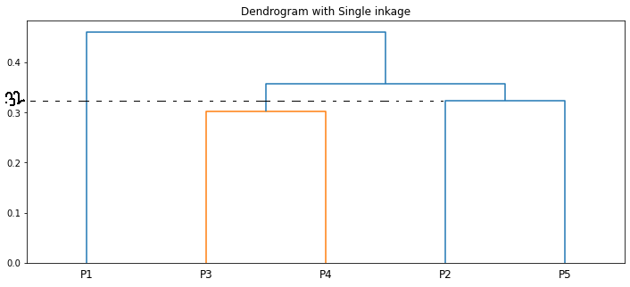
Agglomerative Clustering (AGglomerative NESting(AGNES))

Slide 53
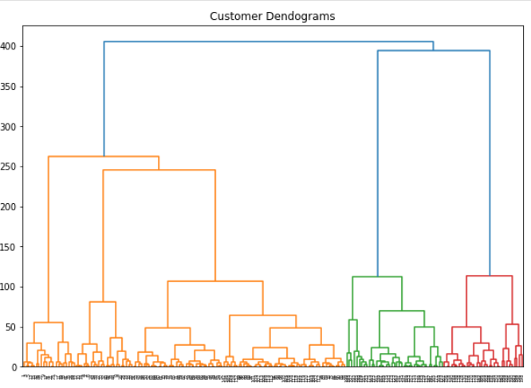
Agglomerative Clustering (AGglomerative NESting(AGNES))
1
2
3
4
5

Slide 54
DBSCAN Clustering
Density-Based Spatial Clustering Of Applications with Noise

Slide 55
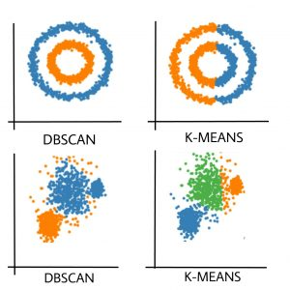
What is DBSCAN
DBSCAN makes clusters based upon the density of the data points or how close the data is. That said, the points which are outside the dense regions are excluded and treated as noise or outliers. This characteristic of the DBSCAN algorithm makes it a perfect fit for outlier detection and making clusters of arbitrary shape.

Slide 56
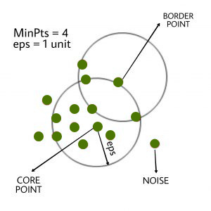
Parameters Required For DBSCAN Algorithm
eps: It defines the neighborhood around a data point
i.e. if the distance between two points is lower or equal to ‘eps’ then they are considered neighbors. If the eps value is chosen too small then a large part of the data will be considered as an outlier. If it is chosen very large then the clusters will merge and the majority of the data points will be in the same clusters. One way to find the eps value is based on the k-distance graph.
MinPts: Minimum number of neighbors (data points) within eps radius. The larger the dataset, the larger value of MinPts must be chosen. As a general rule, the minimum MinPts can be derived from the number of dimensions D in the dataset as, MinPts >= D+1. The minimum value of MinPts must be chosen at least 3.

Slide 57
Parameters Required For DBSCAN Algorithm
Core Point: A point is a core point if it has more than MinPts points within eps.
Border Point: A point which has fewer than MinPts within eps but it is in the neighborhood of a core point.
Noise or outlier: A point which is not a core point or border point.

Slide 58
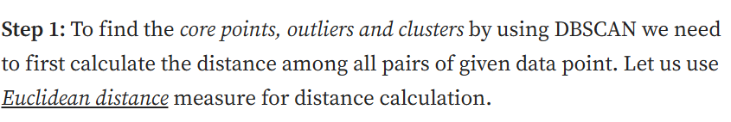
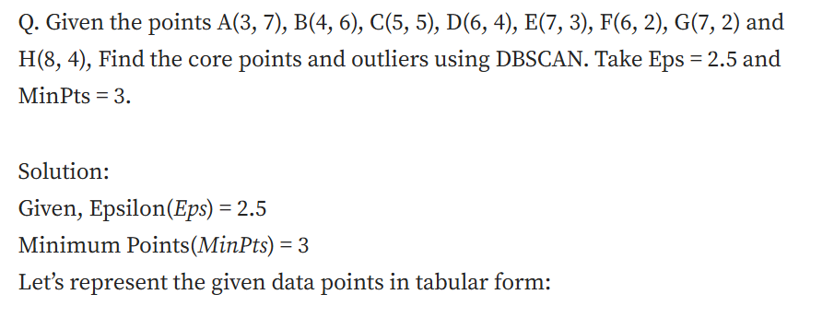
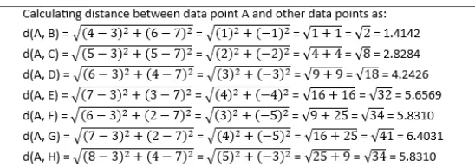
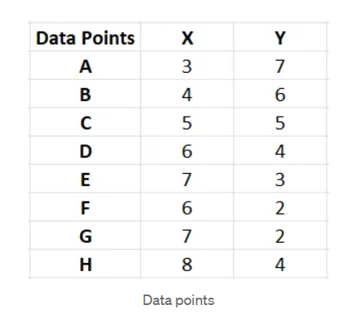
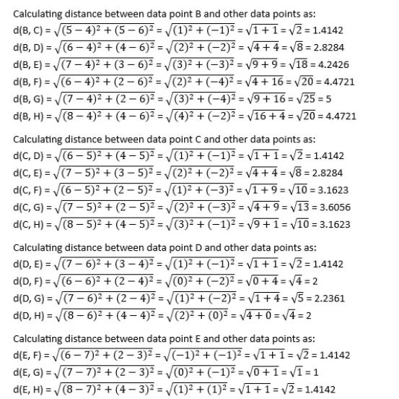
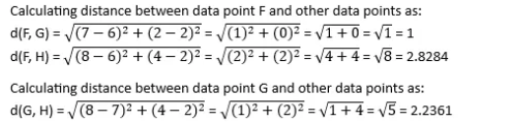
DBSCAN Example

Slide 59
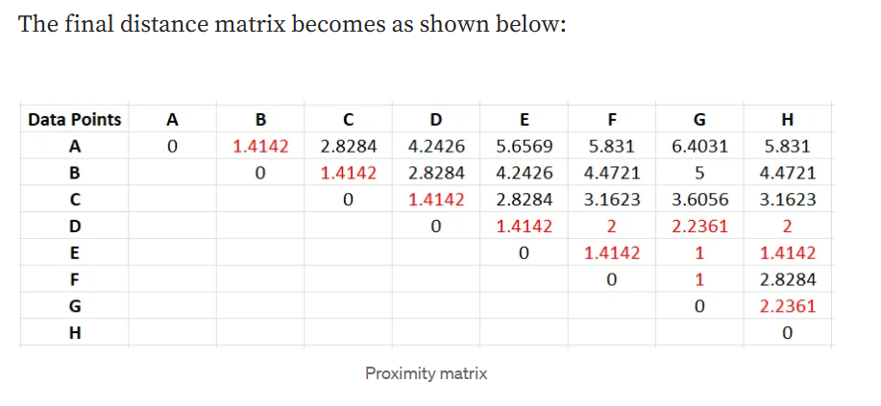
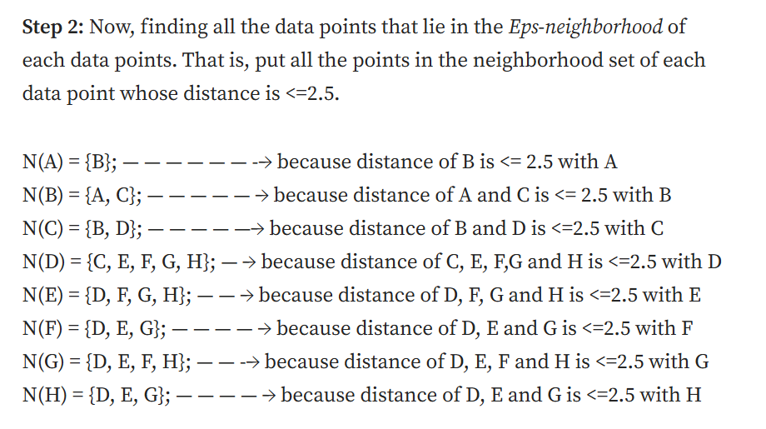
DBSCAN Example

Slide 60
Example
MinPts=4 Epsilon= 1.9
Data Points:
P1: (3, 7)
P2: (4, 6)
P3: (5, 5)
P4: (6, 4)
P5: (7, 3)
P6: (6, 2)
P7: (7, 2)
P8: (8, 4)
P9: (3, 3)
P10: (2, 6)
P11: (3, 5)
P12: (2, 4)
 | P1 | P2 | P3 | P4 | P5 | P6 | P7 | P8 | P9 | P10 | P11 | P12
P1 | 0
P2 | 1.41 | 0
P3 | 2.83 | 1.41 | 0
P4 | 4.24 | 2.83 | 1.41 | 0
P5 | 5.66 | 4.24 | 2.83 | 1.41 | 0
P6 | 5.83 | 4.47 | 3.16 | 2.00 | 1.41 | 0
P7 | 6.40 | 5.00 | 3.61 | 2.24 | 1.00 | 1.00 | 0
P8 | 5.83 | 4.47 | 3.16 | 2.00 | 1.41 | 2.83 | 2.24 | 0
P9 | 4.00 | 3.16 | 2.83 | 3.16 | 4.00 | 3.16 | 4.12 | 5.10 | 0
P10 | 1.41 | 2.00 | 3.16 | 4.47 | 5.83 | 5.66 | 6.40 | 6.32 | 3.16 | 0
P11 | 2.00 | 1.41 | 2.00 | 3.16 | 4.47 | 4.24 | 5.00 | 5.10 | 2.00 | 1.41 | 0
P12 | 3.16 | 2.83 | 4.00 | 4.00 | 5.10 | 4.47 | 5.39 | 6.00 | 1.41 | 2.00 | 1.41 | 0
P1: P2,P10
P2: P1, P3, P11
P3: P2,P4
P4: P3,P5
P5: P4,P6,P7,P8
P6: P5,P7
P7: P5,P6
P8: P5
P9: P12
P10: P1,P11
P11: P2,P10,P12
P12: P9,P11

Slide 61
Example
MinPts=4 Epsilon= 1.9
P1: P2,P10
P2: P1, P3, P11
P3: P2,P4
P4: P3,P5
P5: P4,P6,P7,P8
P6: P5,P7
P7: P5,P6
P8: P5
P9: P12
P10: P1,P11
P11: P2,P10,P12
P12: P9,P11
Points | Status
P1 | Noise | Border
P2 | Core
P3 | Noise | Border
P4 | Noise | Border
P5 | Core
P6 | Noise | Border
P7 | Noise | Border
P8 | Noise | Border
P9 | Noise
P10 | Noise | Border
P11 | Core
P12 | Noise | Border

Slide 62
Exercise
Points on a line: S = {0.0, 0.4, 0.9, 5.0, 5.2, 8.5}, ε = 0.5, minPts = 2.
For each point, list its ε-neighborhood.
Label each point core / border / noise.
List the final clusters.

Slide 63
Solution:
S = {0.0, 0.4, 0.9, 5.0, 5.2, 8.5}, ε = 0.5, minPts = 2.
For 0.0: distances → |0.0−0.4|=0.4 ≤ 0.5; others > 0.5
Nε(0.0)={0.0, 0.4} (size 2)
For 0.4: |0.4−0.0|=0.4 ≤ 0.5, |0.4−0.9|=0.5 ≤ 0.5; others > 0.5
Nε(0.4)={0.0, 0.4, 0.9} (size 3)
For 0.9: |0.9−0.4|=0.5 ≤ 0.5; others > 0.5
Nε(0.9)={0.4, 0.9} (size 2)
For 5.0: |5.0−5.2|=0.2 ≤ 0.5; others > 0.5
Nε(5.0)={5.0, 5.2} (size 2)
For 5.2: |5.2−5.0|=0.2 ≤ 0.5; others > 0.5
Nε(5.2)={5.0, 5.2} (size 2)
For 8.5: all distances > 0.5
Nε(8.5)={8.5} (size 1)

Slide 64
Solution
0.0 (size 2) → core
0.4 (size 3) → core
0.9 (size 2) → core
5.0 (size 2) → core
5.2 (size 2) → core
8.5 (size 1) → noise (not within of any core)

Slide 65
Principal Component Analysis (PCA)

Slide 66
What is Curse of Dimensionality?
It refers to the challenges and issues that emerge when dealing with high-dimensional data, where the number of features or dimensions greatly exceeds the number of data points. This phenomenon has several important implications and consequences:
Data Sparsity: As the number of dimensions increases, the available data points become sparser within the high-dimensional space.
Example1: Sentiment Analysis on Customer Reviews
Task: To determine whether customer reviews of a product are positive or negative.
Dataset Details:
Number of customer reviews (documents): 1,000
Vocabulary size (unique words in all reviews): 50,000

Slide 67
What is Curse of Dimensionality?
Customer Review 1: "The product is great."
Customer Review 2: "I don't like it."
Customer Review 3: "Excellent product!"
Unique Vocabulary:
The
product
is
great
I
don't
like
it
Excellent
Sparse Document-Term Matrix
Document | The | Product | Is | Great | I | Don’t | Like | It | Excellent
Review 1 | 1 | 1 | 1 | 1 | 0 | 0 | 0 | 0 | 0
Review 2 | 0 | 1 | 0 | 0 | 1 | 1 | 1 | 0 | 0
Review 3 | 0 | 1 | 0 | 0 | 0 | 0 | 0 | 0 | 1

Slide 68
What is Curse of Dimensionality?
Example1: Image Dataset for Object Classification
Task: To classify images into one of several categories, such as "cat," "dog," and "tree.“
Dataset Details:
Number of images (samples): 200
Image resolution: 256x256 pixels
Color images (3 channels: red, green, blue)
No feature extraction applied (each pixel is treated as a feature)
Therefore, each image can be represented as a vector of 256x256x3 = 196,608 features (dimensions).

Slide 69
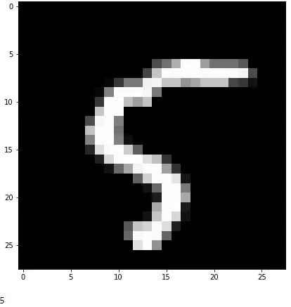
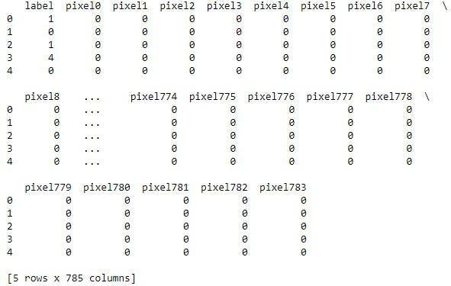
What is Curse of Dimensionality?
784 pixels(28 * 28) .
This is the first 5 data points

Slide 70
What is Curse of Dimensionality?
Increased Computational Complexity: High-dimensional data requires more computational resources. Training models to recognize objects in high-resolution images with millions of features can be computationally expensive and time-consuming.
Overfitting: In high-dimensional feature spaces, there's an increased risk of overfitting. A complex model can potentially fit noise in the data, making it perform well on the training set but poorly on unseen data.
To mitigate the curse of dimensionality, you might need to employ techniques to reduce the number of features while preserving essential information.
Feature Extraction
Dimensionality reduction (e.g., Principal Component Analysis, tSNE, LSA etc…)

Slide 71
How PCA Works ?
Its primary purpose is to reduce the number of features (dimensions) in a dataset while preserving as much of the original variance as possible. PCA does this by finding a new set of orthogonal axes, called principal components, along which the data varies the most.
Overview of how PCA works:
Data Preparation: Start with a dataset that has multiple features (dimensions).
Standardization: Standardize the data (mean = 0, standard deviation = 1) to ensure that variables with different scales do not dominate the analysis.
Covariance Matrix: Calculate the covariance matrix of the standardized data. The covariance matrix represents the relationships between features and helps identify the directions in which the data varies the most.

Slide 72
How PCA Works ?
Eigenvalues and Eigenvectors: Solve for the eigenvectors and eigenvalues of the covariance matrix. Eigenvectors represent the directions of maximum variance (principal components), and eigenvalues represent the amount of variance explained by each eigenvector.
Sort and Select: Sort the eigenvectors in descending order based on their corresponding eigenvalues. The eigenvector with the highest eigenvalue is the first principal component, the one with the second-highest eigenvalue is the second principal component, and so on.
Dimension Reduction: Decide how many principal components to keep. You can choose to keep all of them or select a subset that explains a significant portion of the variance. A common approach is to set a threshold (e.g., 95% of the total variance) and retain enough principal components to reach that threshold.
Create the Projection Matrix: Create a projection matrix that consists of the selected principal components as columns. This matrix is used to transform the data into the new lower-dimensional space.
Transform the Data: Multiply the original data by the projection matrix to obtain the new, lower-dimensional representation of the data. This step reduces the dimensionality of the data while preserving as much variance as possible.

Slide 73
How PCA Works ?
Transform the Data: Multiply the original data by the projection matrix to obtain the new, lower-dimensional representation of the data. This step reduces the dimensionality of the data while preserving as much variance as possible.

Slide 74
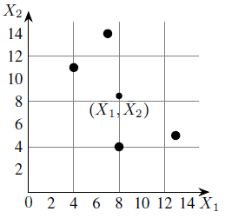

PCA Solved Example
Feature | Example 1 | Example 2 | Example 3 | Example 4
X₁ | 4 | 8 | 13 | 7
X₂ | 11 | 4 | 5 | 14
Step 1: Calculate Mean

Slide 75
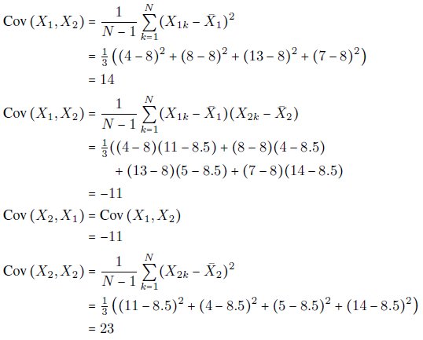
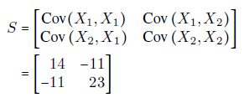
PCA Solved Example
Step 2: Calculation of the covariance matrix.
The covariance matrix is,
1

Slide 76
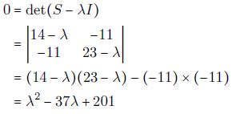

PCA Solved Example
Step 3: Eigenvalues of the covariance matrix.
The characteristic equation of the covariance matrix is,
Solving the characteristic equation we get,

Slide 77



PCA Solved Example
Step 4: Computation of the eigenvectors: To find the first principal components, we need to compute the eigenvector corresponding to the largest eigenvalue. In the present example, the largest eigenvalue is λ₁ and so we compute the eigenvector corresponding to λ₁.
The eigenvector corresponding to λ = λ1 is a vector
This is equivalent to the following two equations:

Slide 78


PCA Solved Example
This is equivalent to the following two equations:
where t is any real number. Taking t = 1, we get an eigenvector corresponding to λ1 as

Slide 79



PCA Solved Example
To find a unit eigenvector, we compute the length of X1 which is given by,
Therefore, a unit eigenvector corresponding to λ1 is
By carrying out similar computations, the unit eigenvector e2 corresponding to the eigenvalue λ= λ2 can be shown to be,

Slide 80




PCA Solved Example
Step 5: Computation of first principal components
be the k^{th} sample in the above Table (dataset). The first principal component of this example is given by (here “T” denotes the transpose of the matrix)
Calculated as follows:
For example, the first principal component corresponding to the first example

Slide 81
PCA Solved Example
The results of the calculations are summarized in the below Table.
X₁ | 4 | 8 | 13 | 7
X₂ | 11 | 4 | 5 | 14
First Principle Components | -4.3052 | 3.7361 | 5.6928 | -5.1238

Slide 82


PCA Solved Example
Step 6: Geometrical meaning of first principal components
Next, we drop perpendiculars from the given data points to the e1-axis (see below Figure).

Slide 83

PCA Solved Example

Slide 84
PCA Case Study
Case Study: Customer Satisfaction Survey
Let's imagine a retail company conducted a customer satisfaction survey with 1000 respondents. The survey included questions on five aspects of the shopping experience:
Product Quality
Price Fairness
Customer Service
Store Atmosphere
Checkout Speed

Slide 85
PCA Case Study
Step 1: Covariance Matrix: First, they calculate the covariance matrix for these five variables.
Step 2: Eigenvalue Calculation
Next, they calculate the eigenvalues of this covariance matrix. Let's say they get the following eigenvalues:
λ1 = 2.5
λ2 = 1.2
λ3 = 0.8
λ4 = 0.3
λ5 = 0.2

Slide 86
PCA Case Study
Step 3: Interpreting Eigenvalues
Here's how these eigenvalues help quantify the rank of principal components:
Variance Explained: Each eigenvalue represents the amount of variance explained by its corresponding principal component. Larger eigenvalues indicate more important components.
Proportion of Variance: We can calculate the proportion of total variance explained by each component: Total variance = 2.5 + 1.2 + 0.8 + 0.3 + 0.2 = 5
PC1 explains 2.5/5 = 50% of the variance
PC2 explains 1.2/5 = 24% of the variance
PC3 explains 0.8/5 = 16% of the variance
PC4 explains 0.3/5 = 6% of the variance
PC5 explains 0.2/5 = 4% of the variance
PC1 and PC2 together explain 74% of the variance
PC1, PC2, and PC3 together explain 90% of the variance

