Slide 1
IBM BOB AI INNOVATION HACKATHON 2026
Predict failures before the outage
GridAdvisor
TEAM SYNTAXX
Anshi Ladani | Aemi Patel | Suyanshi Patel | Drashti Patel
Track: AI · CHARUSAT
Power Outage Prediction & Grid Equipment Failure Advisor
An AI-powered operational intelligence platform for electricity utilities.
LIVE DEMO
grid-advisor-yipp.onrender.com
GRIDADVISOR / SYNTAXX

Slide 2
01 / PROBLEM
02
The grid problem
Failures are often discovered after they become outages.
THE OPPORTUNITY
Transformers and substations generate complex health signals.
Move from reactive maintenance to predictive, prioritised action before equipment fails.
Sensor, weather, and incident data is difficult to analyse together.
Manual inspection does not clearly show what must be fixed first.
One failure can interrupt service for thousands of customers.
GRIDADVISOR / SYNTAXX

Slide 3
02 / SOLUTION
03
One risk picture for every asset
GridAdvisor turns raw grid signals into a clear action plan.
COLLECT
SCORE
PRIORITISE
ACT
Temperature, vibration, partial discharge, oil quality, load, weather, and incidents.
A transparent composite risk formula produces a 0–100 score.
Assets and zones are ranked from Critical to Low using risk and grid impact.
Maintenance deadlines, crew assignments, and Bob AI explanations.
Result: operators know where to act, why it matters, and what to do next.
GRIDADVISOR / SYNTAXX

Slide 4
03 / ARCHITECTURE
04
How the platform works
DATA
FASTAPI
INTELLIGENCE
BOB AI
Synthetic sensor readings
Weather forecasts
Incident history
REST JSON API
Data access
Decision services
Risk scorer
Asset ranker
Maintenance + crew engines
Operational briefing
Asset explanation
watsonx.ai Granite
↓
↓
↓
React + TypeScript dashboard → risk table → zone map → action tabs
SQLite today | PostgreSQL-ready | Docker + Render deployment
GRIDADVISOR / SYNTAXX

Slide 5
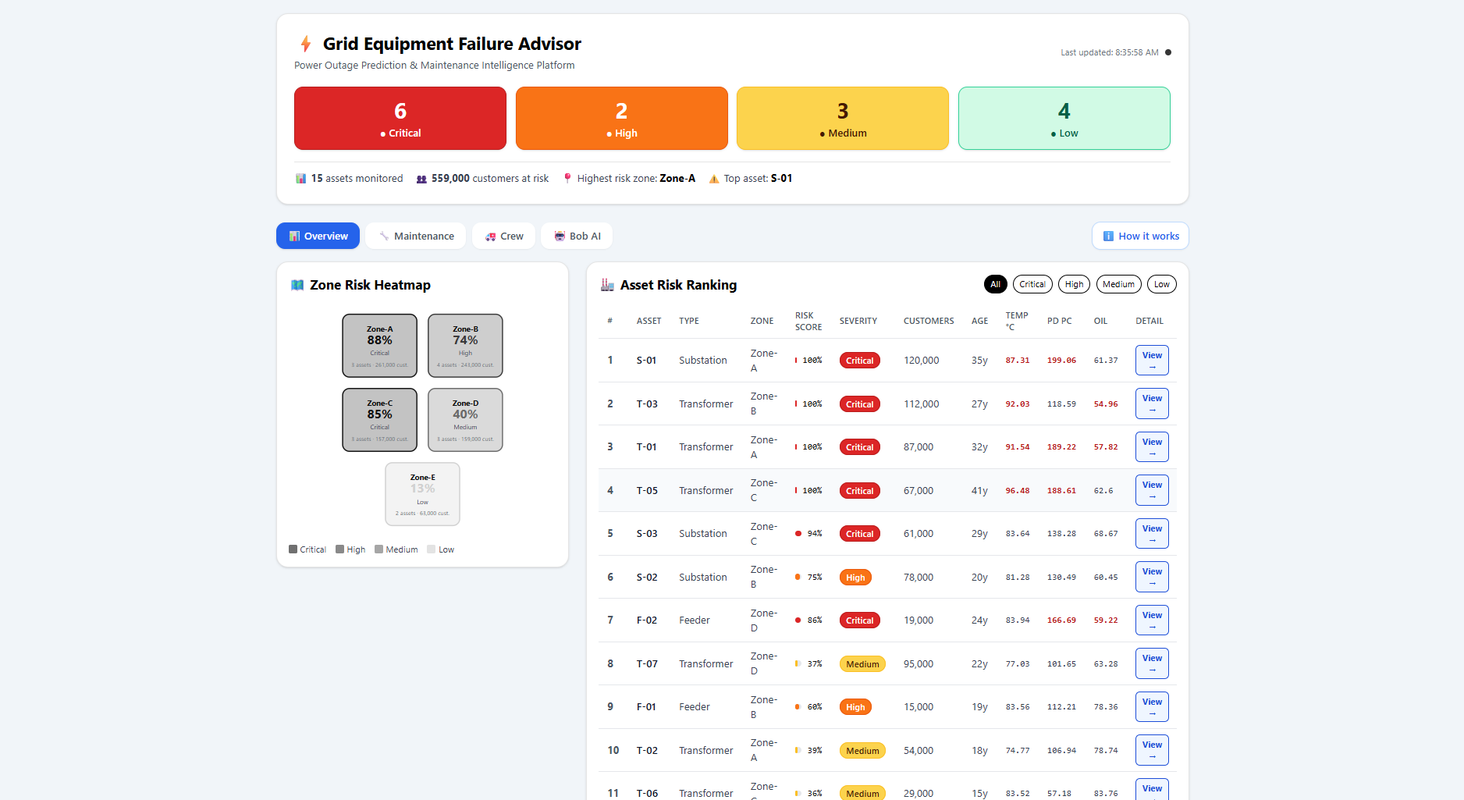
04 / PRODUCT
05
The operator dashboard
AT A GLANCE
• Risk summary by severity
• Zone risk heatmap
• Ranked assets
• Filter by severity
• View asset-level sensors
The interface is designed for fast operational decisions, not raw data exploration.
GRIDADVISOR / SYNTAXX

Slide 6
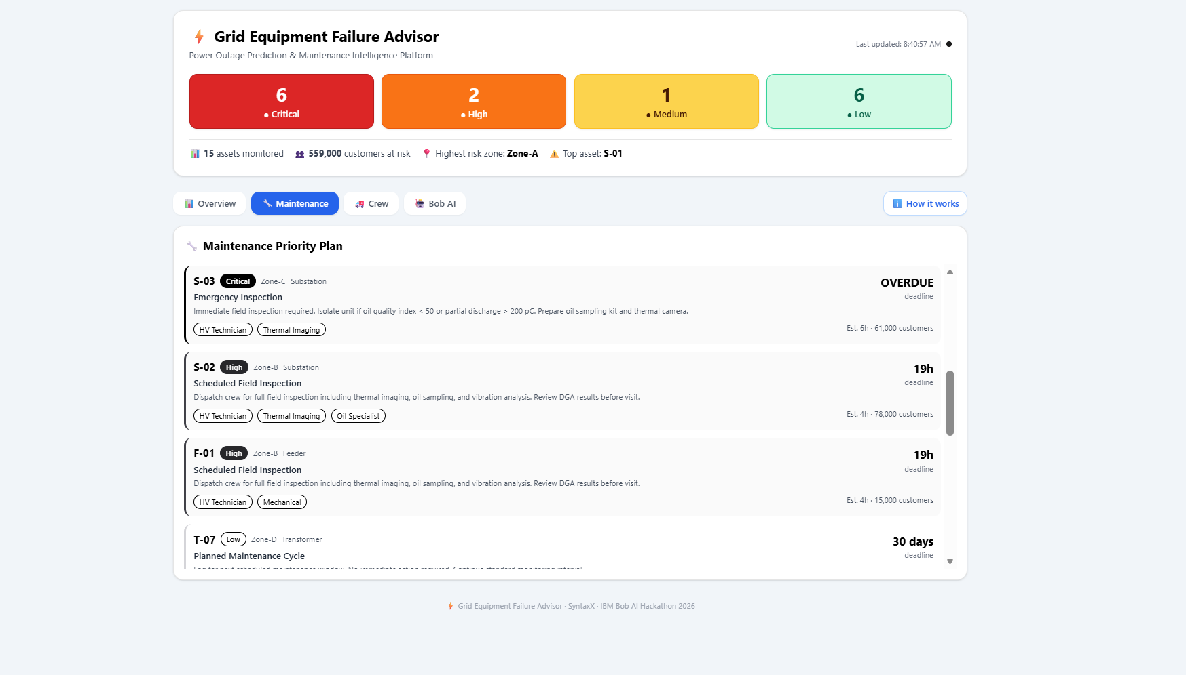
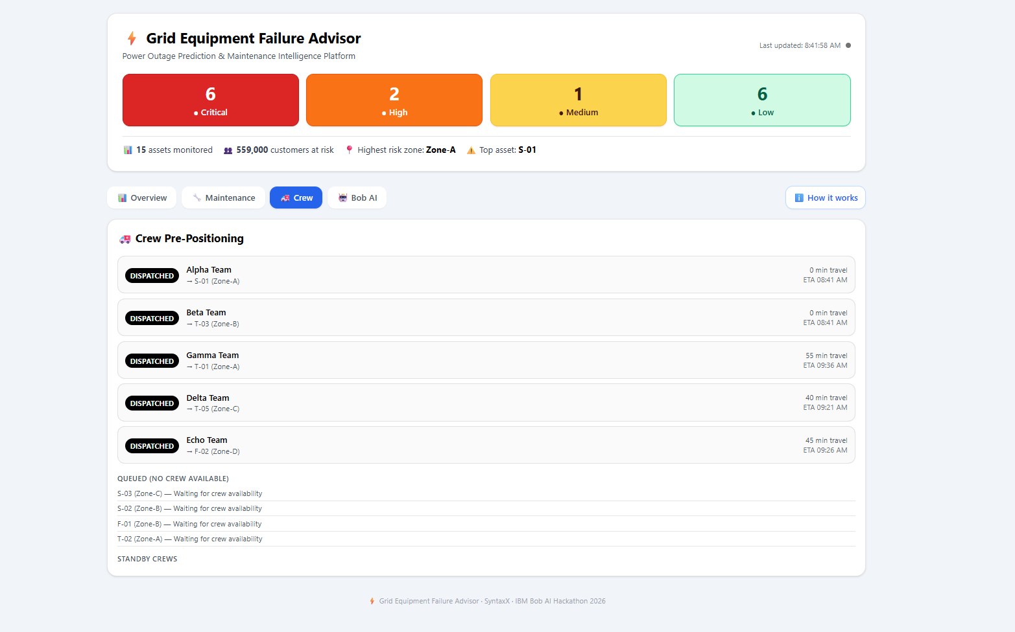
05 / OPERATIONS
06
From risk score to field action
1 SENSOR DETAIL
2 MAINTENANCE PLAN
3 CREW POSITIONING
Click View to inspect seven days of temperature, vibration, partial discharge, and oil quality trends.
Every risky asset gets an action, deadline, skills, duration, and customer impact.
Crews are matched by skill and proximity to reduce response time.
GRIDADVISOR / SYNTAXX

Slide 7
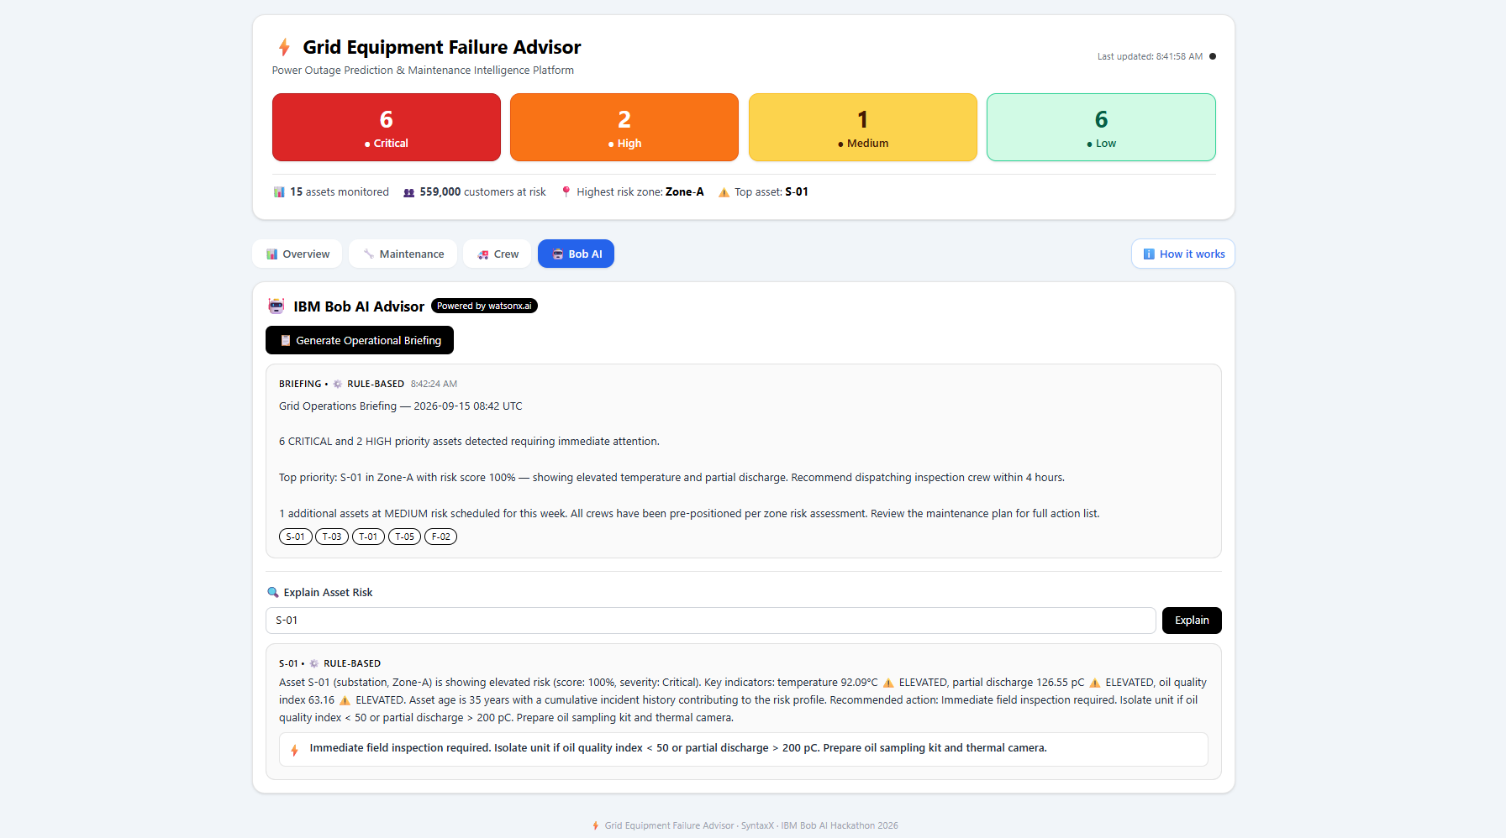
06 / IBM TECHNOLOGY
07
IBM Bob makes risk understandable
WHAT BOB ADDS
• Plain-English operational briefing
• Per-asset risk explanation
• Recommended next action
• watsonx.ai Granite integration
• Rule-based fallback when credentials are unavailable
From technical signals to a decision an operator can act on in seconds.
GRIDADVISOR / SYNTAXX

Slide 8
07 / IMPACT
08
Predict earlier. Respond faster.
VALUE
PROTOTYPE SCALE
TEAM SYNTAXX
Earlier failure detection
Faster maintenance decisions
Better crew utilisation
Reduced outage response time
More customers protected
15 grid assets
5 monitored zones
Multiple sensor types
Critical → Low ranking
Live Render deployment
Anshi Ladani — Team Lead
Aemi Patel — Engineer
Suyanshi Patel — Engineer
Drashti Patel — Engineer
Thank you
Live demo: https://grid-advisor-yipp.onrender.com
GRIDADVISOR / SYNTAXX

