Slide 1

Payment Pattern Analysis and Rental Efficiency Tracking
A Business Data Management Capstone Project on Power Tech Project Associates
Name: Udghosh Rao
Email: 24f2000612@ds.study.iitm.ac.in
Roll No: (24f2000612)
Date: 22.Sept.2025

Slide 2
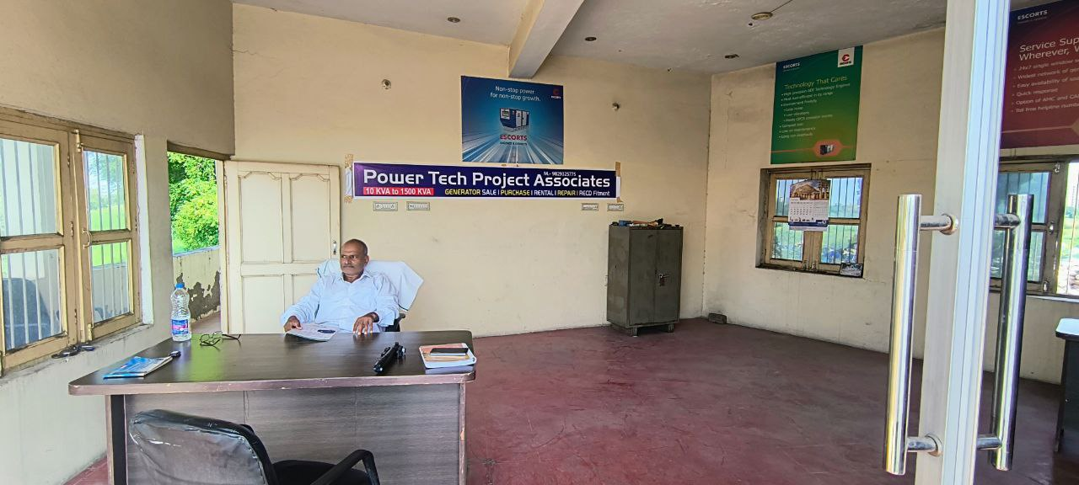
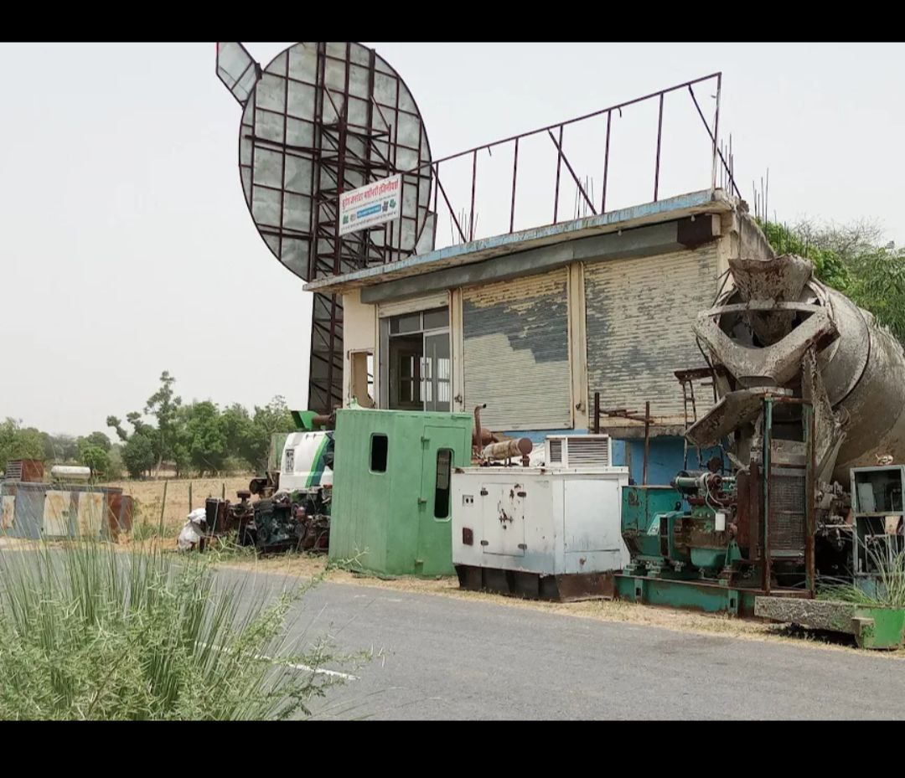
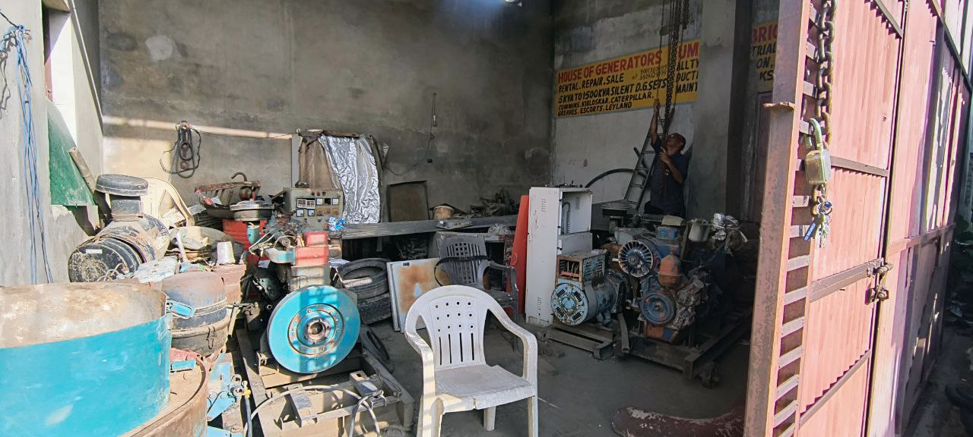
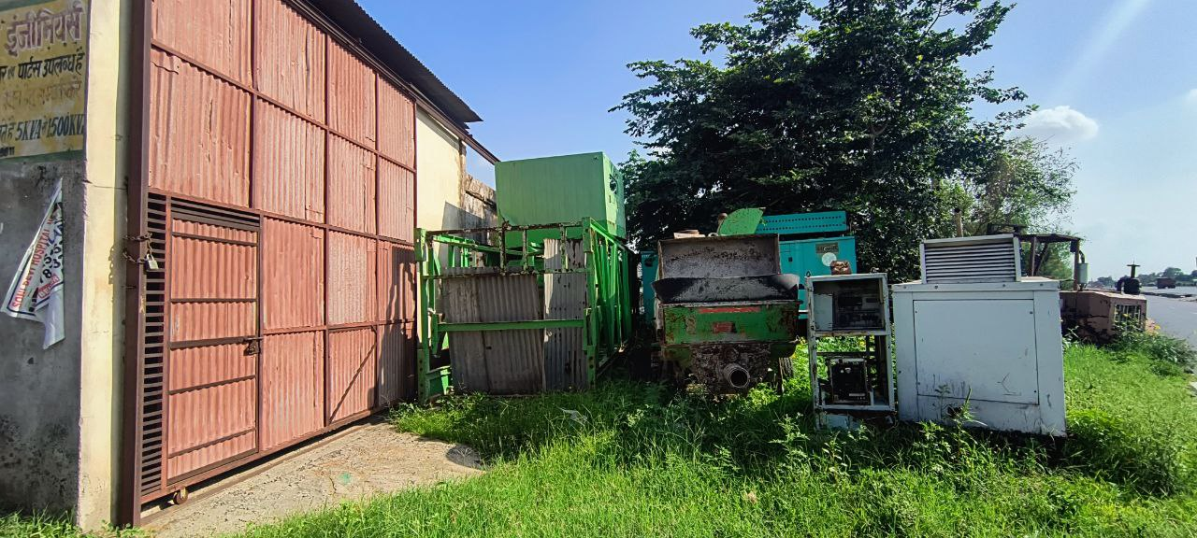
Organizational Background
Business: Power Tech Project Associates (B2B)
Location: Neemrana, Rajasthan
Core Services:
Generator Sales – 5KVA to 1000KVA generators
Generator Rentals – daily/weekly rentals to industries & events
Repairs & Maintenance – servicing, spare parts, and breakdown support
Revenue Model:
Sales: High value, but delayed payments
Rentals: Small revenue share, underutilized
Repairs: Steady, low value, mostly on-time payments

Slide 3
Problem, Data & Methodology
Problem (P):
Delayed payments in generators sales
Underutilization of rental generators
Overdependence on a few clients → business risk
Data (D):
Period: Jan–May 2025
50 transactions across sales, rentals, repairs
Parameters: Entry Date, Customer, Service Type, Item, Amount, Payment Status, Payment Delay
Methodology (M):
Tool: Excel
Descriptive Statistics: Mean, Median, Std. Deviation, Correlation
Visualization: Pie charts, Bar charts, Line charts
Cleaning: Removed symbols, standardized dates, checked duplicates

Slide 4
Metadata & Descriptive Statistics
Transactions: 50
Revenue Range: ₹650 – ₹4,75,650
Mean Transaction Value: ₹95,848
Median: ₹10,805
Standard Deviation: ₹1,39,866 → very high variability
Avg. Payment Delay: 3.2 days (max = 15 days)
👉 Interpretation: Most revenue comes from a few high-value sales. Small repairs are frequent but contribute little.

Slide 5
Data Cleaning Process
Step 1: Converted dates → standard format (DD-MM-YYYY)
Step 2: Checked for duplicates → none found
Step 3: Verified outliers (high-value sales are genuine, not errors)
Step 4: Final dataset: 50 clean records ready for analysis

Slide 6
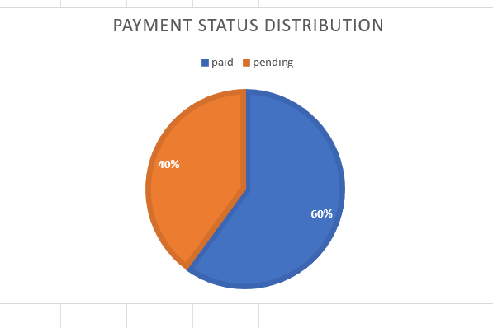
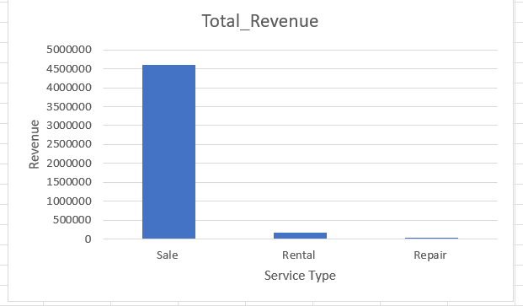
Payment Patterns (Graphs)
Graph 1 – Payment Status Distribution
Paid: 60%
Pending: 40% (₹18.3 Lakhs )
Graph 2 – Service Type Revenue Split
Sales = 96% of revenue
Rentals = 3%
Repairs = <1%
📝 Insights:
High cash flow instability: nearly 40% of business value stuck in receivables.
Sales dominate revenue, but also bring the highest delays →
creates financial stress
Repairs, though small, are most reliable (fastest collection).
💡 Business Impact:
Pending receivables above 30% are considered risky by SMEs.
Here, it’s 40%, far exceeding safe limits.

Slide 7
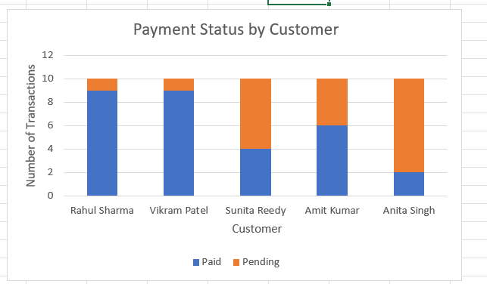
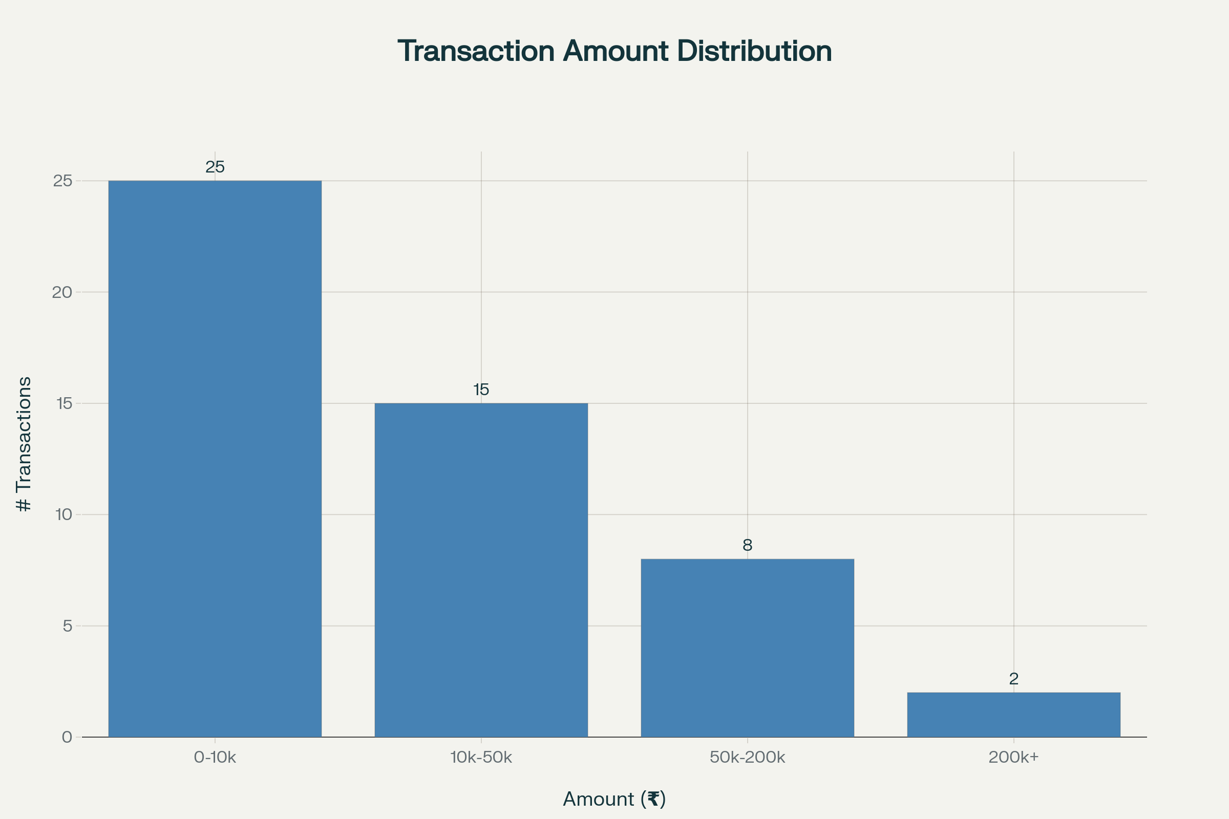
Customer Performance (Graphs)
📊 Graph 3 – Customer-wise Paid vs Pending
Rahul Sharma (90%) & Vikram Patel (90%) = reliable
Anita Singh (20%) & Sunita Reddy (40%) = risky
Amit Kumar = medium risk (60%)
📊 Graph 4 – Transaction Value Distribution
Repairs (₹650–₹3,500) = nearly 100% cleared immediately.
High-value sales (>₹2 lakhs) = most stuck pending.
📝 Insights:
Customer concentration: only 5 clients = high vulnerability.
Two clients (Sunita & Anita) alone cause 60% of pending dues.
Risk categories: Low, Medium, High, Very High → credit limits needed.
💡 Business Impact:
One default can wipe out nearly 25–30% of company’s total cash inflow.

Slide 8
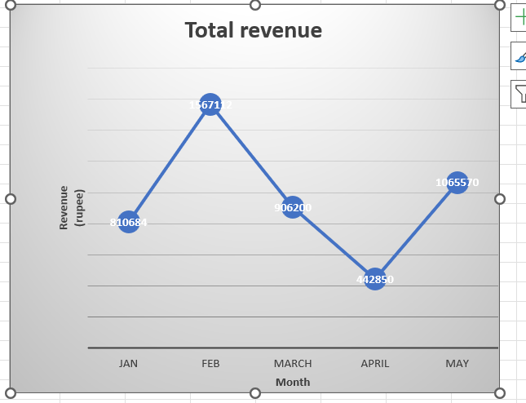
📊 Slide Title: Monthly Revenue Trend (Jan–May 2025)
Graph: Line chart showing revenue per month
Key Points (write on slide):
Revenue peaked in Feb (₹15.6 lakhs)
Lowest revenue in April (₹4.4 lakhs)
May recovered with ₹10.6 lakhs
Clear fluctuation in sales demand
👉 Insight: Seasonal/irregular demand creates unstable cash flow;
April dip shows risk of dependency on a few deals.

Slide 9
Insights & Recommendations
🔑 Key Insights:
40% of revenue pending → unstable cash flow.
High dependency on 2 risky clients.
Rental fleet severely underutilized.
📌 Recommendations:
Payment Policy: Tiered advance collection:
  ₹3 lakhs → 60% advance
  ₹1–3 lakhs → 25–40% advance
  <₹1 lakh → normal terms.
Client Diversification: Target new industries (factories, construction, events). Aim for 10 new clients in 12 months.
Rental Boost:
  Launch monthly rental packages with discounts.
  Loyalty program → free day after 10 rentals.
  Aggressive promotion to industrial & event markets.
Monitoring: Track DSO (Days Sales Outstanding) every month to ensure collection improves from 3.2 days avg. to <2 days.

Slide 10
Conclusion
Total Revenue (Jan–May 2025): ₹47.9 Lakhs
Pending Payments: ₹18.3 Lakhs
Rental Share: Only 3.4% → huge scope for growth
Final Message:
By enforcing stricter payment policies, diversifying clients, and expanding rentals,
Power Tech Project Associates can achieve stable cash flow and long-term growth.

Slide 11
Thank You
Contact: 24f2000612@ds.study.iitm.ac.in
Udghosh Rao

