Slide 1
DEEP LEARNING / CA-2
ImageLab AI
HORSE
PHOTOS
CYCLEGAN
G_AB
ZEBRA
STYLE
Image-to-Image Translation Studio
CycleGAN · Horse → Zebra
Course: Deep Learning and GEN AI (CS312B)
Team: [Member names and roll numbers]
Section: [Section]
Pretrained generator · PyTorch · CPU/CUDA
01
Notes:
Replace the team, roll number, and section fields before submitting. The horse sample photo is CC0: https://commons.wikimedia.org/wiki/File:Horse_in_a_pen.jpg

Slide 2
Problem and motivation
Translate visual style while keeping the scene structure recognizable
The challenge
Collecting aligned horse and zebra versions of the same scene is difficult. CycleGAN learns from two unpaired image collections instead.
DOMAIN A
Horse photographs
DOMAIN B
Zebra photographs
↔
Two independent collections; no matched image pairs are required.
Project objective
Build a runnable studio that accepts an image, runs a real pretrained generator, displays the result, and explains the model’s limits.
ImageLab AI · CA-2 · CS312B
02
Notes:
The included sample photos are independent domain examples, not a paired dataset. Horse image: https://commons.wikimedia.org/wiki/File:Horse_in_a_pen.jpg. Zebra image: https://commons.wikimedia.org/wiki/File:Zebra_at_the_zoo.jpg

Slide 3
CycleGAN system architecture
Two generators translate in opposite directions; two discriminators judge domain realism
Real horse
A
Generator
G_AB
Fake zebra
B′
Generator
G_BA
Cycle output
horse A′
Cycle consistency: G_BA(G_AB(A)) ≈ A
Discriminator D_B
real vs fake zebra patches
Discriminator D_A
real vs fake horse patches
The live app loads one generator for the selected direction. Local training includes both generators and both discriminators.
ImageLab AI · CA-2 · CS312B
03
Notes:
Architecture follows the CycleGAN paper and the official PyTorch implementation. Zhu et al., ICCV 2017: https://arxiv.org/abs/1703.10593. Code: https://github.com/junyanz/pytorch-CycleGAN-and-pix2pix

Slide 4
Dataset and preprocessing
Unpaired horse and zebra collections; no one-to-one image matching
Training data
Preprocessing
Horse2Zebra dataset from the original CycleGAN project
trainA / testA: horse images
trainB / testB: zebra images
The optional downloader fetches the archive only when training is requested.
1 EXIF orientation correction
2 Convert to RGB
3 Resize to 256 × 256
4 Convert pixels to tensors
5 Normalize RGB channels to [−1, 1]
6 Run generator; map tanh output back to RGB
Dataset download: ≈111 MB
Demo samples: <1 MB total
ImageLab AI · CA-2 · CS312B
04
Notes:
Dataset archive: https://efrosgans.eecs.berkeley.edu/cyclegan/datasets/horse2zebra.zip. Official implementation preprocessing uses RGB, resize to 256 square at test time, tensor conversion and 0.5 normalization.

Slide 5
Generator architecture and learning objectives
ResNet generator for translation; PatchGAN discriminators for local realism
Input
3 × 256 × 256
Encode
7 × 7 conv
2 downsample blocks
Transform
9 residual blocks
Decode
2 upsample blocks
Output
3 × 256 × 256
tanh → [−1, 1]
Loss terms used in optional local training
Adversarial · translated patches should resemble the target domain
Cycle · λ = 10; translate there and back to preserve input structure
Identity · λ = 5; discourage unnecessary changes on target-domain images
ImageLab AI · CA-2 · CS312B
05
Notes:
Official pretrained architecture: 9-block ResNet generator, 64 base channels, instance normalization and tanh output. Pix2Pix is paired and typically uses a U-Net plus PatchGAN; it is described for comparison but no Pix2Pix checkpoint is shipped.

Slide 6
Implementation and training plan
A ready pretrained inference path plus an optional, reproducible training path
Live demo
Optional training
Official Berkeley pretrained weights
Loaded once and cached in Streamlit
torch.inference_mode()
CPU fallback; CUDA selected automatically
Strict state-dict key/shape validation
200 epochs · batch size 1 · 256 px
Adam · learning rate 0.0002 · β₁ = 0.5
LSGAN + cycle loss + identity loss
50-image replay pool
CSV loss log and direction-specific weights
This application uses pretrained weights; it does not claim to have trained them.
ImageLab AI · CA-2 · CS312B
06
Notes:
Pretrained checkpoints are hosted at https://efrosgans.eecs.berkeley.edu/cyclegan/pretrained_models/ . The original repo provides PyTorch implementations; upstream code is BSD 3-Clause. Checkpoint archive does not provide a separate model-card license.

Slide 7
ImageLab AI application
Streamlit interface for the complete input → inference → result flow
Home
Translate
Gallery
Project purpose and model overview
Upload → compare → download output
Load small CC0 demo photos
Evaluation and theory
Model details
Shows the generated example and timing. MAE/PSNR appear only for a spatially aligned target.
Framework, input size, device, checkpoint source, and pretrained/trained status.
Run: python -m streamlit run app.py
ImageLab AI · CA-2 · CS312B
07

Slide 8
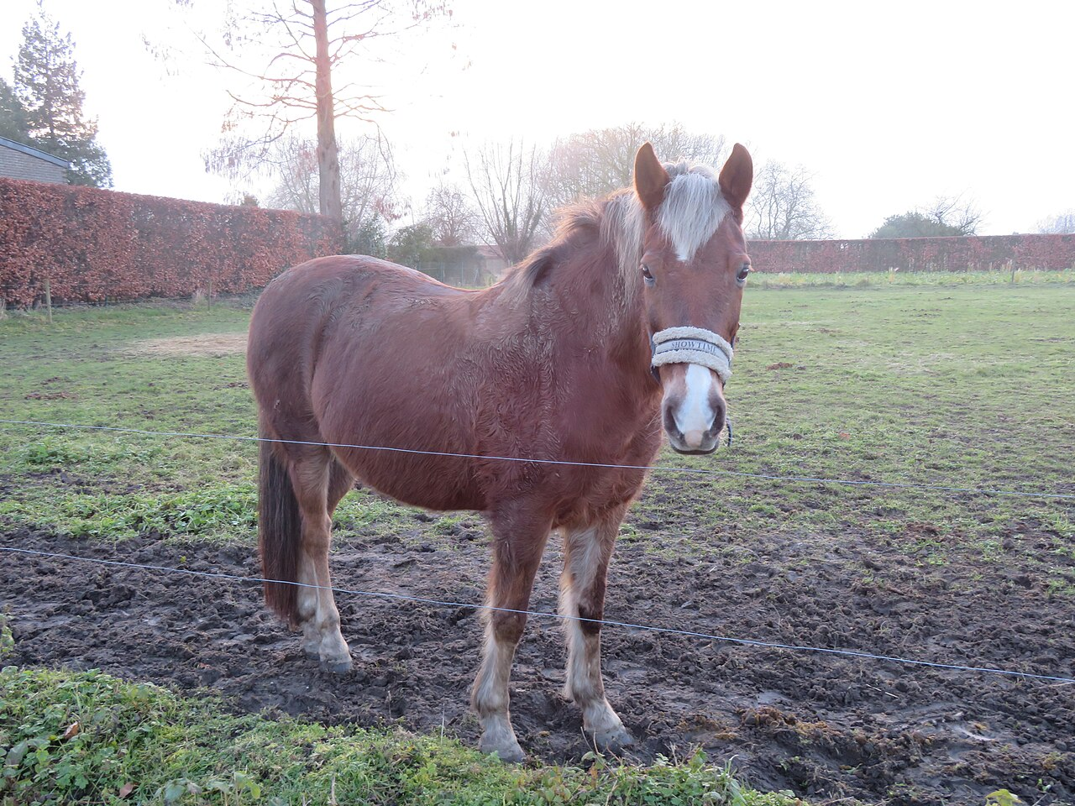
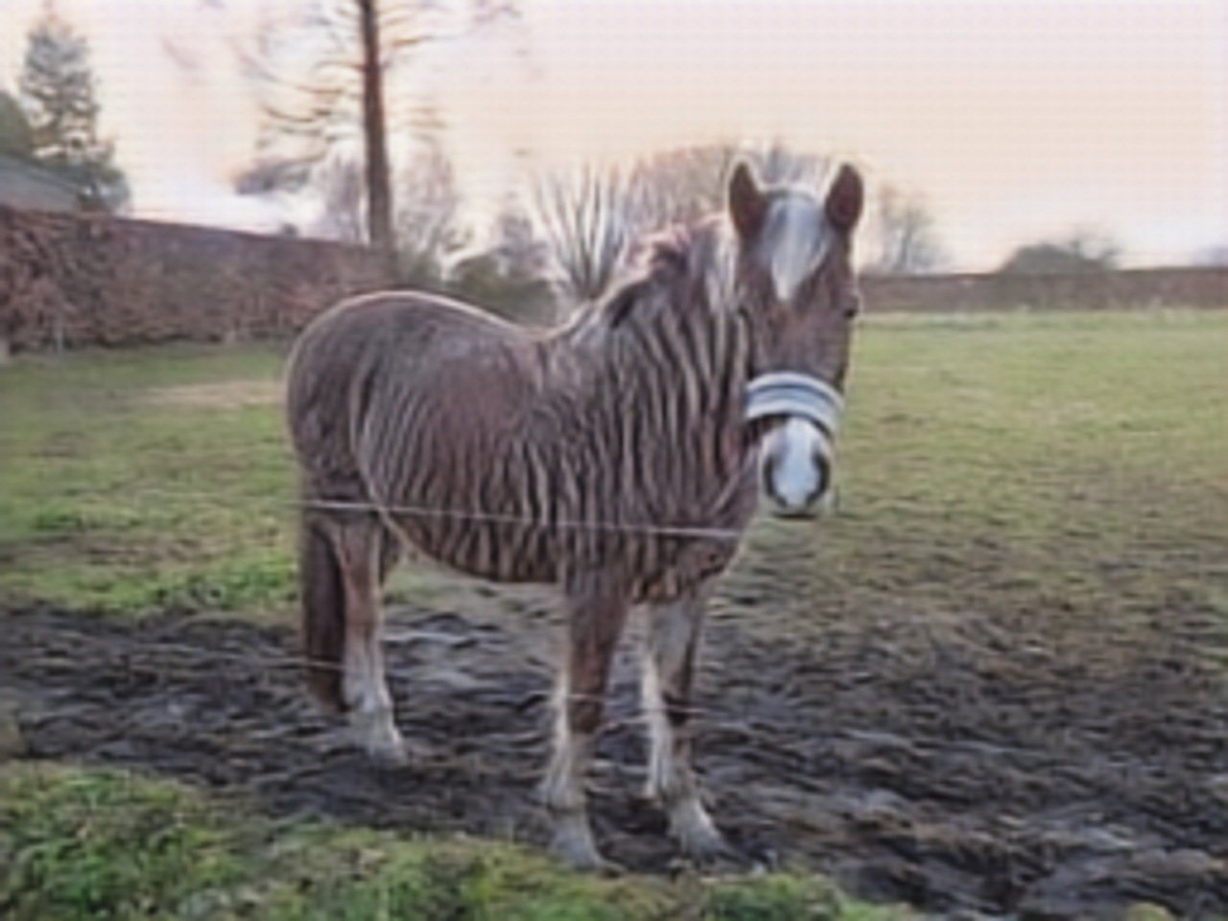
Actual sample inference
Official pretrained Horse → Zebra generator · CPU inference
INPUT · Horse in a pen.jpg · CC0
OUTPUT · pretrained CycleGAN
Inference: 0.632 s · input/output: 1280 × 960 · generator input: 256 × 256
Single qualitative example; no aligned target was used, so MAE/PSNR are not reported.
ImageLab AI · CA-2 · CS312B
08
Notes:
This sample was generated on CPU using the official Berkeley pretrained checkpoint in this project, from a CC0 image by Jojovavasasa: https://commons.wikimedia.org/wiki/File:Horse_in_a_pen.jpg. The measured generator inference time was 0.632 seconds. One example does not prove general accuracy.

Slide 9
Limitations, risks, and responsible use
A learned translation is an image synthesis result, not ground truth
Model limits
Responsible presentation
Can add artifacts or alter details
May fail on unusual subjects or framing
Training domain limits generalization
No segmentation guarantee
Label generated images clearly
Do not present outputs as documentary evidence
Respect source-image rights
Review bias and misuse risks
The model is intended here for an educational demonstration.
ImageLab AI · CA-2 · CS312B
09

Slide 10
Repository and viva walkthrough
Project files include the runnable app, model code, training option, and documentation
Start the application
Explain in the viva
1 Create and activate a Python 3.11 virtual environment
2 Install requirements.txt
3 Download the official checkpoint
4 Run Streamlit and open localhost:8501
Why unpaired data needs cycle consistency
Two generators and two discriminators
Difference between pretrained inference and local training
Why MAE/PSNR need aligned targets
Source package: imagelab-ai-source.zip · README.md contains setup, citations, dataset notes, and troubleshooting.
Before Moodle submission: replace team fields and paste the public GitHub/Drive share URL.
ImageLab AI · CA-2 · CS312B
10

