Slide 1
DIGITAL PORTFOLIO
STUDENT NAME:YESPAL R
REGISTER NUMBER:212402458/24H314
NM ID:1943C9237A5EEBFAF73453A00E51CA97
Department: BCA
College: college/university: Am jain college

Slide 2
AGENDA
Problem Statement
Project Overview
End Users
Tools and Technologies
Portfolio design and Layout
Features and Functionality
Results and Screenshots 8.Conclusion
9.Github Link

Slide 3
PROBLEM STATEMENT
Many students lack a simple, professional way to showcase their skills, projects, and certificates in one place.

Slide 4
PROJECT OVERVIEW
This project is a personal portfolio website built with HTML, CSS. It provides details about education, skills, certificates, and contact information.

Slide 5
END USERS
• Recruiters
• Hiring Managers
• College Faculty
• Peers & Tech Community

Slide 6
TOOLS & TECHNOLOGIES
• HTML
• CSS
• JavaScript (optional future expansion)
• Email form (mailto)
• Hosting platforms like GitHub Pages/Netlify
Visual Studio Code /Codepen(FOR over view)
Technologies :GitHub (Version Control System)

Slide 7
PORTFOLIO DESIGN & LAYOUTS
• Clean and modern UI
• Navigation bar with smooth access
• Sections: About, Skills, Certificates, Contact
• Responsive grid layout for skills and certificates

Slide 8
FEATURES & FUNCTIONALITY
• Personal information section
• Skills and certificates showcase
• Contact form (mail integration)
• Responsive design

Slide 9
RESULTS & SCREENSHOTS
The portfolio successfully demonstrates skills, certificates, and personal branding.
(Screenshots of webpage can be inserted here.)

Slide 10
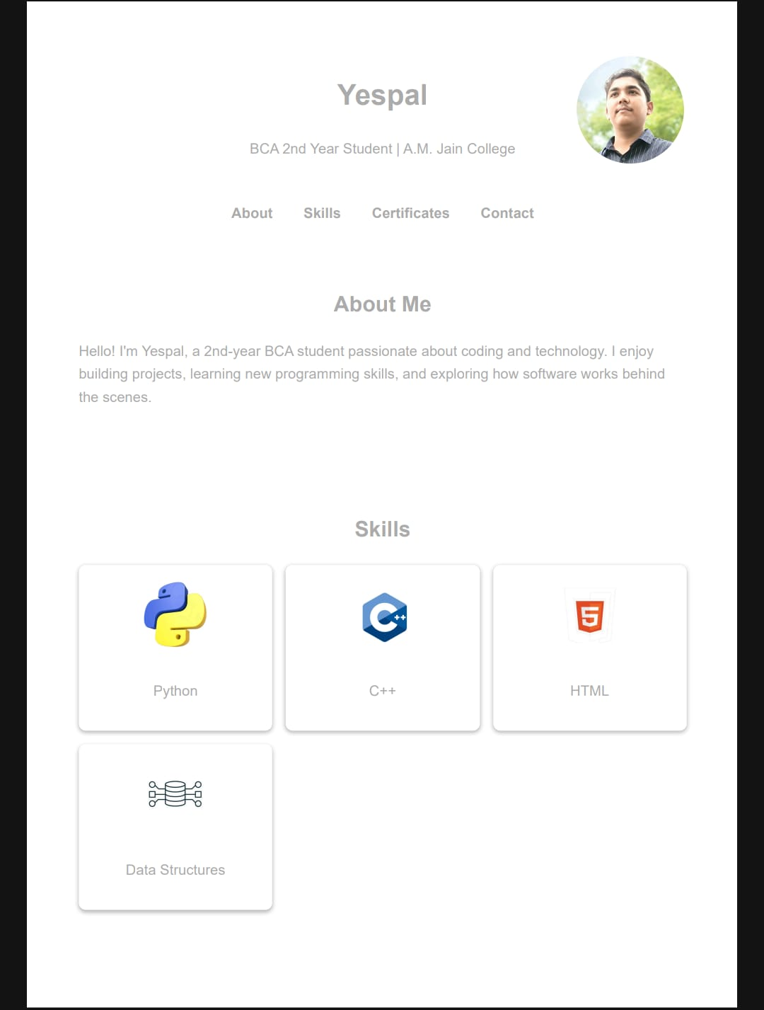
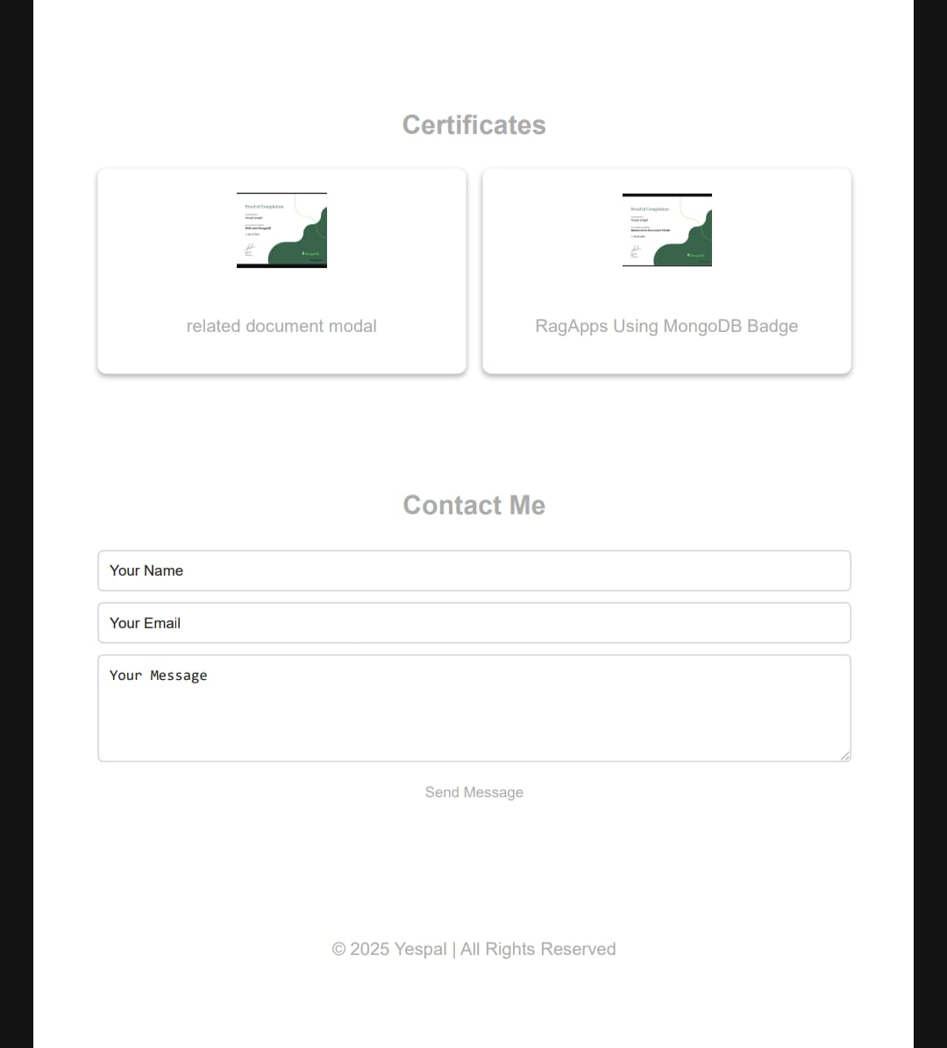
OUTPUT

Slide 11
CONCLUSION
This portfolio helps in personal branding and career opportunities. It acts as a digital resume and showcase of skills.

Slide 12
GITHUB LINK
GitHub Repository:https://github.com/yespal10062006/ my-server.git

