Slide 1

GOVERNMENT POLYTECHNIC
GONDIA
Restaurant Food Ordering System
(REFORDS)
UNDER THE GUIDENCE OF
Mr. D.K.Chouriwar
PRESENTED BY
Vaibhav Nandgaye Karan Rajbhar
Prashun Shukla Shivam Jambhulkar

Slide 2
Introduction
This project that had developed was given name as Restaurant Food Ordering System where short form is REFORDS.
The main function is to get orders from customer and send to kitchen department so more easy to manage customers in their restaurants. Generally this system perform tasks such as add, delete, search, update, data manipulation and more.

Slide 3
What is the reason to make REFORDS?
There are few problems or can be said weekness identified in the current manual food ordering system in restaurant.
Also today food ordering online is very common like foodpanda, fassos, pizza hut etc . But this might be different technology to order food as well in restaurant.
We are in the age of digitalization, everything is becoming on web.

Slide 4
Matter of time….
We are using VB.net software and SQL server database.
Almost 40% of our job work is done.
There are also lots of work have to be done.
All thing that have today will change at the time of deployment..

Slide 5
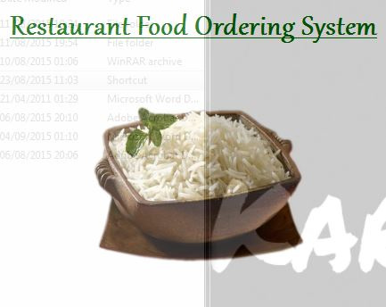
How it will work?
Work as other software in our computer.

Slide 6
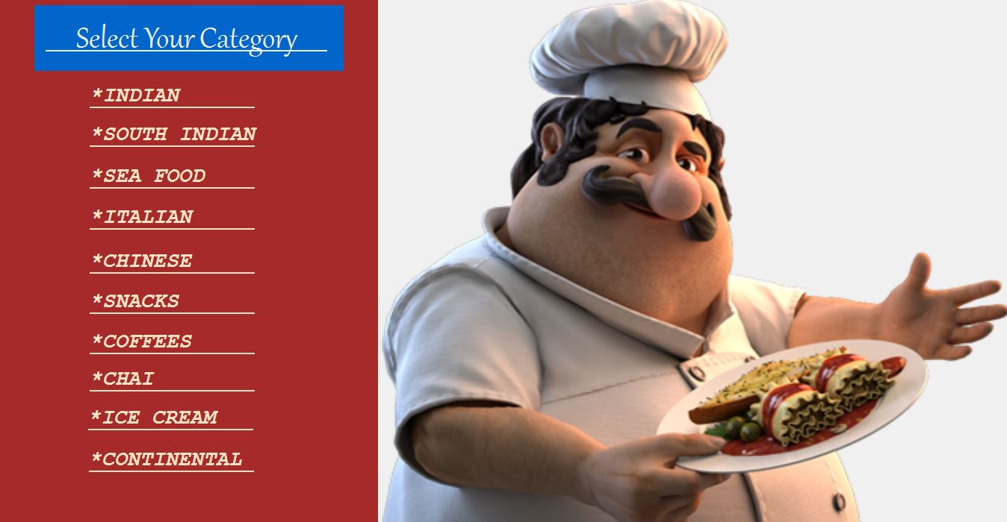
Have numbers of food menu…what you want

Slide 7
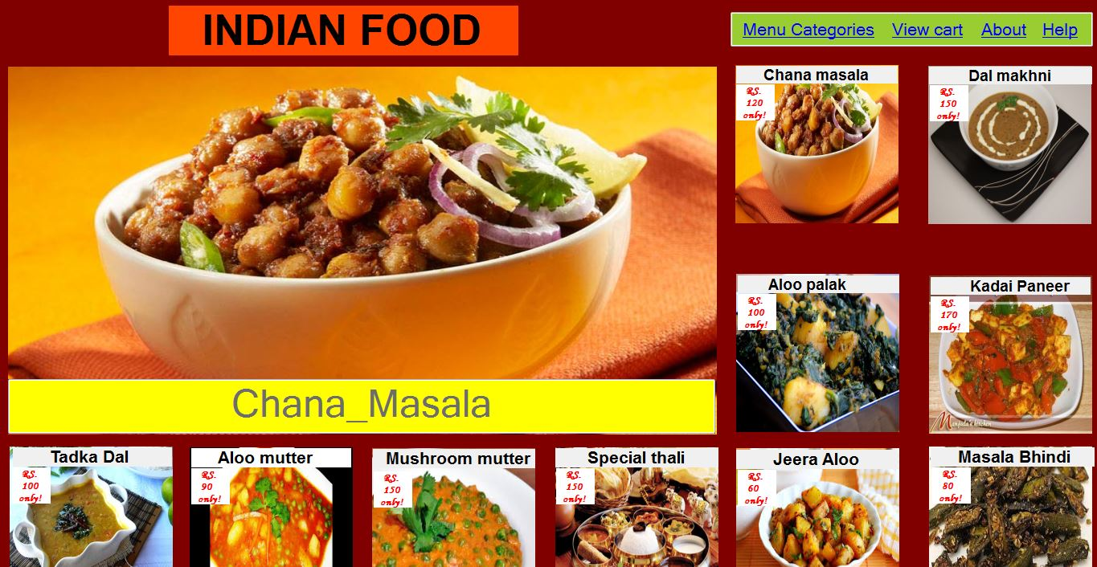
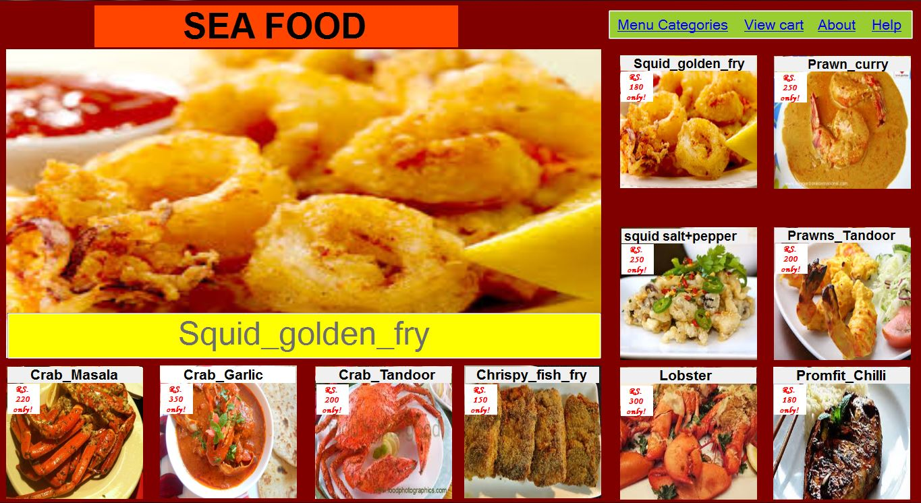
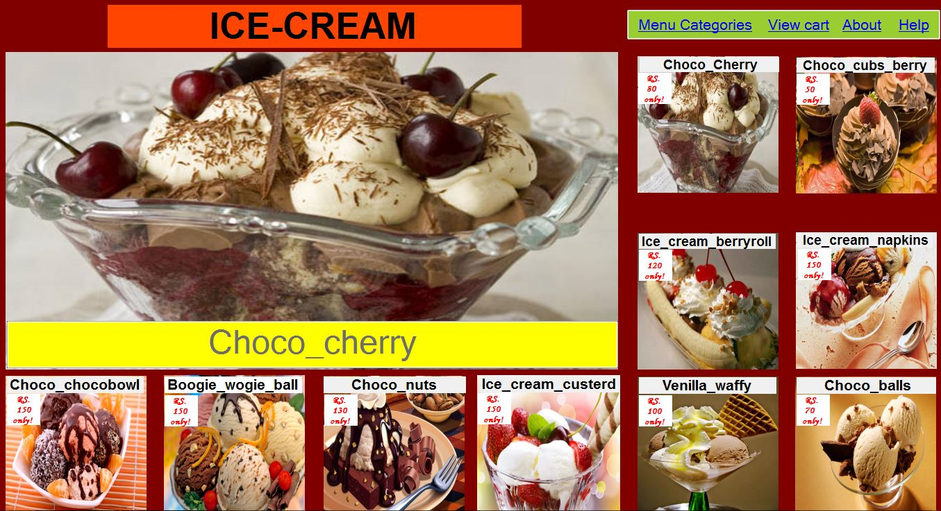
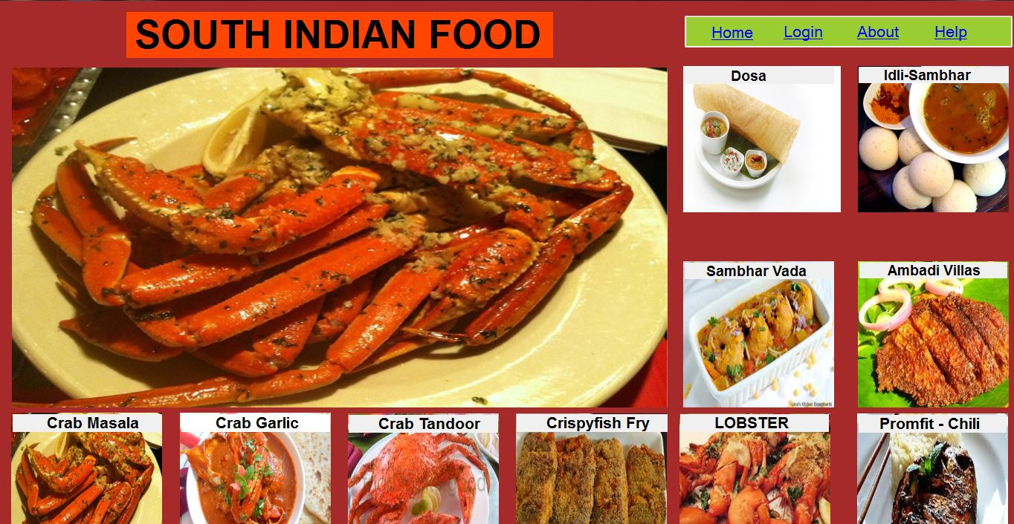
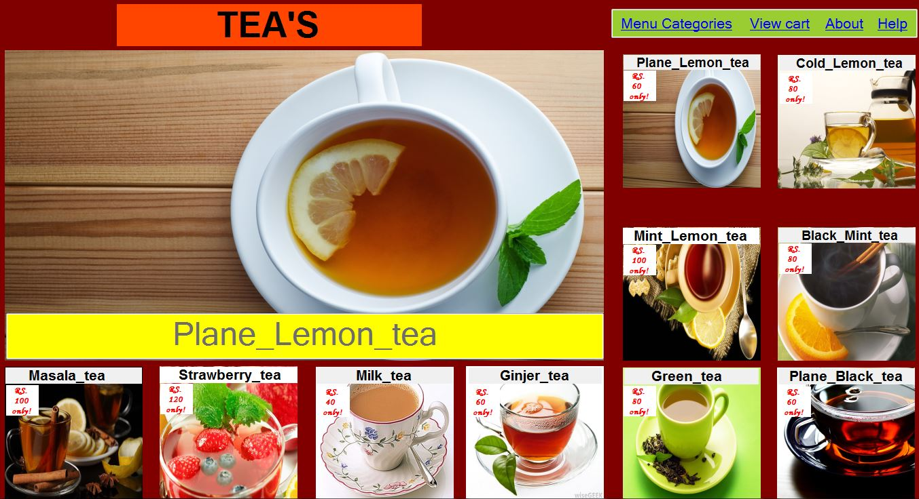
What we got!!!!

Slide 8
And much more….

Slide 9
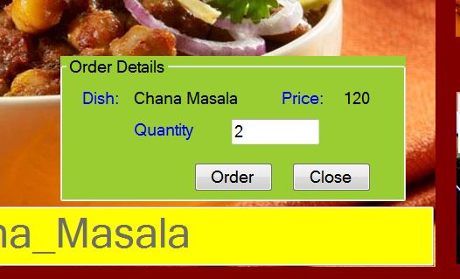


Slide 10
Get added to cart..

Slide 11
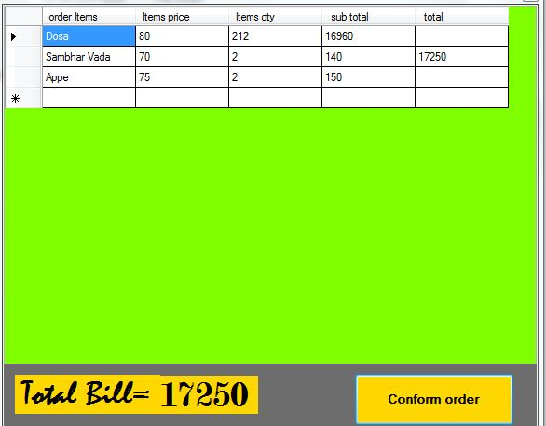
All orders with there details…

Slide 12
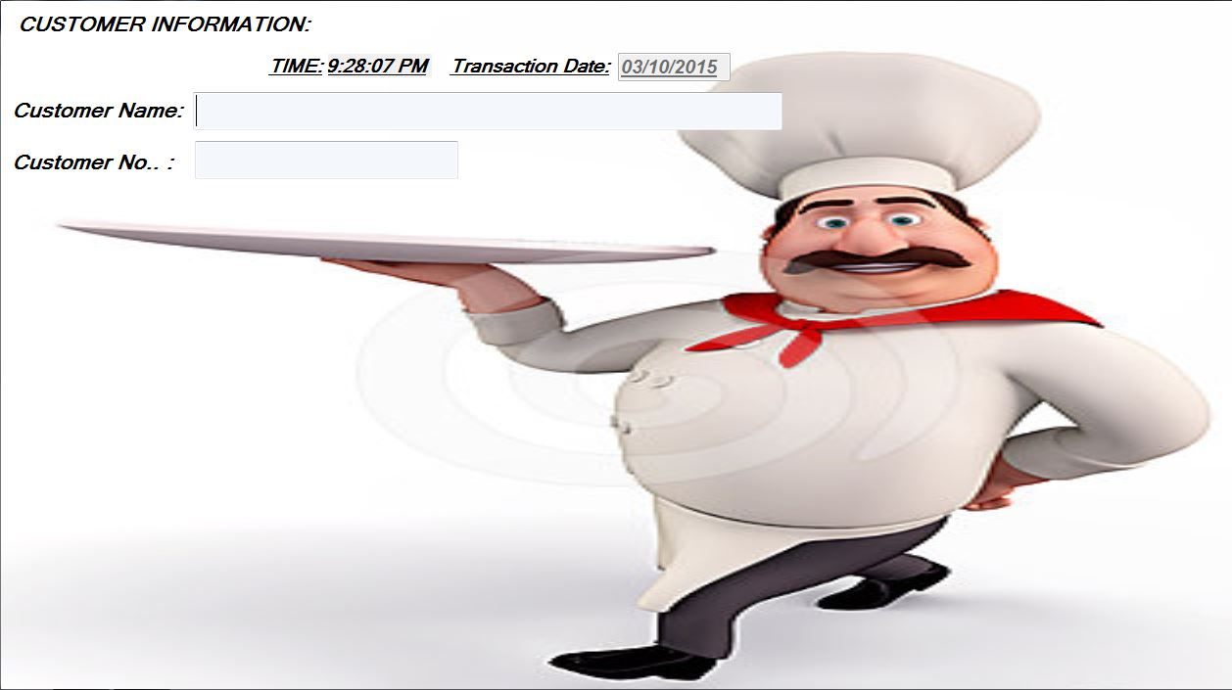
All formalities…

Slide 13
What next..
Connect it with a data base so that we can keep track of any dish that is popular and more ordered by users.
Using new technologies to make it faster, effective and reliable.
Making it user friendly so that many people can use it.
User log in system for premium facilities.

Slide 14
And much more…
Home delivery or cash on delivery option for premium users.
Updateable menus system so that new dishes can be added further in future.
Can be embedded for androids, or other operating systems.

Slide 15
Thank you

