Slide 1
REGISTER TRANSFER AND MICROOPERATIONS
• Register Transfer Language
• Register Transfer
• Bus and Memory Transfers
• Arithmetic Microoperations
• Logic Microoperations
• Shift Microoperations
• Arithmetic Logic Shift Unit

Slide 2
Digital Computer System
A digital system is an interconnection of digital hardware modules that accomplish a specific information-processing task.
The modules are constructed from such digital components as –
  registers, decoders, multiplexers
  arithmetic elements, and
  control logic.
The various modules are interconnected with common data and control paths to form a digital computer system.

Slide 3
Registers
A register is a group of flip-flop with each flip-flop capable of storing one bit of information.
An n-bit register has a group of n flip-flop and is capable of storing any binary information of n bits.
In addition to the flip-flops, a register may have combinational gates that perform certain data-processing tasks.
Various types of registers are available commercially.
The transfer of new information into a register is referred to as loading the register.

Slide 4
MICROOPERATIONS
Register Transfer Language
The operations that are performed on the data stored in registers are called micro-operations.
The result of the micro-operation may replace the previous binary information of a register or may be transferred to another register.
The functions built into registers are examples of micro-operations like
  Shift
  Load
  Clear
  Increment
  …

Slide 5
MICROOPERATION Contd..
Register Transfer Language
Microoperation is an elementary operation performed (during one clock pulse), on the information stored in one or more registers
Registers
(R)
ALU
(f)
1 clock cycle
R ← f(R, R)
f: shift, load, clear, increment, add, subtract, complement,
and, or, xor, …

Slide 6
ORGANIZATION OF A DIGITAL SYSTEM
Register Transfer Language
Definition of the (internal) organization of a computer:- The internal hardware organization of a digital computer is best defines by specifying:
The Set of registers it contains and their functions
Micro-operations set , the sequence of
micro-operation performed on binary information
stored in the registers. (Set of allowable microoperations provided by the organization of the computer)
-The Control signals that initiate the sequence
of microoperations (to perform the functions)

Slide 7
REGISTER TRANSFER LEVEL
Register Transfer Language
Viewing a computer, or any digital system, in this way is called the register transfer level.
This is because we’re focusing on
  The system’s registers
  The data transformations in them, and
  The data transfers between them.
  The term “register transfer” implies the availability of hardware logic circuits that can perform the stated microoperation and transfer the result of the operation to the same or another register.

Slide 8
REGISTER TRANSFER LANGUAGE (RTL)
Register Transfer Language
Rather than specifying a digital system in words, a specific notation is used named register transfer language
For any function of the computer, the register transfer language can be used to describe the (sequence of) microoperations
Register transfer language is:
  A symbolic language
  A convenient tool for describing the internal organization of digital computers
  Can also be used to facilitate the design process of digital systems.
(The symbolic notation used to describe the micro-operation transfers among registers is called a register transfer language)

Slide 9
DESIGNATION OF REGISTERS
Register Transfer Language
Registers are designated by capital letters, sometimes followed by numbers (e.g., A, R13, IR)
Often the names indicate function:
  MAR - memory address register
  PC - program counter
  IR - instruction register
Registers and their contents can be viewed and represented in various ways
  A register can be viewed as a single entity:
  Registers may also be represented showing the bits of data they contain
Register R
MAR
1 0 1 0 0 0 1 1

Slide 10
DESIGNATION OF REGISTERS
Register Transfer Language
Designation of a register
- a register
- portion of a register
- a bit of a register
Common ways of drawing the block diagram of a register
Register
Showing individual bits
R1
7 6 5 4 3 2 1 0
15
0
15
8
7
0
R2
PC(H)
PC(L)
Numbering of bits
Subfields
0-7 are low byte , and 8-15 are high bit

Slide 11
REGISTER TRANSFER
Register Transfer
Information transfer (the contents) of one register to another is a register transfer.
A register transfer is indicated as
  R2 ← R1
  In this case the contents of register R1 are copied (loaded) into register R2.
  A simultaneous transfer of all bits from the source R1 to the destination register R2, during one clock pulse. (If more than 1 bit, then there will be a parallel communication)
  Note that this is a non-destructive; i.e. the contents of R1 are not altered by copying (loading) them to R2 (the content of the R1 does not change after the transfer).
  - ← Known as replacement operator.

Slide 12
REGISTER TRANSFER
Register Transfer
A register transfer such as
  R3 ← R5
  Implies that the digital system has
  the data lines from the source register (R5) to the destination register (R3)
  Parallel load capacity in the destination register R3)
  Control lines to perform the action

Slide 13
CONTROL FUNCTIONS
Register Transfer
Normally, we want the transfer to occur only under a predetermined control condition. Often actions need to only occur if a certain condition is true.
This is similar to an “if” statement in a programming language.
like ---- If (P= 1) then (R1 ← R2)
In digital systems, this is often done via a control signal, called a control function generated by control section. (P is a Boolean variable equal 0 or 1)
  If the signal is 1, the action takes place
This is represented as: P: R2 ← R1
  Which means “if P = 1, then load the contents of register R1 into register R2”, i.e., if (P = 1) then (R2 ← R1)

Slide 14
HARDWARE IMPLEMENTATION OF CONTROLLED TRANSFERS
Register Transfer
Implementation of controlled transfer
P: R2 ← R1
Registers are assumed to use positive-edge-triggered flip-flops.
P is activated in the control section by rising edge of a clock pulse at time t.
Control
Circuit
P
Load
R2
Clock
n
R1
Block diagram
t
t+1
Clock
Load
Transfer occurs here
Timing diagram
The next positive transition of the clock at time t+1 finds the load input active and the data inputs of R2 are then loaded into the register in parallel. P may go back to 0 at time t+1, (transfer will occur with every clock pulse while P remains active).

Slide 15
SIMULTANEOUS OPERATIONS
Register Transfer
If two or more operations occur simultaneously, they are separated with commas:
  P: R3 ← R5, MAR ← IR
Here, if the control function P = 1, load the contents of R5 into R3, and at the same time (clock), load the contents of register IR into register MAR.

Slide 16
BASIC SYMBOLS FOR REGISTER TRANSFERS
Register Transfer
Symbols
Description Examples
Capital letters Denotes a register MAR, R2
& numerals
Parentheses () Denotes a part of a register R2(0-7), R2(L)
Arrow ← Denotes transfer of information R2 ← R1
Colon : Denotes termination of control function P:
Comma , Separates two micro-operations A ← B, R1 ← R2

Slide 17
CONNECTING REGISTRS
Register Transfer
In a digital system with many registers, it is impractical to have data and control lines to directly allow each register to be loaded with the contents of every possible other registers.
To completely connect n registers → n(n-1) lines are required
O(n²) cost.

Slide 18
CONNECTING REGISTRS
Register Transfer
This is not a realistic approach to use in a large digital system. Instead, take a different approach.
Have one centralized set of circuits for data transfer – the bus.
Have control circuits to select which register is the source, and which is the destination.

Slide 19
BUS AND MEMORY TRANSFERS
Bus and Memory Transfers
Bus is a path (of a group of wires) over which information is transferred, from any of several sources to any of several destinations.
From a register to bus:
BUS ← R
Register A
Register B
Register C
Register D
X Y Register Select
0 0 A
0 1 B
1 0 C
1 1 D
Bus lines
Register A
Register B
Register C
Register D
1
2
3
4
1
2
3
4
1
2
3
4
1
2
3
4
B
C
D
B
C
D
B
C
D
B
C
D
1
1
1
2
2
2
3
3
3
4
4
4
n bits = n MUX
Size of MUX = k x 1
(k is the no of registers)
Select lines will be depend of the k (2^{s} = k) s = no of select lines
4 x1
4 x1
4 x1
4 x1
MUX1
MUX2
MUX3
MUX4
x
select
y
4-line Common bus

Slide 20
One way of constructing a common bus system is with multiplexers. The multiplexers select the source register whose binary information is then placed on the bus.
MUX 0 multiplexes the four 0 bits of the registers, MUX 1 multiplexes the four 1 bits of the registers, and similarly for the other two bits.
When S1S0 = 00, the 0 data inputs of all four multiplexers are selected and applied to the outputs that form the bus.
This causes the bus lines to receive the content of register A since the outputs of this register are connected to the 0 data inputs of the multiplexers.
In general, a bus system will multiplex k registers of n bits each to produce an n-line common bus. The number of multiplexers needed to construct the bus is equal to n , the number of bits in each register. The size of each multiplexer must be k x 1 since it multiplexes k data lines.

Slide 21
TRANSFER FROM BUS TO A DESTINATION REGISTER
Bus and Memory Transfers
Bus lines
R1 ← BUS
BUS ← C
R1 ← BUS
Means R1 ← C
Reg. R0
Reg. R1
Reg. R2
Reg. R3
Load
D
D
D
D
z
0
1
2
3
E (enable)
Select
w
2 x 4
Decoder
Three-State Bus Buffers: The bus system can be constructed with three
state gates instead of multiplexers. Two states are signals equivalent to logic
1 and 0. The third state is high-impedance state.
Normal input A
Output Y=A if C=1
High-impedance if C=0
Control input C
Bus line with three-state buffers
Bus line for bit 0
A0
B0
C0
D0
S0
0
Select
2X4 Decoder
S1
1
2
Enable
3

Slide 22
The transfer of information from a bus into one of many destination registers can be accomplished by connecting the bus lines to the inputs of all destination registers and activating the load control of the particular destination register selected.
The content of register C is placed on the bus, and the content of the bus is loaded into register R1 by activating its load control input. If the bus is known to exist in the system, it may be convenient just to show the direct transfer. R1 ← C
From this statement the designer knows which control signals must be activated to produce the transfer through the bus.

Slide 23
BUS TRANSFER IN RTL
Bus and Memory Transfers
Depending on whether the bus is to be mentioned explicitly or not, register transfer can be indicated as either
or
In the former case the bus is implicit, but in the latter, it is explicitly indicated
R2 ← R1
BUS ← R1
R2 ← BUS

Slide 24
MEMORY (RAM)
Bus and Memory Transfers
Memory (RAM) can be thought as a sequential circuits containing some number of registers.
These registers hold the words of memory.
Each of the r registers is indicated by an address.
These addresses range from 0 to r-1
Each register (word) can hold n bits of data.
Assume the RAM contains r = 2^{k} words n bit each. It needs the following:
  n data input lines
  n data output lines
  k address lines
  A Read control line
  A Write control line
  (128 x 8 RAM : 8 data input/output
  lines, 7 bit address lines for 128 words/registers)
data input lines
n
address lines
k
RAM
unit
Read
Write
n
data output lines

Slide 25
MEMORY TRANSFER
Bus and Memory Transfers
Collectively, the memory is viewed at the register level as a device, M.
Since it contains multiple locations, we must specify which address in memory we will be using.
This is done by indexing memory references.
Memory is usually accessed in computer systems by putting the desired address in a special register, the Memory Address Register (MAR, or AR).
When memory is accessed, the contents of the MAR get sent to the memory unit’s address lines
M
Memory
unit
Read
AR
Write
Memory Address Lines
Data out
Data in

Slide 26
MEMORY READ
Bus and Memory Transfers
To read a value from a location in memory and load it into a register, the register transfer language notation looks like this:
or R1 ← M[AR]
This causes the following to occur--
  The contents of the MAR/AR get sent to the memory address lines.
  A Read (= 1) gets sent to the memory unit.
  The contents of the specified address are put on the memory’s output data lines.
  These get sent over the bus to be loaded into register R1.
R1 ← M[MAR]

Slide 27
MEMORY WRITE
Bus and Memory Transfers
To write a value from a register to a location in memory looks like this in register transfer language:
or M[AR] ← R1
This causes the following to occur
  The contents of the MAR/AR get sent to the memory address lines.
  A Write (= 1) gets sent to the memory unit.
  The values in register R1 get sent over the bus to the data input lines of the memory.
  The values get loaded into the specified address in the memory.
M[MAR] ← R1

Slide 28
SUMMARY OF R. TRANSFER MICROOPERATIONS
Bus and Memory Transfers
A ← B Transfer content of reg. B into reg. A
AR ← DR(AD) Transfer content of AD portion of reg. DR into reg. AR
A ← constant Transfer a binary constant into reg. A
ABUS ← R1, Transfer content of R1 into bus A and, at the same time,
R2 ← ABUS transfer content of bus A into R2
MAR/AR Memory Address Register
DR Data register
M[R] Memory word specified by reg. R
M Equivalent to M[AR]
DR ← M Memory read operation: transfers content of
memory word specified by AR into DR
M ← DR Memory write operation: transfers content of
DR into memory word specified by AR

Slide 29
MICROOPERATIONS
Arithmetic Microoperations
Computer system microoperations are of four types:
- Register transfer microoperations
- Arithmetic microoperations
- Logic microoperations
- Shift microoperations

Slide 30
ARITHMETIC MICROOPERATIONS
Arithmetic Microoperations
The basic arithmetic microoperations are
  Addition
  Subtraction
  Increment
  Decrement
Typical Arithmetic Micro-Operations
  R3 ← R1 + R2 Contents of R1 plus R2 transferred to R3
  R3 ← R1 - R2 Contents of R1 minus R2 transferred to R3
  R2 ← R2’ Complement the contents of R2
  R2 ← R2’+ 1 2's complement the contents of R2
  R3 ← R1 + R2’+ 1 Subtraction
  R1 ← R1 + 1 Increment
  R1 ← R1 - 1 Decrement

Slide 31
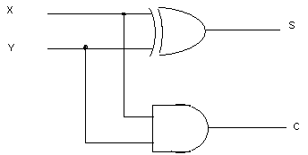
HALF Adder
A combinational circuit that performs the arithmetic addition of two bits is called a half-adder . One that performs the addition of three bits (two significant bits and a previous carry) is called a full-adder. Two half adder are needed to implement a full adder.
HALF ADDER: The input variables x and y represents the two significant bits to be added. The output variables the sum and carry.
The Boolean function can be obtained directly from the truth table : S = x’y + xy’ = x y
C = xy
X Y C S
0 0 0 0
0 1 0 1
0 0 1
1 1 1 0

Slide 32
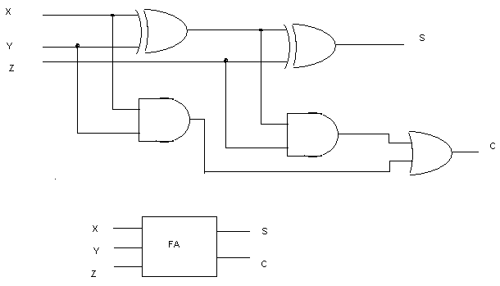
FULL Adder
It consists of three inputs and two outputs . Two of the inputs variables, denoted by x and y, represents the two significant bits to be added . The third input z represents the carry from the previous lower significant bit position. The two Boolean expression for the full adder :
S = x y z
C = xy + (x y )z
x y z c s
0 0 0 0 0
0 0 1 0 1
0 1 0 0 1
0 1 1 1 0
0 0 0 1
1 0 1 1 0
1 1 0 1 0
1 1 1 1 1

Slide 33
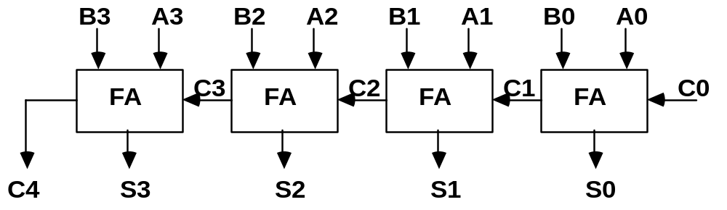
BINARY ADDER
Arithmetic Microoperations
Binary Adder
(4 bit binary adder)

Slide 34
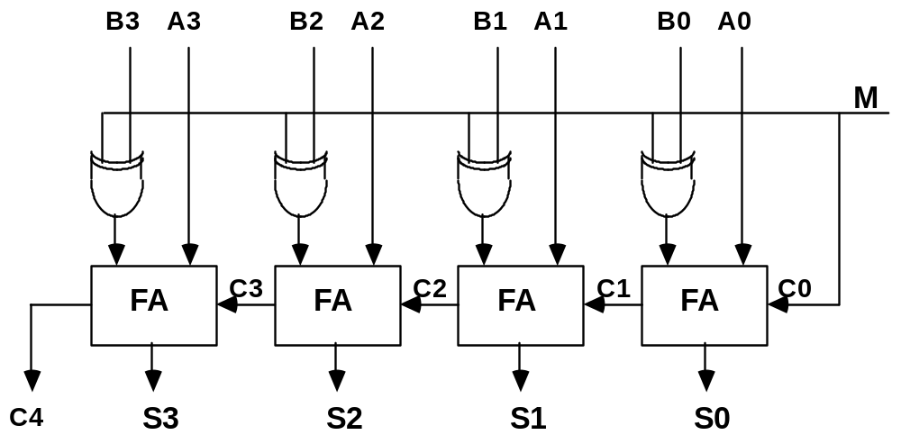
BINARY ADDER / SUBTRACTOR
Arithmetic Microoperations
Binary Adder-Subtractor
When M =0 , then B 0 =B, When M = 1 then we have B 1 = B’ and carry C0 = 1
Mode input
M=0 adder
M=1
subtractor

Slide 35
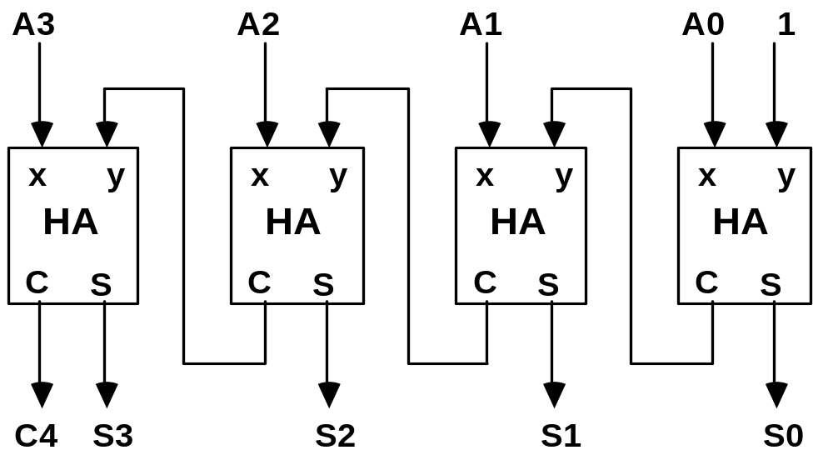
BINARY INCREMENTER
Arithmetic Microoperations
Binary Incrementer

Slide 36
ARITHMETIC CIRCUIT
Arithmetic Microoperations
Cin
S1
S0
A0
X0
C0
S1
FA
D0
B0
S0
4x1
Y0
C1
0
1
MUX
2
3
Output can be calculated from
D = A + Y + Cin
A1
X1
C1
S1
FA
D1
B1
S0
4x1
Y1
C2
0
1
MUX
2
3
A2
X2
C2
S1
FA
D2
B2
S0
4x1
Y2
C3
0
1
MUX
2
3
A3
X3
C3
S1
FA
D3
B3
S0
4x1
Y3
C4
0
1
MUX
2
Cout
0
1
3
S1 S0 Cin Y Output Microoperation
0 0 0 B D = A + B Add
0 0 1 B D = A + B + 1 Add with carry
0 1 0 B’ D = A + B’ Subtract with borrow
0 1 1 B’ D = A + B’+ 1 Subtract
1 0 0 0 D = A Transfer A
1 0 1 0 D = A + 1 Increment A
1 1 0 1 D = A - 1 Decrement A
1 1 1 1 D = A Transfer A

Slide 37
Arithmetic Circuit
It has four full-adder circuits that constitute the 4-bit adder and four multiplexers for choosing different operations.
There are two 4-bit inputs A and B and a 4-bit output D.
The four inputs from A go directly to the X inputs of the binary adder.
Each of the four inputs from B are connected to the data inputs of the multiplexers.
The multiplexers data inputs also receive the complement of B .
The other two data inputs are connected to logic-0 and logic-1 . Logic-0 i s a fixed voltage value (0 volts for TTL integrated circuits) and the logic-1 signal can be generated through· an inverter whose input is 0.
The four multiplexers are controlled by two selection inputs, S1 and S0. The input carry goes to the carry input of the FA in the least significant position.
The other carries are connected from one stage to the next.
By controlling the value of Y with the two selection inputs S1 and S0 and making Cin equal to 0 or 1, it is possible to generate the eight arithmetic microoperations.
When S1So = 11, all 1' s are inserted into the Y inputs of the adder to produce the decrement operation D = A - 1 when Cin = 0. This is because a number with all 1's is equal to the 2's complement of 1 (the 2's complement of binary 0001 is 1111). Adding a number A to the 2's complement of 1 produces F = A + 2's complement of 1 = A - 1.
When Cin = 1, then D = A - 1 + 1 = A, which causes a direct transfer from input A to output D.

Slide 38
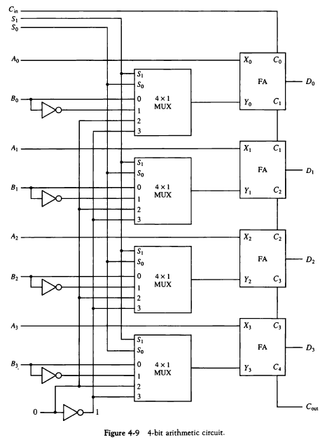
ARITHMETIC CIRCUIT
Arithmetic Microoperations

Slide 39
LOGIC MICROOPERATIONS
Logic Microoperations
Specify binary operations on the strings of bits in registers
  Logic microoperations are bit-wise operations, i.e., they work on the individual bits of data
  useful for bit manipulations on binary data
  useful for making logical decisions based on the bit value
There are, in principle, 16 different logic functions that can be defined over two binary input variables
However, most systems only implement four of these
  AND (∧), OR (∨), XOR (⊕), Complement/NOT
The others can be created from combination of these
A B F₀ F₁ F₂ … F₁₃ F₁₄ F₁₅
0 0 0 0 0 … 1 1 1
0 1 0 0 0 … 1 1 1
1 0 0 0 1 … 0 1 1
1 1 0 1 0 … 1 0 1

Slide 40
LIST OF LOGIC MICROOPERATIONS
Logic Microoperations
List of Logic Microoperations
- 16 different logic operations with 2 binary vars.
- n binary vars → functions
2
2
n
Truth tables for 16 functions of 2 variables and the
corresponding 16 logic micro-operations
x 0 0 1 1
y 0 1 0 1
Boolean
Function
Micro-
Operations
Name
  0 0 0 0 F0 = 0 F ← 0 Clear
  0 0 0 1 F1 = xy F ← A ∧ B AND
  0 0 1 0 F2 = xy' F ← A ∧ B’
  0 0 1 1 F3 = x F ← A Transfer A
  0 1 0 0 F4 = x'y F ← A’∧ B
  0 1 0 1 F5 = y F ← B Transfer B
  0 1 1 0 F6 = x ⊕ y F ← A ⊕ B Exclusive-OR
  0 1 1 1 F7 = x + y F ← A ∨ B OR
  1 0 0 0 F8 = (x + y)' F ← (A ∨ B)’ NOR
  1 0 0 1 F9 = (x ⊕ y)' F ← (A ⊕ B)’ Exclusive-NOR
  1 0 1 0 F10 = y' F ← B’ Complement B
  1 0 1 1 F11 = x + y' F ← A ∨ B’
  1 1 0 0 F12 = x' F ← A’ Complement A
  1 1 0 1 F13 = x' + y F ← A’∨ B
  1 1 1 0 F14 = (xy)' F ← (A ∧ B)’ NAND
  1 1 1 1 F15 = 1 F ← all 1's Set to all 1's

Slide 41
HARDWARE IMPLEMENTATION OF LOGIC MICROOPERATIONS
Logic Microoperations
A
There are 16 logic microoperations, most computers use only four- AND, OR, XOR, and complement.
i
0
B
i
1
4 X 1
F
MUX
i
2
3
Select
S
1
S
0
Function table
S₁ S₀
Output
μ-operation
0 0 F = A ∧ B AND
0 1 F = A ∨ B OR
1 0 F = A ⊕ B XOR
1 1 F = A’ Complement

Slide 42
APPLICATIONS OF LOGIC MICROOPERATIONS
Logic Microoperations
Logic microoperations can be used to manipulate individual bits or a portions of a word in a register
Consider the data in a register A. In another register, B, is bit data that will be used to modify the contents of A
  Selective-set A ← A + B
  Selective-complement A ← A ⊕ B
  Selective-clear A ← A • B’
  Mask (Delete) A ← A • B
  Clear A ← A ⊕ B
  Insert A ← (A • B) + C
  Compare A ← A ⊕ B
  . . .

Slide 43
SELECTIVE SET
Logic Microoperations
The selective set operation sets to 1 the bits in register A where there are corresponding 1’s in register B .
1 1 0 0 A_{t}
1 0 1 0 B
1 1 1 0 A_{t+1} (A ← A OR B)
If a bit in B is set to 1, that same position in A gets set to 1, otherwise that bit in A keeps its previous value

Slide 44
SELECTIVE COMPLEMENT
Logic Microoperations
The selective complement operation complement bits in A where there are corresponding 1’s in B. It does not affect bit positions that have 0’s in B.
1 1 0 0 A_{t}
1 0 1 0 B
0 1 1 0 A_{t+1} (A ← A ⊕ B)
If a bit in B is set to 1, that same position in A gets complemented from its original value, otherwise it is unchanged

Slide 45
SELECTIVE CLEAR
Logic Microoperations
The selective clear operation clears to 0 the bit in A only where there are corresponding 1’s in B.
1 1 0 0 A_{t}
1 0 1 0 B
0 1 0 0 A_{t+1} (A ← A ⋅ B’)
If a bit in B is set to 1, that same position in A gets set to 0, otherwise it is unchanged

Slide 46
MASK OPERATION
Logic Microoperations
The mask operation is similar to the selective-clear operation except that the bits of A are cleared only where there are corresponding 0’s in B.
1 1 0 0 A_{t}
1 0 1 0 B
1 0 0 0 A_{t+1} (A ← A ⋅ B)
If a bit in B is set to 0, that same position in A gets set to 0, otherwise it is unchanged

Slide 47
CLEAR OPERATION
Logic Microoperations
The clear operation compares the words in A and B and produces an all 0’s result if the two numbers are equal.
1 1 0 0 A_{t}
1 0 1 0 B
0 1 1 0 A_{t+1} (A ← A ⊕ B)
1 0 1 0 A_{t}
1 0 1 0 B
0 0 0 0 A_{t+1} (A ← A ⊕ B)

Slide 48
INSERT OPERATION
Logic Microoperations
An insert operation is used to introduce a specific bit pattern into A register, leaving the other bit positions unchanged
This is done as
  A mask operation to clear the desired bit positions, followed by
  An OR operation to introduce the new bits into the desired positions
  Example
    Suppose you wanted to introduce 1010 into the low order four bits of A: 1101 1000 1011 0001 A (Original) 1101 1000 1011 1010 A (Desired)
    1101 1000 1011 0001 A (Original)
    1111 1111 1111 0000 Mask
    1101 1000 1011 0000 A (Intermediate)
    0000 0000 0000 1010 Added bits (OR)
    1101 1000 1011 1010 A (Desired)

Slide 49
SHIFT MICROOPERATIONS
Shift Microoperations
There are three types of shifts
  Logical shift (left and right)
  Circular shift (left and right)
  Arithmetic shift (left and right)
What differentiates them is the information that goes into the serial input
A right shift operation
A left shift operation
Serial
input
Serial
input

Slide 50
LOGICAL SHIFT
Shift Microoperations
In a logical shift the serial input to the shift is a 0.
A right logical shift operation:
A left logical shift operation:
In a Register Transfer Language, the following notation is used
  shl for a logical shift left
  shr for a logical shift right
  Examples:
    R2 ← shr R2 (R2 = 1010) after shr = 0101
    R3 ← shl R3 (R3 = 0110) after shl = 1100
0
0

Slide 51
CIRCULAR SHIFT
Shift Microoperations
In a circular shift the serial input is the bit that is shifted out of the other end of the register.
A right circular shift operation:
A left circular shift operation:
In a RTL, the following notation is used
  cil for a circular shift left
  cir for a circular shift right
  Examples:
    R2 ← cir R2 (R2 = 1001 after cir = 1100)
    R3 ← cil R3 (R3 = 1011 after cil = 0111)

Slide 52
ARITHMETIC SHIFT
Shift Microoperations
An arithmetic shift is meant for signed binary numbers (integer)
An arithmetic left shift multiplies a signed number by two
An arithmetic right shift divides a signed number by two
The main distinction of an arithmetic shift is that it must keep the sign of the number the same as it performs the multiplication or division
A right arithmetic shift operation:
A left arithmetic shift operation:
sign
bit
0
sign
bit

Slide 53
ARITHMETIC SHIFT
Shift Microoperations
An left arithmetic shift operation must be checked for the overflow
0
sign
bit
Before the shift, if the leftmost two
bits differ, the shift will result in an
Overflow (V s the overflow flip-flop )
V
In a RTL, the following notation is used
  ashl for an arithmetic shift left
  ashr for an arithmetic shift right
  Examples:
    R2 ← ashr R2 (R2 = 1001 after ashr = 1100)
    R3 ← ashl R3 (R3 = 0110 after ashl = 1100)

Slide 54
HARDWARE IMPLEMENTATION OF SHIFT MICROOPERATIONS
Shift Microoperations
Serial
input (I_{R})
Select
0 for shift right (down)
1 for shift left (up)
S
H0
0
MUX
Function Table
Select Output
S H0 H1 H2 H3
0 IR A0 A1 A2
1 A1 A2 A3 IL
1
A0
A1
S
H1
0
MUX
A2
1
A3
S
0
MUX
H2
1
S
H3
0
MUX
1
Serial
input (I_{L})

Slide 55
ARITHMETIC LOGIC SHIFT UNIT
Shift Microoperations
S3
S2
C
S1
i
S0
D
Arithmetic
i
Circuit
Select
C
0
4 x 1
F
i+1
1
MUX
i
2
3
Logic
E
B
i
i
Circuit
A
i
shr
A
i-1
shl
A
i+1
  S3 S2 S1 S0 Cin Operation Function
  0 0 0 0 0 F = A Transfer A
  0 0 0 0 1 F = A + 1 Increment A
  0 0 0 1 0 F = A + B Addition
  0 0 0 1 1 F = A + B + 1 Add with carry
  0 0 1 0 0 F = A + B’ Subtract with borrow
  0 0 1 0 1 F = A + B’+ 1 Subtraction
  0 0 1 1 0 F = A - 1 Decrement A
  0 0 1 1 1 F = A TransferA
  0 1 0 0 X F = A ∧ B AND
  0 1 0 1 X F = A ∨ B OR
  0 1 1 0 X F = A ⊕ B XOR
  0 1 1 1 X F = A’ Complement A
  1 0 X X X F = shr A Shift right A into F
  1 1 X X X F = shl A Shift left A into F

