Slide 1
PROGRAMMING THE BASIC COMPUTER
Introduction
Machine Language
Assembly Language
Assembler
Program Loops
Programming Arithmetic and Logic Operations
Subroutines
Input-Output Programming

Slide 2
INTRODUCTION
A total computer system includes both hardware and software.
Writing a program for a computer consists of specifying, directly or indirectly, a sequence of machine instructions.
Machine instruction inside the computer from a binary pattern.
It is preferable to write a program with the more familiar symbols of the alphanumeric character set.
A program written by a user may be either dependent or independent of the physical computer that runs his program.

Slide 3
Instruction Set of the Basic Computer
Introduction
Symbol Hexadecimal Code Description
m: effective address
M: memory word (operand) found at m
AND 0 or 8 AND M to AC
ADD 1 or 9 Add M to AC, carry to E
LDA 2 or A Load AC from M
STA 3 or B Store AC in M
BUN 4 or C Branch unconditionally to m
BSA 5 or D Save return address in m and branch to m+1
ISZ 6 or E Increment M and skip if zero
CLA 7800 Clear AC
CLE 7400 Clear E
CMA 7200 Complement AC
CME 7100 Complement E
CIR 7080 Circulate right E and AC
CIL 7040 Circulate left E and AC
INC 7020 Increment AC, carry to E
SPA 7010 Skip if AC is positive
SNA 7008 Skip if AC is negative
SZA 7004 Skip if AC is zero
SZE 7002 Skip if E is zero
HLT 7001 Halt computer
INP F800 Input information and clear flag
OUT F400 Output information and clear flag
SKI F200 Skip if input flag is on
SKO F100 Skip if output flag is on
ION F080 Turn interrupt on
IOF F040 Turn interrupt off

Slide 4
MACHINE LANGUAGE
Machine Language
A Program is a list of instructions or statements for directing the computer to perform a required data processing task.
There are various types of programming languages that one may write for a computer, but the computer can execute programs only when they are represented internally in binary form.
Programs written in other language must be translated to the binary representation of instruction before they can be executed by the computer.

Slide 5
MACHINE LANGUAGE
Hierarchy of programming languages: Programs written for a computer may be in one of the following categories:-
Machine-language
- Binary code
- Octal or hexadecimal code
Assembly-language (Assembler – Symbols to binary)
- Symbolic code
High-level language (Compiler – High level language program to binary)

Slide 6
MACHINE LANGUAGE
Strictly speaking a machine language program is a binary program. (It is customary refer to octal or hexadecimal code because of the simple equivalency between binary and octal or hexadecimal).
Because of the one-to-one relationship between a symbolic instruction and its binary equivalent, an assembly language is considered to be a machine-level language.

Slide 7
?????????
Location Instruction Code
0 0010 0000 0000 0100
1 0001 0000 0000 0101
10 0011 0000 0000 0110
11 0111 0000 0000 0001
100 0000 0000 0101 0011
101 1111 1111 1110 1001
110 0000 0000 0000 0000

Slide 8
COMPARISON OF PROGRAMMING LANGUAGES
Machine Language
Binary Program to Add Two Numbers
Hexa program
Location Instruction Code
Instruction code – binary content of the location
Location Instruction
Location – memory Location
0 0010 0000 0000 0100
1 0001 0000 0000 0101
10 0011 0000 0000 0110
11 0111 0000 0000 0001
100 0000 0000 0101 0011
101 1111 1111 1110 1001
110 0000 0000 0000 0000
000 2004
001 1005
002 3006
003 7001
004 0053
005 FFE9
006 0000
Program with Symbolic OP-Code
Assembly-Language Program
Location Instruction Comments
ORG 0 /Origin of program is location 0
LDA A /Load operand from location A
ADD B /Add operand from location B
STA C /Store sum in location C
HLT /Halt computer
A, DEC 83 /Decimal operand
B, DEC -23 /Decimal operand
C, DEC 0 /Sum stored in location C
END /End of symbolic program
000 LDA 004 Load 1st operand into AC
001 ADD 005 Add 2nd operand to AC
002 STA 006 Store sum in location 006
003 HLT Halt computer
004 0053 1st operand
005 FFE9 2nd operand (negative)
006 0000 Store sum here
Fortran Program
The symbol ORG followed by a number is not a machine instruction , its purpose is to specify an origin, that is, the memory location of the next instruction is below it.
INTEGER A, B, C
DATA A,83 / B,-23
C = A + B
END

Slide 9
ASSEMBLY LANGUAGE
Assembly Language
A programming language is defined by a set of rules.
Syntax of the Basic Computer assembly language
Each line is arranged in three columns called fields
Label field
-May be empty or may specify a symbolic address (Up to 3 characters)
- Terminated by a comma

Slide 10
ASSEMBLY LANGUAGE
Assembly Language
Instruction field
- Specifies a machine or a pseudo instruction
- May specify ---
* Memory reference instruction. (MRI)
MRI consists of two or three symbols separated by
spaces.
ADD OPR (direct address MRI)
ADD PTR I (indirect address MRI)
* Register reference or input-output instruction.
(Non-MRI) (Non-MRI does not have an address part)
* Pseudo instruction with or without an operand
Comment field
- May be empty or may include a comment

Slide 11
ASSEMBLY LANGUAGE
Symbolic address used in the instruction field must be defined somewhere as a label (it consists of 1, 2 or 3 alphanumeric character but not more than 3). The first character must be a letter, the next two may be letters or numerals. The symbols can be chosen arbitrarily by the programmer.
Example of MRI, non-MRI
CLA non-MRI
ADD OPR direct Address MRI
ADD PTR I indirect address MRI

Slide 12
PSEUDO-INSTRUCTIONS
Assembly Language
A pseudo-instruction is not a machine instruction but rather an instruction to the assembler giving information about some phase of the translation.
ORG N
Hexadecimal number N is the memory location for the instruction or operand listed in the
following line
END
Denotes the end of symbolic program
DEC N
Signed decimal number N to be converted to
the binary
HEX N
Hexadecimal number N to be converted to the
binary

Slide 13
PSEUDO-INSTRUCTIONS
Assembly Language
Example: Assembly language program to subtract two numbers
First line is pseudo-instr., next six lines machine instr., last four lines pseudo-instr.
ORG 100
LDA SUB
CMA
INC
ADD MIN
STA DIF
HLT
DEC 83
DEC -23
HEX 0
END
/ Origin of program is location 100
/ Load subtrahend to AC
/ Complement AC
/ Increment AC
/ Add minuend to AC
/ Store difference
/ Halt computer
/ Minuend
/ Subtrahend
/ Difference stored here
/ End of symbolic program
MIN,
SUB,
DIF,
First column is label field (Symbolic address), second is instr. Field and 3rd is comment field

Slide 14
TRANSLATION TO BINARY
Assembly Language
Hexadecimal Code
Location Content
Symbolic Program
100 2107
101 7200
102 7020
103 1106
104 3108
105 7001
106 0053
107 FFE9
108 0000
MIN,
SUB,
DIF,
ORG 100
LDA SUB
CMA
INC
ADD MIN
STA DIF
HLT
DEC 83
DEC -23
HEX 0
END
What will be the binary code ?

Slide 15
Address Symbol Table
The translation process can be simplified if we scan entire symbolic program twice.
No translation is done during the first scan.
We merely assign a memory location to each machine instruction and operands.
The location assignment will define the address value of labels and facilitate the translation process during the second scan.

Slide 16
Address Symbol Table
For the assembly language program to subtract two numbers, the address symbol table is as follows:
Address Symbol hexadecimal Address
MIN 106
SUB 107
DIF 108

Slide 17
Representation of Symbolic Program in Memory
The program consist of symbols, its representation in memory must use an alphanumeric character code.
In basic computer, each character is represented by an 8-bit code.
The higher-order bit is always 0 and the other seven bits are specified by ASCII.

Slide 18
Representation of Symbolic Program in Memory
Each character is assigned two hexadecimal digits which can be easily converted to their equivalent 8-bit binary code.
The hexadecimal equivalent of the character set is listed in next slide.

Slide 19
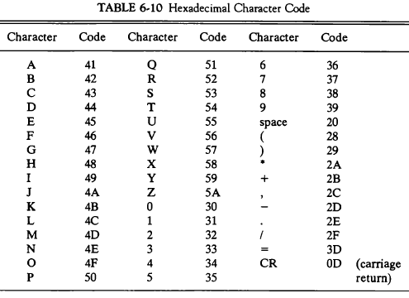
Hexadecimal Character Code (Table)

Slide 20
Line of Code
A line of code is stored in consecutive memory locations with two characters in each location. Two characters can be stored in each word since a memory word has the capacity of 16 bits. For example, the following line of code:
PL3, LDA SUB I
Is stored in seven consecutive memory locations as shown in figure:
Memory Word Symbol Hexadecimal Code Binary Representation
P L 50 4C 0101 0000 0100 1100
3 , 33 2C 0011 0011 0010 1100
L D 4C 44 0100 1100 0100 0100
A 41 20 0100 0001 0010 0000
S U 53 55 0101 0011 0101 0101
B 42 20 0100 0010 0010 0000
I CR 49 0D 0100 1001 0000 1101

Slide 21
Line of Code
A label symbol is terminated with a comma. Operation and address symbols are terminated with a space and the end of the line is recognized by the CR (carriage return) code.
If the line of code has a comment, the assembler recognizes it by the code for a slash (/) 2F. The assembler neglects all character in the comment field and keep checking for a CR code.
When CR code is encountered, it replaces the space code after the last symbol in the line of code.

Slide 22
TWO PASS ASSEMBLER
A two pass assembler scans the entire symbolic program twice.
During the first pass, it generates a table that correlates all user-defined address symbols with their binary equivalent value.
The binary translation is done during the second pass.
To keep track of the location of instructions, the assembler uses a memory word called a location counter (LC).
The ORG pseudo instruction initializes the LC to the value of the first memory location.
Since instructions are stored in sequential locations, the content of LC is incremented by 1 after each line of code.

Slide 23
TWO PASS ASSEMBLER
Assembler- is a program that accepts the symbolic language program and produces its binary machine language equivalent.
Source Program - Symbolic Assembly Language Program [Input of assembler]
Object Program - Binary Machine Language Program [Output of the assembler]
Two pass assembler :
1st pass: generates a table that correlates all user defined (address) symbols with their binary equivalent value.
2nd pass: binary translation (of a full program).

Slide 24
ASSEMBLER - FIRST PASS -
Assembler
LC is initially set to 0. A line of symbolic code is analyzed to determine if it has label (by the presence of ,). If the line of code has no label, the assembler checks the symbol in the instruction field. If it contains an ORG, the assembler sets LC to the number followed by ORG and process the next line. If the line has an END, the assembler terminates the first pass and goes to the second pass.
If the line of code contains a label, it is stored in the address symbol table together with its binary equivalent specified by LC. Nothing is stored in the table of no label is encountered.
First pass
First pass
LC := 0
Scan next line of code
Set LC
yes
Label
no
ORG
no
yes
Store symbol
END
yes
in address-
symbol table
no
together with
Go to
LC = location counter used to keep track of the location of instructions
value of LC
second
pass
Increment LC

Slide 25
Address symbol table for subtract program
ORG 100
100 LDA SUB
101 CMA
102 INC
103 ADD MIN
104 STA DIF
105 HLT
106 DEC 83
107 DEC -23
108 HEX 0
END
/ Origin of program is location 100
/ Load subtrahend to AC
/ Complement AC
/ Increment AC
/ Add minuend to AC
/ Store difference
/ Halt computer
/ Minuend
/ Subtrahend
/ Difference stored here
/ End of symbolic program
MIN,
SUB,
DIF,
Memory Word Symbol Hexadecimal code Binary Representation
1 M I 4D 49 0100 1101 0100 1001
2 N , 4E 2C 0100 1110 0010 1100
3 (LC) 01 06 0000 0001 0000 0110
4 S U 53 55 0101 0011 0101 0101
5 B , 42 2C 0100 0010 0010 1100
6 (LC) 01 07 0000 0001 0000 0111
7 D I 44 49 0100 0100 0100 1001
8 F , 46 2C 0100 0110 0010 1100
9 (LC) 01 08 0000 0001 0000 1000

Slide 26
ASSEMBLER - SECOND PASS -
Assembler
Machine instructions are translated by means of table-lookup procedures; (is a
Search of tables entries to determine whether a specific item matches one of the
Items stored in the table )[The assembler uses four tables 1st Pseudo-Instruction
Table, 2nd MRI Table, 3rd Non-MRI Table and 4th Address Symbol Table]
Second pass
The entries of the pseudoinstruction tables are the four symbols ORG, END, DEC, and HEX.
MRI table contains the seven symbols of memory reference instructions.
Non-MRI tables contains the 18 register ref. and I/O ref. instruction.
The address symbol table is generated during the first pass.
Labels are neglected during the second pass.
LC <- 0
Scan next line of code
Done
Set LC
yes
yes
Pseudo
yes
ORG
no
END
instr.
If the symbol is MRI then the assembler extract its 3-bit code and insert it in bits 2 through 4 of a word. Address field of the MRI is converted into binary by address symbol table.
no
no
DEC or
yes
MRI
no
HEX
Convert
Get operation code
operand
and set bits 2-4
Valid
no
to binary
non-MRI
and store
instr.
in location
Search address-
given by LC
symbol table for
yes
binary equivalent
of symbol address
and set bits 5-16
Store binary
Error in
yes
equivalent of
line of
I
no
instruction
code
in location
given by LC
Set
Set
first
first
bit to 1
bit to 0
Assemble all parts of
Increment LC
binary instruction and
store in location given by LC

Slide 27
PROGRAM LOOPS
Program Loops
Loop: A sequence of instructions that are executed many times, each time with a different set of data.
Line
Assembly-language program to add 100 numbers:
1 ORG 100
2 LDA ADS
3 STA PTR
4 LDA NBR
5 STA CTR
6 CLA
7 ADD PTR I
8 ISZ PTR
9 ISZ CTR
10 BUN LOP
11 STA SUM
12 HLT
13 HEX 150
14 HEX 0
15 DEC -100
16 HEX 0
17 HEX 0
18 ORG 150
19 DEC 75
.
.
118 DEC 23
119 END
/ Origin of program is HEX 100
/ Load first address of operand
/ Store in pointer
/ Load -100
/ Store in counter
/ Clear AC
/ Add an operand to AC (indirectly)
/ Increment pointer
/ Increment counter
/ Repeat loop again
/ Store sum
/ Halt
/ First address of operands
/ Reserved for a pointer
/ Initial value for a counter
/ Reserved for a counter
/ Sum is stored here
/ Origin of operands is HEX 150
/ First operand
/ Last operand
/ End of symbolic program
LOP,
ADS,
PTR,
NBR,
CTR,
SUM,
Fortran program to add 100 numbers:
DIMENSION A(100)
INTEGER SUM, A
SUM = 0
DO 3 J = 1, 100
SUM = SUM + A(J)
3
.
.
.

Slide 28
PROGRAMMING ARITHMETIC AND LOGIC OPERATIONS
Programming Arithmetic and Logic Operations
Implementation of Arithmetic and Logic Operations
- Software Implementation
- Implementation of an operation with a program
using machine instruction set
- Usually when the operation is not included
in the instruction set
- Hardware Implementation
- Implementation of an operation in a computer
with one machine instruction
Software Implementation example:
* Multiplication
- For simplicity, unsigned positive numbers
- 8-bit numbers -> 16-bit product

Slide 29
FLOWCHART OF A PROGRAM - Multiplication -
Programming Arithmetic and Logic Operations
CTR ← - 8
P ← 0
E ← 0
X holds the multiplicand 4 bit (Memory Word )
Y holds the multiplier 4 bit (Memory Word)
P holds the product 8 bit (Memory Word)
CTR - Counter
AC ← Y
cir EAC
Y ← AC
=0
E
=1
P ← P + X
Example with four significant digits
E ← 0
P
AC ← X
X =
Y =
0000 1111
0000 1011 0000 0000
0000 1111 0000 1111
0001 1110 0010 1101
0000 0000 0010 1101
0111 1000 1010 0101
1010 0101
cil EAC
cil
X ← AC
CTR ← CTR + 1
≠ 0
CTR
=0
Stop

Slide 30
ASSEMBLY LANGUAGE PROGRAM - Multiplication -
Programming Arithmetic and Logic Operations
LOP,
ONE,
ZRO,
CTR,
X,
Y,
P,
ORG 100
CLE
LDA Y
CIR
STA Y
SZE
BUN ONE
BUN ZRO
LDA X
ADD P
STA P
CLE
LDA X
CIL
STA X
ISZ CTR
BUN LOP
HLT
DEC -8
HEX 000F
HEX 000B
HEX 0
END
/ Clear E
/ Load multiplier
/ Transfer multiplier bit to E
/ Store shifted multiplier
/ Check if bit is zero
/ Bit is one; goto ONE
/ Bit is zero; goto ZRO
/ Load multiplicand
/ Add to partial product
/ Store partial product
/ Clear E
/ Load multiplicand
/ Shift left
/ Store shifted multiplicand
/ Increment counter
/ Counter not zero; repeat loop
/ Counter is zero; halt
/ This location serves as a counter
/ Multiplicand stored here
/ Multiplier stored here
/ Product formed here

Slide 31
SUBROUTINES
Subroutines
Subroutine
- A set of common instructions that can be used in a program many times.
Subroutine linkage : a procedure for branching to a subroutine and
returning to the main program
Example
Loc.
100
101
102
103
104
105
106
107
108
109
10A
10B
10C
10D
10E
10F
110
X,
Y,
SH4,
MSK,
ORG 100
LDA X
BSA SH4
STA X
LDA Y
BSA SH4
STA Y
HLT
HEX 1234
HEX 4321
HEX 0
CIL
CIL
CIL
CIL
AND MSK
BUN SH4 I
HEX FFF0
END
/ Main program
/ Load X
/ Branch to subroutine
/ Store shifted number
/ Load Y
/ Branch to subroutine again
/ Store shifted number
/ Subroutine to shift left 4 times
/ Store return address here
/ Circulate left once
/ Circulate left fourth time
/ Set AC(13-16) to zero (lower order bit.)
/ Return to main program
/ Mask operand

Slide 32
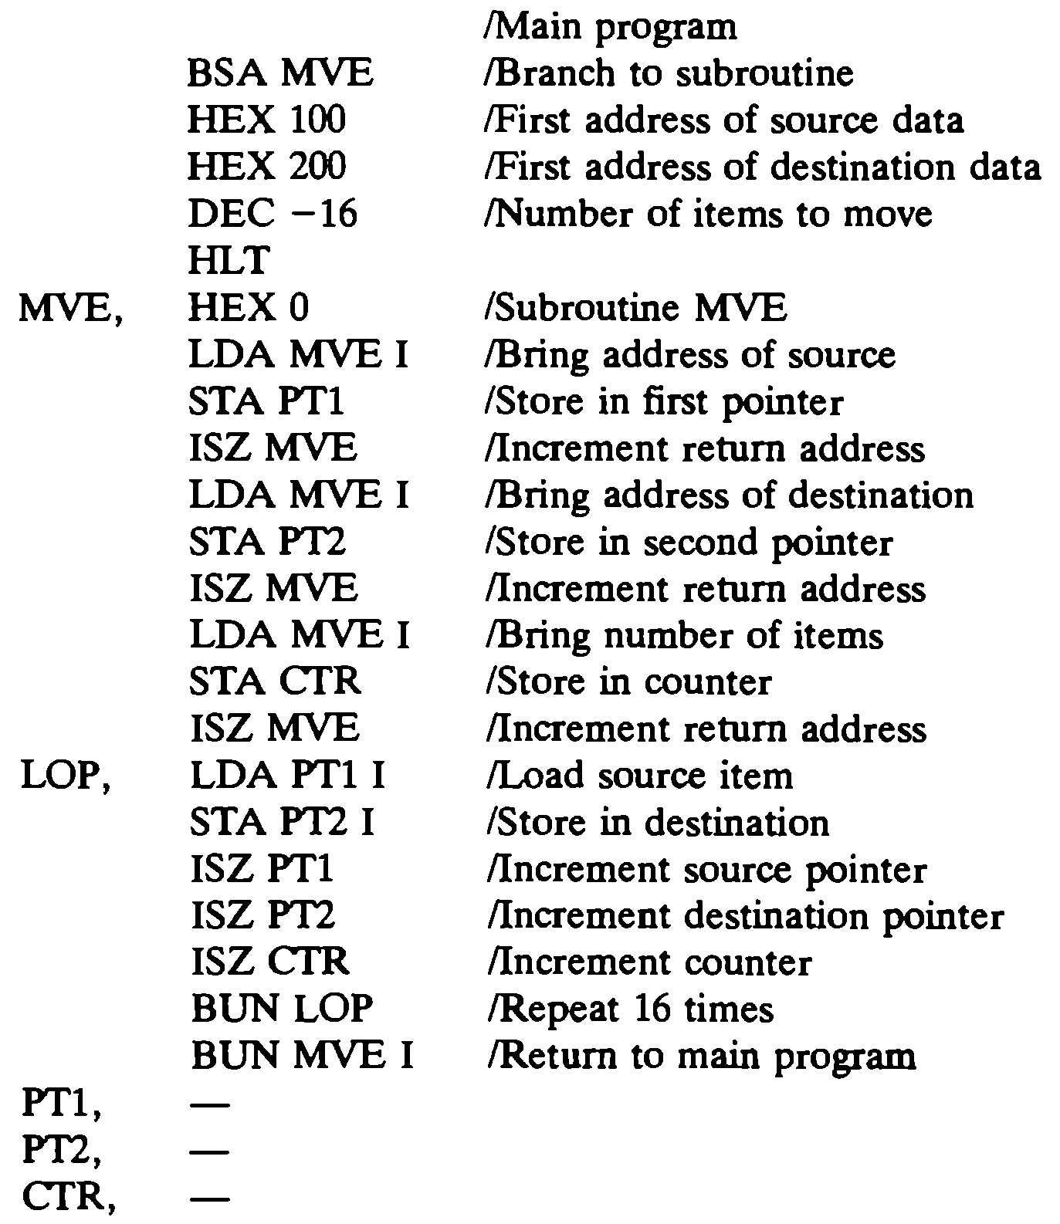
Subroutine to Move a Block of Data

Slide 33
INPUT OUTPUT PROGRAM
Input Output Program
Program to Input one Character(Byte)
CIF,
CHR,
SKI
BUN CIF
INP
OUT
STA CHR
HLT
--
/ Check input flag
/ Flag=0, branch to check again
/ Flag=1, input character
/ Display to ensure correctness
/ Store character
/ Store character here
Program to Output a Character
COF,
CHR,
LDA CHR
SKO
BUN COF
OUT
HLT
HEX 0057
/ Load character into AC
/ Check output flag
/ Flag=0, branch to check again
/ Flag=1, output character
/ Character is "W"

Slide 34
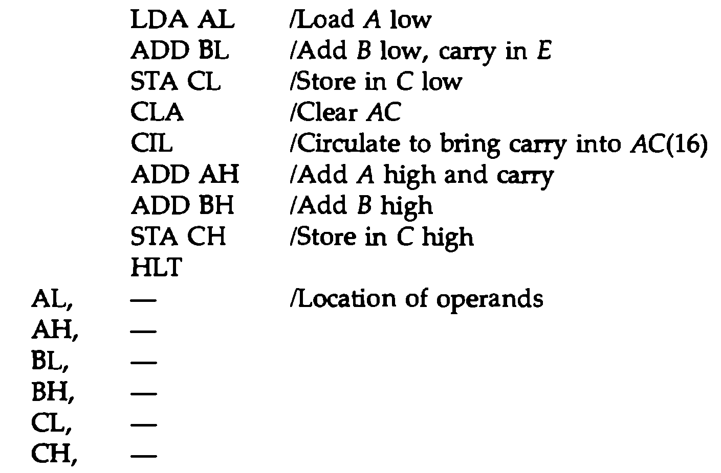
Double Precision Addition
When two 16 bit unsigned numbers are multiplied, the result is a 32 bit product that must be stored in two memory words. A number stored in two memory words is said to have double precision.

Slide 35



