Slide 1
CENTRAL PROCESSING UNIT
  Introduction
  General Register Organization
  Stack Organization
  Instruction Formats
  Addressing Modes
  Data Transfer and Manipulation
  Program Control
  Reduced Instruction Set Computer

Slide 2
Introduction
The part of the computer that performs the bulk of data-processing operations is called the central processing unit and is referred to as CPU.
The CPU is made up of three major parts as shown in figure:
Register Set
Control
Arithmetic
logic unit
(ALU)
This chapter describes the organization and architecture of the CPU. This includes the instruction formats, addressing modes, the instruction set, and the general organization of the CPU registers.

Slide 3
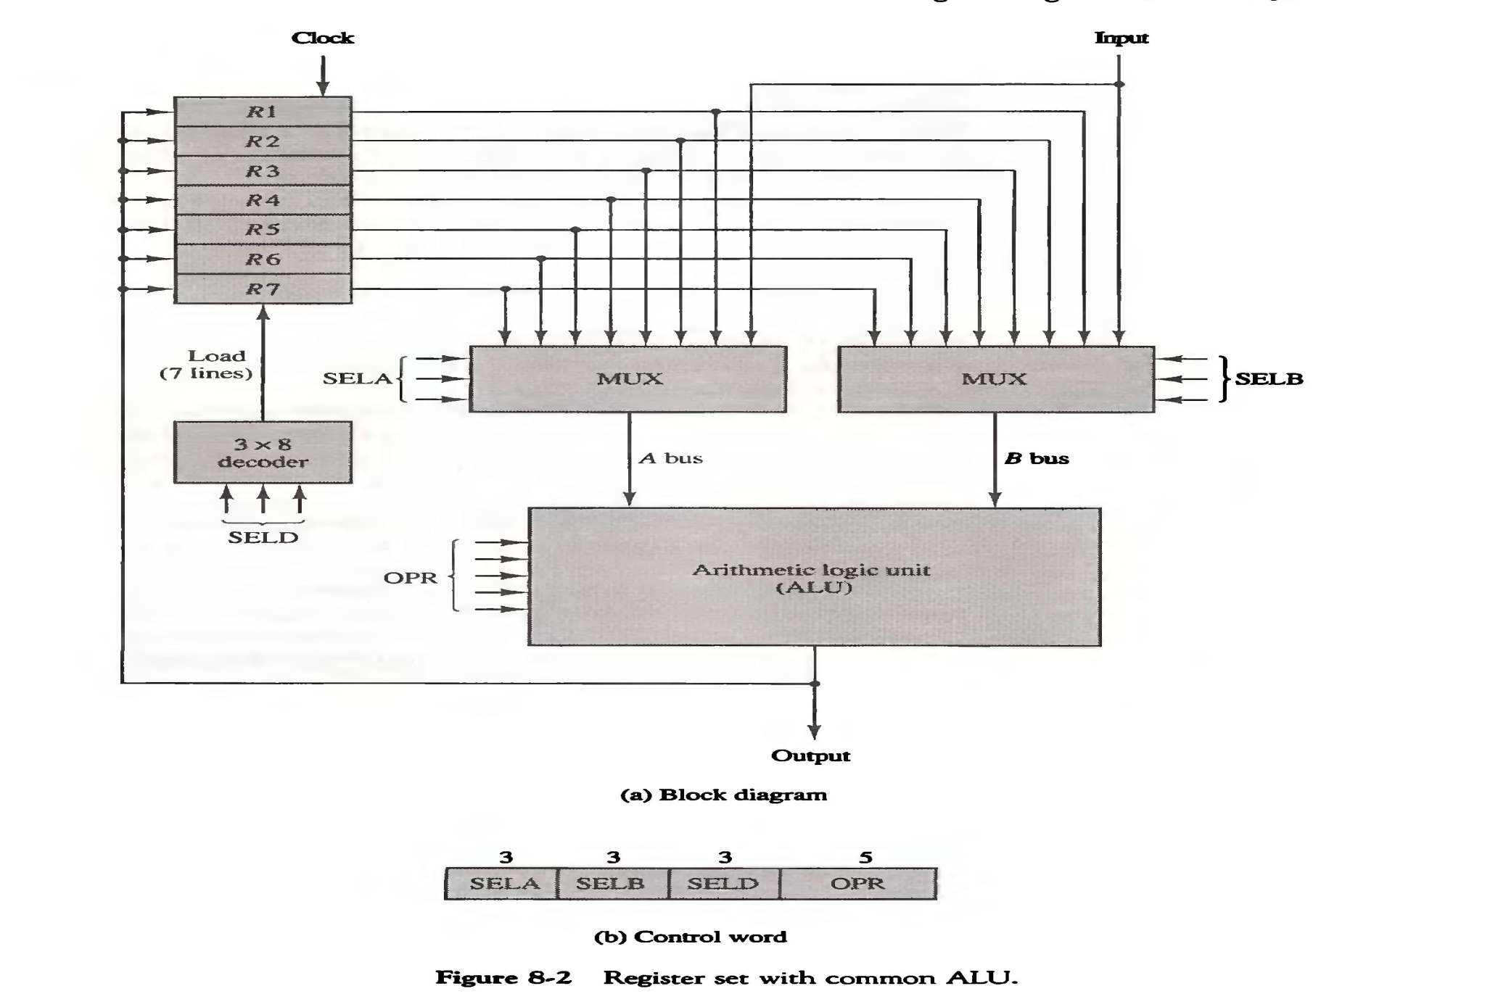
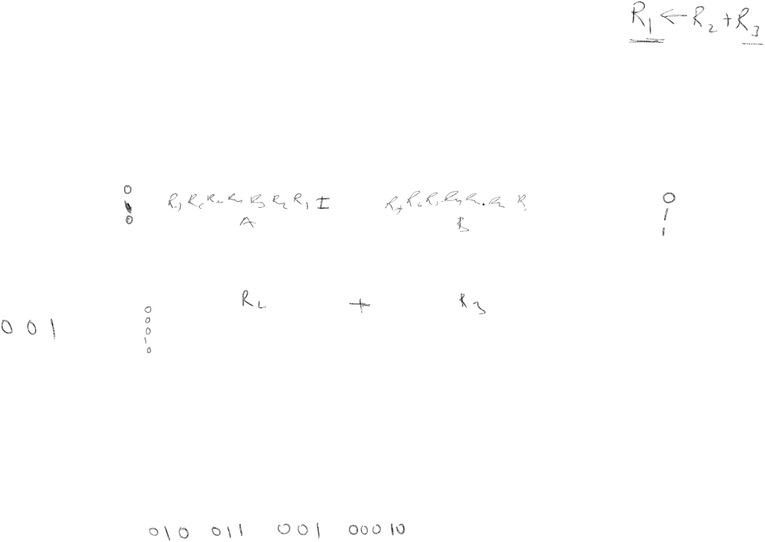
GENERAL REGISTER ORGANIZATION

Slide 4
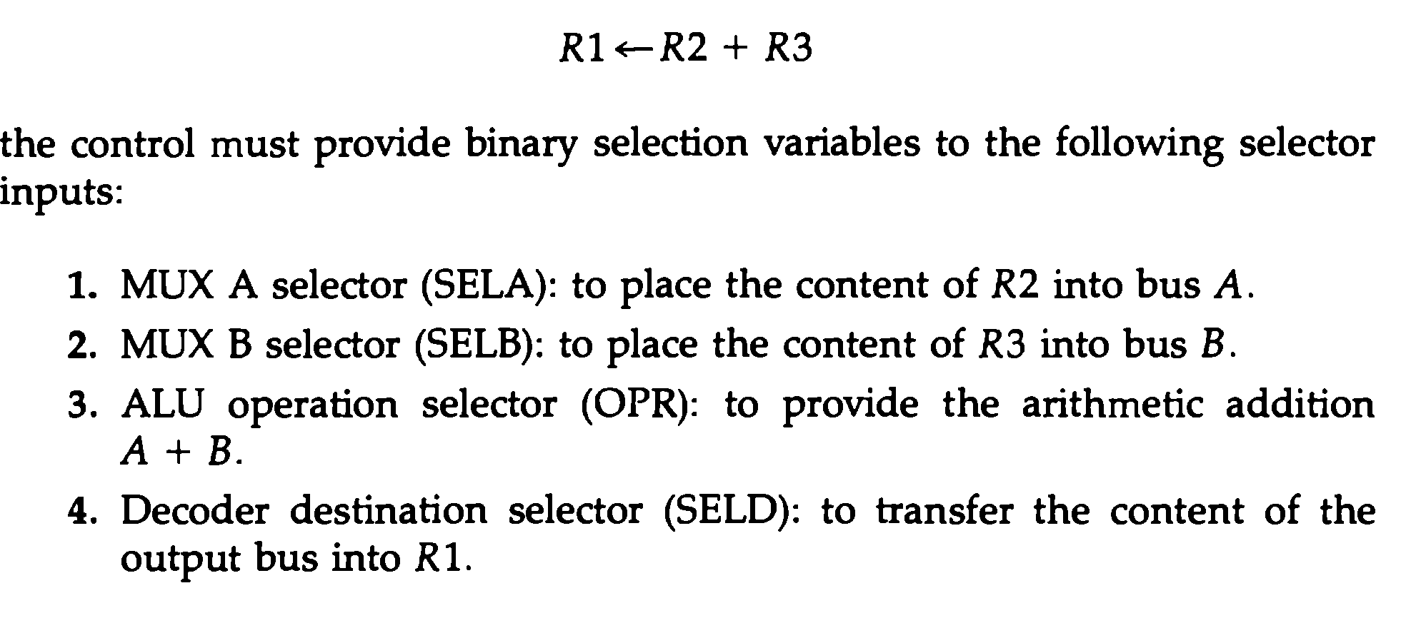
GENERAL REGISTER ORGANIZATION

Slide 5
CONTROL WORD
There are 14 binary selection inputs in the unit, and their combination value specifies a control word.
It consists of four field :
  Three fields contain three bits each.
  (SELA, SELB, SELD)
  and one field has five bits. (OPR)

Slide 6
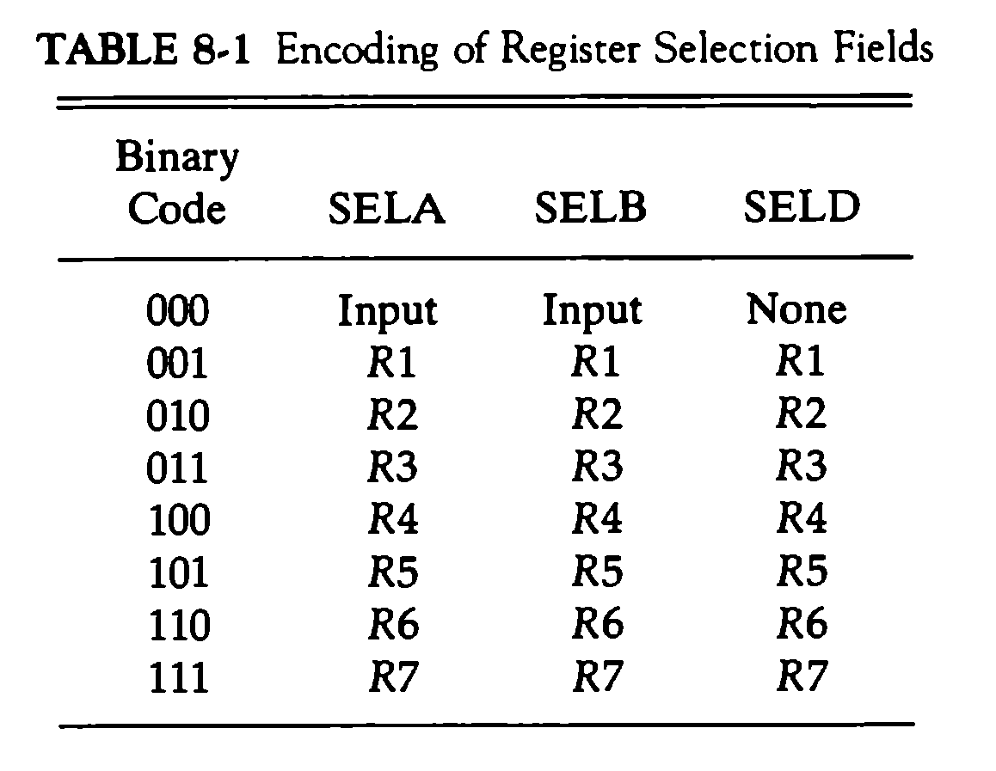

CONTROL WORD

Slide 7
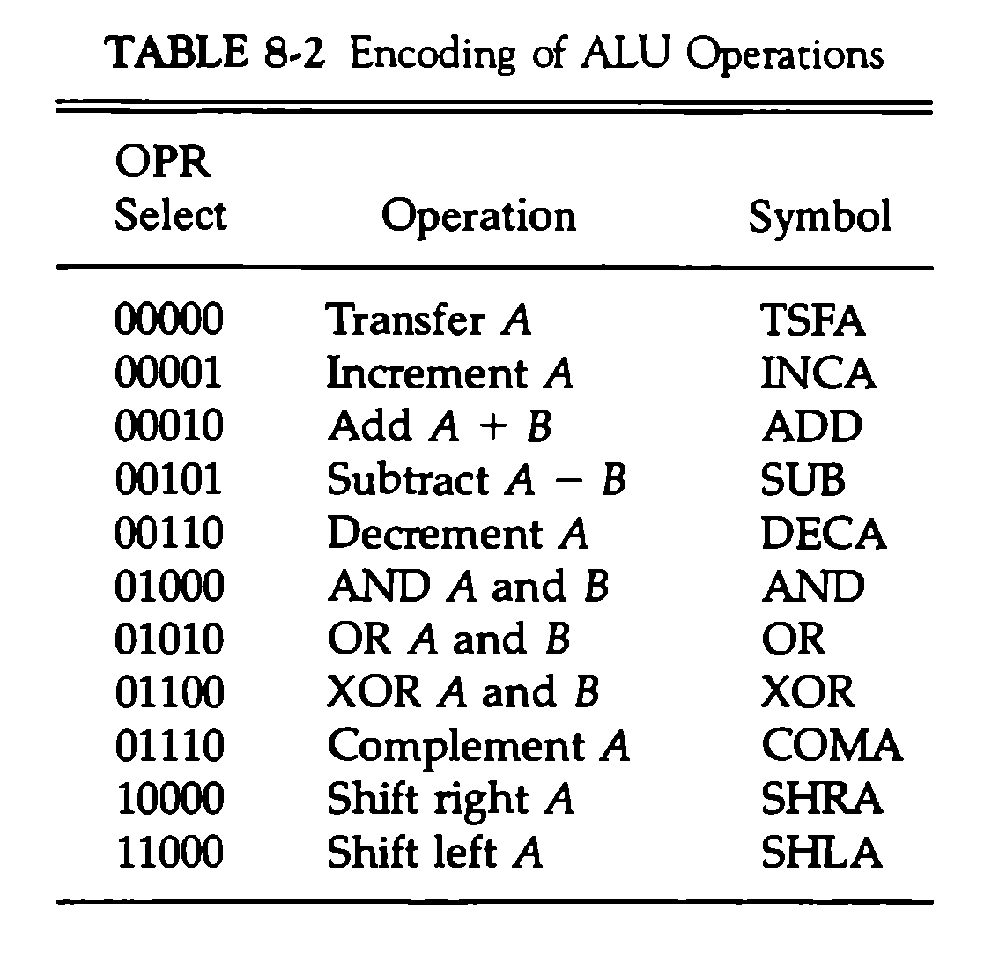
CONTROL WORD

Slide 8
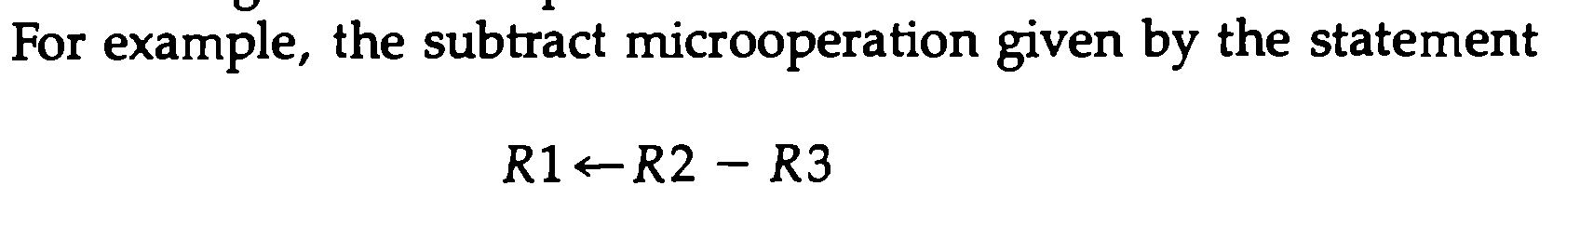
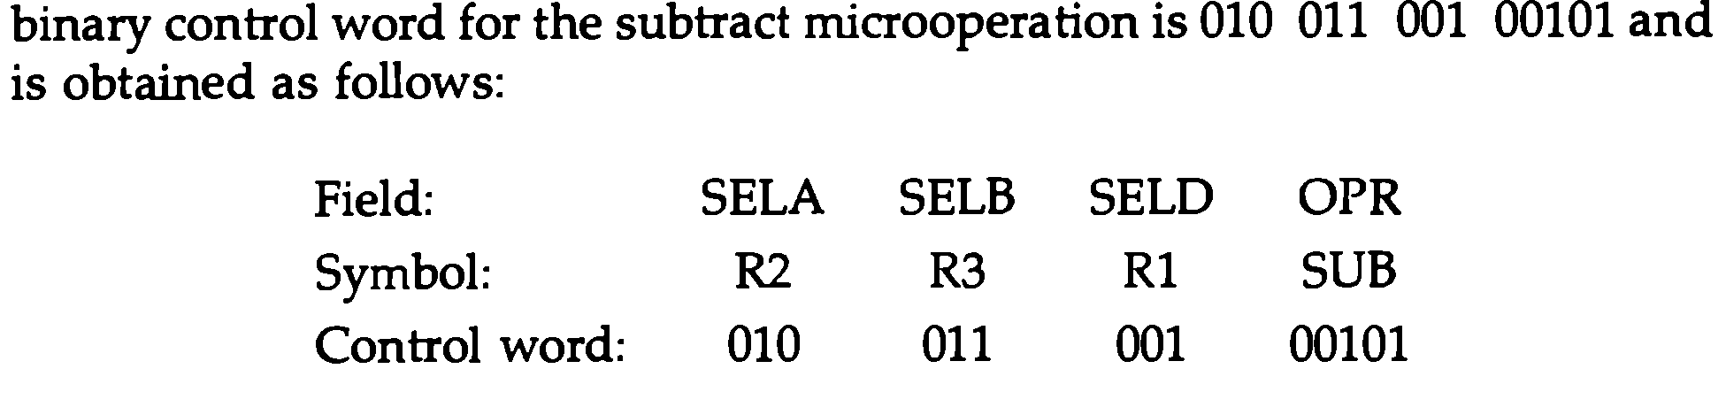
CONTROL WORD

Slide 9
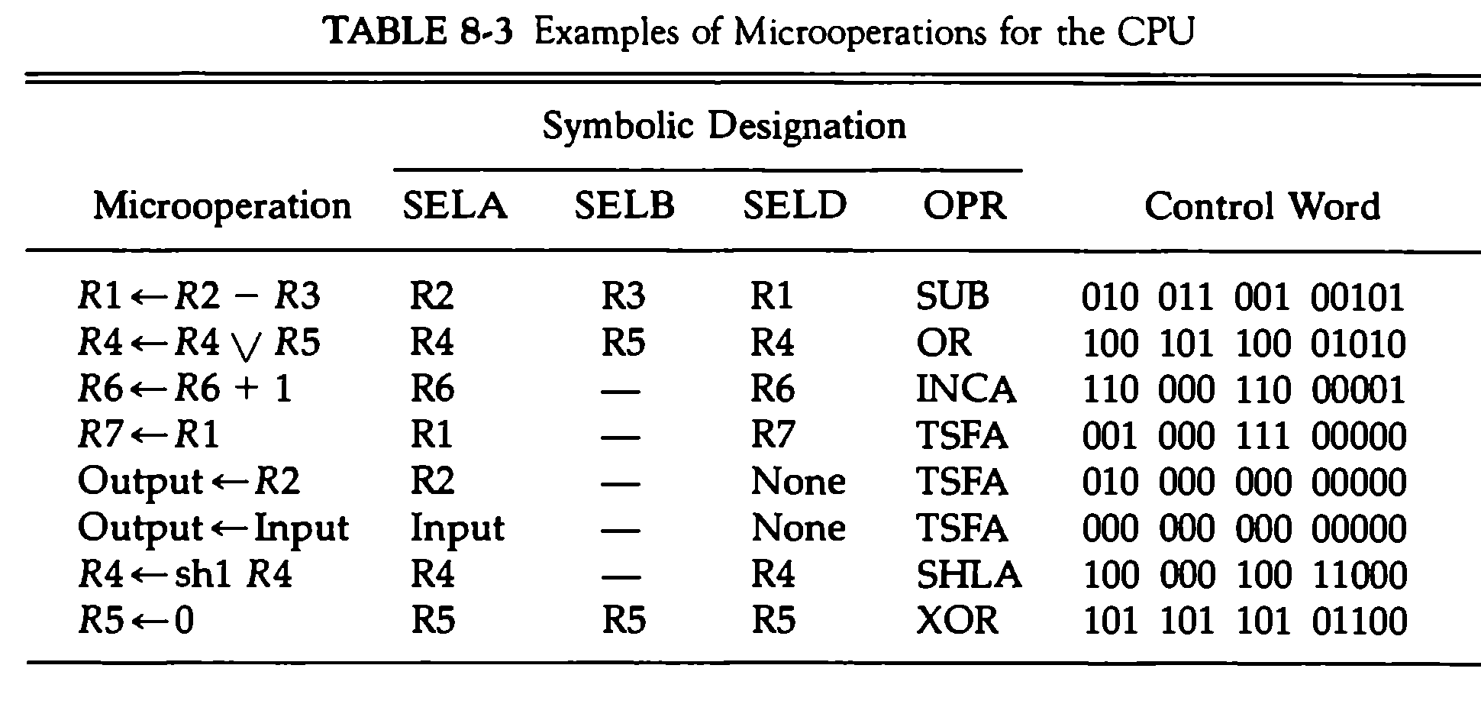
CONTROL WORD

Slide 10
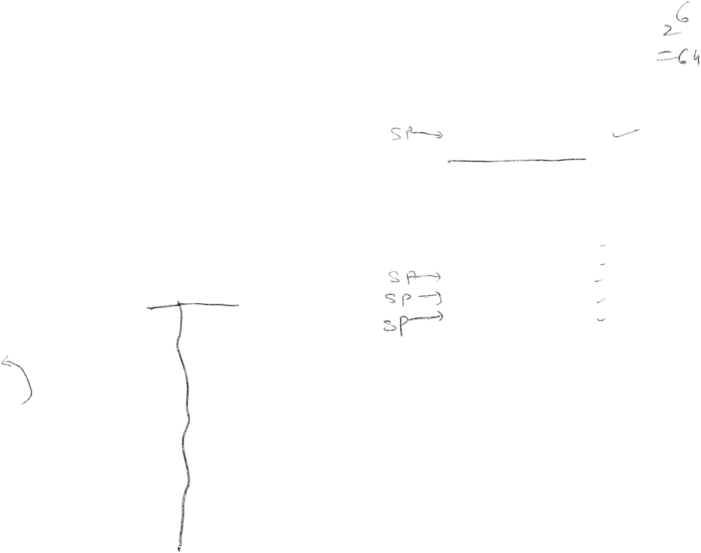
REGISTER STACK ORGANIZATION
Stack Organization
Stack
- Very useful feature for nested subroutines, nested
interrupt services
- Also efficient for arithmetic expression evaluation
- Storage which can be accessed in LIFO
- Pointer: SP
- Only PUSH and POP
operations are applicable
stack
Address
Flags
63
FULL
EMPTY
Push, Pop operations
Stack pointer
4
SP
C
3
/* Initially, SP = 0, EMPTY = 1, FULL = 0 */
6 bits
B
2
A
1
PUSH
POP
0
DR
  SP ← SP + 1 DR ← M[SP]
  M[SP] ← DR SP ← SP − 1
  If (SP = 0) then (FULL ← 1) If (SP = 0) then (EMPTY ← 1)
  EMPTY ← 0 FULL ← 0
Register Stack

Slide 11
MEMORY STACK ORGANIZATION
Stack Organization
Memory with Program, Data, and Stack Segments
1000
PC
Program
A portion of memory is used
as a stack with a processor
register as a stack pointer
- PUSH:
SP ← SP - 1
  M[SP] ← DR
- POP:
DR ← M[SP]
  SP ← SP + 1
(instructions)
AR
Data
(operands)
SP
3000
stack
3997
3998
3999
4000
4001
Stack grows
In this direction
Most computers do not provide hardware to
check stack overflow (full stack) or underflow
(empty stack) → must be done in software

Slide 12
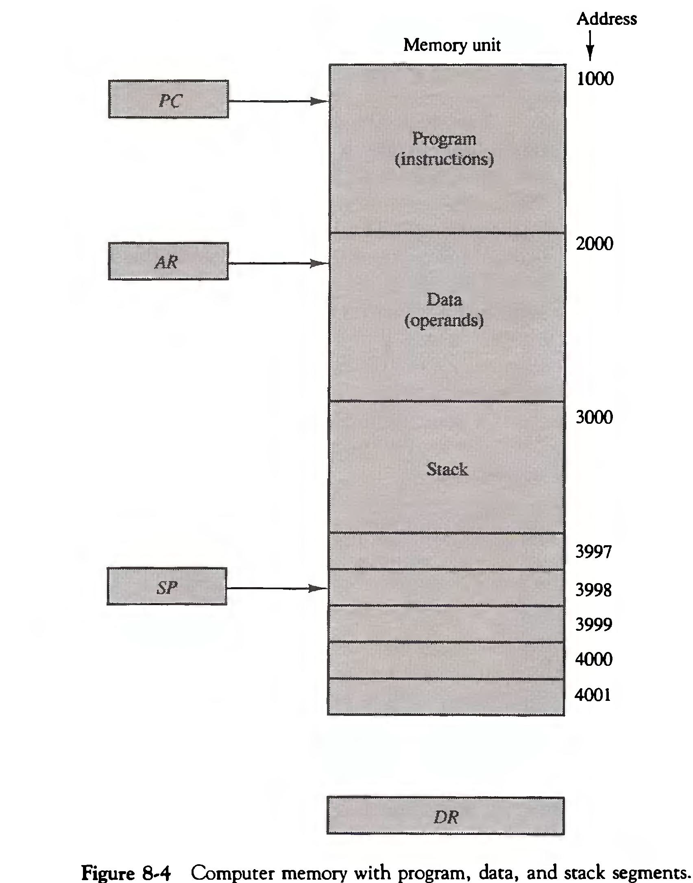
MEMORY WITH PROGRAM, DATA & STACK SEGMENTS

Slide 13


REVERSE POLISH NOTATION (RPN)
Stack Organization
Arithmetic Expressions: A + B
A + B Infix notation
+ A B Prefix or Polish notation
A B + Postfix or reverse Polish notation
- The reverse Polish notation is very suitable for stack manipulation
Evaluation of Arithmetic Expressions
Any arithmetic expression can be expressed in
parenthesis-free Polish notation, including reverse Polish
notation
(3 * 4) + (5 * 6) ⇒ 3 4 * 5 6 * +
6
4
5
5
30
3
3
12
12
12
12
42
3
4
*
5
6
*
+

Slide 14

Example
Convert the following into RPN and show the stack operation evaluating the result.
(3+2*4)*[5*(3-4/2)+3]
Converting into RPN
= (3+24*)*[5*(3-42/)+3] => (324*+)*[5*(342/-)+3]
=> (324*+)*[5342/-*+3] => (324*+)*[5342/-*3+]
=> 324*+ 35342/-*+*
How many push and pop operation are required?

Slide 15
INSTRUCTION FORMAT
Instruction Format
Instruction Fields
OP-code field - specifies the operation to be
performed
Address field - designates memory address (es) or
a processor register(s)
Mode field - determines how the address field is
to be interpreted (to get effective
address or the operand)
The number of address fields in the instruction format depends on the internal organization of CPU

Slide 16

INSTRUCTION FORMAT
Instruction Format
The three most common CPU organizations:
  Single accumulator organization:
  ADD X /* AC ← AC + M[X] */
  General register organization:
  ADD R1, R2, R3 /* R1 ← R2 + R3 */
  ADD R1, R2 /* R1 ← R1 + R2 */
  MOV R1, R2 /* R1 ← R2 */
  ADD R1, X /* R1 ← R1 + M[X] */
  Stack organization:
  PUSH X /* TOS ← M[X] */
  ADD /* operation performed on two items that’s are on
  the top of stack (in a stack computer consists
  of an operation code only with no address
  filed) */

Slide 17
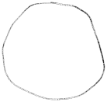
THREE, AND TWO-ADDRESS INSTRUCTIONS
Instruction Format
Three-Address Instructions
Program to evaluate X = (A + B) * (C + D) :
ADD R1, A, B /* R1 ← M[A] + M[B] */
ADD R2, C, D /* R2 ← M[C] + M[D] */
MUL X, R1, R2 /* M[X] ← R1 * R2 */
- Results in short programs
- Instruction becomes long (many bits)

Slide 18

THREE, AND TWO-ADDRESS INSTRUCTIONS
Instruction Format
Two-Address Instructions
Program to evaluate X = (A + B) * (C + D) :
MOV R1, A /* R1 ← M[A] */
ADD R1, B /* R1 ← R1 + M[B] */
MOV R2, C /* R2 ← M[C] */
ADD R2, D /* R2 ← R2 + M[D] */
MUL R1, R2 /* R1 ← R1 * R2 */
MOV X, R1 /* M[X] ← R1 */

Slide 19

ONE, AND ZERO-ADDRESS INSTRUCTIONS
Instruction Format
One-Address Instructions
Use an implied AC register for all data
manipulation
- Program to evaluate X = (A + B) * (C + D) :
LOAD A /* AC ← M[A] */
ADD B /* AC ← AC + M[B] */
STORE T /* M[T] ← AC */
LOAD C /* AC ← M[C] */
ADD D /* AC ← AC + M[D] */
MUL T /* AC ← AC * M[T] */
STORE X /* M[X] ← AC */

Slide 20
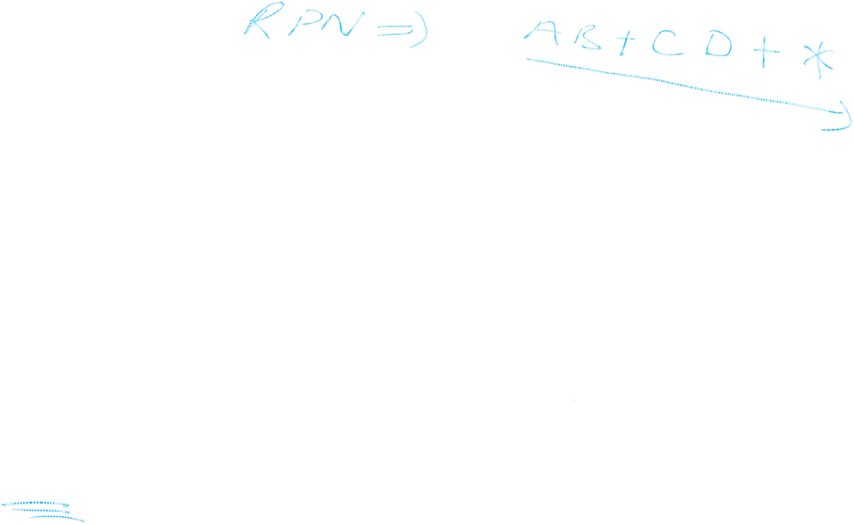
ONE, AND ZERO-ADDRESS INSTRUCTIONS
Instruction Format
Zero-Address Instructions
- Can be found in a stack-organized computer
- Program to evaluate X = (A + B) * (C + D) :
PUSH A /* TOS ← A */
PUSH B /* TOS ← B */
ADD /* TOS ← (A + B) */
PUSH C /* TOS ← C */
PUSH D /* TOS ← D */
ADD /* TOS ← (C + D) */
MUL /* TOS ← (C + D) * (A + B) */
POP X /* M[X] ← TOS */

Slide 21
ADDRESSING MODES
Addressing Modes
Addressing Modes - The way the operands are chosen during program execution is dependent on the addressing mode of the instruction.
The addressing mode specifies a rule for Interpreting or modifying the address field of the Instruction.
Variety of addressing modes
- to give programming flexibility to the user
- to use the bits in the address field of the
instruction efficiently
Opcode Mode Address
Instruction format with mode field

Slide 22
TYPES OF ADDRESSING MODES
Addressing Modes
Implied Mode:
In this mode the operands are specified implicitly in the definition of the instruction.
- No need to specify address in the instruction
- EA = AC
Examples from Basic Computer (All register reference instructions that use an accumulator are implied-mode instructions, Zero address instructions in a stack - organized computer are implied-mode instructions since the operand are implied to be on top of the stack)
CLA, CME, INP, CMA, OUT etc.

Slide 23
TYPES OF ADDRESSING MODES
Addressing Modes
Immediate Mode:
In this mode the operand is specified in the instruction itself. In other words, an immediate mode instruction has an operand field rather than an address field.
- No need to specify address in the instruction
- However, operand itself needs to be specified
- Sometimes, require more bits than the address
- Fast to acquire an operand

Slide 24
TYPES OF ADDRESSING MODES
Addressing Modes
Register Mode: In this mode the operands are in the registers that reside within the CPU.
- Faster to acquire an operand than the memory addressing
Register Indirect Mode: In this mode, Instruction specifies a register which contains the memory address of the operand. In other words the selected register contain the address of the operand rather than the operand itself.
- Slower to acquire an operand than both the register addressing or memory addressing
- EA = IR(R[m1]) {M[m1]=[x]:Content of
memory and address m1 is x}

Slide 25
TYPES OF ADDRESSING MODES
Addressing Modes
Auto-increment or Auto-decrement Mode:
It is similar to the register indirect mode except that the register is incremented or decremented after its value is used to access the memory.
When the address in the register is used to access memory, the value in the register is incremented or decremented by 1 automatically

Slide 26
TYPES OF ADDRESSING MODES
Addressing Modes
Direct Address Mode:
In this mode effective address is equal to the address part of the Instruction.
This specifies the memory address which can be used directly to access the memory
- Faster than the other memory addressing modes
- Too many bits are needed to specify the address for a large physical memory space
- EA = IR(addr) {IR(addr): address field of
IR}

Slide 27
TYPES OF ADDRESSING MODES
Addressing Modes
Indirect Addressing Mode:
The address field of an instruction specifies the address of a memory location that contains the address of the operand
When the abbreviated address is used large physical memory can be addressed with a relatively small number of bits
- Slow to acquire an operand because of an additional memory access
- EA = M[IR(address)]

Slide 28
TYPES OF ADDRESSING MODES
Addressing Modes
Relative Addressing Modes:
In this mode the content of the program counter (PC) is added to the address part of the instruction in order to obtain the effective address.
For example PC= 825, address part of the instruction contain 24. The instruction at location 825 is read from the memory during the fetch phase and the program counter is incremented by 1 to 826. The effective address for the relative mode is 826 + 24 = 850.

Slide 29
TYPES OF ADDRESSING MODES
Addressing Modes
3 different Relative Addressing Modes depending on Register used(R);
* PC Relative Addressing Mode (R = PC)
- EA = PC + IR(address)
* Indexed Addressing Mode (R = IX, where
IX: Index Reg.)
- EA = IX + IR(address)
* Base Register Addressing Mode (R =
BAR, where BAR: Base Address Register)
- EA = BAR + IR(address)

Slide 30
ADDRESSING MODES - EXAMPLES -
Addressing Modes
The two word instruction at address 200 and 201 is a “Load to AC” instruction with an address field 500. PC has the value 200 for fetching this instruction. The content of processor register R1 is 400, and the content of an index register XR is 100. AC receives the operands after the instruction is executed.
Address
Memory
200
Load to AC Mode
PC = 200
201
Address = 500
202
Next instruction
R1 = 400
XR = 100
399
450
400
700
AC
500
800
600
900
Addressing
Mode
Effective
Address
Content
of AC
702
325
  Direct address 500 /* AC ← M(500) */ 800
  Immediate operand - /* AC ← 500 */ 500
  Indirect address 800 /* AC ← M(M(500)) */ 300
  Relative address 702 /* AC ← (PC+500) */ 325
  Indexed address 600 /* AC ← (RX+500) */ 900
  Register - /* AC ← R1 */ 400
  Register indirect 400 /* AC ← M(R1) */ 700
  Autoincrement 400 /* AC ← M(R1)+ */ 700
  Autodecrement 399 /* AC ← -M(R) */ 450
800
300

Slide 31
DATA TRANSFER INSTRUCTIONS
Data Transfer and Manipulation
Typical Data Transfer Instructions
Name Mnemonic
Load LD
Store ST
Move MOV
Exchange XCH
Input IN
Output OUT
Push PUSH
Pop POP
Data Transfer Instructions with Different Addressing Modes
Mode
Assembly
Convention
Register Transfer
Direct address LD ADR AC ← M[ADR]
Indirect address LD @ADR AC ← M[M[ADR]]
Relative address LD $ADR AC ← M[PC + ADR]
Immediate operand LD #NBR AC ← NBR
Index addressing LD ADR(X) AC ← M[ADR + XR]
Register LD R1 AC ← R1
Register indirect LD (R1) AC ← M[R1]
Autoincrement LD (R1)+ AC ← M[R1], R1 ← R1 + 1
Autodecrement LD -(R1) R1 ← R1 - 1, AC ← M[R1]

Slide 32
TYPICAL ARITHMETIC INSTRUCTIONS
Increment INC
Decrement DEC
Add ADD
Subtract SUB
Multiply MUL
Divide DIV
Add with Carry ADDC
Subtract with borrow SUBB
Negate(2’s Complement) NEG

Slide 33
TYPICAL LOGIC AND BIT MANIPULATION INSTRUCTIONS
Clear CLR
Complement COM
AND AND
OR OR
Excusive-OR XOR
Clear Carry CLRC
Set Carry SETC
Complement Carry COMC
Enable interrupt EI
Disable interrupt DI

Slide 34
TYPICAL SHIFT INSTRUCTIONS
Logical Shift Right SHR
Logical Shift Left SHL
Arithmetic Shift Right SHRA
Arithmetic Shift Left SHLA
Rotate Right ROR
Rotate Left ROL
Rotate Right through carry RORC
Rotate Left through carry ROLC

Slide 35
TYPICAL PROGRAM CONTROL INSTRUCTIONS
Branch BR
Jump JMP
Skip SKP
Call CALL
Return RET
Compare (by subtraction) CMP
Test (by ANDing) TST

Slide 36
FLAG, PROCESSOR STATUS WORD
In Basic Computer, the processor had several (status) flags – 1 bit value that indicated various information about the processor’s state – E, FGI, FGO, I, IEN, R
In some processors, flags like these are often combined into a register – the processor status register (PSR); sometimes called a processor status word (PSW)

Slide 37
FLAG, PROCESSOR STATUS WORD
Common flags in PSW are
Bit C (Carry): Set to 1 if the carry C8 is 1.
Bit S (Sign): Set to 1 if the highest-order bit F7 is 1. Set 0 if it is 0.
Bit Z (Zero): Set to 1 if the output of the ALU contain all 0’s.
Bit V (Overflow): Set to 1 if the exclusive-OR of the last two carries is equal to 1. and cleared to 0 otherwise.
Status Flag Circuit
A B
8 8
c₇
8-bit ALU
c₈
F₇ - F₀
V Z S C
F₇
8
Check for
zero output
F

Slide 38
Example
An 8-bit computer has a register R. Determine the values of status bits C, S, Z and V after each of the following instructions. The initial value of register R in each case is hexadecimal 72. The numbers below are also in hexadecimal.
a. Add immediate operand C6 to R.
b. Add immediate operand 1E to R.
c. Subtract immediate operand 9A from R.
d. AND immediate operand 8D to R.
e. Exclusive-OR R with R.

Slide 39
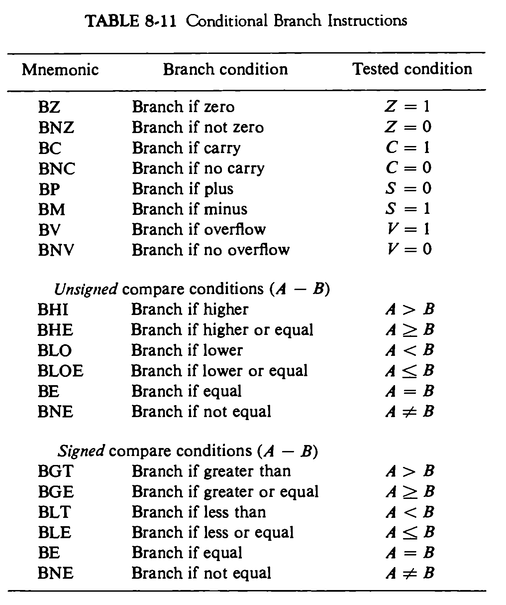
Conditional Branch Instruction

