Slide 1
Collocations
Prof. Vipin Tyagi

Slide 2
Collocation
“a sequence of two or more consecutive words, that has characteristics of a syntactic and semantic unit, and whose exact and unambiguous meaning or connotation cannot be derived directly from the meaning or connotation of its components."
A COLLOCATION is an expression consisting of two or more words that correspond to some conventional way of saying things.
The words together can mean more than their sum of parts
The Times of India, disk drive, hot dog, mother in law
Examples of collocations
noun phrases like strong tea and weapons of mass destruction
phrasal verbs like to make up, and other phrases like the rich and powerful.
a stiff breeze but not a stiff wind (while either a strong breeze or a strong wind is okay).
broad daylight (but not bright daylight or narrow darkness).

Slide 3
Criteria for Collocations
Collocations usually cannot be translated into other languages word by word.
A phrase can be a collocation even if it is not consecutive (as in the example knock . . . door)
Typical criteria for collocations:
non-compositionality
non-substitutability
non-modifiability

Slide 4
Non-Compositionality
A phrase is compositional if the meaning can be predicted from the meaning of the parts
e.g. new companies
A phrase is non-compositional if the meaning cannot be predicted from the meaning of the parts
e.g. hot dog
Collocations are not necessarily fully compositional in that there is usually an element of meaning added to the combination. e.g. strong tea
Idioms are the most extreme examples of non-compositionality. e.g. To shed crocodile tears

Slide 5
Non-Substitutability
We cannot substitute near-synonyms for the components of a collocation
For example
We can’t say yellow wine instead of white wine even though yellow is as good a description of the color of white wine as white is (it is kind of a yellowish white).
Non-modifiability
Many collocations cannot be freely modified with additional lexical material or through grammatical transformations
e.g. white wine, but not whiter wine
mother in law, but not mother in laws

Slide 6
Principal Approaches to Find Collocations
Selection of collocations by frequency
Selection based on mean and variance of the distance between focal word and collocating word
Hypothesis testing
Mutual information

Slide 7
Frequency based approach
Find collocations by counting the number of occurrences.
Need also to define a maximum size window
Usually results in a lot of redundant function word pairs that need to be filtered out. To resolve this problem, pass the candidate phrases through a part of-speech filter which only lets through those patterns that are likely to be “collocations”

Slide 8
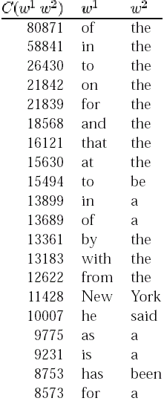
Most frequent bigrams in an
Example Corpus

Slide 9
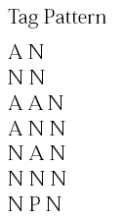
Part of speech tag patterns for collocation filtering

Slide 10
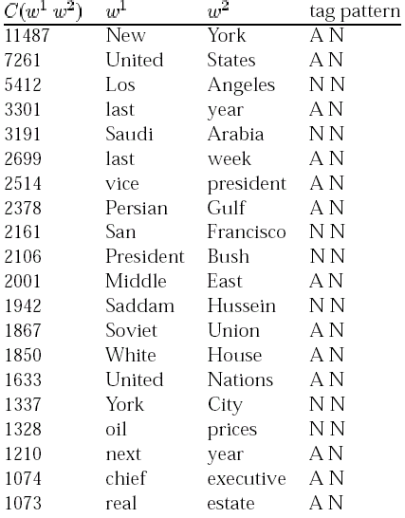
The most highly ranked
phrases after applying the filter on the same corpus as before.

Slide 11
Mean and Variance based approach
Many collocations occur at variable distances. A collocational window needs to be defined to locate these. Frequency based approach can’t be used in such cases.
she knocked on his door
they knocked at the door
100 persons knocked on Ram’s door
a man knocked on the metal front door

Slide 12
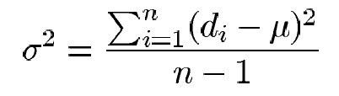
The mean μ is the average offset between two words in the corpus.
The variance is
where n is the number of times the two words co-occur, d_{i} is the offset for co-occurrence i, and μ is the mean.
Mean and variance characterize the distribution of distances between two words in a corpus.
High variance means that co-occurrence is mostly by chance
Low variance means that the two words usually occur at about the same distance.

Slide 13

For example , for two words in different sentences the sample mean is:
¼(3+3+5+5) = 4.0
And the sample variance:

Slide 14
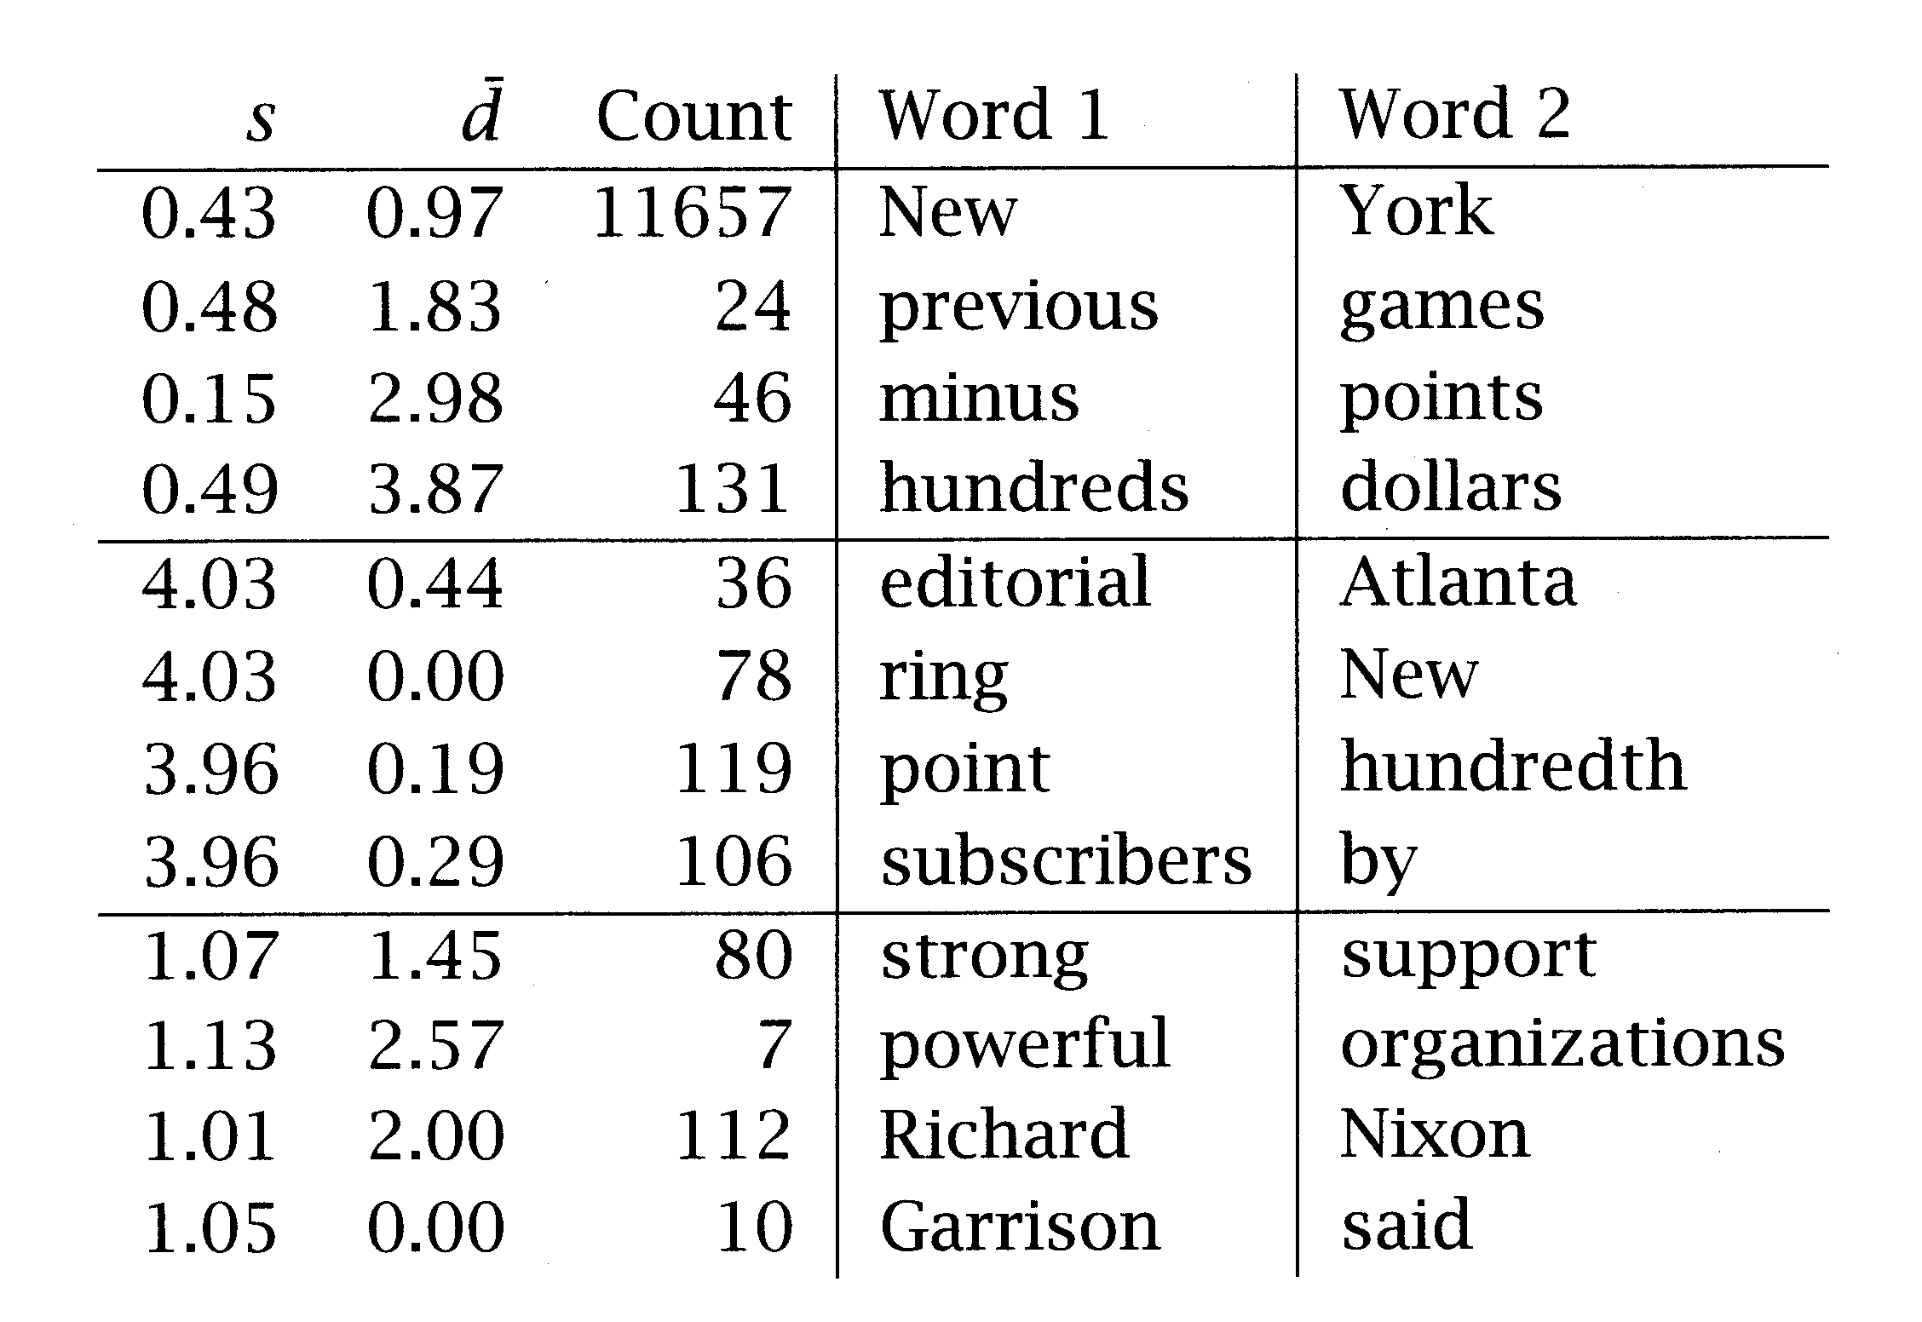
Mean and variance versus Frequency
std. dev. ~0 & mean offset ~1 --> would be found by frequency method
std. dev. ~0 & high mean offset --> very interesting, but would not be found by frequency method
high deviation --> not interesting

Slide 15
Thank You

