Slide 1
NLP
Prof. Vipin tyagi

Slide 2
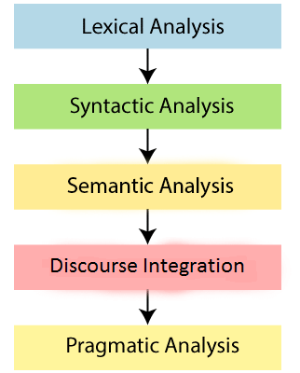
The Steps in NLP

Slide 3
The steps in NLP (Cont.)
Morphological Analysis: Concerns the way words are built up, smaller meaning bearing units.
Syntax: concerns how words are put together to form correct sentences and what structural role each word has.
Semantics: concerns what words mean and how these meanings combine in sentences to form sentence meanings.

Slide 4
The steps in NLP (Cont.)
Discourse Integration: concerns how the immediately preceding sentences affect the interpretation of the next sentence.
Pragmatics: concerns how sentences are used in different situations and how use affects the interpretation of the sentence.

Slide 5
Example
stems
Surface form
I (pronoun) want (verb)
to (prep)
print (verb)
Bill (noun)
‘s (possessive) .init (adj)
file (noun)
file (verb)
I want to print Bill’s .init file
Morphological
analysis

Slide 6
Syntactic
Example
S
analysis
stems
NP
VP
I (pronoun) want (verb)
to (prep)
print (verb)
Bill (noun)
‘s (possessive) .init (adj)
file (noun)
S
PRO
V
Parse tree
NP
VP
I
want
PRO
V
NP
ADJ
NP
I
print
ADJ
N
Bill’s
.init
file

Slide 7
Semantic Net
Example
I
Bill
who
S
who
Who’s
NP
want
print
file
VP
what
what
S
type
PRO
V
.init
NP
VP
I
want
PRO
V
NP
ADJ
NP
Semantic
I
print
ADJ
N
analysis
Parse tree
Bill’s
.init
file

Slide 8
To whom the pronoun ‘I’ refers
To whom the proper noun ‘Bill’ refers
What are the files to be printed
Discourse &
Pragmatic
I
Ali
who
who
Who’s
want
print
file
what
what
type
Semantic Net
.init
Execute the command
print /bill/stuff.init

Slide 9
Stages of NLP
Syntactic Analysis
user
stems
Morphological Analysis
parse tree
Surface form
Semantic Analysis
lexicon
Pragmatic Analysis
Perform action
Internal representation
Discourse Analysis
Resolve references

Slide 10
Lexicon
Lexicon is a vocabulary data bank, that contains the language words and their linguistic information.
There are many on-line lexicon
WordNet is a lexical database that contains English vocabulary words
http://wordnet.princeton.edu/

Slide 11
Spoken Dialogue System
Us e r
Discourse
Speech
Semantic
Recognition
Interpretation
Interpretation
Speech
Response
Dialogue
Synthesis
Generation
Management

Slide 12
Parts of the Spoken Dialogue System
Signal Processing: Convert the audio wave into a sequence of feature vectors.
Speech Recognition: Decode the sequence of feature vectors into a sequence of words.
Semantic Interpretation: Determine the meaning of the words.
Discourse Interpretation: Understand what the user intends by interpreting utterances in context.
Dialogue Management: Determine system goals in response to user utterances based on user intention.
Speech Synthesis: Generate synthetic speech as a response.

Slide 13
Levels in a Dialogue System
Touch-tone replacement:
System Prompt: "For checking information, press one." Caller Response: "One."
Directed dialogue:
System Prompt: "Would you like checking account information or rate information?" Caller Response: "Checking", or "checking account," or "rates."
Natural language:
System Prompt: "What transaction would you like to perform?" Caller Response: "Transfer Rs. 500 from current to savings.“

Slide 14
Thank you

