Slide 1
Language Models
PrOF. Vipin Tyagi

Slide 2
Language Models
A language model
an abstract representation of a (natural) language phenomenon
an approximation to real language
Statistical models
predictive
explicative

Slide 3
A useful part of the knowledge needed to allow letter/word predictions can be captured using simple statistical techniques.
Compute:
probability of a sequence
likelihood of letters/words co-occurring
Rank the likelihood of sequences containing various alternative hypotheses
Assess the likelihood of a hypothesis

Slide 4
Applications
Speech recognition
Handwriting recognition
Spelling correction
Machine translation systems
Optical character recognizers

Slide 5
Handwriting Recognition
Assume a note is given to a bank clerk, which the clerk reads as I have a gub.
NLP to the rescue ….
gub is not a word
gun, gum, Gus, and gull are words, but gun has a higher probability in the context of a bank

Slide 6
They are leaving in about fifteen minuets to go to her house.
The study was conducted mainly be John Black.
Hopefully, all with continue smoothly in my absence.
Can they lave him my messages?
I need to notified the bank of….
He is trying to fine out.

Slide 7
Real Word Spelling Errors
They are leaving in about fifteen minuets to go to her house.
The study was conducted mainly be John Black.
Hopefully, all with continue smoothly in my absence.
Can they lave him my messages?
I need to notified the bank of….
He is trying to fine out.

Slide 8
For Spell Checkers
Collect list of commonly substituted words
piece/peace, whether/weather, their/there ...
Example: “On Tuesday, the whether …’’ “On Tuesday, the weather …”

Slide 9
Approximating natural language

Slide 10
Letter-based Language Models
Approximating natural language
Shannon’s Game
Guess the next letter:

Slide 11
Letter-based Language Models
Shannon’s Game
Guess the next letter:
W

Slide 12
Letter-based Language Models
Shannon’s Game
Guess the next letter:
Wh

Slide 13
Letter-based Language Models
Shannon’s Game
Guess the next letter:
Wha

Slide 14
Letter-based Language Models
Shannon’s Game
Guess the next letter:
What

Slide 15
Letter-based Language Models
Shannon’s Game
Guess the next letter:
What d

Slide 16
Letter-based Language Models
Shannon’s Game
Guess the next letter:
What do

Slide 17
Letter-based Language Models
Shannon’s Game
Guess the next letter:
What do you think the next letter is?

Slide 18
Letter-based Language Models
Shannon’s Game
Guess the next letter:
What do you think the next letter is?
Guess the next word:

Slide 19
Letter-based Language Models
Shannon’s Game
Guess the next letter:
What do you think the next letter is?
Guess the next word:
What

Slide 20
Letter-based Language Models
Shannon’s Game
Guess the next letter:
What do you think the next letter is?
Guess the next word:
What do

Slide 21
Letter-based Language Models
Shannon’s Game
Guess the next letter:
What do you think the next letter is?
Guess the next word:
What do you

Slide 22
Letter-based Language Models
Shannon’s Game
Guess the next letter:
What do you think the next letter is?
Guess the next word:
What do you think

Slide 23
Letter-based Language Models
Shannon’s Game
Guess the next letter:
What do you think the next letter is?
Guess the next word:
What do you think the

Slide 24
Letter-based Language Models
Shannon’s Game
Guess the next letter:
What do you think the next letter is?
Guess the next word:
What do you think the next

Slide 25
Letter-based Language Models
Shannon’s Game
Guess the next letter:
What do you think the next letter is?
Guess the next word:
What do you think the next word is?

Slide 26
Approximating Natural Language Words
Zero-order approximation:
letter sequences are independent of each other and all equally probable

Slide 27
Approximating Natural Language Words
First-order approximation:
letters are independent, but occur with the frequencies of English text

Slide 28
Approximating Natural Language Words
Second-order approximation:
the probability that a letter appears depends on the previous letter

Slide 29
Approximating Natural Language Words
Third-order approximation:
the probability that a certain letter appears, depends on the two previous letters

Slide 30
https://books.google.com/ngrams/

Slide 31
Approximating Natural Language Words
Higher frequency trigrams for different languages:
English: THE, ING, ENT, ION
German: EIN, ICH, DEN, DER
French: ENT, QUE, LES, ION
Italian: CHE, ERE, ZIO, DEL
Spanish: QUE, EST, ARA, ADO

Slide 32
Language Syllabic Similarity
Languages within the same family are more similar among them than with other languages
Syllabic based similarity
How similar (sounding) are languages within the same family?

Slide 33
Syllable Ranks
Gather the most frequent words in each language in the family;
Syllabify words;
Rank syllables;
Compute language similarity based on syllable rankings;

Slide 34
Terminology
Sentence: unit of written language
Utterance: unit of spoken language
Lemma: lexical forms having the same stem, part of speech, and word sense
Types (V): number of distinct words that might appear in a corpus (vocabulary size)
Tokens (N_{T}): total number of words in a corpus
Types seen so far (T): number of distinct words seen so far in corpus (smaller than V and N_{T})

Slide 35
Word-based Language Models
A model that enables us to compute the probability, or likelihood, of a sentence S, P(S).
Simple: Every word follows every other word with equal probability (0-gram)
Assume |V| is the size of the vocabulary V
Likelihood of sentence S of length n is = 1/|V|× 1/|V| … × 1/|V|
If English has 100,000 words, probability of each next word is 1/100000 = .00001

Slide 36
Word Prediction: Simple vs. Smart
Smarter: Probability of each next word is related to word frequency (Unigram)
– Likelihood of sentence S = P(w₁) × P(w₂) × … × P(w_{n})
– Assumes probability of each word is independent of probabilities of other words.
Even smarter: Look at probability given previous words (N-gram)
– Likelihood of sentence S = P(w₁) × P(w₂|w₁) × … × P(w_{n}|w_{n-1})
– Assumes probability of each word is dependent on probabilities of other words.

Slide 37
Chain Rule
Conditional Probability
P(w₁,w₂) = P(w₁) · P(w₂|w₁)
The Chain Rule generalizes to multiple events
P(w₁, …,w_{n}) = P(w₁) P(w₂|w₁) P(w₃|w₁w₂)…P(w_{n}|w₁…w_{n-1})
Examples:
P(the dog) = P(the) P(dog | the)
P(the dog barks) = P(the) P(dog | the) P(barks| the dog)

Slide 38
Relative Frequencies and Conditional Probabilities
Relative word frequencies are better than equal probabilities for all words
In a corpus with 10K word types, each word would have P(w) = 1/10K
Does not match our intuitions that different words are more likely to occur (e.g. the)
Conditional probability more useful than individual relative word frequencies
dog may be relatively rare in a corpus
But if we see barking, P(dog|barking) may be very large

Slide 39
For a Word String
In general, the probability of a complete string of words w₁^{n} = w₁…w_{n} is
P(w₁^{n}) = P(w₁)P(w₂|w₁)P(w₃|w₁..w₂)…P(w_{n}|w₁…w_{n-1})
=
But this approach to determine the probability of a word sequence is not very helpful in general – gets to be computationally very expensive

Slide 40
Markov Assumption
How do we compute P(w_{n}|w₁^{n-1})? Instead of P(rabbit|I saw a), find P(rabbit|a).
This lets us collect statistics in practice
A bigram model: P(the barking dog) = P(the|<start>)P(barking|the)P(dog|barking)
Markov models are the class of probabilistic models that assume that we can predict the probability of some future unit without looking too far into the past
Specifically, for N=2 (bigram):
P(w₁^{n}) ≈ Π_{k=1} ^{n} P(w_{k}|w_{k-1}); w₀ = <start>
Order of a Markov model: length of prior context
bigram is first order, trigram is second order, …

Slide 41
Counting Words in Corpora
What is a word?
e.g., are cat and cats the same word?
September and Sept?
zero and oh?
Is seventy-two one word or two? AT&T?
Punctuation?
How many words are there in English?
Where do we find the things to count?
Brown corpus, consists of about a million words, all labeled with POS

Slide 42
Simple N-Grams
An N-gram model uses the previous N-1 words to predict the next one:
P(w_{n} | w_{n-N+1} w_{n-N+2…} w_{n-1} )
unigrams: P(dog)
bigrams: P(dog | big)
trigrams: P(dog | the big)
quadrigrams: P(dog | chasing the big)

Slide 43
Using N-Grams
For a bigram grammar
P(sentence) can be approximated by multiplying all the bigram probabilities in the sequence
Example: P(I want to eat Chinese food) = P(I | <start>) P(want | I) P(to | want) P(eat | to) P(Chinese | eat) P(food | Chinese)
P(unlikely sentence) < P(likely sentence)

Slide 44
A Bigram Grammar Fragment
Eat on | .16 | Eat Thai | .03
Eat some | .06 | Eat breakfast | .03
Eat lunch | .06 | Eat in | .02
Eat dinner | .05 | Eat Chinese | .02
Eat at | .04 | Eat Mexican | .02
Eat a | .04 | Eat tomorrow | .01
Eat Indian | .04 | Eat dessert | .007
Eat today | .03 | Eat British | .001

Slide 45
Additional Grammar
<start> I | .25 | Want some | .04
<start> I’d | .06 | Want Thai | .01
<start> Tell | .04 | To eat | .26
<start> I’m | .02 | To have | .14
I want | .32 | To spend | .09
I would | .29 | To be | .02
I don’t | .08 | British food | .60
I have | .04 | British restaurant | .15
Want to | .65 | British cuisine | .01
Want a | .05 | British lunch | .01

Slide 46
Computing Sentence Probability
P(I want to eat British food) =
P(I|<start>) P(want|I) P(to|want) P(eat|to) P(British|eat) P(food|British)
= .25×.32×.65×.26×.001×.60 = .000080
vs.
P(I want to eat Chinese food) = .00015
Probabilities capture “syntactic'' facts, “world knowledge''
eat is often followed by a NP
British food is not too popular
N-gram models can be trained by counting and normalization

Slide 47
N-grams Issues
Determine reliable sentence probability estimates
apply back-off strategies: if N-grams are not possible, back-off to (N-1) grams
P(“And nothing but the truth”) ≈ 0.001
P(“And nuts sing on the roof”) ≈ 0

Slide 48
Bigram Probabilities: Use Unigram Count
Normalization: divide bigram count by unigram count of first word.
Computing the probability of
P(I|I) = C(I I)/C(I) = 8 / 3437 = .0023
A bigram grammar is an VxV matrix of probabilities, where V is the vocabulary size
I | Want | To | Eat | Chinese | Food | Lunch
3437 | 1215 | 3256 | 938 | 213 | 1506 | 459

Slide 49
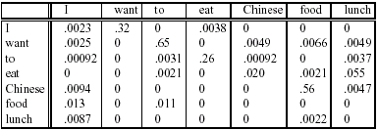
Learning a Bigram Grammar
The formula
P(w_{n}|w_{n-1}) = C(w_{n-1}w_{n})/C(w_{n-1})
is used for bigram “parameter estimation”

Slide 50
Training and Testing
Probabilities come from a training corpus, which is used to design the model.
overly narrow corpus: probabilities don't generalize
overly general corpus: probabilities don't reflect task or domain
A separate test corpus is used to evaluate the model, typically using standard metrics
held out test set
cross validation
evaluation differences should be statistically significant

Slide 51
Bigram Counts
 | I | Want | To | Eat | Chinese | Food | lunch
I | 8 | 1087 | 0 | 13 | 0 | 0 | 0
Want | 3 | 0 | 786 | 0 | 6 | 8 | 6
To | 3 | 0 | 10 | 860 | 3 | 0 | 12
Eat | 0 | 0 | 2 | 0 | 19 | 2 | 52
Chinese | 2 | 0 | 0 | 0 | 0 | 120 | 1
Food | 19 | 0 | 17 | 0 | 0 | 0 | 0
Lunch | 4 | 0 | 0 | 0 | 0 | 1 | 0

Slide 52
Smoothing Techniques
Every N-gram training matrix is sparse, even for very large corpora (Zipf’s law )
Solution: estimate the likelihood of unseen N-grams

Slide 53
Add-one Smoothing
Add 1 to every N-gram count
P(w_{n}|w_{n-1}) = C(w_{n-1}w_{n})/C(w_{n-1})
P(w_{n}|w_{n-1}) = [C(w_{n-1}w_{n}) + 1] / [C(w_{n-1}) + V]

Slide 54
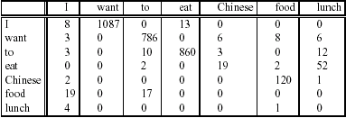
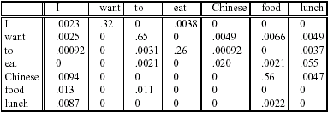
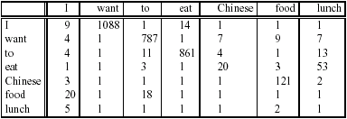
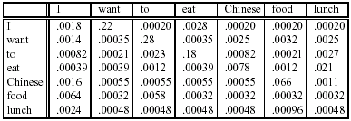
Add-one Smoothed Bigrams
Assume a vocabulary V=1500
P(w_{n}|w_{n-1}) = C(w_{n-1}w_{n})/C(w_{n-1})
P′(w_{n}|w_{n-1}) = [C(w_{n-1}w_{n})+1]/[C(w_{n-1})+V]

Slide 55
Back-off Methods
Notice that:
N-grams are more precise than (N-1)grams
But also, N-grams are more sparse than (N-1) grams
How to combine things?
Attempt N-grams and back-off to (N-1) if counts are not available
e.g. attempt prediction using 4-grams, and back-off to trigrams (or bigrams, or unigrams) if counts are not available

Slide 56
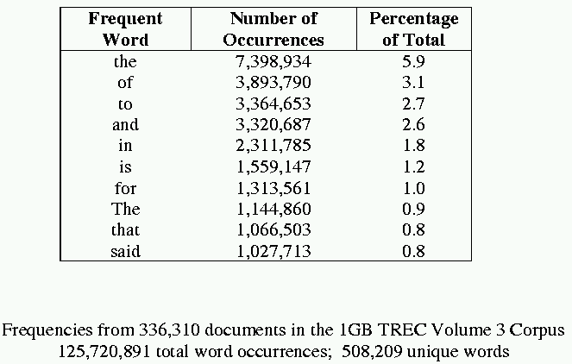
Distribution of words in language
Sample word frequency data

Slide 57
Zipf’s Law
Rank (r): The numerical position of a word in a list sorted by decreasing frequency (f ).
Zipf (1949) “discovered” that:

Slide 58
Letter-based models – do WE need them?…
Aoccdrnig to rscheearch at an Elingsh uinervtisy, it deosn't mttaer
in waht oredr the ltteers in a wrod are, olny taht the frist and
lsat ltteres are at the rghit pcleas. The rset can be a toatl mses
and you can sitll raed it wouthit a porbelm. Tihs is bcuseae we do
not raed ervey lteter by ilstef, but the wrod as a wlohe.

Slide 59
Thank YOU

