Slide 1
Morphology
Prof. Vipin Tyagi

Slide 2
Morphology
Morpheme = "minimal meaning-bearing unit in a language"
Morphology handles the formation of words by using morphemes
base form (stem), e.g., believe
affixes (suffixes, prefixes, infixes), e.g., un-, -able, -ly
Morphological parsing = the task of recognizing the morphemes inside a word
e.g., hands, foxes, children
Important for many tasks
machine translation
information retrieval
any further processing (e.g., part-of-speech tagging)

Slide 3
Morpheme types:
Free morpheme: A free morpheme is a word that can occur by itself. It can stand alone. However, we can add other morphemes in it. e.g. boy, man, establish, measure etc are free morphemes.
Bound morpheme: It is a grammatical unit that never occurs by itself, but is always attached to some other morphemes such as [s] in cats, [ness] in kindness, [ize] in visualize etc.

Slide 4
Morphemes and Words
Combine morphemes to create words
Inflection
combination of a word stem with a grammatical morpheme
same word class, e.g. clean (verb), clean-ing (verb)
Derivation
combination of a word stem with a grammatical morpheme
Yields different word class, e.g. clean (verb), clean-ing (noun)
Compounding
combination of multiple word stems
Cliticization
combination of a word stem with a clitic
different words from different syntactic categories, e.g. I’ve = I + have

Slide 5
Inflectional Morphology
Inflectional Morphology
word stem + grammatical morpheme cat + s
only for nouns, verbs, and some adjectives
Nouns
plural:
regular: +s, +es irregular: mouse - mice; ox - oxen
rules for exceptions: e.g. -y -> -ies like: butterfly - butterflies
possessive: +'s, +'
Verbs
main verbs (sleep, eat, walk)
modal verbs (can, will, should)
primary verbs (be, have, do)

Slide 6
Inflectional Morphology (nouns)
Noun Inflections for:
regular nouns (cat, hand); irregular nouns(child, ox)
Morph. Form Regularly Inflected Form
stem cat hand
plural form cats hands
Morph. Form Irregularly Inflected Form
stem child ox
plural form children oxen

Slide 7
Inflectional Morphology (verbs)
Verb Inflections for:
main verbs (sleep, eat, walk); primary verbs (be, have, do)
Morpholog. Form Regularly Inflected Form
stem walk merge try map
-s form walks merges tries maps
-ing participle walking merging trying mapping
past; -ed participle walked merged tried mapped
Morph. Form Irregularly Inflected Form
stem eat catch cut
-s form eats catches cuts
-ing participle eating catching cutting
-ed past ate caught cut
-ed participle eaten caught cut

Slide 8
Inflectional and Derivational Morphology (adjectives)
Adjective Inflections and Derivations:
prefix un- unhappy adjective, negation
suffix -ly happily adverb, mode
-er happier adjective, comparative 1
-est happiest adjective, comparative 2
suffix -ness happiness noun
plus combinations, like unhappiest, unhappiness.
Distinguish different adjective classes, which can or cannot take certain inflectional or derivational forms, e.g. no negation for big.

Slide 9
Derivational Morphology (nouns)

Slide 10
Derivational Morphology (adjectives)

Slide 11
Clitics

Slide 12
Affixation (making new words by adding affixes to stems)
Reduplication (making new words by doubling an entire free morpheme or part of it)
Alternations (making new words by morpheme-internal modifications)
Suppletion (making new words that are phonetically unrelated to the shape of the root)

Slide 13
Affixation
making new words by adding affixes (prefix, suffix, infix) to stems
Tagalog example of an infix
Verb stem Infinitive
sulat ‘write’ sumulat ‘to write’
bili ‘buy’ bumili ‘to buy’
kuha ‘take’ kumuha ‘to take’
Tagalog is a language of Philippines

Slide 14
Compounding
making new words from two or more independent words
English: girlfriend, blackboard, airconditioner, lifeinsurance, salesman

Slide 15
Reduplication
making new words by doubling an entire free morpheme or part of it
Indonesian: rumah ‘house’ vs.
rumahrumah ‘houses’

Slide 16
Alternation
making new words by morpheme-internal modifications
English: ring, rang, rung,
man vs. men
strife vs. strive

Slide 17
Suppletion
Making new words that are phonetically unrelated to the shape of the root (irregular)
English:
is vs. was
go vs. went

Slide 18
Open vs. Closed Word Classes
Open Class Types
The set of words in these classes can change over time, with the development of the language, e.g. download
nouns, verbs, adjectives, adverbs

Slide 19
Open vs. Closed Word Classes
Closed Class Types
The set of words in these classes are very much determined and hardly ever change for one language.
prepositions, determiners, pronouns, conjunctions, auxiliary verbs, particles, numerals

Slide 20
Closed Word Classes
Closed Class Types:
Prepositions: on, under, over, at, from, to, with, ...
Determiners: a, an, the, ...
Pronouns: he, she, it, his, her, who, I, ...
Conjunctions: and, or, as, if, when, ...
Auxiliary verbs: can, may, should, are, …
Particles: up, down, on, off, in, out, …
Numerals: one, two, three, ..., first, second, ...

Slide 21
Methods, Algorithms

Slide 22
Stemming
Stemming algorithms strip off word affixes
yield stem only, no additional information (like plural etc.)
used, e.g. in web search engines
famous stemming algorithm: the Porter stemmer

Slide 23
Stemming
Reduce tokens to “root” form of words to recognize morphological variation.
“computer”, “computational”, “computation” all reduced to same token “compute”
Correct morphological analysis is language specific and can be complex.
Stemming “blindly” strips off known affixes (prefixes and suffixes) in an iterative fashion.
for example compressed
and compression are both
accepted as equivalent to
compress.
for exampl compres and
compres are both accept
as equival to compres.

Slide 24
There are mainly two errors in stemming – over-stemming and under-stemming.
Over-stemming
Under-stemming

Slide 25
Porter Stemmer
Simple procedure for removing known affixes in English without using a dictionary.
Can produce unusual stems that are not English words:
“computer”, “computational”, “computation” all reduced to same token “comput”
May conflate (reduce to the same token) words that are actually distinct.
Does not recognize all morphological derivations
Typical rules in Porter stemmer
sses → ss
ies → i
ational → ate
tional → tion
ing → ε

Slide 26
The Porter Stemmer: definitions
Definitions:
VOWEL: A, E, I, O, U, and Y preceded by consonant
CONSONANT: a letter other than vowel
With this definition, all words are of the form:
(C)(VC)^{m}(V)
C=string of one or more consonants
V=string of one or more vowels
e.g.,
Tr o ubl e s
C V C V C

Slide 27
The Porter Stemmer: rule format
The rules are of the form:
(condition) S1 -> S2, where S1 and S2 are suffixes
Conditions:
m | The measure of the stem
*S | The stem ends with S
*v* | The stem contains a vowel
*d | The stem ends with a double consonant
*o | The stem ends in CVC (second C not W, X, or Y)

Slide 28
The Porter Stemmer: Step 1
SSES -> SS
caresses -> caress
IES -> I
ponies -> poni
ties -> ti
SS -> SS
caress -> caress
S -> є
cats -> cat

Slide 29
The Porter Stemmer: Step 2a (past tense, progressive)
(m>1) EED -> EE
Condition verified: agreed -> agree
Condition not verified: feed -> feed
(*V*) ED -> є
Condition verified: plastered -> plaster
Condition not verified: bled -> bled
(*V*) ING -> є
Condition verified: motoring -> motor
Condition not verified: sing -> sing

Slide 30
The Porter Stemmer: Step 2b (cleanup)
(These rules are applied if second or third rule in 2a apply)
AT-> ATE
conflat(ed) -> conflate
BL -> BLE
Troubl(ing) -> trouble
(*d & ! (*L or *S or *Z)) -> single letter
Condition verified: hopp(ing) -> hop, tann(ed) -> tan
Condition not verified: fall(ing) -> fall
(m=1 & *o) -> E
Condition verified: fil(ing) -> file
Condition not verified: fail -> fail

Slide 31
The Porter Stemmer: Steps 3 and 4
Step 3: Y Elimination (*V*) Y -> I
Condition verified: happy -> happi
Condition not verified: sky -> sky
Step 4: Derivational Morphology, I
(m>0) ATIONAL -> ATE
Relational -> relate
(m>0) IZATION -> IZE
generalization-> generalize
(m>0) BILITI -> BLE
sensibiliti -> sensible

Slide 32
The Porter Stemmer: Steps 5 and 6
Step 5: Derivational Morphology, II
(m>0) ICATE -> IC
triplicate -> triplic
(m>0) FUL -> є
hopeful -> hope
(m>0) NESS -> є
goodness -> good
Step 6: Derivational Morphology, III
(m>0) ANCE -> є
allowance-> allow
(m>0) ENT -> є
dependent-> depend
(m>0) IVE -> є
effective -> effect

Slide 33
The Porter Stemmer: Step 7 (cleanup)
Step 7a
(m>1) E -> є
probate -> probat
(m=1 & !*o) NESS -> є
goodness -> good
Step 7b
(m>1 & *d & *L) -> single letter
Condition verified: controll -> control
Condition not verified: roll -> roll

Slide 34
Examples
computers
Step 1, Rule 4: -> computer
Step 6, Rule 4: -> compute
singing
Step 2a, Rule 3: -> sing
Step 6, Rule 4: -> compute
controlling
Step 2a, Rule 3: -> controll
Step 7b : -> control
generalizations
Step 1, Rule 4: -> generalization
Step 4, Rule 11: -> generalize
Step 6, last rule: -> general

Slide 35
Problems
elephants -> eleph
Step 1, Rule 4: -> elephant
Step 6, Rule 7: -> eleph
doing - > doe
Step 2a, Rule 3: -> do

Slide 36
http://textanalysisonline.com/nltk-porter-stemmer
gives
gas (noun) → ga
gases (plural) → gase
gasses (verb, present tense) → gass
gassing (verb, present continuous) → gass
gaseous (adjective) → gaseou
This is not good – all these words should ideally reduce to the same stem.
Trade-off: More rules (accurate but slow) vs Less rules (efficient but sometimes wrong).

Slide 37
Tokenization, Word Segmentation
Tokenization or word segmentation
separate out “words” (lexical entries) from running text
expand abbreviated terms
e.g. I’m into I am, it’s into it is
collect tokens forming single lexical entry
e.g. New York marked as one single entry

Slide 38
Simple Tokenization
Analyze text into a sequence of discrete tokens (words)
Sometimes punctuation (e-mail), numbers (1999), and case (Republican vs. republican) can be a meaningful part of a token
Simplest approach is to ignore all numbers and punctuation and use only case-insensitive unbroken strings of alphabetic characters as tokens

Slide 39
Punctuation
Children’s: use language-specific mappings to normalize
State-of-the-art: break up hyphenated sequence
U.S.A. vs. USA
a.out

Slide 40
Numbers
3/12/91
Mar. 12, 1991
55 A.D.
B-52
100.2.86.144

Slide 41
Lemmatization
Reduce inflectional/derivational forms to base form
Direct impact on vocabulary size
e.g.,
am, are, is → be
car, cars, car's, cars' → car
the boy's cars are different colors → the boy car be different color
How to do this?
Need a list of grammatical rules + a list of irregular words
Children → child, spoken → speak …

Slide 42
Morphological Processing
Knowledge
lexical entry: stem plus possible prefixes, suffixes plus word classes, e.g. endings for verb forms
rules: how to combine stem and affixes, e.g. add s to form plural of noun as in dogs
orthographic rules: spelling, e.g. double consonant as in mapping
Processing: Finite State Transducers
take information above and analyze word token / generate word form

Slide 43
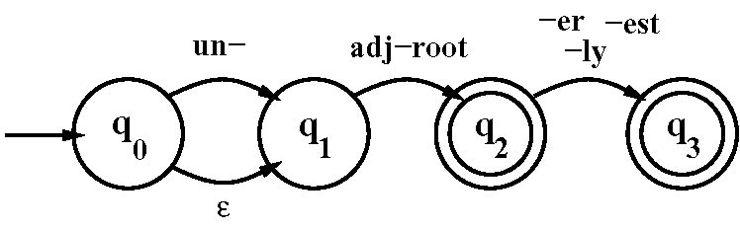
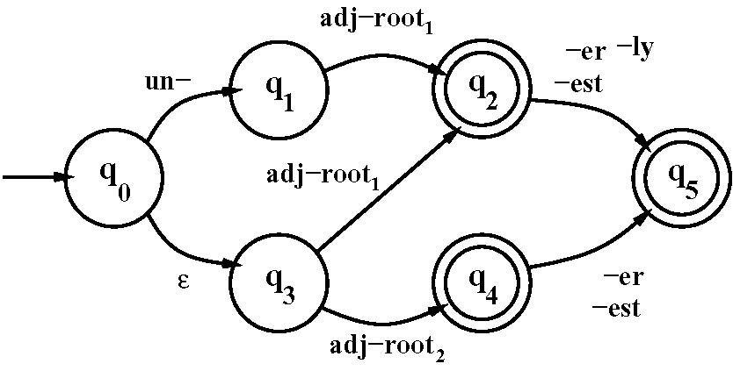
Simple Finite State Automata for adjective inflection
More detailed FSA for adjective inflection

Slide 44
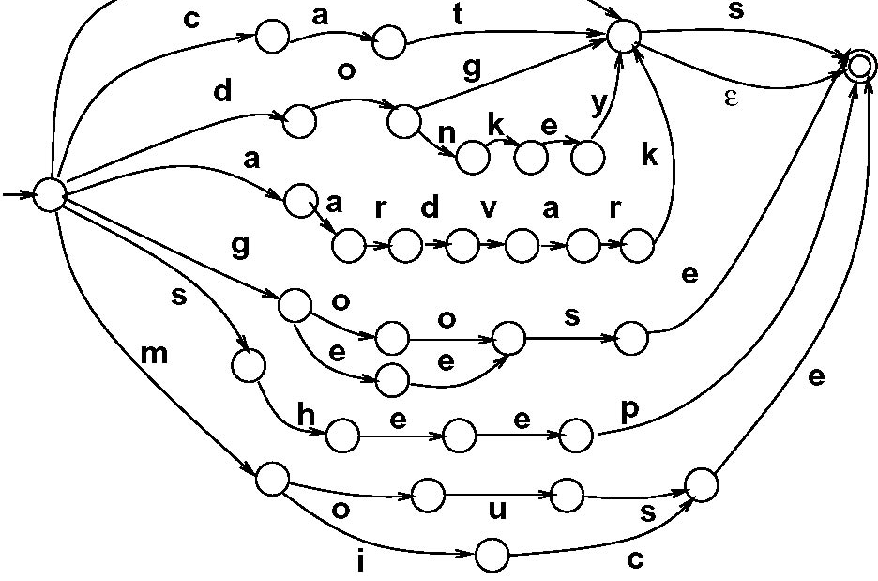
Compiled FSA for noun inflection

