Slide 1
Alice in wonderland
“Would you tell me, please, which way I ought to go from here?” “That depends a good deal on where you want to get to,” said the Cat. “I don’t much care where—” said Alice. “Then it doesn’t matter which way you go,” said the Cat. “—so long as I get somewhere,” Alice added as an explanation. “Oh, you’re sure to do that,” said the Cat, “if you only walk long enough.”

Slide 2
Question Answering
Prof. Vipin Tyagi‏

Slide 3
What is Question Answering?
Question Answering (QA) is a computer science discipline within the fields of information retrieval and natural language processing (NLP), which is concerned with building systems that automatically answer questions posed by humans in a natural language. -Wikipedia

Slide 4
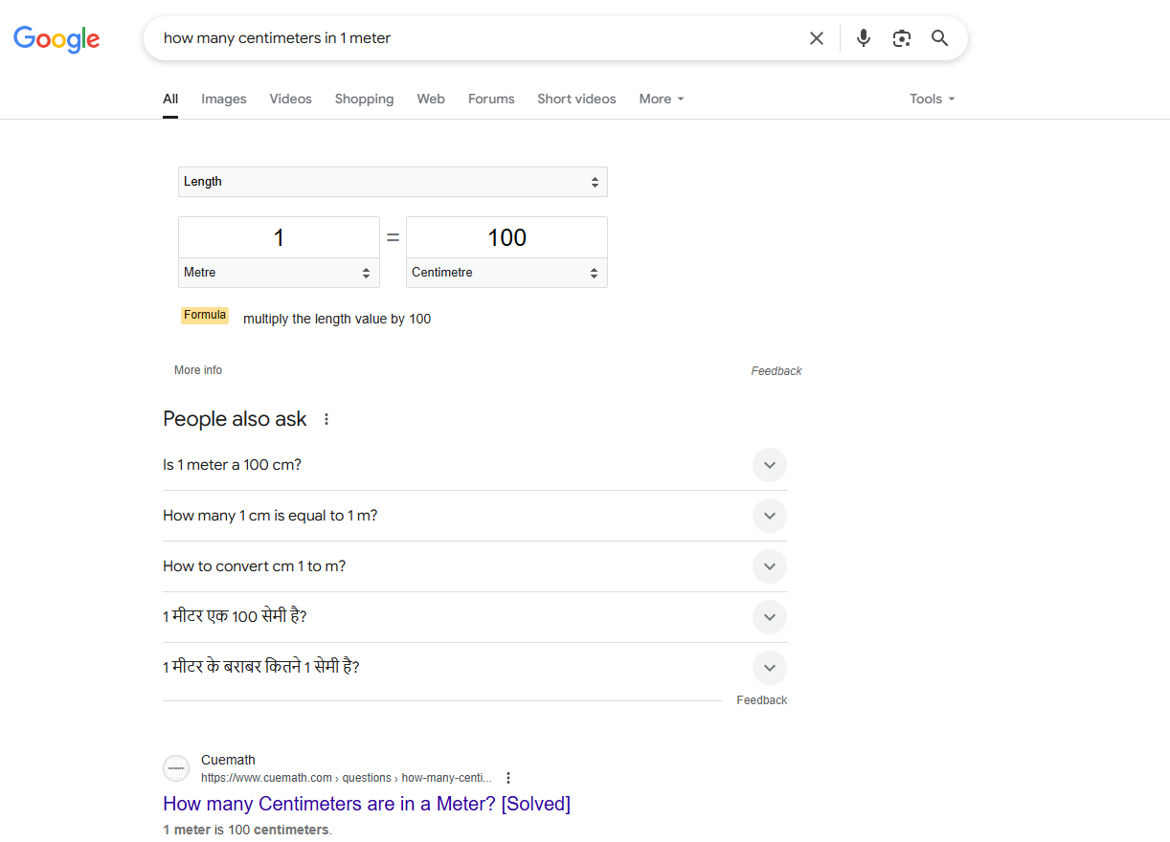
Google Search

Slide 5
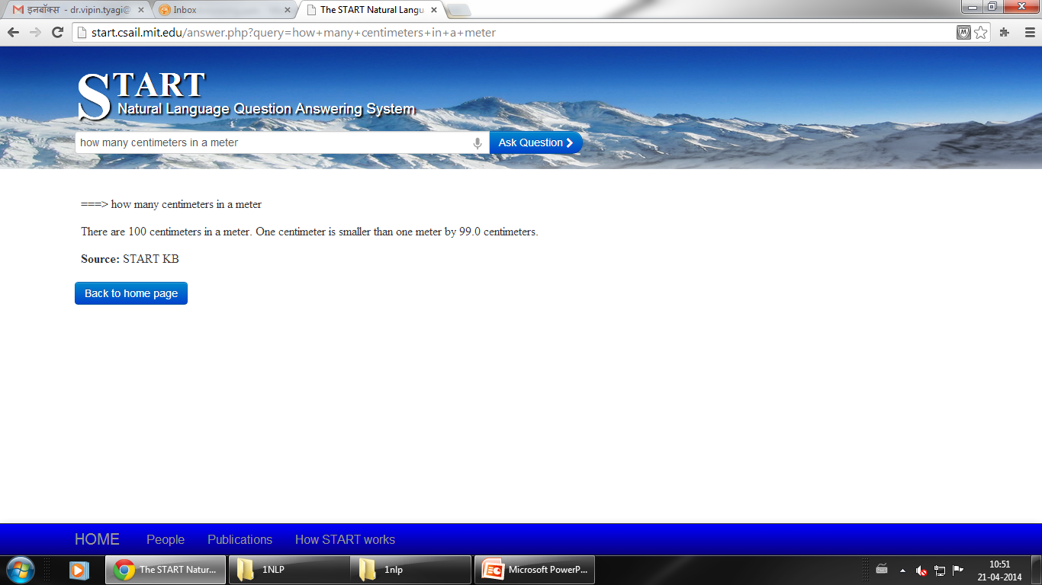
https://start.csail.mit.edu/

Slide 6
QA Different From Search
QA
Search
Input
Natural Language Question
Query containing keywords
Output
Concise answer
List of documents
Uses
Quick references
Extensive research

Slide 7
Issues to be Considered
Question Classes
Question Processing
Data Sources
Answer Extraction
Answer Formulation
Advanced Reasoning for QA

Slide 8
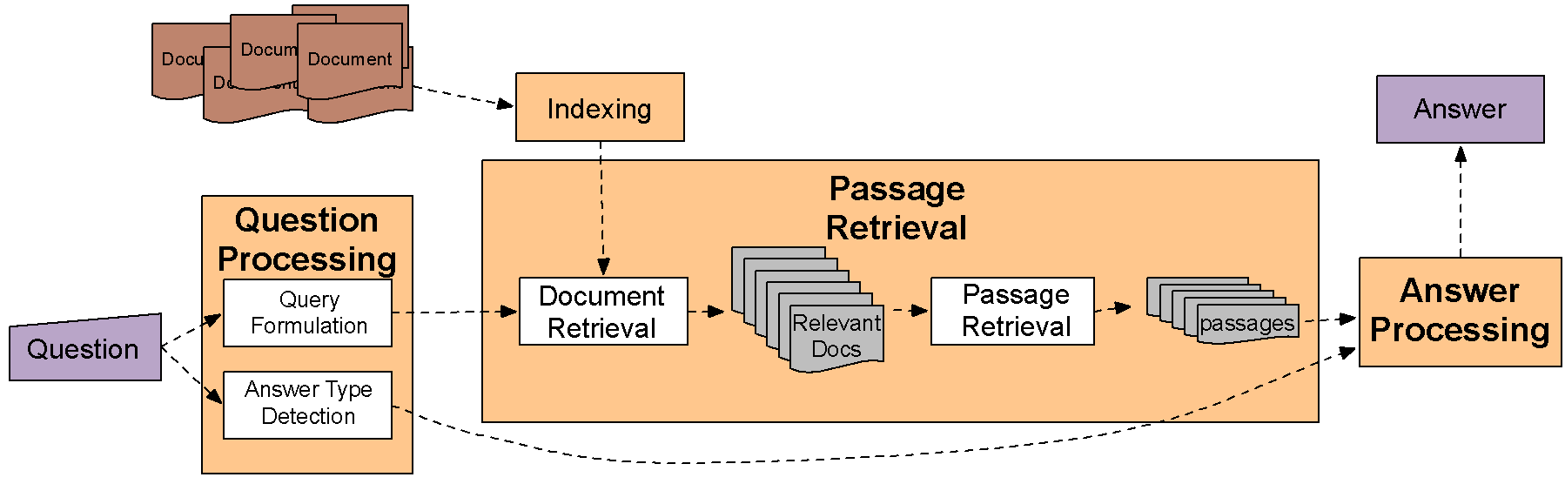
IR-based Factoid QA

Slide 9
START (SynTactic Analysis using Reversible Transformations) ‏http://start.csail.mit.edu/index.php

Slide 10
developed by Boris Katz at MIT's Artificial Intelligence Laboratory
On World Wide Web in December, 1993
Key technique is "natural language annotation"

Slide 11
Two basic foundations
Sentence level Natural Language Processing capabilities
Natural Language Annotations

Slide 12
T-expressions(Ternary expressions)‏
<subject, relation, object>
Exp:
Sentence: “Bill surprised Hillary with his answer”
T-expression:
<Bill surprise Hillary>< with answer><answer related-to Bill>
History:
contains other parameters (adverbs, tense, etc.)‏
attached to the expression
Knowledge base is searched for the T-expression

Slide 13
Solution by T-expression
Q: Whom did Bill surprise with his answer?
Step1: Bill surprised whom with his answer
Step2:
<Bill surprise whom> <with answer><answer related-to Bill>
Step3: It matches to the earlier T-expression
Step4: produce the answer
A: Bill surprised Hillary with his answer.

Slide 14
S-rules
Q: Whose answer surprised Hillary?
T-expression :
<answer surprise Hillary>
<answer related-to whom>
No match for this T-expresssion

Slide 15
S-rules(Cont.)‏
Need a rule like:
A surprised B with C => A's C surprised B
Surprise S-rule:
If<<subject surprise object1> with object2>
Then<object2 surprise object1>

Slide 16
S-rules(Cont.)‏
Should be generalised for similar verbs as surprise like anger, disappoint, please, etc.(emotional-reaction class)‏
Property-factoring S-rule:
If<<subject verb object1> with object2>
Then<object2 verb object1>
Provided verb IN emotional-reaction class

Slide 17
Natural Language Annotations
Computer analyzable collections of natural language sentences and phrases that describe the contents of various information segments
A pointer is associated with sentences which points to the information segment summarized by the annotations.
Instead of producing just the sentence as answer, START follows the pointer and gives the text segment with the answer sentence.

Slide 18
Omnibase assists START
Q: “Who directed gone with the wind?”
START should know that “Gone with the wind” is an entity(movie name).
Omnibase (a virtual database) helps here with this info
It also tells where to find the info (here in movie data source)‏
Now the question is : “Who directed X”

Slide 19
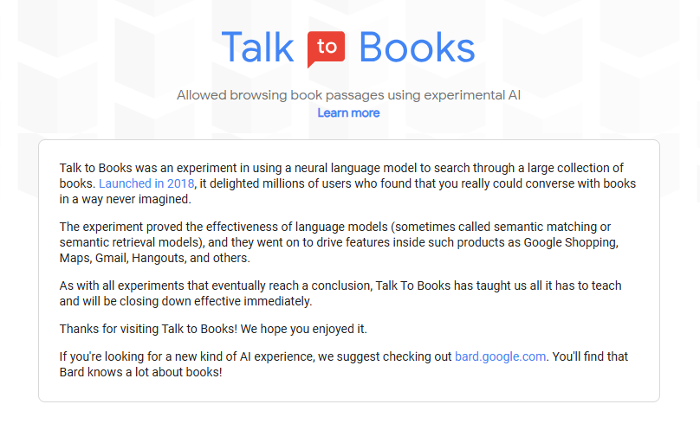
Google Research
Now Gemini

Slide 20


Slide 21
In Talk to books, when a question is asked , the model looks at every sentence in over 100,000 books to find the responses that would most likely come next in a conversation. The response sentence is shown in bold, along with some of the text that appeared next to the sentence for context.

Slide 22
https://www.geonames.org/
The GeoNames geographical database contains over 25 million geographical names and consists of over 12 million unique features whereof 4.8 million populated places and 16 million alternate names. All features are categorized into one out of nine feature classes and further subcategorized into one out of 645 feature codes.
The data is accessible free of charge.

Slide 23
OpenEphyra
OpenEphyra, an open framework for question answering

Slide 24
Ephyra Introduction
Open domain question answering system
Has a very modular approach and can be adapted to other languages
Uses semantic role labeling and pattern matching
Time dependent questions not taken into consideration
Like all other systems composed mainly of three modules
Query formulation
Search
Answer selection

Slide 25
Process of Question Interpretation
Co-reference resolution
Resolve personal, possessive and demonstrative pronouns
Question Normalization
Drops punctuation and quotation marks
Stems verbs and nouns
Semantic Parsing of Questions
Question is transformed into a statement
Semantic Role Labeling is done
Query Generation and Expansion
Keyword queries
Term queries
Predicate queries
Reformulation queries

Slide 26
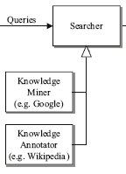
Search Module
The search module consists of two kind of searchers:
Knowledge Miners: searches from unstructured data
Knowledge Annotators: provide semi-structured information
Answer
Candidates

Slide 27
Answer Extraction
Two ways to extract answers
Answer Type analysis
Pattern Learning approach
Answer Type Analysis
Consists of a set of 154 answer types
Uses features to classify answers
Lexical Features: UNIGRAM
Syntactic Features: MAIN_VERB, WH_WORD
Semantic Features: FOCUS_TYPE
Patterns are associated with the types
Example Named Entity Type: Weekday
Example Pattern: (what|which|name) (.*)?(day of the)?week|weekday)‏
Has high precision but fails for answers that cannot be tagged

Slide 28
Semantic Role based extraction of Candidate Answers
Initial Pruning
Number of tokens is within limit
The predicate verb or a semantically related verb must be present
Must contain an entity of the same type as that of the question
If type not known; must contain one semantically similar term
Similarity Score
Term similarity
Verb similarity
Argument Similarity
Predicate Similarity

Slide 29
Pattern Learning Approach
Answer patterns can be learned using question answer pairs as training data
Learning algorithm
Tuples containing target, context and answer are fed to searchers
Example tuple: calories, Burger, 560
All named entities are replaced by their types
Some generic patterns are used to learn property specific pattern
Generalization done by keeping the NE types and making other tokens optional
Answer ranking is done by adding the confidence value
Answer Evaluation
Confidence = (correct/(correct+incorrect))‏

Slide 30
A Joint Answer Ranking Model

Slide 31
Joint Answer Ranking
A graph model based method
Estimates the correctness of individual answers
Gives correlation between the answers

Slide 32
Candidate Generation
Document retrieval
Question analysis
Answer extraction

Slide 33
Issues with Candidates
Answer Relevance
Answer Similarity

Slide 34
The model
Estimate the joint probability of all the answer candidates
Infer the probability of individual candidates from the above

Slide 35
Algorithm
Create empty answer pool
Estimate joint probability of all answer candidates
Calculate the marginal probability that an individual answer candidate is correct
Choose the answer candidate whose marginal probability is highest, and move it to the answer pool

Slide 36
For the remaining answer candidates :
The problem is modeled into an undirected graph model problem
Calculate the conditional probability of individual answers given the chosen answer(s)
Calculate the score of each answer candidate from the marginal and conditional probability
Choose the answer whose Score(Aj) is maximum, and move it to the answer pool

Slide 37
Thank You

