Slide 1
Automatic Summarization
Prof. Vipin Tyagi

Slide 2
MILAN, Italy, April 18. A small airplane crashed into a government
building in heart of Milan, setting the top floors on fire, Italian
police reported. There were no immediate reports on casualties as
rescue workers attempted to clear the area in the city's financial
district. Few details of the crash were available, but news reports
about it immediately set off fears that it might be a terrorist act
akin to the Sept. 11 attacks in the United States. Those fears sent
U.S. stocks tumbling to session lows in late morning trading.
Witnesses reported hearing a loud explosion from the 30-story
office building, which houses the administrative offices of the local
Lombardy region and sits next to the city's central train station.
Italian state television said the crash put a hole in the 25th floor
of the Pirelli building. News reports said smoke poured from the
opening. Police and ambulances rushed to the building in downtown
Milan. No further details were immediately available.

Slide 3
What happened?
MILAN, Italy, April 18. A small airplane crashed into a government
building in heart of Milan, setting the top floors on fire, Italian
police reported. There were no immediate reports on casualties as
rescue workers attempted to clear the area in the city's financial
district. Few details of the crash were available, but news reports
about it immediately set off fears that it might be a terrorist act
akin to the Sept. 11 attacks in the United States. Those fears sent
U.S. stocks tumbling to session lows in late morning trading.
Witnesses reported hearing a loud explosion from the 30-story
office building, which houses the administrative offices of the local
Lombardy region and sits next to the city's central train station.
Italian state television said the crash put a hole in the 25th floor
of the Pirelli building. News reports said smoke poured from the
opening. Police and ambulances rushed to the building in downtown
Milan. No further details were immediately available.
When, where?
How many victims?
Says who?
Was it a terrorist act?
What was the target?

Slide 4
1. How many people were injured?
2. How many people were killed? (age, number, gender, description)
3. Was the pilot killed?
4. Where was the plane coming from?
5. Was it an accident (technical problem, illness, terrorist act)?
6. Who was the pilot? (age, number, gender, description)
7. When did the plane crash?
8. How tall is the Pirelli building?
9. Who was on the plane with the pilot?
10. Did the plane catch fire before hitting the building?
11. What was the weather like at the time of the crash?
12. When was the building built?
13. What direction was the plane flying?
14. How many people work in the building?
15. How many people were in the building at the time of the crash?
16. How many people were taken to the hospital?
17. What kind of aircraft was used?

Slide 5
Text Summarization
produce an abridged version of a text that contains information that is important or relevant to a user.
Summarization Applications
outlines or abstracts of any document, article, etc.
summaries of email threads
action items from a meeting
simplifying text by compressing sentences

Slide 6
Single vs. multiple documents
Single-document summarization
Given a single document, produce
abstract
outline
headline
Multiple-document summarization
Given a group of documents, produce a gist of the content:
a series of news stories on the same event
a set of web pages about some topic or question

Slide 7
Summarization
Generic summarization:
Summarize the content of a document
Query-focused summarization:
summarize a document with respect to an information need expressed in a user query.
a kind of complex question answering:
Answer a question by summarizing a document that has the information to construct the answer

Slide 8
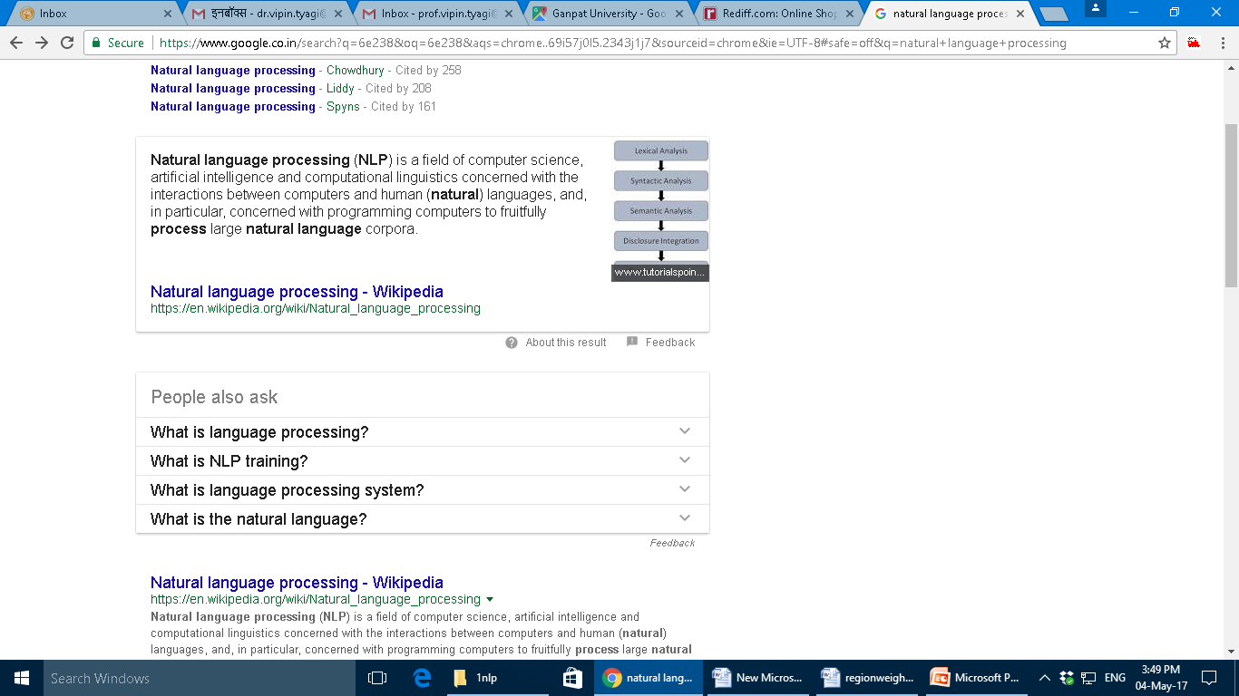
Snippets
Create snippets summarizing a web page for a query
Google: 156 characters (about 26 words) plus title and link

Slide 9
Summarization for Question Answering: Multiple documents
Create answers to complex questions summarizing multiple documents.
Instead of giving a snippet for each document
Create a cohesive answer that combines information from each document

Slide 10
Extractive summarization & Abstractive summarization
Extractive summarization:
create the summary from phrases or sentences in the source document(s)
Abstractive summarization:
express the ideas in the source documents using (at least in part) different words

Slide 11
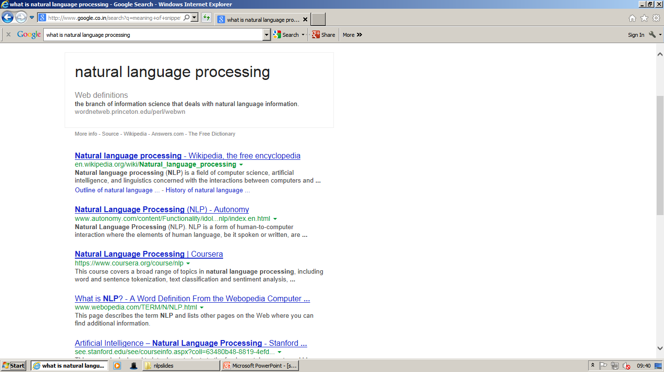
Simple baseline: take the first sentence
Natural language processing (NLP) is a field of computer science, artificial intelligence, and linguistics concerned with the interactions between computers and human (natural) languages

Slide 12
Summarization: Three Stages
content selection: choose sentences to extract from the document
information ordering: choose an order to place them in the summary
sentence realization: clean up the sentences

Slide 13
Supervised content selection
Given:
a labeled training set of good summaries for each document
Align:
the sentences in the document with sentences in the summary
Extract features
position (first sentence?)
length of sentence
word informativeness, cue phrases
cohesion
Train
Problems:
hard to get labeled training data
performance not better than unsupervised algorithms
So in practice:
Unsupervised content selection is more common
a binary classifier (put sentence in summary? yes or no)

Slide 14
Definition questions
Q: What is water spinach?
A: Water spinach (ipomoea aquatica) is a semi-aquatic leafy green plant with long hollow stems and spear- or heart-shaped leaves, widely grown throughout Asia as a leaf vegetable. The leaves and stems are often eaten stir-fried flavored with salt or in soups. Other common names include morning glory vegetable, kangkong (Malay), rau muong (Viet.), ong choi (Cant.), and kong xin cai (Mand.). It is not related to spinach, but is closely related to sweet potato and convolvulus.

Slide 15
Medical questions
Q: In children with an acute febrile illness, what is the efficacy of single medication therapy with acetaminophen or ibuprofen in reducing fever?
A: Ibuprofen provided greater temperature decrement and longer duration of antipyresis than acetaminophen when the two drugs were administered in approximately equal doses. (PubMedID: 1621668, Evidence Strength: A)

Slide 16
Other complex questions
How is compost made and used for gardening (including different types of compost, their uses, origins and beneﬁts)?
What causes train wrecks and what can be done to prevent them?
Where have poachers endangered wildlife, what wildlife has been endangered and what steps have been taken to prevent poaching?
What has been the human toll in death or injury of tropical storms in recent years?

Slide 17
Answering harder questions: Query-focused multi-document summarization
The (bottom-up) snippet method
Find a set of relevant documents
Extract informative sentences from the documents
Order and modify the sentences into an answer
The (top-down) information extraction method
build specific answers for different question types:
definition questions
biography questions
certain medical questions

Slide 18
Simplifying sentences
Simplest method: parse sentences, use rules to decide which modifiers to prune (using machine-learning methods)
Rajam, 28, an artist who was living at the time in Philadelphia, found the inspiration in the back of city magazines.
Rebels agreed to talks with government officials, international observers said Tuesday.
The commercial fishing restrictions in Washington will not be lifted unless the salmon population increases [PP to a sustainable number]]
“For example”, “On the other hand”, “As a matter of fact”, “At this point”

Slide 19
Maximal Marginal Relevance (MMR)
An iterative method for content selection from multiple documents
Iteratively (greedily) choose the best sentence to insert in the summary/answer so far:
Relevant: Maximally relevant to the user’s query
high cosine similarity to the query
Novel: Minimally redundant with the summary/answer so far
low cosine similarity to the summary
Stop when desired length

Slide 20
Information Ordering
Chronological ordering:
Order sentences by the date of the document (for summarizing news)..
Coherence:
Choose orderings that make neighboring sentences similar
Choose orderings in which neighboring sentences discuss the same entity
Topical ordering:
Learn the ordering of topics in the source documents

Slide 21
Domain-specific answering: The Information Extraction method
a good biography of a person contains:
a person’s birth/death, fame factor, education, nationality and so on
a good definition contains:
genus or hypernym
a medical answer about a drug’s use contains:
the problem (the medical condition),
the intervention (the drug or procedure), and
the outcome (the result of the study).

Slide 22
Thank You

