Slide 1
Relation Extraction
Prof. Vipin Tyagi

Slide 2
Extracting relations from text
Company report: “International Business Machines Corporation (IBM or the company) was incorporated in the State of New York on June 16, 1911, as the Computing-Tabulating-Recording Co. (C-T-R)…”
Extracted Complex Relation:
Company-Founding
Company IBM
Location New York
Date June 16, 1911
Original-Name Computing-Tabulating-Recording Co.
Simpler relation triples
Founding-year(IBM,1911)
Founding-location(IBM,New York)

Slide 3
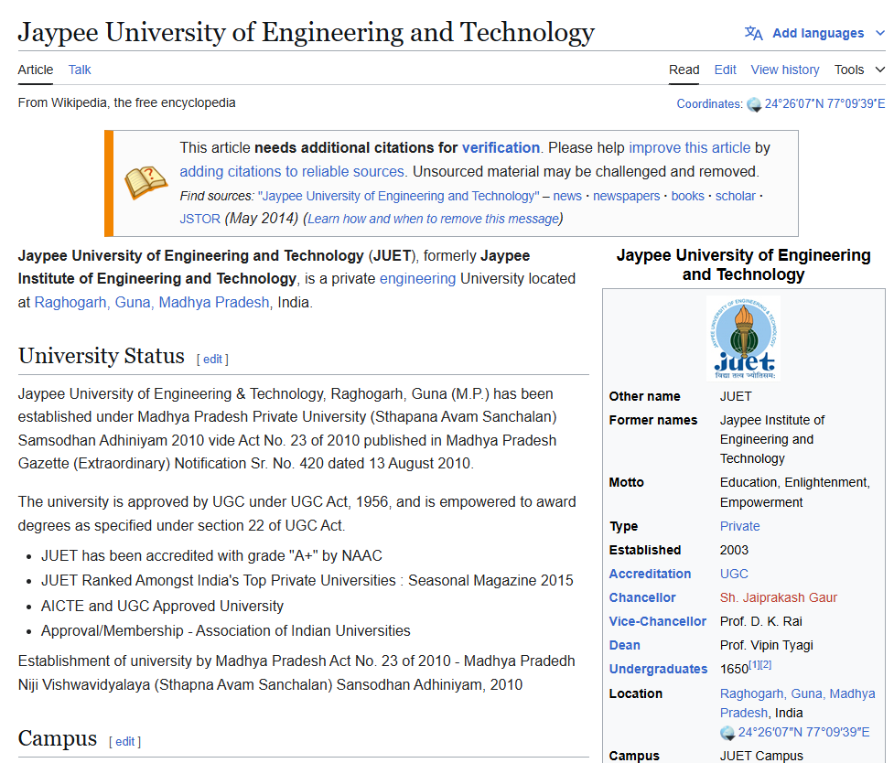
Extracting Relation Triples from Text
Jaypee University of Engineering and Technology (JUET), formerly Jaypee Institute of Engineering and Technology, is a private Engineering University located at Raghogarh, Guna, Madhya Pradesh, India.
JUET LOC-IN RAGHOGARH
JUET IS-A engineering university

Slide 4
Relation Extraction
Create new structured knowledge bases, useful for any application
Augment current knowledge bases
Adding words to WordNet thesaurus
Support question answering
The granddaughter of which actor starred in the movie “E.T.”?
(acted-in ?x “E.T.”)(is-a ?y actor)(granddaughter-of ?x ?y)

Slide 5
Automated Content Extraction
17 relations from 2008 “Relation Extraction Task”

Slide 6
Automated Content Extraction
Physical-Located PER-GPE
He was in Guna
Part-Whole-Subsidiary ORG-ORG
XYZ, the parent company of ABC
Person-Social-Family PER-PER
Ram’s wife Sita
Org-AFF-Founder PER-ORG
Steve Jobs, co-founder of Apple…

Slide 7
UMLS: Unified Medical Language System
The Unified Medical Language System (http://www.nlm.nih.gov/research/umls/) is a terminology integration system to establish correspondence among terms from different terminologies for a given biomedical entity.
127 semantic types, 54 relations
Injury disrupts Physiological Function
Bodily Location location-of Biologic Function
Anatomical Structure part-of Organism
Pharmacologic Substance causes Pathological Function
Pharmacologic Substance treats Pathologic Function

Slide 8
Extracting UMLS relations from a sentence
Doppler echocardiography can be used to diagnose left anterior descending artery stenosis in patients with type 2 diabetes
⬇
Echocardiography, Doppler DIAGNOSIS Acquired stenosis

Slide 9
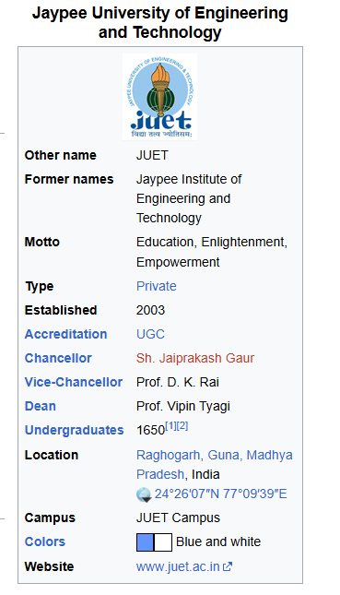
Databases of Wikipedia Relations
Wikipedia Infobox
Relations extracted from Infobox
JUET Type Private
JUET motto “Education, Enlightenment, Empowerment”
……

Slide 10
Relation databases from Wikipedia
dbpedia.org
Resource Description Framework (RDF) triples
subject predicate object
Golden Gate Park location San Francisco
dbpedia:Golden_Gate_Park dbpedia-owl:location dbpedia:San_Francisco
DBPedia: 1 billion RDF triples, many from English Wikipedia
Frequent Freebase relations:
people/person/nationality, location/location/contains
people/person/profession, people/person/place-of-birth
biology/organism_higher_classification film/film/genre

Slide 11
Ontological relations
Examples from the WordNet Thesaurus
IS-A (hypernym): subsumption between classes
Giraffe IS-A ruminant IS-A ungulate IS-A mammal IS-A vertebrate IS-A animal…
Instance-of: relation between individual and class
Guna instance-of city

Slide 12
Rules for extracting IS-A relation
Hearst (1992)
“Agar is a substance prepared from a mixture of red algae, such as Gelidium, for laboratory or industrial use”
What does Gelidium mean?
How do you know?`

Slide 13
Hearst’s Patterns for extracting IS-A relations
“Y such as X ((, X)* (, and|or) X)”
“such Y as X”
“X or other Y”
“X and other Y”
“Y including X”
“Y, especially X”

Slide 14
Hearst’s Patterns for extracting IS-A relations
Hearst pattern | Example occurrences
X and other Y | ...temples, treasuries, and other important civic buildings.
X or other Y | Bruises, wounds, broken bones or other injuries...
Y such as X | The bow lute, such as the Bambara ndang...
Such Y as X | ...such authors as Herrick, Goldsmith, and Shakespeare.
Y including X | ...common-law countries, including Canada and England...
Y , especially X | European countries, especially France, England, and Spain...

Slide 15
Extracting Richer Relations Using Rules
Intuition: relations often hold between specific entities
located-in (ORGANIZATION, LOCATION)
founded (PERSON, ORGANIZATION)
cures (DRUG, DISEASE)
Start with Named Entity tags to help extract relation!

Slide 16


Which relations hold between 2 entities?
Cure?
Prevent?
Drug
Cause?
Disease

Slide 17
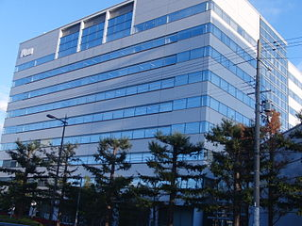

Founder?
Investor?
Member?
PERSON
ORGANIZATION
Employee?
President?

Slide 18
Extracting Richer Relations Using Rules and Named Entities
Who holds what office in what organization?
PERSON, POSITION of ORG
Narendra Modi, Prime Minister of India
PERSON(named|appointed|chose|etc.) PERSON Prep? POSITION
Ram appointed Shyam Secretary of Society
PERSON [be]? (named|appointed|etc.) Prep? ORG POSITION
Shyam was named Secretary of Society

Slide 19
Building relation extractors
Hand-written patterns
Supervised machine learning
Semi-supervised and unsupervised machine learning

Slide 20
Supervised machine learning for relations
Choose a set of relations to extract
Choose a set of relevant named entities
Find and label data
Choose a representative corpus
Label the named entities in the corpus
Hand-label the relations between these entities
Break into training, development, and test set
Train a classifier on the training set

Slide 21
Classification in supervised relation extraction
Find all pairs of named entities (usually in same sentence)
Decide if 2 entities are related
If yes, classify the relation

Slide 22

Relation Extraction
Classify the relation between two entities in a sentence
American Airlines, a unit of AMR, immediately matched the move, spokesman Tim Wagner said.
EMPLOYMENT
FAMILY
NIL
CITIZEN
…
INVENTOR
SUBSIDIARY
FOUNDER

Slide 23
Word Features for Relation Extraction
American Airlines, a unit of AMR, immediately matched the move, spokesman Tim Wagner said
Mention 1
Mention 2
Headwords of M1 and M2, and combination
Airlines Wagner Airlines-Wagner
Bag of words and bigrams in M1 and M2
{American, Airlines, Tim, Wagner, American Airlines, Tim Wagner}
Words or bigrams in particular positions left and right of M1/M2
M2: -1 spokesman
M2: +1 said
Bag of words or bigrams between the two entities
{a, AMR, of, immediately, matched, move, spokesman, the, unit}

Slide 24
American Airlines, a unit of AMR, immediately matched the move, spokesman Tim Wagner said
Mention 1
Mention 2
Named-entity types
M1: ORG
M2: PERSON
Concatenation of the two named-entity types
ORG-PERSON
Entity Level of M1 and M2 (NAME, NOMINAL, PRONOUN)
M1: NAME [it or he would be PRONOUN]
M2: NAME [the company would be NOMINAL]

Slide 25
Thank You

