Slide 1
Sentiment Analysis & Opinion on the Web
Prof. Vipin Tyagi

Slide 2

Sentiment Analysis
Identify the orientation of opinion in a piece of text
Can be generalized to a wider set of emotions
The movie
was fabulous!
The movie
stars Mr. X
The movie
was horrible!
[ Sentimental ]
[ Factual ]
[ Sentimental ]

Slide 3
SA at different levels
Word-level SA
The movie was
interesting and
fabulous
The movie was
very boring
The police stopped
corruption
His last movie was
great.
His last movie was
Great and interesting.
This one is boring.
Sentence-level SA
Document-level SA
fabulous
interesting
boring

Slide 4
Challenges
Contrasts with standard text-based categorization
Domain dependent
Thwarted expressions
Mere presence of words is
Indicative of the category
in case of text categorization.
Not the case with
sentiment analysis
Sentiment of a word
is w.r.t. the
domain.
Example: ‘unpredictable’
For steering of a car,
For movie review,
Sarcasm uses words of
a polarity to represent
another polarity.
Example: The perfume is so
amazing that I suggest you wear it
with your windows shut
the sentences/words that
contradict the overall sentiment
of the set are in majority
Example: The actors are good,
the music is brilliant and appealing.
Yet, the movie fails to strike a chord.

Slide 5
Opinion on the Web

Slide 6
Web has emotions!

Slide 7
Sentiment Analysis aims at getting (textual) sentiment-related information from documents (on the web)
Does web really contain sentiment-related information?
Where?
How much?

Slide 8
Blogs
User comments
Review websites
Community websites

Slide 9
Blog
A blog (a contraction of the term "weblog") is a type of website, usually maintained by an individual with regular entries of commentary, descriptions of events.
The collective community of all blogs is known as the blogosphere.
Who?
• Hobbyists (72%)
• Part-Timers (15%)
• Corporate (4%)
• Self Employed (9%)

Slide 10
How is the blogosphere formed?
Bloggers (people who blog) get connected by:
Comments (on each others’ blogs.)
* Something coming up
Blogroll : List of blogs that I follow
Memetrackers : Check citations moving around to track how a ‘meme’ is moving around the blogosphere

Slide 11
Size of the blogosphere
About 12,000 created each day. Average, a new weblog created every 7.4 seconds
Social networks/blogs very popular online category

Slide 12
Size of the blogosphere
On www.blogger.com alone, (by Google., Claims to be the largest.) a blog crawler could extract 88 million blog URLs.
Blogging providers: Blogger, WordPress.com, LiveJournal, Xanga
Blogging Listers: Technorati,

Slide 13
Why blogs for SA?
User-controlled: I speak my heart
Blogs represent individual writers, whose texts exhibit both written and spoken qualities
Temporal nature of blog entries and the structure of the blogosphere

Slide 14
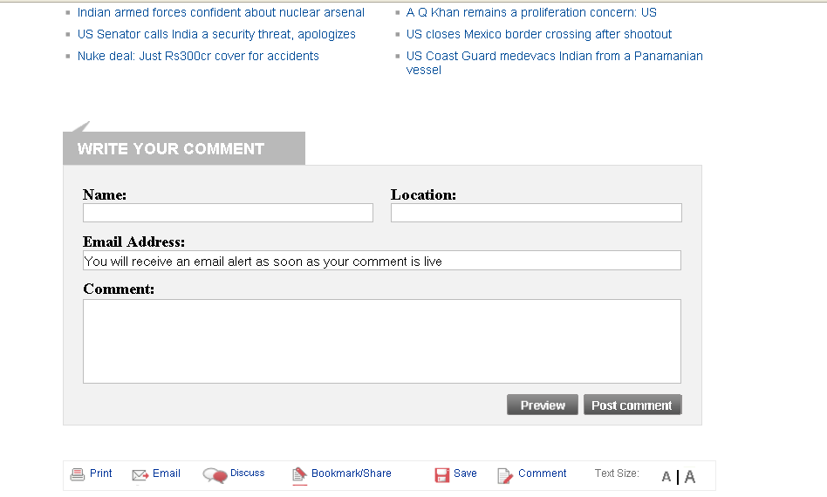
User Comments

Slide 15
User Comments
Comments about the article/ blogpost:
Very well-written indeed…
Comments about the topic of the article:
I agree with you.. I used to love **’s movies at a point of time but these days all he comes out with is trash. <Leads to a discussion>
- Comments about the blogger:
If you think Shahid Kapoor is ugly, go buy glasses. (While you are at it, buy yourself a brain too)

Slide 16
Some Review Websites
Restaurant reviews (now, for a variety of ‘lifestyle’ products/services)
www.zomato.com
www.mouthshut.com
www.justdial.com
www.yelp.com
www.bollywoodhungama.com
www.tripadvisor.in
A wide variety of reviews
Prof. reviews : Well-formed
User reviews: More mistakes
Movie reviews by professional critics, users. Links to external reviews also present

Slide 17
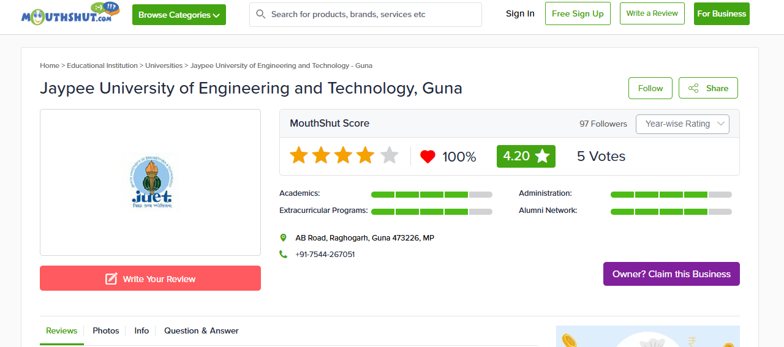
A typical Review website

Slide 18
Sample Review 1 (This, that and this)
‘Touch screen’ today signifies
a positive feature.
Will it be the same in the future?
FLY E300 is a good mobile which i purchased recently with lots of hesitation. Since this Brand is not familiar in Market as well known as Sony Ericsson. But i found that E300 was cheap with almost all the features for a good mobile. Any other brand with the same set of features would come around 19k Indian Ruppees.. But this one is only 9k. Touch Screen, good resolution, good talk time, 3.2Mega Pixel camera, A2DP, IRDA and so on... BUT BEWARE THAT THE CAMERA IS NOT THAT GOOD, THOUGH IT FEATURES 3.2 MEGA PIXEL, ITS NOT AS GOOD AS MY PREVIOUS MOBILE SONY ERICSSION K750i which is just 2Mega Pixel. Sony ericsson was excellent with the feature of camera. So if anyone is thinking for Camera, please excuse. This model of FLY is not apt for you.. Am fooled in this regard.. Audio is not bad, infact better than Sony Ericsson K750i. FLY is not user friendly probably since we have just started to use this Brand.
Comparing old products
The confused conclusion

Slide 19
Sample Review 2 (Noise)
Hi, I have Haier phone.. It was good when i was buing this phone.. But I invented A lot of bad features by this phone those are It’s cost is low but Software is not good and Battery is very bad..,,Ther are no signals at out side of the city..,, People can’t understand this type of software..,, There aren’t features in this phone, Design is better not good..,, Sound also bad..So I’m not intrest this side.They are giving heare phones it is good. They are giving more talktime and validity these are also good.They are giving colour screen at display time it is also good because other phones aren’t this type of feature.It is also low wait.
Lack of punctuation marks,
Grammatical errors
Wait.. err.. Come again

Slide 20
Sample Review 3 (Alternating sentiments)
I suggest that instead of fillings songs in tunes you should fill tunes (not made of songs) only. The phone has good popularity in old age people. Third i had tried much for its data cable but i find it nowhere. It should be supplied with set with some extra cost.
Good features of this phone are its cheapest price and durability . It should have some features more than nokia 1200. it is easily available in market and repair is also available

Slide 21
Sample Review 4 (Subject-centric or not?)
I have this personal experience of using this cell phone. I bought it one and half years back. It had modern features that a normal cell phone has, and the look is excellent. I was very impressed by the design. I bought it for Rs. 8000. It was a gift for someone. It worked fine for first one month, and then started the series of multiple faults it has. First the speaker didnt work, I took it to the service centre (which is like a govt. office with no work). It took 15 days to repair the handset, moreover they charged me Rs. 500. Then after 15 days again the mike didnt work, then again same set of time was consumed for the repairs and it continued. Later the camera didnt work, the speakes were rubbish, it used to hang. It started restarting automatically. And the govt. office had staff which I doubt have any knoledge of cell phones?? These multiple faults continued for as long as one year, when the warranty period ended. In this period of time I spent a considerable amount on the petrol, a lot of time (as the service centre is a govt. office). And at last the phone is still working, but now it works as a paper weight. The company who produces such items must be sacked. I understand that it might be fault with one prticular handset, but the company itself never bothered for replacement and I have never seen such miserable cust service. For a comman man like me, Rs. 8000 is a big amount. And I spent almost the same amount to get it work, if any has a good suggestion and can guide me how to sue such companies, please guide. For this the quality team is faulty, the cust service is really miserable and the worst condition of any organisation I have ever seen is with the service centre for Fly and Sony Erricson, (it’s near Sancheti hospital, Pune). I dont have any thing else to say.

Slide 22
Community websites
Expressing opinion are an important element of social networking e.g. facebook
Comments (on photographs, status msgs.)
Status messages
‘RAM loved the pasta he had at Pizza hut today’ * (MICRO-BLOGGING)
‘Become a fan’ on facebook
‘Nokia E51. Become a fan’.
‘4 of your friends are a fan of Ganpati. Become a fan’.

Slide 23
GOOD LUCK

