Slide 1
Spelling Correction
Prof. Vipin Tyagi

Slide 2
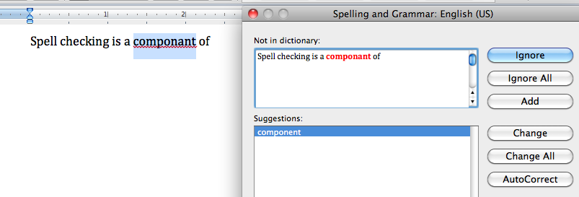
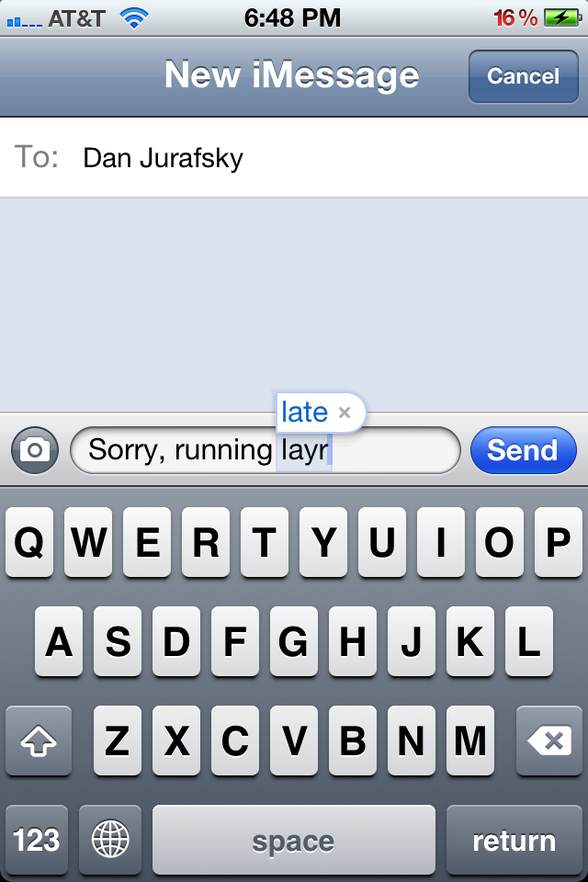
Applications for spelling correction
Word processing
Phones
Web search

Slide 3
Spelling Tasks
Spelling Error Detection
Spelling Error Correction:
Autocorrect
hte→the
Suggest a correction
Suggestion lists

Slide 4
Types of spelling errors
Non-word Errors
graffe →giraffe
Real-word Errors
Typographical errors
three →there
Cognitive Errors (homophones)
piece→peace,
too → two

Slide 5
Non-word spelling errors
Non-word spelling error detection:
Any word not in a dictionary is an error
The larger the dictionary the better
Non-word spelling error correction:
Generate candidates: real words that are similar to error
Choose the one which is best

Slide 6
Real word spelling errors
For each word w, generate candidate set:
Find candidate words with similar pronunciations
Find candidate words with similar spelling
Include w in candidate set
Choose best candidate

Slide 7
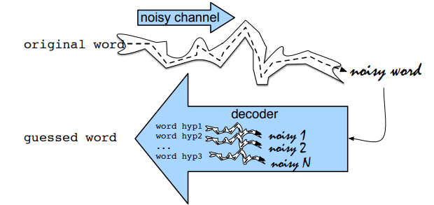
Noisy Channel Approximation

Slide 8
Noisy Channel
We see an observation x of a misspelled word
Find the correct word w
Notes:
Bayes Rule

Slide 9
Non-word spelling error example
acress

Slide 10
Candidate generation
Words with similar spelling
Small edit distance to error
Words with similar pronunciation
Small edit distance of pronunciation to error

Slide 11
Edit distance
Minimal edit distance between two strings, where edits are:
Insertion
Deletion
Substitution
Transposition of two adjacent letters

Slide 12
Words within distance 1 of acress
Error | Candidate Correction | Correct Letter | Error Letter | Type (error due to)
acress | actress | t | - | deletion
acress | cress | - | a | insertion
acress | caress | ca | ac | transposition
acress | access | c | r | substitution
acress | across | o | e | substitution
acress | acres | - | s | insertion

Slide 13
Candidate generation
80% of errors are within edit distance 1
Almost all errors within edit distance 2
Also allow insertion of space or hyphen
thisidea → this idea
inlaw → in-law

Slide 14
Language Model
Use any of the language modeling algorithms
Unigram, bigram, trigram

Slide 15
Peter Norvig’s list of errors
http://norvig.com/ngrams/spell-errors.txt
raining: rainning, raning
writings: writtings
disparagingly: disparingly
yellow: yello
four: forer, fours, fuore
woods: woodes
hanging: haing
aggression: agression
looking: loking, begining, luing

Slide 16
Unigram Prior probability
Counts from 1.1 billion words in Corpus of Contemporary English (COCA)
word | Frequency of word | P(word)
actress | 9,321 | .0000230573
cress | 220 | .0000005442
caress | 686 | .0000016969
access | 37,038 | .0000916207
across | 120,844 | .0002989314
acres | 12,874 | .0000318463

Slide 17
Channel model probability
Error model probability, Edit probability
Misspelled word x = x₁, x₂, x₃… x_{m}
Correct word w = w₁, w₂, w₃,…, w_{n}
P(x|w) = probability of the edit
(deletion/insertion/substitution/transposition)

Slide 18
Computing error probability
del[x,y]: count(xy typed as x)
ins[x,y]: count(x typed as xy)
sub[x,y]: count(x typed as y)
trans[x,y]: count(xy typed as yx)
Insertion and deletion conditioned on previous character

Slide 19
Channel model

Slide 20
Channel model for acress
Candidate Correction | Correct Letter | Error Letter | x|w | P(x|word)
actress | t | - | c|ct | .000117
cress | - | a | a|# | .00000144
caress | ca | ac | ac|ca | .00000164
access | c | r | r|c | .000000209
across | o | e | e|o | .0000093
acres | - | s | es|e | .0000321
acres | - | s | ss|s | .0000342

Slide 21
Using a bigram language model
“a stellar and versatile acress whose combination of sass and glamour…”
Counts from the Corpus of Contemporary American English
P(actress|versatile)=.000021 P(whose|actress) = .0010
P(across|versatile) =.000021 P(whose|across) = .000006
P(“versatile actress whose”) = .000021*.0010 = 210 x10⁻¹⁰
P(“versatile across whose”) = .000021*.000006 = 1 x10⁻¹⁰

Slide 22
Using a bigram language model
“a stellar and versatile acress whose combination of sass and glamour…”
Counts from the Corpus of Contemporary American English with add-1 smoothing
P(actress|versatile)=.000021 P(whose|actress) = .0010
P(across|versatile) =.000021 P(whose|across) = .000006
P(“versatile actress whose”) = .000021*.0010 = 210 x10⁻¹⁰
P(“versatile across whose”) = .000021*.000006 = 1 x10⁻¹⁰

Slide 23
Evaluation
Spelling error test set
Wikipedia’s list of common English misspelling
http://en.wikipedia.org/wiki/Wikipedia:Lists_of_common_misspellings/For_machines

Slide 24
Real-word spelling errors
…leaving in about fifteen minuets to go to her house.
The design an construction of the system…
Can they lave him my messages?
The study was conducted mainly be John Black.
25-40% of spelling errors are real words

Slide 25
Solving real-world spelling errors
For each word in sentence
Generate candidate set
the word itself
all single-letter edits that are English words
words that are homophones
Choose best candidates
Noisy channel model
Task-specific classifier

Slide 26
Noisy channel for real-word spell correction
Given a sentence w₁,w₂,w₃,…,w_{n}
Generate a set of candidates for each word w_{i}
Candidate(w₁) = {w₁, w’₁ , w’’₁ , w’’’₁ ,…}
Candidate(w₂) = {w₂, w’₂ , w’’₂ , w’’’₂ ,…}
Candidate(w_{n}) = {w_{n}, w’_{n} , w’’_{n} , w’’’_{n} ,…}
Choose the sequence W that maximizes P(W)

Slide 27
Noisy channel for real-word spell correction

Slide 28
Real-word spell correction

Slide 29
Simplification: One error per sentence
Out of all possible sentences with one word replaced
w₁, w’’₂,w₃,w₄ two off thew
w₁,w₂,w’₃,w₄ two of the
w’’’₁,w₂,w₃,w₄ too of thew
…
Choose the sequence W that maximizes P(W)

Slide 30
Probabilities
Same as for non-word spelling correction
Plus need probability for no error, P(w|w)

Slide 31
Probability of no error
Channel probability for a correctly typed word :
P(“the”|“the”)
This depends on the application
.90 (1 error in 10 words)
.95 (1 error in 20 words)
.99 (1 error in 100 words)
.995 (1 error in 200 words)

Slide 32
Actions to be taken
If very confident in correction
Autocorrect
Less confident
Give the best correction
Less confident
Give a correction list
Unconfident
Just flag as an error

Slide 33
Factors that could influence p(misspelling|word)
The source letter
The target letter
Surrounding letters
The position in the word
Nearby keys on the keyboard
Pronunciations

Slide 34
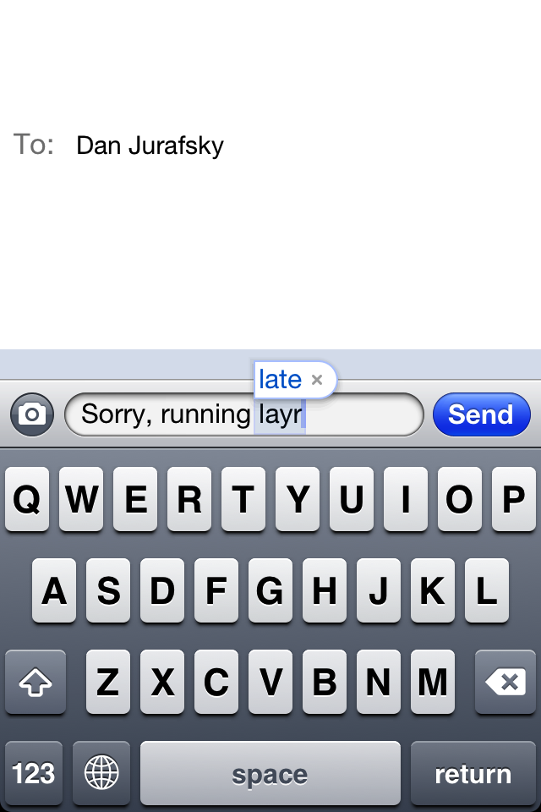
Nearby keys

Slide 35
Thank YOU

