Slide 1
Part of Speech Tagging
Prof. Vipin Tyagi

Slide 2
lead ?

Slide 3
POS Tagging Techniques
Rule based POS Tagging
Transformation based POS Tagging
Statistical POS Tagging

Slide 4
Part of Speech Tagging
Input: the lead paint is unsafe
Output: the/Det lead/N paint/N is/V unsafe/Adj

Slide 5
Markov Models
A discrete (finite) system:
N distinct states.
Begins (at time t=1) in some initial state(s).
At each time step (t=1,2,…) the system moves from current to next state (possibly the same as the current state) according to transition probabilities associated with current state.
This kind of system is called a finite, or discrete Markov model
After Andrei Andreyevich Markov (1856 -1922)

Slide 6
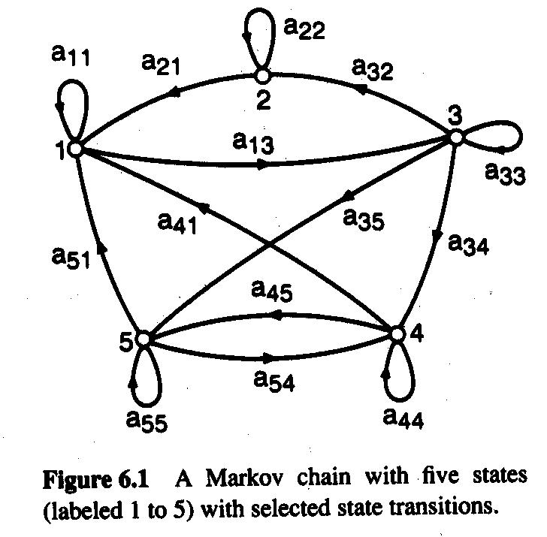
Discrete Markov Model: Example
Discrete Markov Model with 5 states.
Each a_{ij} represents the probability of moving from state i to state j
The a_{ij} are given in a matrix A = {a_{ij}}
The probability to start in a given state i is π_{i ,} The vector π represents these start probabilities.

Slide 7
Markov Property
Markov Property: The state of the system at time t+1 depends only on the state of the system at time t
X_{t=1}
X_{t=2}
X_{t=3}
X_{t=4}
X_{t=5}

Slide 8
Hidden Markov Models (probabilistic finite state automata)
Where states cannot be directly observed.
Hidden Markov Models
a₁₁
a₂₂
a₃₃
a₄₄
a₁₂
a₂₃
a₃₄
b₁₁
b₁₄
b₁₃
b₁₂
4
1
2
3
a_{ij} are state transition probabilities.
b_{ik} are observation (output) probabilities.
Observed
phenomenon
b₁₁ + b₁₂ + b₁₃ + b₁₄ = 1,
b₂₁ + b₂₂ + b₂₃ + b₂₄ = 1, etc.

Slide 9
Sample Probabilities
Tag Frequencies
Φ ART N V P
300 633 1102 358 366
Bigram Probabilities
Bigram(Ti, Tj) Count(i, i + 1) Prob(Tj|Ti)
φ,ART 213 .71
φ,N 87 .29
φ,V 10 .03
ART,N 633 1
N,V 358 .32
N,N 108 .10
N,P 366 .33
V,N 134 .37
V,P 150 .42
V,ART 194 .54
P,ART 226 .62
P,N 140 .38
V,V 30 .08

Slide 10
Sample Lexical Generation Probabilities
P(an | ART) .36
P(an | N) .001
P(flies | N) .025
P(flies | V) .076
P(time | N) .063
P(time | V) .012
P(arrow | N) .076
P(like | N) .012
P(like | V) .10
P(like | P) .068

Slide 11
Tag Sequences
In theory, we want to generate all possible tag sequences to determine which one is most likely. But there are an exponential number of possible tag sequences!
Because of the independence assumptions already made, we can model the process using Markov models. Each node represents a tag and each arc represents the probability of one tag following another.
The probability of a tag sequence can be easily computed by finding the appropriate path through the network and multiplying the probabilities together.
In a Hidden Markov Model (HMM), the lexical (word | tag) probabilities are stored with each node. For example, all of the (word | ART) probabilities would be stored with the ART node. Then everything can be computed using HMM

Slide 12
Viterbi Algorithm
The Viterbi algorithm is used to compute the most likely tag sequence in O(W x T²) time, where T is the number of possible part-of-speech tags and W is the number of words in the sentence.
The algorithm sweeps through all the tag possibilities for each word, computing the best sequence leading to each possibility. The key that makes this algorithm efficient is that we only need to know the best sequences leading to the previous word because of the Markov assumption.
Note: statistical part-of-speech taggers can usually achieve 95-97% accuracy. While this is reasonably good, it is 5-7% above the 90% accuracy that can be achieved by just using the highest frequency tags.

Slide 13
Computing the Probability of a Sentence and Tags
Find the sequence of tags that maximizes
P (T₁..T_{n}| w_{i}..w_{n}), which can be estimated as:
P (T_{i}| T_{i−1}) is computed by multiplying the arc values in the HMM.
P (w_{i}| T_{i}) is computed by multiplying the lexical generation probabilities associated with each word

Slide 14
The Viterbi Algorithm
Let T = # of part-of-speech tags
W = # of words in the sentence
/* Initialization Step */
for t = 1 to T
Score(t, 1) = Pr(Word₁| T ag_{t}) * Pr(Tag_{t}| φ)
BackPtr(t, 1) = 0;
/* Iteration Step */
for w = 2 to W
for t = 1 to T
Score(t, w) = Pr(Word_{w}| Tag_{t}) *MAX_{j=1,T}(Score(j, w-1) * Pr(Tag_{t}| Tag_{j}))
BackPtr(t, w) = index of j that gave the max above
/* Sequence Identification */
Seq(w) = t that maximizes Score(t,w )
for w = W -1 to 1
Seq(w) = BackPtr(Seq(w+1),w+1)

Slide 15
Computing Probabilities
viterbi [ s, t ] = max(s’) ( viterbi [ s’, t-1] * transition probability P(s | s’) * emission probability P (token[t] | s) )
for each s, t:
record which s’, t-1 contributed the maximum

Slide 16
Example
Fish sleep.
start -> noun = 0.8
start -> verb =0.2
noun -> noun = 0.1
noun -> verb = 0.8
noun-> end = 0.1
verb -> verb = 0.1
verb-> noun = 0.2
verb -> end = 0.7

Slide 17
A Simple POS HMM
0.2
0.1
0.8
start
0.8
noun
verb
0.7
end
0.2
0.1
0.1

Slide 18
Word Emission Probabilities P ( word | state )
A two-word language: “fish” and “sleep”
Suppose in our training corpus,
“fish” appears 8 times as a noun and 5 times as a verb
“sleep” appears 2 times as a noun and 5 times as a verb
Emission probabilities:
Noun
P(fish | noun) : 0.8
P(sleep | noun) : 0.2
Verb
P(fish | verb) : 0.5
P(sleep | verb) : 0.5

Slide 19
Viterbi Probabilities

Slide 20
0.2
0.1
0.8
0.8
0.7
end
start
noun
verb
0.2
0.1
0.1

Slide 21
0.2
0.1
0.8
0.8
0.7
end
start
noun
verb
0.2
0.1
0.1
Token 1: fish

Slide 22
0.2
0.1
0.8
0.8
0.7
end
start
noun
verb
0.2
0.1
0.1
Token 1: fish

Slide 23
0.2
0.1
0.8
0.8
0.7
end
start
noun
verb
0.2
0.1
0.1
Token 2: sleep
(if ‘fish’ is verb)

Slide 24
0.2
0.1
0.8
0.8
0.7
end
start
noun
verb
0.2
0.1
0.1
Token 2: sleep
(if ‘fish’ is verb)

Slide 25
0.2
0.1
0.8
0.8
0.7
end
start
noun
verb
0.2
0.1
0.1
Token 2: sleep
(if ‘fish’ is a noun)

Slide 26
0.2
0.1
0.8
0.8
0.7
end
start
noun
verb
0.2
0.1
0.1
Token 2: sleep
(if ‘fish’ is a noun)

Slide 27
0.2
0.1
0.8
0.8
0.7
end
start
noun
verb
0.2
0.1
0.1
Token 2: sleep take maximum, set back pointers

Slide 28
0.2
0.1
0.8
0.8
0.7
end
start
noun
verb
0.2
0.1
0.1
Token 2: sleep take maximum, set back pointers

Slide 29
0.2
0.1
0.8
0.8
0.7
end
start
noun
verb
0.2
0.1
0.1
Token 3: end

Slide 30
0.2
0.1
0.8
0.8
0.7
end
start
noun
verb
0.2
0.1
0.1
Token 3: end take maximum, set back pointers

Slide 31
0.2
0.1
0.8
0.8
0.7
end
start
noun
verb
0.2
0.1
0.1
Decode: fish = noun sleep = verb

Slide 32
Assigning Tags Probabilistically
Instead of identifying only the best tag for each word, a better approach is to assign a probability to each tag.
We could use simple frequency counts to estimate context-independent probabilities.
P(tag | word) =#times word occurs with the tag / #times word occurs
But these estimates are unreliable because they do not take context into account.
A better approach considers how likely a tag is for a word given the specific sentence and words around it

Slide 33
An Example
Consider the sentence: Outside pets are often hit by cars.
Assume “outside” has 4 possible tags: ADJ, NOUN, PREP, ADVERB.
Assume “pets” has 2 possible tags: VERB, NOUN.
If “outside” is a ADJ or PREP then “pets” has to be a NOUN.
If “outside” is a ADV or NOUN then “pets” may be a NOUN or VERB.
Now we can sum the probabilities of all tag sequences that end with “pets” as a NOUN and sum the probabilities of all tag sequences that end with “pets” as a VERB. For this sentence, the chances that “pets” is a NOUN should be much higher.

Slide 34
Forward Probability
The forward probability α_{i}(m) is the probability of the words w₁, w₂, …, w_{m} with w_{m} having tag T_{i}.
α_{i}(m) = P(w₁, w₂, …, w_{m} & w_{m /}T_{i})
The forward probability is computed as the sum of the probabilities computed for all tag sequences ending in tag T_{i} for word w_{m}.
Ex: α₁(2) would be the sum of probabilities computed for all tag sequences ending in tag #1 for word #2.
The lexical tag probability is computed as:

Slide 35
Forward Algorithm
Let T = # of part-of-speech tags
W = # of words in the sentence
/* Initialization Step */
for t = 1 to T
SeqSum(t, 1) = Pr(W ord₁| T ag_{t}) * Pr(T ag_{t}| φ)
/* Compute Forward Probabilities*/
for w = 2 to W
for t = 1 to T
/* Compute Lexical Probabilities*/
for w = 2 to W
for t = 1 to T

Slide 36
Backward Algorithm
The forward probability β_{i}(m) is the probability of the words w_{m}, w_{m+1}, …, w_{N} with w_{m} having tag T_{i}.
β_{i}(m) = P(w_{m}, …, w_{N} & w_{m /}T_{i})
The backward probability is computed as the sum of the probabilities computed for all tag sequences starting with tag T_{i} for word w_{m}.
Ex: β₁(2) would be the sum of probabilities computed for all tag sequences starting with tag #1 for word #2.
The algorithm for computing the backward probability is analogous to the forward probability, except that we start at the end of the sentence and work backwards.
The best way to estimate lexical tag probabilities uses both forward and backward probabilities

Slide 37
Forward-Backward Algorithm
Make estimates starting with raw data
Repeat until convergence:
Compute forward probabilities
Compute backward probabilities
Re-estimate P(w_{m}|t_{i}) and P(t_{j}|t_{i})

