Slide 1
Word Sense Disambiguation

Slide 2
Approaches to Word Sense Disambiguation
Knowledge-Based Disambiguation
use of external lexical resources such as dictionaries and thesauri
discourse properties
Supervised Disambiguation
based on a labeled training set
the learning system has:
a training set of feature-encoded inputs AND
their appropriate sense label (category)
Unsupervised Disambiguation
based on unlabeled corpora
The learning system has:
a training set of feature-encoded inputs BUT
NOT their appropriate sense label (category)

Slide 3
All Words Word Sense Disambiguation
Attempt to disambiguate all open-class words in a text
“He put his suit over the back of the chair”
Use information from dictionaries
Definitions / Examples for each meaning
Find similarity between definitions and current context
Position in a semantic network
Find that “table” is closer to “chair/furniture” than to “chair/person”
Use discourse properties
A word exhibits the same sense in a discourse / in a collocation

Slide 4
All Words Word Sense Disambiguation
Minimally supervised approaches
Learn to disambiguate words using small annotated corpora
e.g. SemCor – corpus where all open class words are disambiguated
200,000 running words
Most frequent sense

Slide 5
Targeted Word Sense Disambiguation
Disambiguate one target word
“Take a seat on this chair”
“The chair of the Math Department”
WSD is viewed as a typical classification problem
use machine learning techniques to train a system
Training:
Corpus of occurrences of the target word, each occurrence annotated with appropriate sense
Build feature vectors:
a vector of relevant linguistic features that represents the context (ex: a window of words around the target word)
Disambiguation:
Disambiguate the target word in new unseen text

Slide 6
Unsupervised Disambiguation
Disambiguate word senses:
without supporting tools such as dictionaries and thesauri
without a labeled training text
Without such resources, word senses are not labeled
We cannot say “chair/furniture” or “chair/person”
We can:
Cluster/group the contexts of an ambiguous word into a number of groups
Discriminate between these groups without actually labeling them

Slide 7
Unsupervised Disambiguation
Hypothesis: same senses of words will have similar neighboring words
Disambiguation algorithm
Identify context vectors corresponding to all occurrences of a particular word
Partition them into regions of high density
Assign a sense to each such region
“Sit on a chair”
“Take a seat on this chair”
“The chair of the Math Department”
“The chair of the meeting”

Slide 8
One Sense Per Discourse
A word tends to preserve its meaning across all its occurrences in a given discourse (Gale, Church, Yarowksy 1992)
What does this mean?
Evaluation:
8 words with two-way ambiguity, e.g. plant, crane, etc.
98% of the two-word occurrences in the same discourse carry the same meaning
E.g. The ambiguous word PLANT occurs 10 times in a discourse
all instances of “plant” carry the same meaning

Slide 9
One Sense per Collocation
A word tends to preserve its meaning when used in the same collocation (Yarowsky 1993)
Strong for adjacent collocations
Weaker as the distance between words increases
An example
Evaluation:
97% precision on words with two-way ambiguity
The ambiguous word PLANT preserves its meaning in all its
occurrences within the collocation “industrial plant”, regardless
of the context where this collocation occurs

Slide 10
Minimally Supervised Methods for Word Sense Disambiguation

Slide 11
Task Definition
Supervised WSD = learning sense classifiers starting with annotated data
Minimally supervised WSD = learning sense classifiers from annotated data, with minimal human supervision
Examples
Automatically bootstrap a corpus starting with a few human annotated examples
Use monosemous relatives / dictionary definitions to automatically construct sense tagged data

Slide 12
Bootstrapping
Requirements
(Some) labeled data
(Large amounts of) unlabeled data
(One or more) basic classifiers
Output
Classifier that improves over the basic classifiers

Slide 13
… plant#1 growth is retarded …
… a nuclear power plant#2 …
… building the only atomic plant …
… plant growth is retarded …
… a herb or flowering plant …
… a nuclear power plant …
… building a new vehicle plant …
… the animal and plant life …
… the passion-fruit plant …
… plants#1 and animals …
… industry plant#2 …
Classifier 1
Classifier 2

Slide 14
Co-training/Self-training
A set L of labeled training examples
A set U of unlabeled examples
Classifiers C_{i}
1. Create a pool of examples U'
choose P random examples from U
2. Loop for I iterations
Train C_{i} on L and label U'
Select G most confident examples and add to L
maintain distribution in L
Refill U' with examples from U
keep U' at constant size P

Slide 15
Bootstrapping Algorithm
Iterative procedure:
Train decision list algorithm on seed set
Classify residual data with decision list
Create new seed set by identifying samples that are tagged with a probability above a certain threshold
Retrain classifier on new seed set
Selecting training seeds
Initial training set should accurately distinguish among possible senses
Strategies:
Select a single, defining seed collocation for each possible sense.
Ex: “life” and “manufacturing” for target plant
Use words from dictionary definitions
Hand-label most frequent collocates

Slide 16
Yarowsky Algorithm
(Yarowsky 1995)
Relies on two heuristics and a decision list
One sense per collocation :
Nearby words provide strong and consistent clues as to the sense of a target word
One sense per discourse :
The sense of a target word is highly consistent within a single document

Slide 17
Learning Algorithm
A decision list is used to classify instances of target word :
“the loss of animal and plant species through extinction …”
Classification is based on the highest ranking rule that matches the target context
LogL | Collocation | Sense
… | … | …
9.31 | flower (within +/- k words) | A (living)
9.24 | job (within +/- k words) | B (factory)
9.03 | fruit (within +/- k words) | A (living)
9.02 | plant species | A (living)
... | ... | …

Slide 18
Yarowsky’s Algorithm
Algorithm Details
Step1:Store Word and its contexts as line
e.g.:….zonal distribution of plant life…..
Step2: Identify a few words that represent the word Sense
e.g. plant(manufacturing/life)
Step3a: Get rules from the training set
plant + X => A, weight
plant + Y => B, weight
Step3b:Use the rules created in 3a to classify all occurrences of plant sample set.

Slide 19
Step3c: Use one-sense-per-discourse rule to filter or augment this addition
Step3d: Repeat Step 3 a-b-c iteratively.
Step4: the training converges on a stable residual set.
Step 5: Result will be a set of rules. Those rules will be used to disambiguate the word “plant”.
e.g. plant + growth => life
plant + car => manufacturing

Slide 20
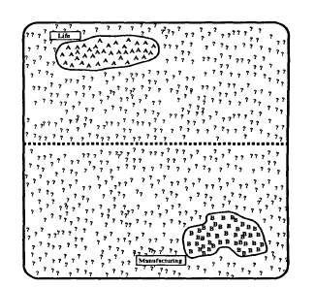
Bootstrapping Algorithm
Sense-A: life
Sense-B: factory
All occurrences of the target word are identified
A small training set of seed data is tagged with word sense

Slide 21
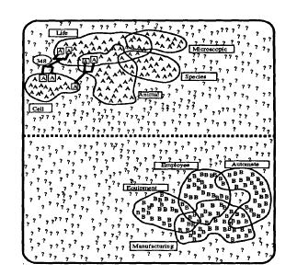
Bootstrapping Algorithm
Seed set grows and residual set shrinks ….

Slide 22
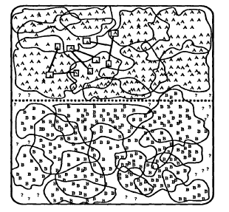
Bootstrapping Algorithm
Convergence: Stop when residual set stabilizes

Slide 23
Evaluation
Test corpus: extracted from 460 million word corpus of multiple sources (news articles, transcripts, novels, etc.)
Word | Senses | Supervised | Unsupervised | Unsupervised Bootstrapping
plant | living/factory | 97.7 | 92 | 98.6
space | volume/outer | 93.9 | 90 | 93.6
tank | vehicle/container | 97.1 | 95 | 96.5
motion | legal/physical | 98.0 | 92 | 97.9
… | … | … | - | …
Avg. | - | 96.1 | 92.2 | 96.5

Slide 24
The Web as a Corpus
Use the Web as a large textual corpus
Build annotated corpora using monosemous relatives
Bootstrap annotated corpora starting with few seeds
Similar to (Yarowsky 1995)
Use the (semi)automatically tagged data to train WSD classifiers

Slide 25
Senseval
Evaluation of WSD systems
Senseval 1: 1999 – about 10 teams
Senseval 2: 2001 – about 30 teams
Senseval 3: 2004 – about 55 teams
Senseval 4: 2007
Senseval 5 : 2010
Provides sense annotated data for many languages, for several tasks
Languages: English, Romanian, Chinese, Basque, Spanish, etc.
Tasks: Lexical Sample, All words, etc.
Provides evaluation software
Provides results of other participating systems

Slide 26
Thank You!

