Slide 2
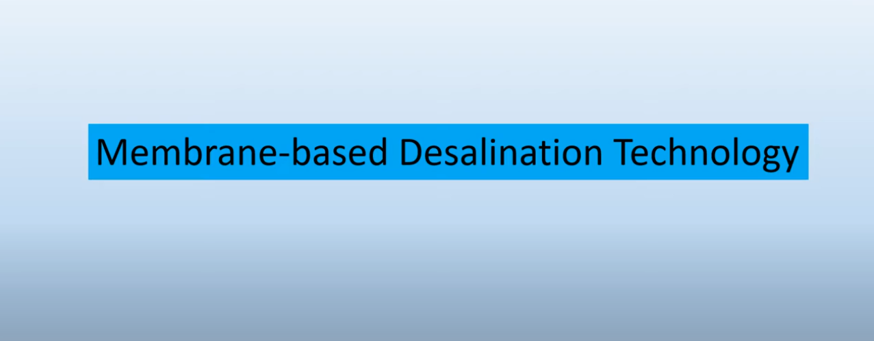
Multi-stage flash (MSF)

Slide 3
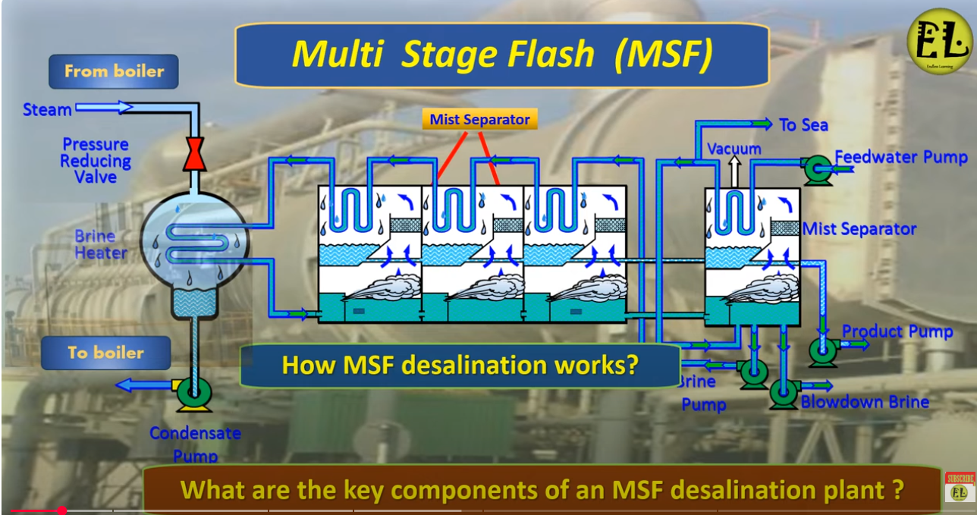

Slide 4
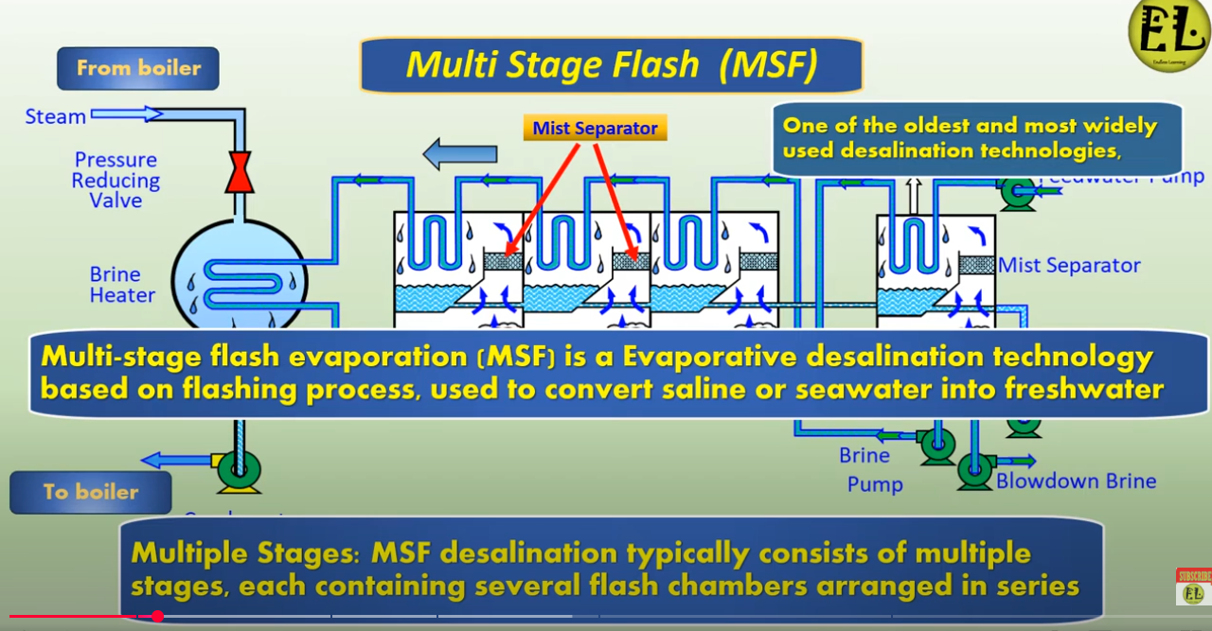

Slide 5
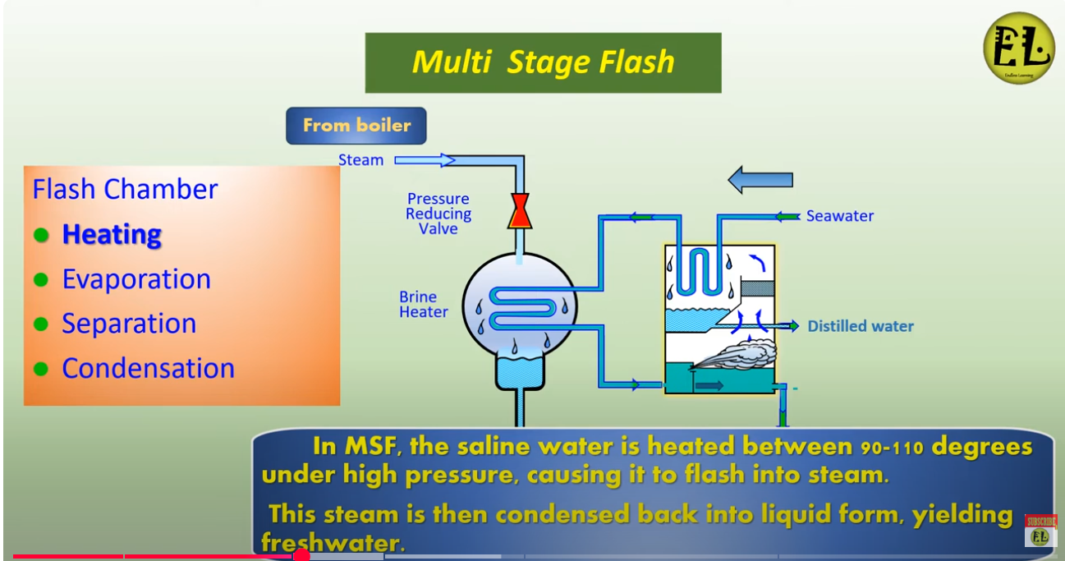

Slide 6
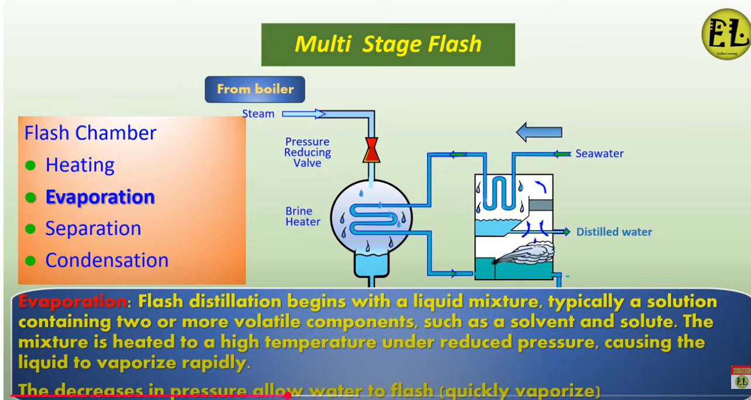

Slide 7
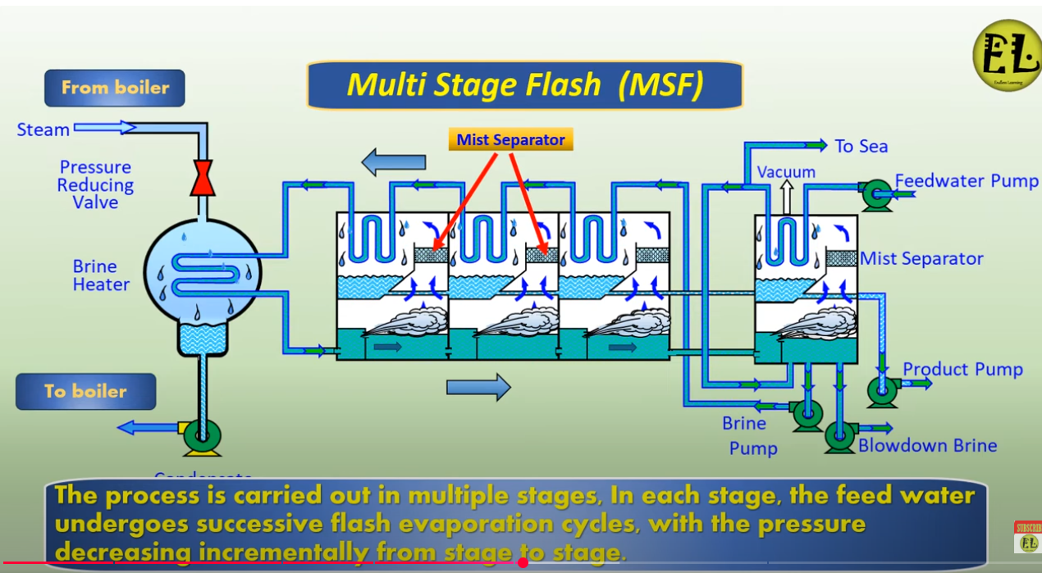

Slide 8
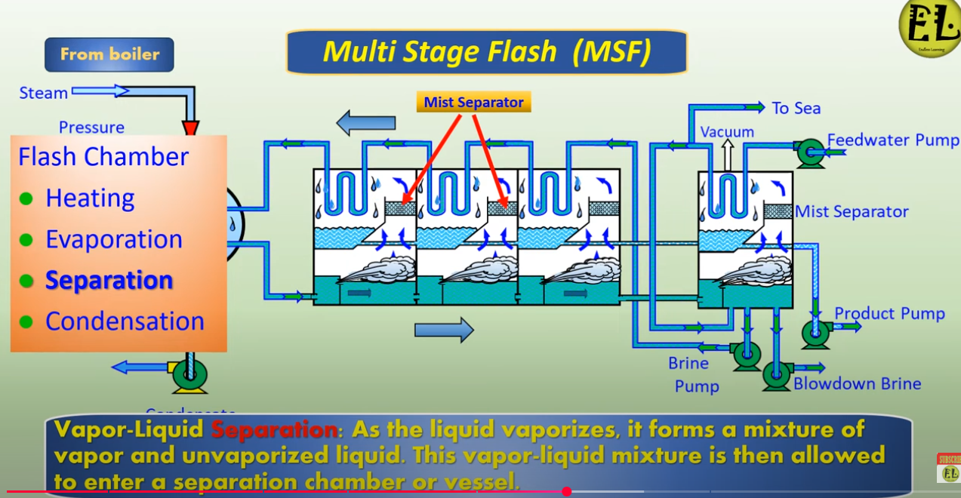

Slide 9
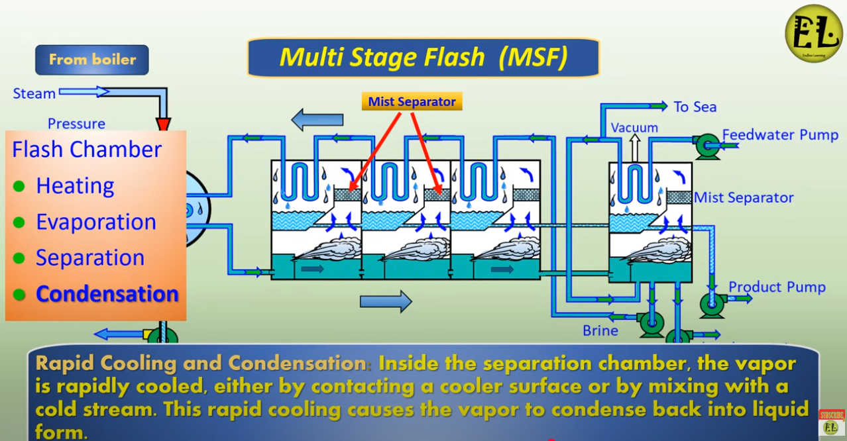

Slide 10
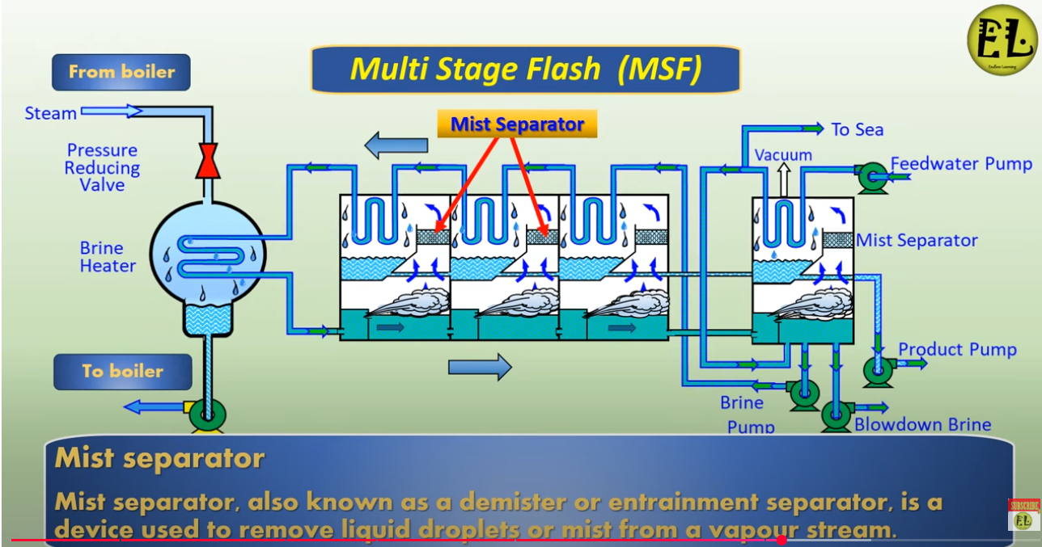

Slide 11
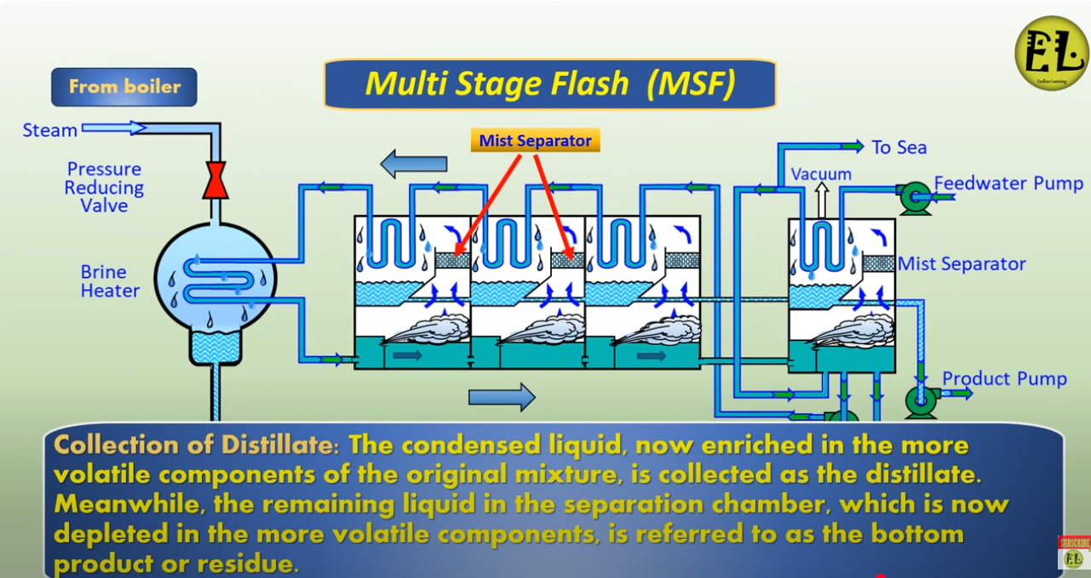

Slide 12
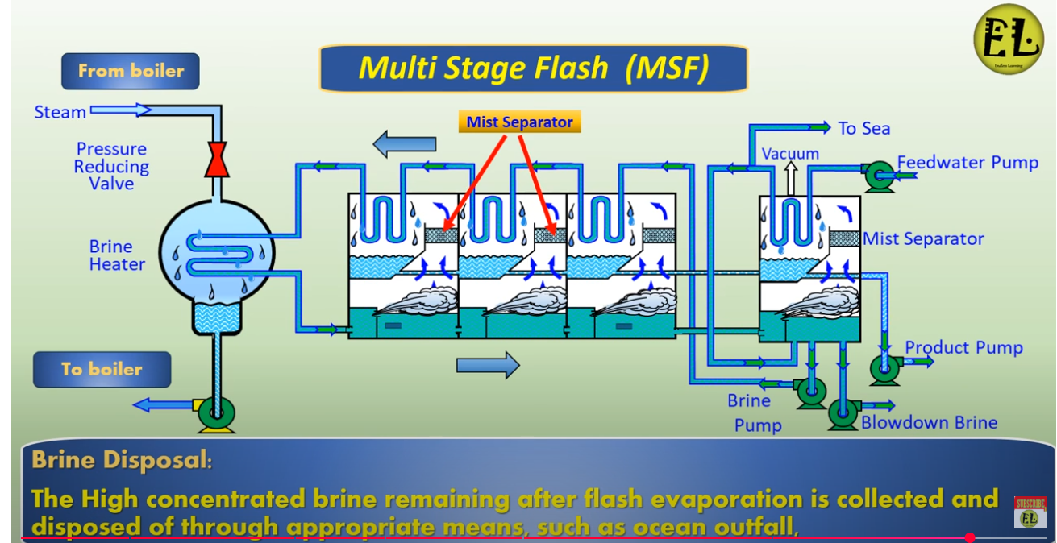

Slide 13
Multi-stage flash (MSF) distillation offers several advantages, primarily in water desalination. It excels at rejecting dissolved salts, producing high-quality treated water, and can be implemented on a large scale with relatively low operational costs. Additionally, it can be integrated with power plants to utilize waste heat and is known for its reliability and ease of large-scale implementation.
High Dissolved Salt Rejection:
MSF can effectively remove up to 99.9% of dissolved salts from seawater, producing potable water.
High-Quality Distillate:
The process yields water with very low salt content, making it suitable for various applications, including boiler feed water.
Large-Scale Implementation:
MSF is a well-established technology with a proven track record of building large-capacity units, some capable of producing up to 78,000 m3 per day.
Reliability and Durability:
MSF systems are known for their robustness and can be designed for long-term, reliable operation.

Slide 14
Waste Heat Utilization:
MSF plants can be integrated with power plants, allowing for the utilization of waste heat, which reduces overall energy consumption.
Low Operational Costs:
While initial capital costs can be higher, operational costs (OPEX) for MSF are generally low.
Flexibility in Operation:
MSF plants can operate at part load and can be adapted to different heat sources.
Reduced Scaling:
The separation of heat transfer and evaporation minimizes scaling issues, which can significantly reduce maintenance and downtime.
Proven Technology:
MSF is a mature technology with extensive operational experience, leading to well-developed construction and operational procedures.
Suitable for Various Applications:
Beyond desalination, MSF can be used to treat industrial wastewater, including wastewater from petrochemical, printing, dyeing, and paper industries.

Slide 15
Multi-stage flash (MSF) distillation, while widely used, has several disadvantages. These include high energy consumption, potential for corrosion and scaling, large plant size, and high capital costs. Additionally, it can be sensitive to feed water quality and may require significant pretreatment.
Detailed Disadvantages:
High Energy Consumption:
MSF distillation requires a substantial amount of energy, particularly thermal energy, to operate. This is a major drawback, especially when considering the cost of energy and its environmental impact.
Corrosion and Scaling:
The high temperatures involved in MSF can lead to corrosion of the equipment and scaling (mineral buildup) on heat transfer surfaces, which reduces efficiency and requires frequent maintenance and cleaning.
High Initial Capital Cost:
Building and installing MSF plants can be expensive due to the complex equipment and large scale of the operation.
Large Plant Size:
MSF plants typically require a large footprint, which can be a limitation in areas with limited space.

Slide 16
Sensitivity to Feed Water Quality:
The presence of contaminants like organic and inorganic chemicals, and biological matter in the feed water can cause scaling, fouling, and corrosion. This necessitates pretreatment processes, adding to the complexity and cost.
Low Performance Ratio (Limited Efficiency):
Compared to other desalination methods, MSF may have a lower performance ratio, meaning it requires more energy to produce a given amount of fresh water.
Potential for Greenhouse Gas Emissions:
If fossil fuels are used to power the MSF plant, it can contribute to greenhouse gas emissions.
Transient Time for Operation:
MSF plants require a certain amount of time to stabilize at the desired operating conditions after startup, which can be a disadvantage in applications where rapid changes in production are needed.

Slide 17
Limited Flexibility for Solar Energy:
MSF plants can be less suitable for solar energy applications due to the need for precise temperature and pressure control, although this can be mitigated with thermal buffering systems.

