Slide 1
Computer Organization and Architecture
UNIT – I
Digital Computers

Slide 2
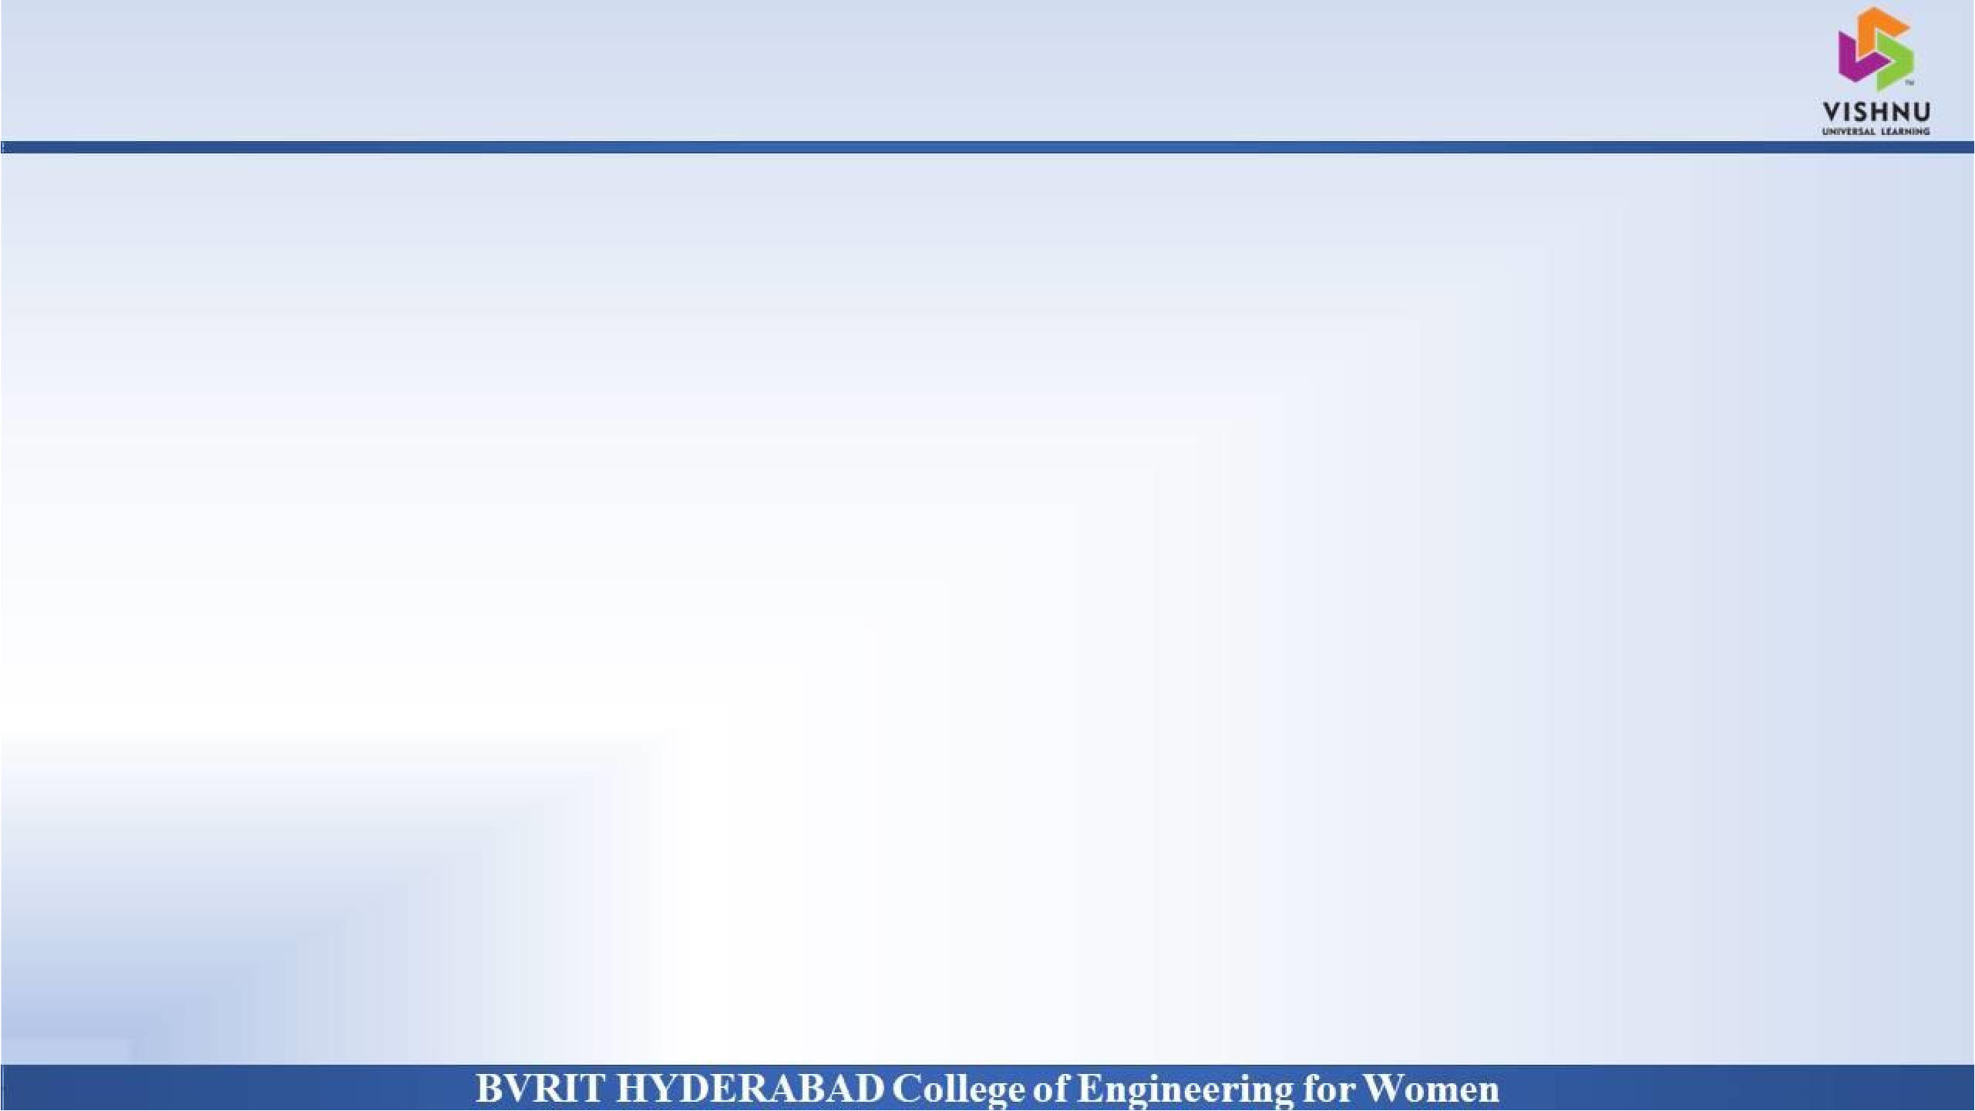

Introduction
Why Should I Study this course?
Examples
BVRIT HYDERABAD College of Engineering for Women
What is a Computer?
Computer is an Electronic Device, that
Accepts the information from the outside world.
Stores it
Process it to Produce the results
Transfers the results to the outside world
How Computers are classified based on the kind of I/O?
Analog Computers
Digital Computers
Hybrid Computers

Slide 3
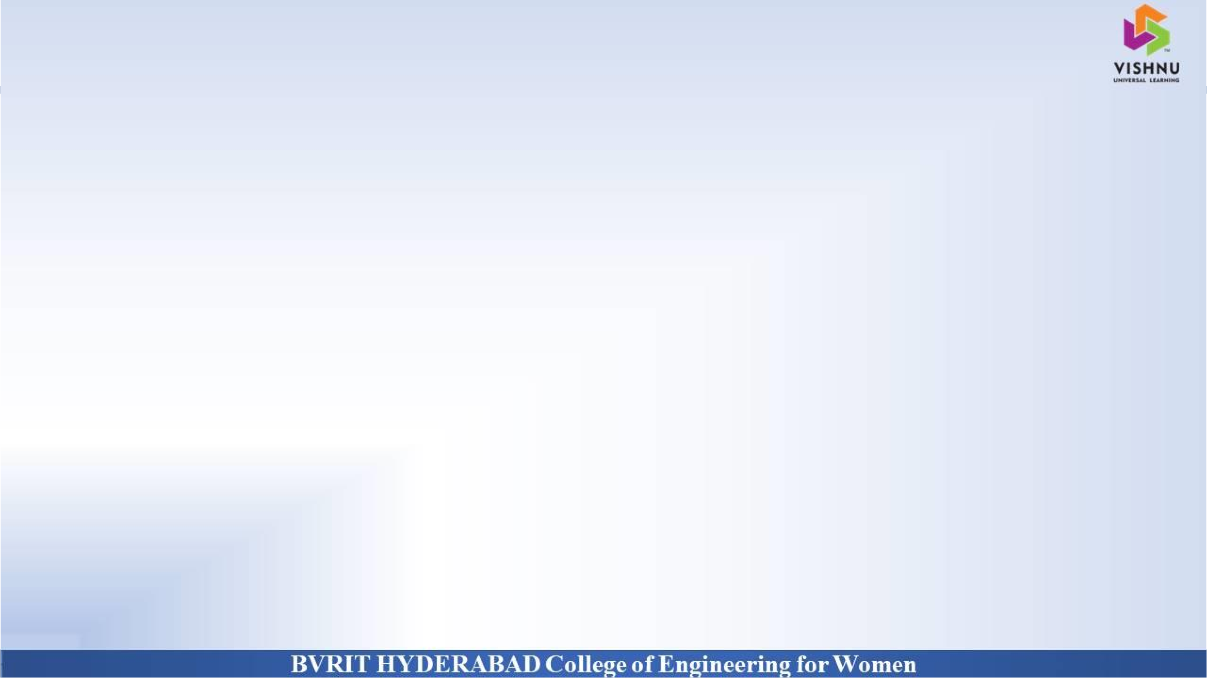
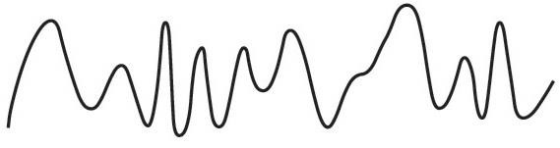

Analog Computer:
Set up according to initial conditions and can be later changed freely
Deals with continuously varying physical quantities such as temperature, pressure, humidity, etc.,
Solutions to the given problem are obtained by measuring the variables/parameters
Digital Computer:
Performs Various Computational Tasks
Represents the information as discrete values
Uses variables to store information
BVRIT HYDERABAD College of Engineering for Women

Slide 4
Hybrid Computer:
Consists of both Analog and Digital components
Solves differential equations and complex mathematical equations
Handles logical and numerical operations
What could be result of our logic and/or Decision Making?
Our logic and/or decision makes results in either True-or-False OR Yes-or-No. That is consisting of two states.
Hence, Digital computers function more reliably with only two states.
So, digital computers use the binary number system, which has two digits: 0 and 1.
A binary digit is called a bit.
They also called as Binary Computers.
BVRIT HYDERABAD College of Engineering for Women

Slide 5
The information in digital computers is represented / stored as groups of bits.
What these group of bits can represent?
Values
Letters of alphabet
Special Symbols
Instructions or Commands
What is the decimal equivalent for “1001011”?
1 X 2⁶ + 0 X 2⁵ + 0 X 2⁴ + 1 X 2³ + 0 X 2² + 1 X 2¹ + 1 X 2⁰ = 75
BVRIT HYDERABAD College of Engineering for Women

Slide 6
A computer system is subdivided into two functional entities:
Hardware
Software
Hardware, consists of all the electronic and electromechanical components, i.e., the physical parts.
Software, consists of the programs and data that are manipulated to perform various data-processing tasks.
What is a program?
A sequence of instructions for the computer to perform a task is called a
program.
The data manipulated by the program usually constitute the data base.
BVRIT HYDERABAD College of Engineering for Women

Slide 7
The software is basically classified into two types:
System Software, consists of a collection of programs, to make more effective use of the computer. It is an indispensable part of a total computer system.
Ex: OS, linkers, loaders, compilers, interpreters, etc.,
Application Software, consists of programs written by the user for the purpose of solving particular problem(s).
Examples?
BVRIT HYDERABAD College of Engineering for Women

Slide 8
Block Diagram of Digital Computer
Why Should I Study this course?
Examples
BVRIT HYDERABAD College of Engineering for Women
Random Access Memory (RAM)
Registers
Arithmetic & Logic Unit
(ALU)
Central Processing Unit (CPU)
Control Unit
Input Devices
Input-Output Processor (IOP)
Output Devices
Communication
Controlling the Transfer

Slide 9
Points of View
Why Should I Study this course?
Examples
BVRIT HYDERABAD College of Engineering for Women
There exists three different points of view for the computer hardware.
Computer Architecture
Computer Organization
- Computer Design
Instruction Formats
Behavior
Instruction Set
Computer Architecture
Addressing Modes
Specifications &
Structure

Slide 10
Connection among Hardware Components
Computer Organization
Verification for
Operations
Determination of Hardware
Computer Design
Way of Connecting the Parts
Computer Implementation
BVRIT HYDERABAD College of Engineering for Women

Slide 11
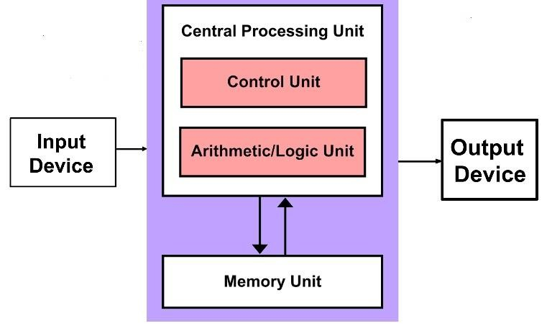
Classification of Architectures
Why Should I Study this course?
Examples
BVRIT HYDERABAD College of Engineering for Women
All the Computer Architectures are based on the one of the following:
Von-Neumann Architecture
Harvard Architecture
1. Von-Neumann Architecture:
Address
Bus
Data
Control

Slide 12
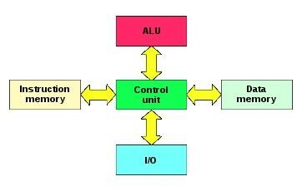
2. Harvard Architecture:
BVRIT HYDERABAD College of Engineering for Women

Slide 13
Thank You
BVRIT HYDERABAD College of Engineering for Women

