Slide 1


DEPARTMENT OF ARTIFICIAL INTELLIGENCE AND DATA SCIENCE
CROP YIELD PREDICTION USING CLIMATE DATA
PROJECT MEMBERS :
24ADR015 - Bhagyalakshmi R
24ADR042- Divya R
24ADR002 - Abinesh D

Slide 2
INTRODUCTION
Overview :
Crop Yield Prediction Using Climate Data is a smart agricultural system that helps predict crop production using historical weather and soil data. It uses factors like rainfall, temperature, humidity, and soil quality to improve farming decisions and reduce crop loss.
The project uses a Deep Learning model called Multi-Layer Perceptron (MLP) built with Keras and TensorFlow. The model is trained using past agricultural data to provide accurate crop yield predictions for future planning.
This system is useful for farmers and agribusiness companies to improve crop selection, resource management, and productivity. It helps increase food security and supports modern farming with AI- based solutions.

Slide 3
PROBLEM STATEMENT
The Problem
Crop yield prediction is difficult because it depends on factors like rainfall, temperature, humidity, and soil quality. Farmers often face problems in estimating future crop production accurately
Traditional prediction methods are less accurate and may result in poor farming decisions, financial loss, and reduced productivity. Wrong predictions can also affect food supply and market planning
The Challenge
Managing and preprocessing large amounts of climate and soil data accurately.
Selecting the right Deep Learning model for better crop yield prediction.
Providing fast and reliable predictions for effective farming decisions

Slide 4
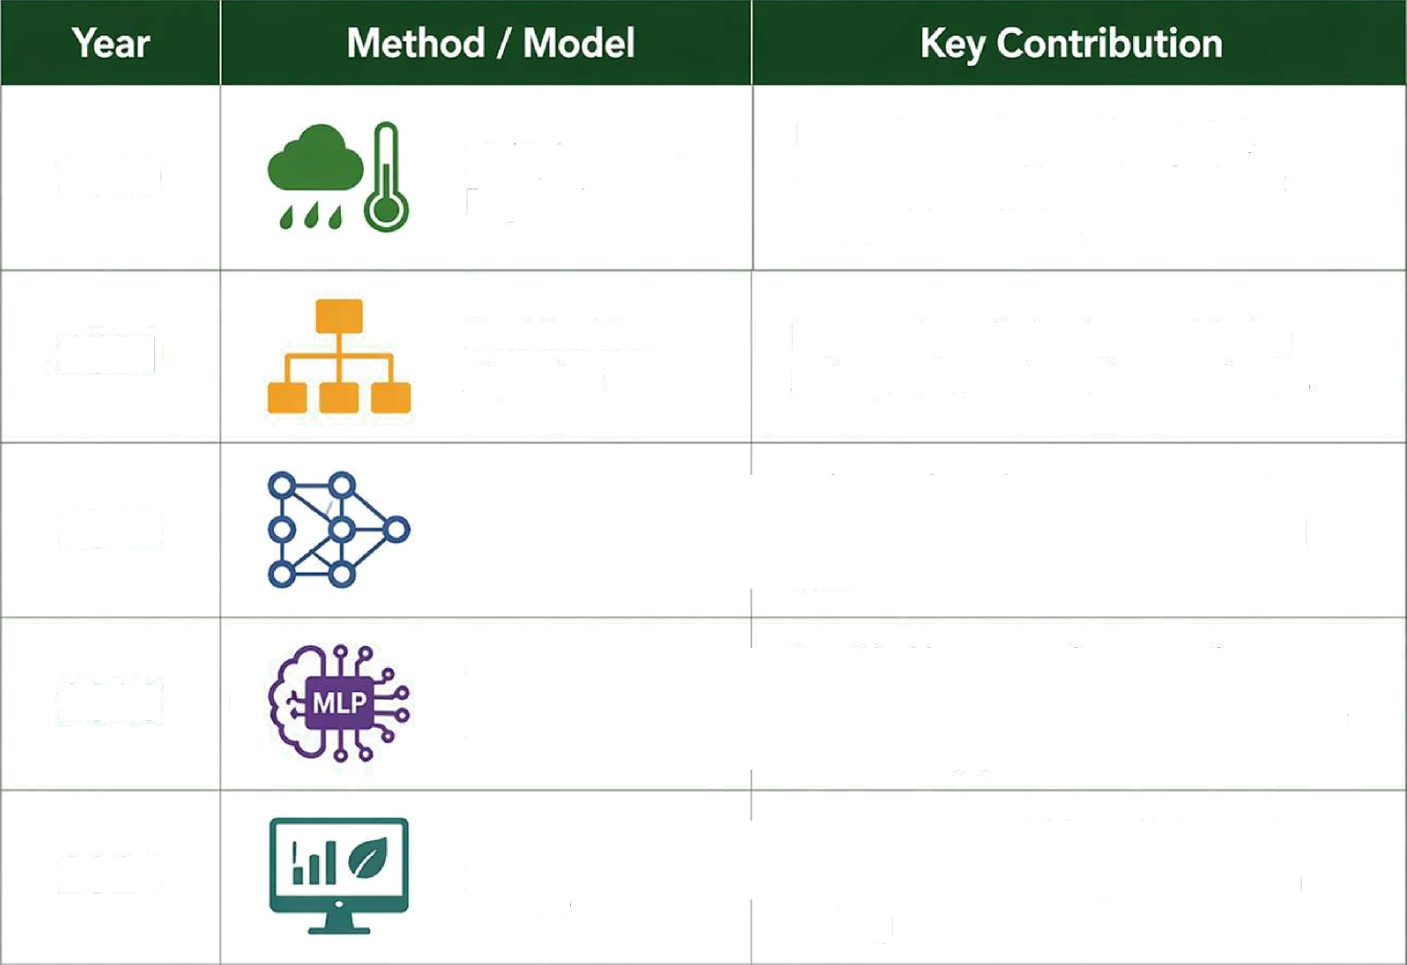
LITERATURE SURVEY
Used climate factors like rainfall, temperature and humidity for basic crop yield prediction
2020
Multiple Linear Regression
2021
Decision Tree
Algorithm
Improved prediction by considering soil nutrients and weather conditions
Enhanced prediction accuracy using multiple input features and historical data
2022
Artificial Neural
Network (ANN)
Multi-Layer Perceptron (MLP)
Provided better performance for complex relstionships between climate, soil and crop yield
2023
Deep Learning
Improved crop yield prediction and suppols smal farming and decision making
2024

Slide 5
EXISTING SYSTEM
Prediction Method: Linear Regression, Decision Tree, and simple statistical analysis.
Accuracy: Limited and depends on fewer factors like rainfall and temperature.
Efficiency: Time-consuming and less effective for large agricultural datasets.

Slide 6
PROPOSED IDEA
Automation: The system automatically predicts crop yield using historical climate and soil data. It reduces manual estimation and helps farmers make faster and better decisions.
Model Used: A Deep Learning model based on Multi-Layer Perceptron (MLP) is used for prediction. It learns complex relationships between weather, soil, and crop production data.
Data Processing: The dataset is preprocessed using cleaning, normalization, and feature selection techniques. This improves model accuracy and prediction performance.
Training Strategy: The model is trained using Keras and TensorFlow with optimized parameters and validation methods. This helps reduce errors and improves prediction reliability.

Slide 7
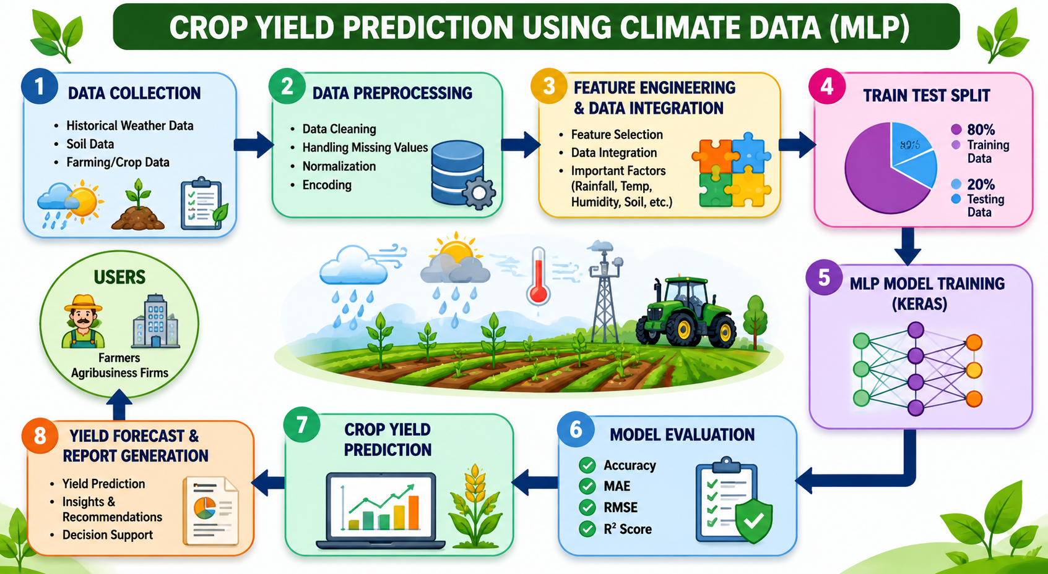
FLOW DIAGRAM

Slide 8
DATASET DESCRIPTION
Column No | Column Name | Description | Data Type
1 | Region | Farming region (North, South, East, West) | Categorical
2 | Soil Type | Type of soil (Clay, Sandy, Loam, Peaty, Silt, Chalky) | Categorical
3 | Crop Type | Crop grown (Rice, Wheat, Maize, Cotton, Soybean, Barley) | Categorical
4 | Rainfall | Amount of rainfall received | Numerical

Slide 9
DATASET DESCRIPTION
5 | Temperature | Temperature in C | Numerical
6 | Fertilizer used | Whether fertilizer was used | Boolean
7 | Irrigation used | Whether irrigation was used | Boolean
8 | Weather condition | Weather condition (Sunny, Rainy, Cloudy) | Categorical
9 | Days_to_Harvest | Number of days taken for harvest | Numerical
10 | Yield_ton_per_hectare | Crop yield/production per hectare | Numerical (Target Variable

Slide 10
SOFTWARE REQUIREMENTS
Operating System: Windows 10/11
Programming Language: Python
Libraries & Frameworks: Tensorflow, NumPy, Pandas
Development Tools: Jupyter Notebook, VS Code, Google Colab
Dataset Handling: CSV files (for loading climate, soil, and crop yield data)

Slide 11
MODULES WITH DESCRIPTION
Data Preprocessing Module:
Processes climate and soil data using cleaning, normalization, and feature selection. Improves data quality for better model performance.
Training Module:
Trains the MLP model using optimized techniques in Keras and TensorFlow
Evaluation Module:
Tests the model using validation data. Measures performance using accuracy and loss.
Prediction Module:
Predicts crop yield using new climate and soil input data. Provides fast and reliable results

Slide 12

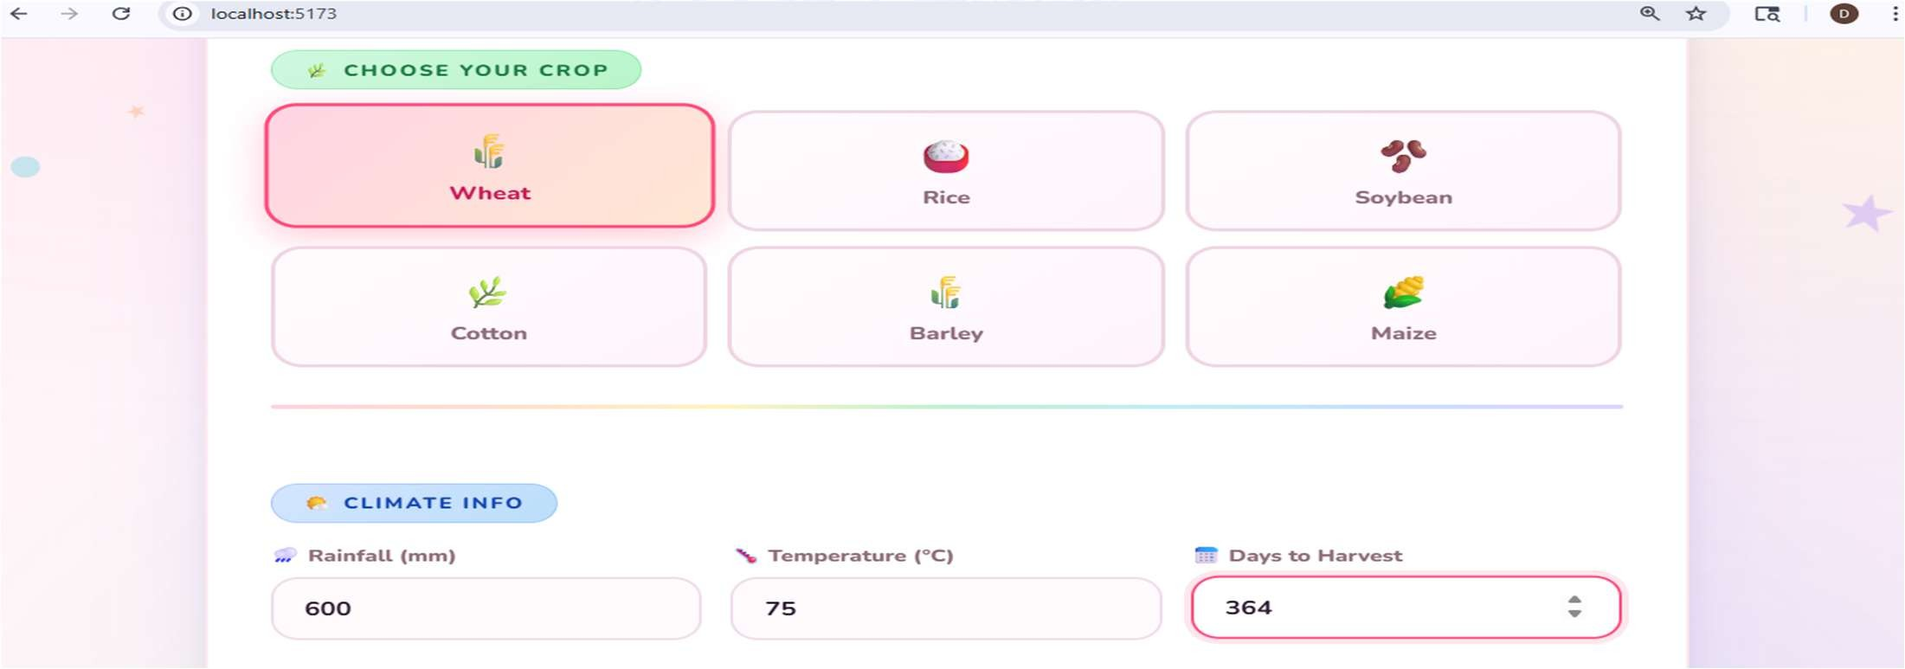
PROJECT SCREENSHOT

Slide 13
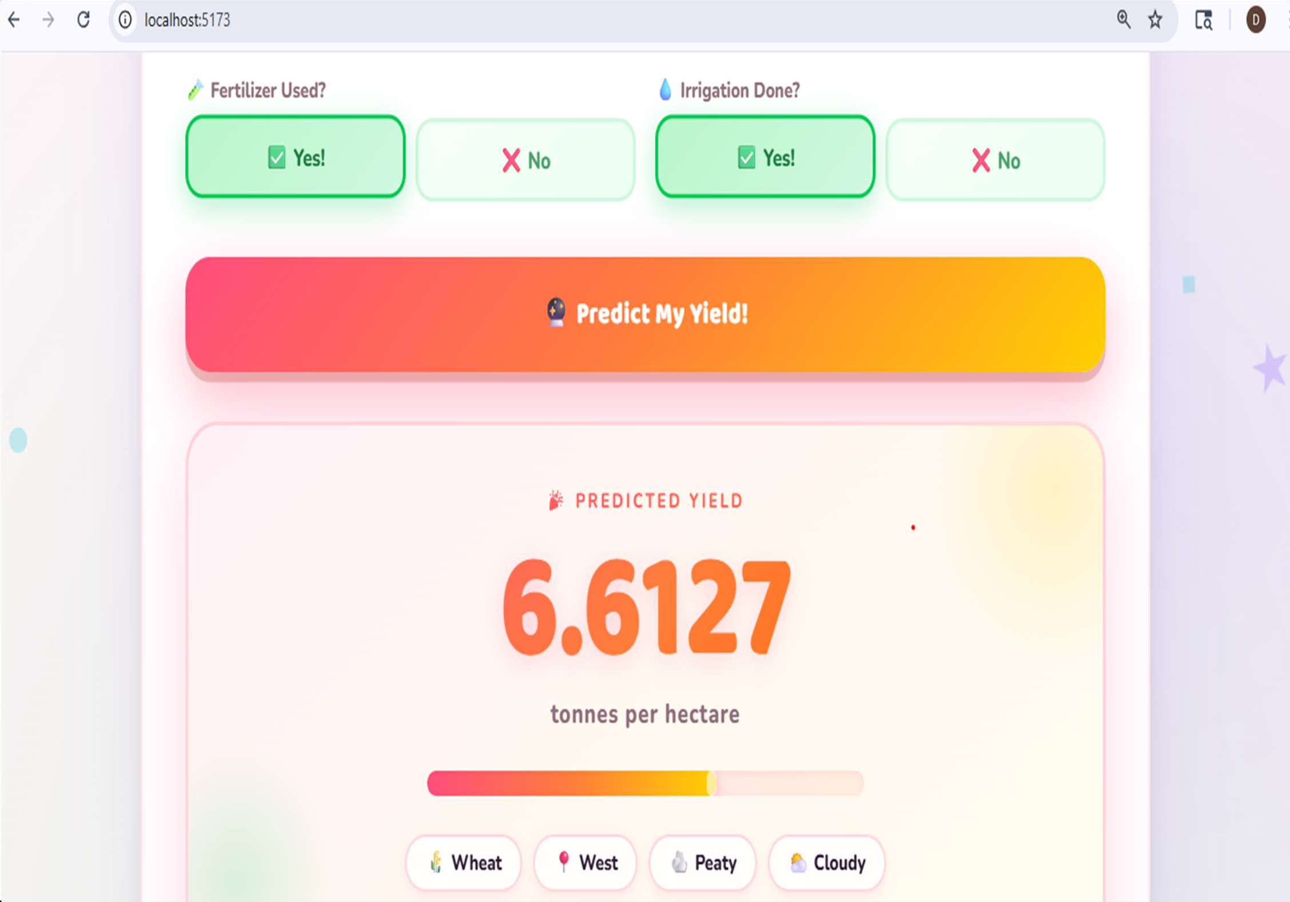
PROJECT SCREENSHOT

Slide 14
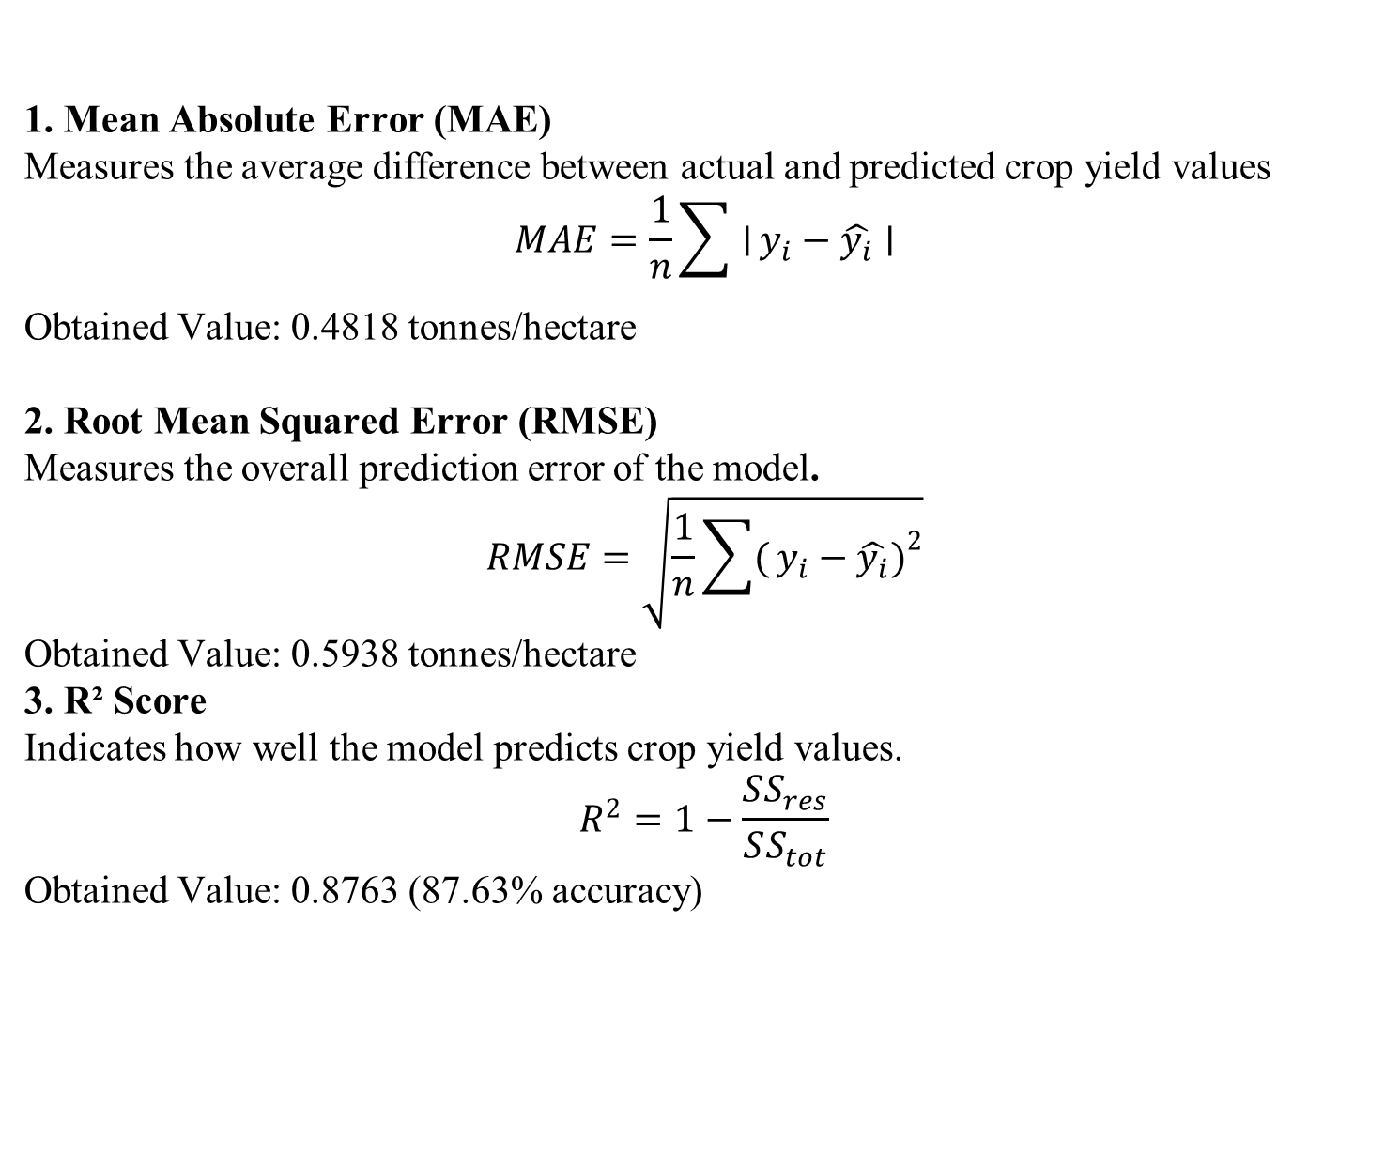
PERFORMANCE METRICS
1. Mean Absolute Error (MAE)
Measures the average difference between actual and predicted crop yield values
$$MAE=\frac{1}{n}\sum{∣}y_{i}−\hat{y_{i}}∣$$
Obtained Value: 0.4818 tonnes/hectare
2. Root Mean Squared Error (RMSE)
Measures the overall prediction error of the model.
$$RMSE=\sqrt{\frac{1}{n}\sum{(}\left.y_{i}−\hat{y_{i}}{\left.)\right.}^{2}\right.}$$
Obtained Value: 0.5938 tonnes/hectare
3. R² Score
Indicates how well the model predicts crop yield values.
$$R^{2}=1−\frac{SS_{res}}{SS_{tot}}$$
Obtained Value: 0.8763 (87.63% accuracy)

Slide 15
RESULT ACHIEVED
Model predicts crop yield based on climate, soil, and farming data.
Successfully developed a Crop Yield Prediction system using Deep Learning (MLP).
Achieved high prediction performance with 87.63% accuracy. Obtained low error values:
MAE: 0.4818 tonnes/hectare
RMSE: 0.5938 tonnes/hectare
Improved yield prediction for better agricultural planning.
Helps farmers make better farming decisions and increase productivity.

Slide 16
CONCLUSION
The Crop Yield Prediction System was successfully developed using Deep Learning techniques.
The model analyzes factors such as soil type, rainfall, temperature, weather conditions, fertilizer usage, and irrigation to predict crop yield accurately.
The system achieved 87.63% accuracy with low error rates, showing effective prediction performance.
This project helps improve agricultural planning, supports smart farming, and assists farmers in making better decisions to increase crop productivity.

Slide 17
REFERENCES
Mingxing Tan, Quoc V. Le, “Deep Learning Techniques for Agricultural Prediction Systems”, 2020.
Iam Goodfellow, Yoshua Bengio, Aaron Courville, “Deep Learning”, MIT Press, 2016
TensorFlow Official Documentation – https://www.tensorflow.org
Keras Official Documentation – https://keras.io
Research Articles on Crop Yield Prediction using Machine Learning and Deep Learning (IEEE, Springer, Elsevier Journals).

Slide 18
THANK YOU

