Slide 1


Prototype Submission Phase

Slide 2
Team Edurites
THEME:
Employee Attrition Prediction Model
Akhil Shrivastava (Accenture)
Work exp. – 3 yrs
LinkedIn - https://www.linkedin.com/in/akhil-shrivastava-18931814b/
Shivam Gupta (Cognizant)
Work exp. – 3 yrs
LinkedIn - https://www.linkedin.com/in/shivam-gupta-325297134/

Slide 3
PROBLEM STATEMENT
People are the lifeblood of an organization. Employee attrition is an extremely important and relevant business problem all organizations face. The major problem with high attrition is the cost to the organization and the time and resource investment. We invite you to propose ideas that can help in predicting and finding proactive ways of reducing attrition using technologies of your choice For eg: use available data/ and create modelling tools to predict which employees are more likely to leave given some attributes like absenteeism, stagnation in a role, active disengagement, etc.
Idea/Solution
The objective of this model is to predict the behaviour of employees who are more likely to churn the organization. So that the organization can proactively take the measures to retain the valuable employees.

Slide 4
SOLUTION
The solution starts with data gathering which can be done by using feedback forms or data from the targeted population.
Initially we will check for missing and improper data fields in our data set this includes handling outliers.
Once data is mature then we will perform some analysis to get the insights like our data can have columns like Job Satisfaction Rating, Marital Status, Years in current role, Distance from home, Environment Satisfaction. We observed high influence of these factors in employee’s decision to look for other job opportunities.
After the features are finalized then we have to prepare the data to be used in our algorithms, and we will apply normalization and standardization to get optimum performance.
In this stage our data is prepared and we have analysed the features, now we will select an algorithm and check for the optimum performance according to the needs.
Now we will further improve the algorithm by hyper parameter tuning.
Once our model is ready to be deployed. We can create our own server or use any PaaS (Platform as a service).
Further we can ensure to build a pipeline to update our model based on data added and new knowledge addition.

Slide 5
Benefits
Reduces cost of company on hiring and training new employees.
Improves company employee retention rate.
Retaining existing employee's will help organization to use employee's current experience which in turn will lead to company's growth rather than investing in new recruitment process.
Constraints
To an extent the model is dependent on the quality and sources of data..

Slide 6
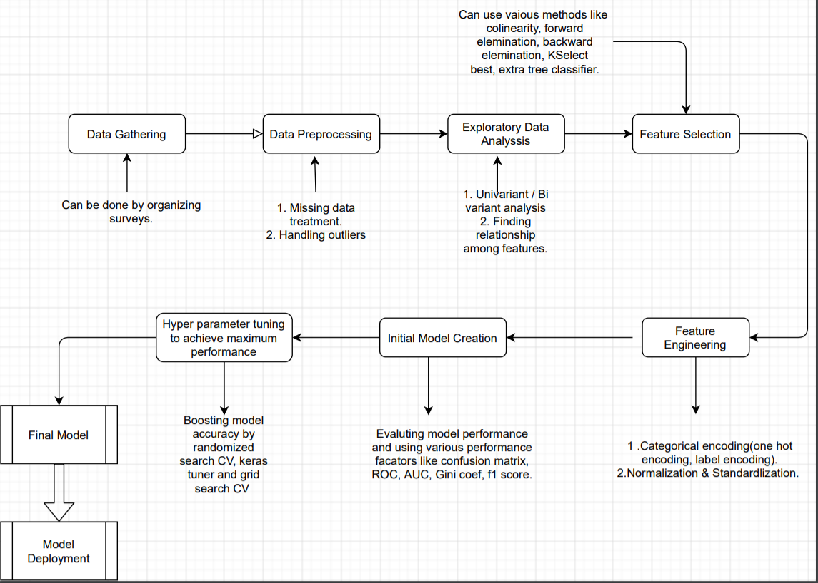
Flow Chart

Slide 7
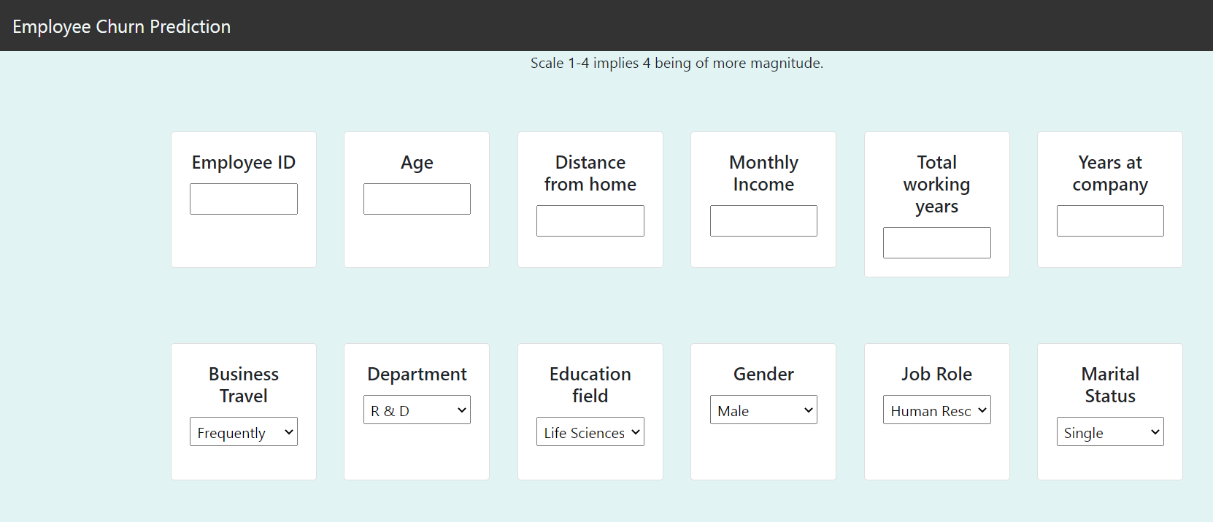
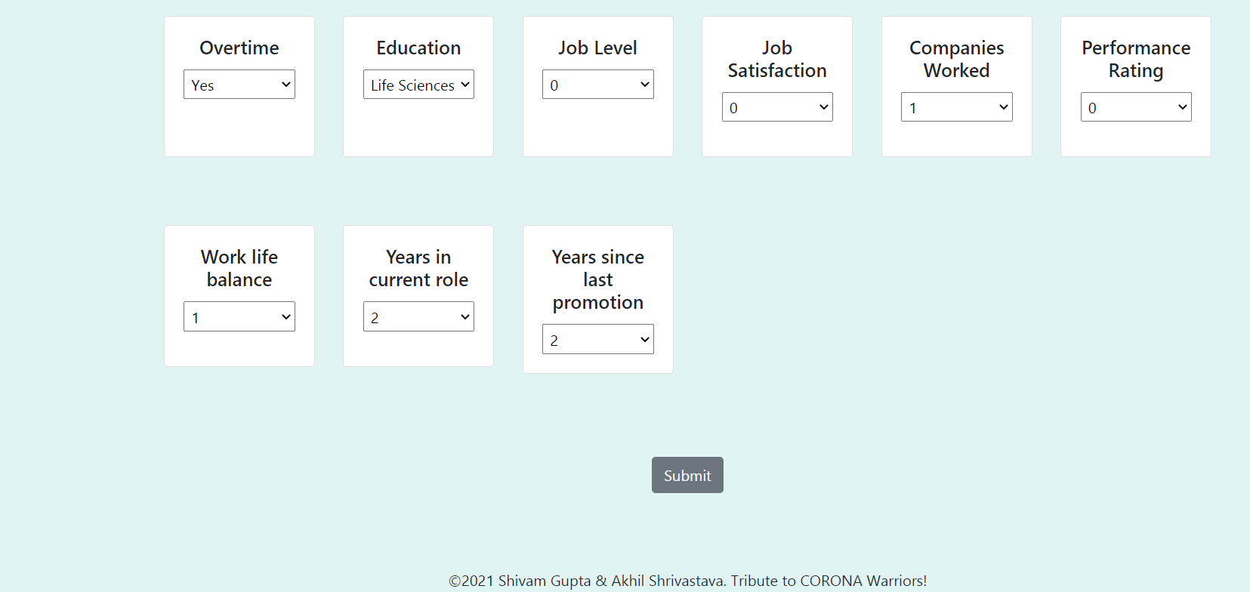
Demo
[ attach Video, link for demo ]

Slide 8
Links and attachments
zz
GitHub Link: https://github.com/24akhil/employee-churn-notebook.git
Demo Link: https://employee-churn-pred.herokuapp.com/
Contact Details
Shivam Gupta – gshivam014@gmail.com
Akhil Shrivastava – shriakhil24@gmail.com

Slide 9

Technologies Used
Bug/Feature Request
If you find a bug (the website couldn't handle the query and / or gave undesired results), kindly open an issue here by including your search query and the expected result

Slide 10
Thank you!

